Slide 1

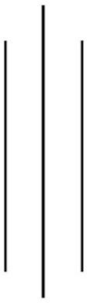
Tribhuvan University
Bhaktapur Multiple Campus
Dudhpati-1 Bhaktapur, Nepal
"Lab Report 3: Numerical Methods"(CSC212)
Semester: III
Name: Mark Dangal
Roll No: 26
Level: B.Sc. CSIT
Submitted to: Surya Bam
Submission Date:
Signature of subject teacher

Slide 2
Table of contents
S.N. | Topics: (WAP to implement:) | Date of submission: | Signature:

Slide 3
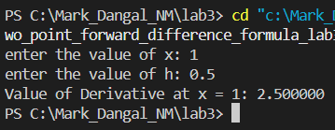
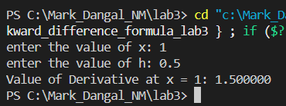
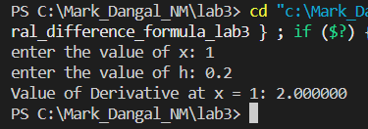
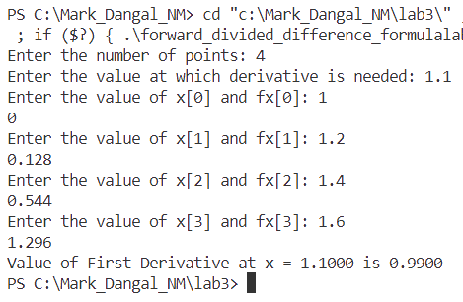
Two-point forward
Two-point backward
Three-point central
Derivative Newton’s forward difference

Slide 4
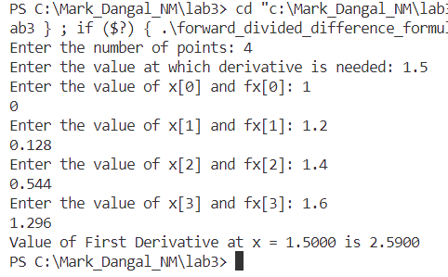
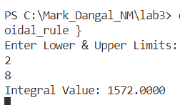
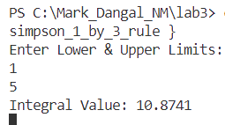
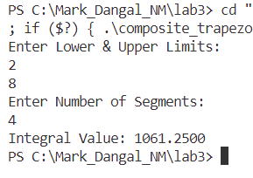
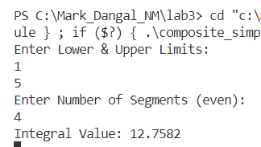
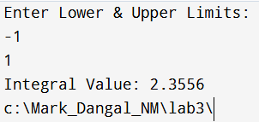
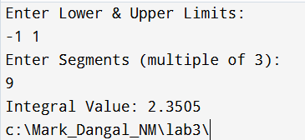
Derivative using Newton’s Backward difference
Trapezoidal rule:
Simpson’s 1/3 rule:
Composite Simpson’s 1/3 :
Composite Trapezoidal:
Simpson’s 3/8 rule:
Composite Simpson’s 3/8:

