Slide 1
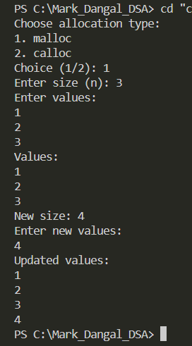
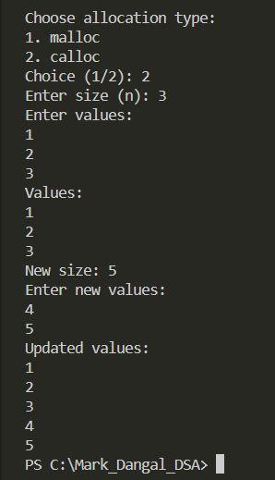
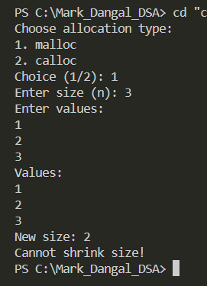
if (new_n > old_n)
also using malloc
if (new_n > old_n)
also using calloc
If(new_n<old_n

