Slide 1
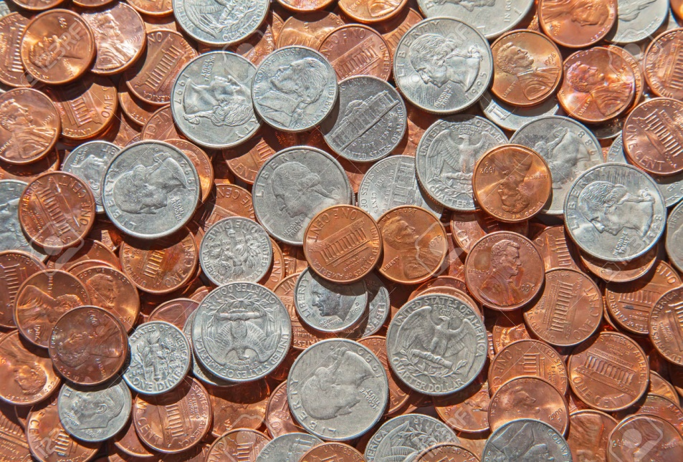
Which of the following is NOT a real U.S. coin?
½ cent coin
2 cent coin
3 cent coin (or trime)
Half dime
12 ½ cent coin (or bit)
20 cent coin

Slide 2
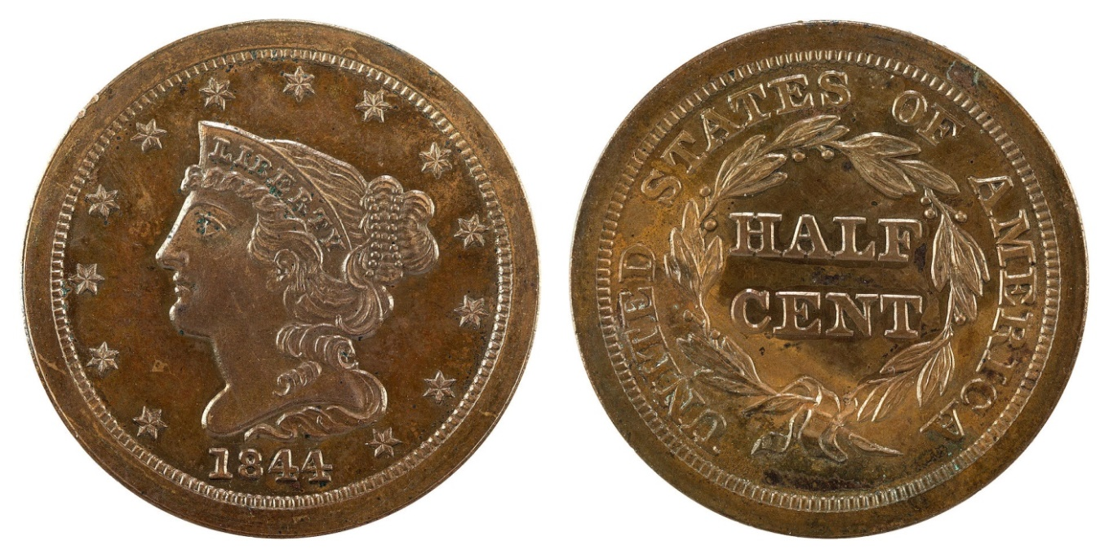
½ cent coin
Minted from 1793 to 1857
Slightly smaller than a modern quarter
*

Slide 3
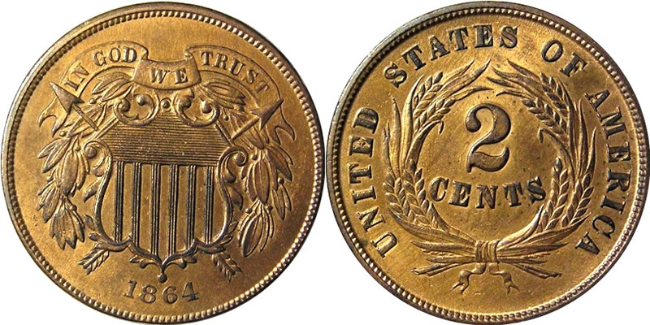
2 cent coin
Minted from 1864 to 1873
First U.S. coin with the motto, “In God We Trust”
*

Slide 4
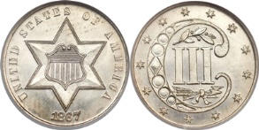
3 cent coin
Minted from 1851 to 1889
Smallest coin made of silver
78% as big as a dime
*

Slide 5
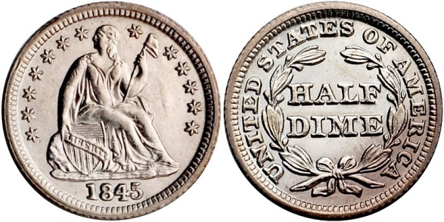
Half dime
Minted from 1792 to 1873
Made of silver
Nickels started in 1860’s
*

Slide 6
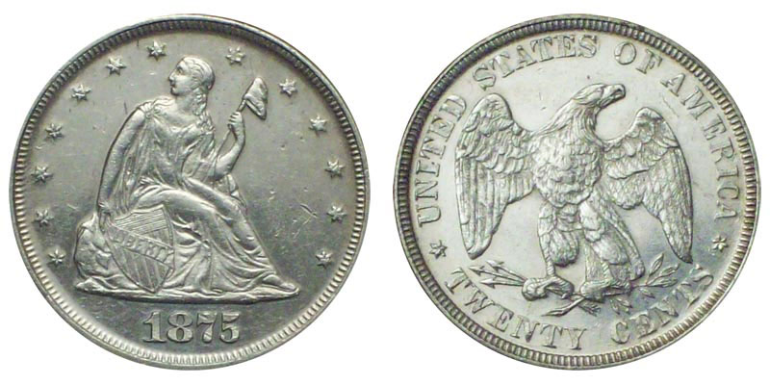
20 cent coin
Minted from 1875 to 1878
Made due to shortage of small change in the far west
Nickels started in 1860’s
*

