Slide 1
1150 Programming Logic
APIs and JSON

Slide 2


How do different computer systems talk to each other?
Scenario to consider:
An e-commerce retailer. Which systems may work together to display products (with reviews, similar product suggestions) on pages, take orders, process orders, ship orders... ?
Typical IT infrastructure within a company has many separate systems that communicate as needed
product catalog
product suggestions application
web server
product reviews application

Slide 3


Many technologies to connect different computer systems over a network
Various technologies including CORBA, Message Passing, PubSub... (we won't cover these)
One technology that's become very popular is using HTTP
Same technology used in your web browser, to request web pages
HTTP can also be used by programs to make requests to API servers
An API server is much like a web server, but it's designed to respond to programs, not humans, and send data, not web pages
HTTP Request
A program
on your computer
API server
HTTP Response (JSON)

Slide 4
HTTP
HTTP is the protocol used for browsers to request web pages, and for servers to send pages, images, other resources in response
Can also use HTTP to send requests from your program to another computer, somewhere else on the network (or internet)
The other computer can respond with data of some kind - a file, text, error message, or JSON

Slide 5
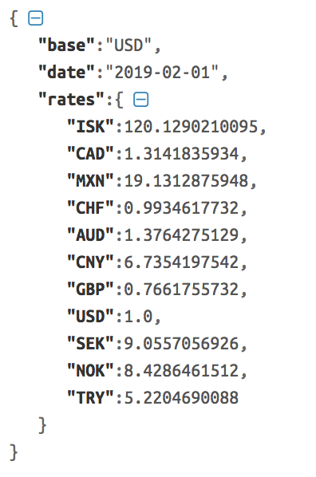
JSON
JavaScript Object Notation, used by the JavaScript language, but widely understood by many other programming languages
The structure looks a lot like a Python dictionary
And, we can turn a JSON response into a Python dictionary in our program, and use the data
https://api.exchangeratesapi.io/latest?base=USD, request from Spring 2019

Slide 6
HTTP Requests with requests
Python has built-in libraries for making HTTP requests, but it needs a lot of configuration to use
So we'll use the requests library instead which is easier to use - it assumes sensible defaults so basic requests are easy to make
http://docs.python-requests.org/en/master/
Libraries: Python code that someone else wrote, that we can import and use in our projects. There are 1000's of python libraries for all kinds of different tasks - working with word documents, processing images, creating a web application, building games, processing text, AI, computer vision, machine learning, processing and analyzing data, drawing maps, creating charts… https://www.ubuntupit.com/best-python-libraries-and-packages-for-beginners/

Slide 7
Installing requests
PyCharm is smart enough to install it for us
If you write a program that uses requests, PyCharm will offer to install the requests library

Slide 8
First HTTP request - getting random cat facts
We need a random cat fact
So we need a random cat fact service
Let's use the https://catfact.ninja API

Slide 9
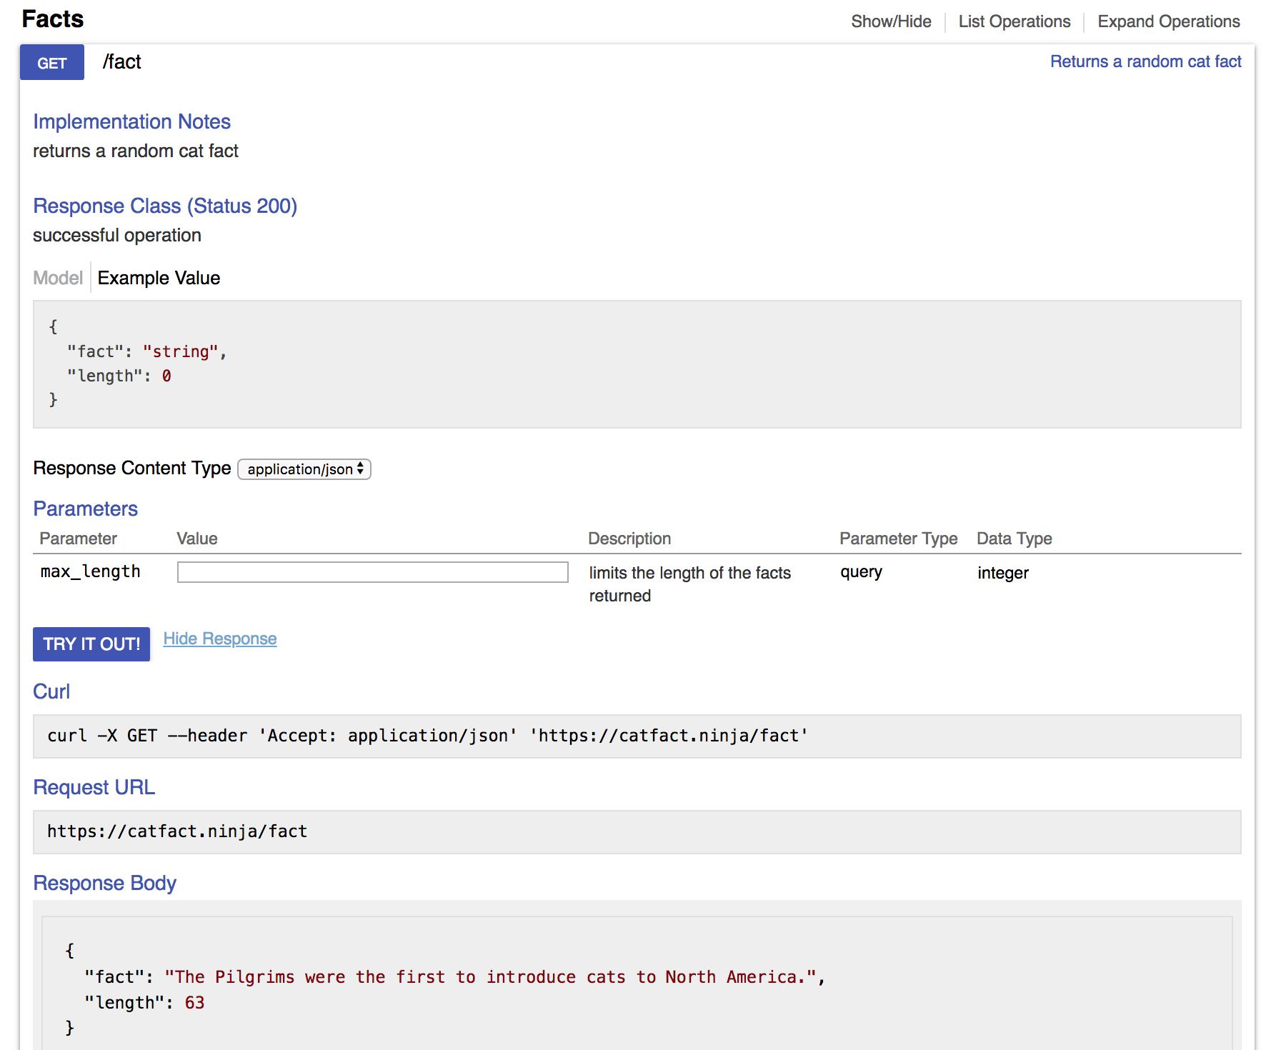
Using an API
Step 1: read the documentation to figure out what request to make
There's an example URL
Paste it into your browser address bar to see what happens

Slide 10
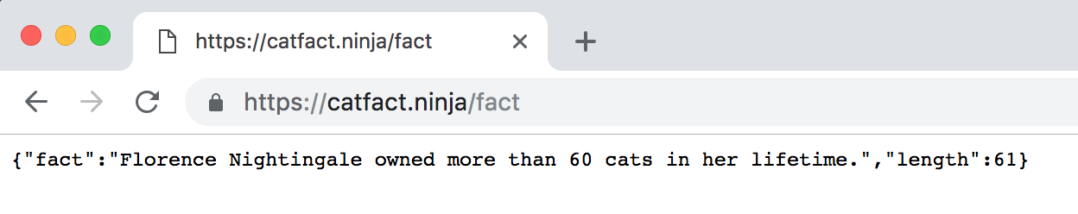
Step 2: Test out the API
Test in browser or with curl
Looks like a random cat fact
What format is the data in?
JSON response - it's plain text but formatted to be readable by computers. The structure is the same as a Python dictionary

Slide 11
Step 3: How is the response structured?
Note the JSON has keys "fact" and "length".
We are interested in the fact

Slide 12
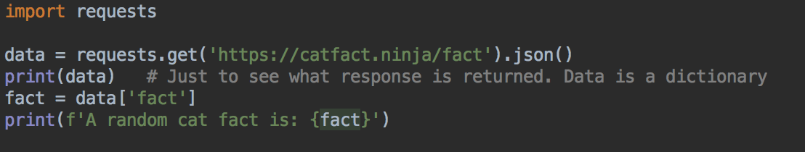
Step 4: Use in program
Import requests
Make request
Parse response into JSON, which is provided to your program as a dictionary
Use response in program

Slide 13
Step 4: Use in program
Put your cursor over requests
Press Alt + Enter ( PCs )
Or Option + Enter (Macs)
Choose the option to Import requests

Slide 14
Results
Run and test
Should get a new random fact every time

Slide 15
Another API - Exchange rates
https://exchangeratesapi.io/
You used this in a previous lab
List of currency codes: https://www.iban.com/currency-codes

Slide 16
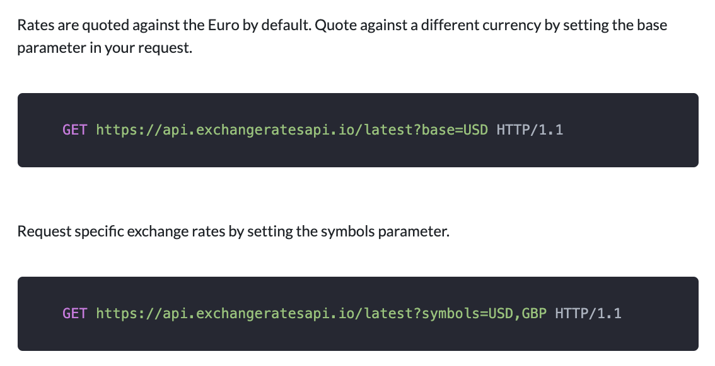
A basic exchange rate program
Example: we want the dollars-euros exchange rate for conversions
From reading the documentation, we can specify a base currency, and symbols (the currencies to convert to) with this URL
https://api.exchangeratesapi.io/latest?base=USD&symbols=EUR

Slide 17
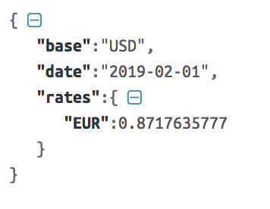
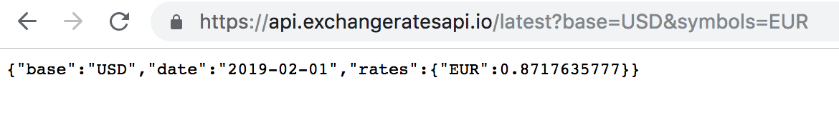
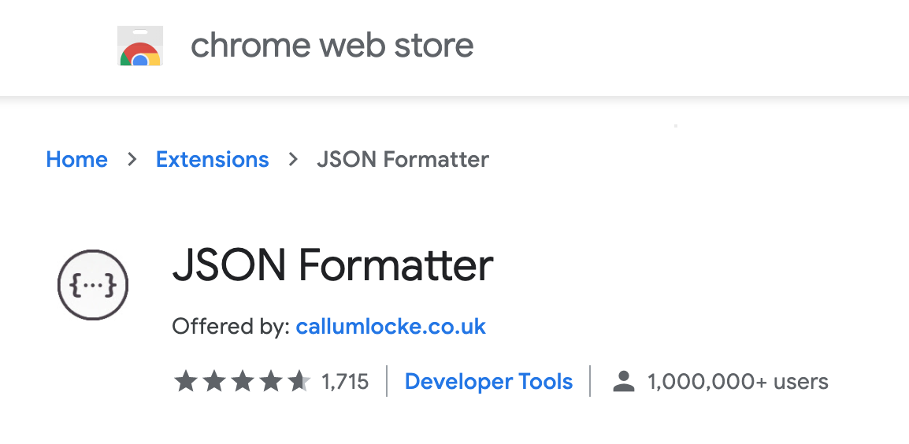
Formatting JSON
Paste text into JSON formatter - easier to read
Doesn't change the data, just adds newlines and indents so it's easier to read
Helpful to see the structure of the response
https://jsonformatter.curiousconcept.com/
Or, use Firefox, which formats JSON by default
Chrome users can install a browser extension, like https://chrome.google.com/webstore/detail/json-formatter/bcjindcccaagfpapjjmafapmmgkkhgoa?hl=en

Slide 18
Response
The response has a rates key
The value for this key is another dictionary
This dictionary has a EUR key, and its value is the exchange rate from dollars to Euros

Slide 19
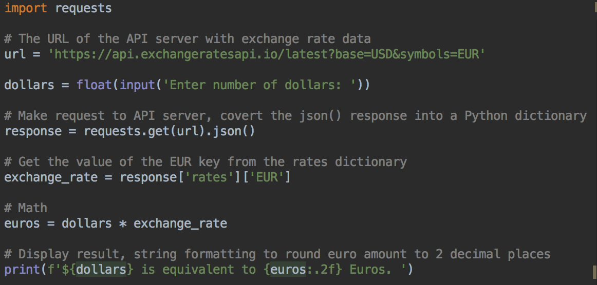

Run and test

Slide 20
Weather
Try this URL
https://api.weather.gov/gridpoints/MPX/107,71/forecast
This is the current weather forecast for Minneapolis, from weather.gov

Slide 21
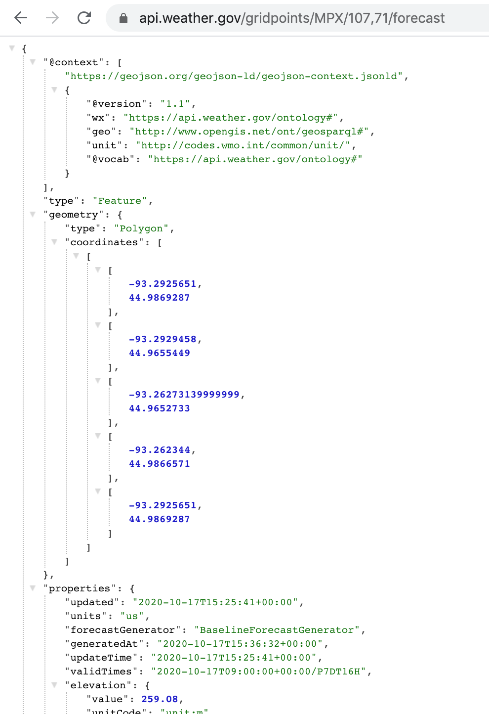
JSON looks more complicated...
It's got a lot more data in it
But we can ignore a lot of it and focus on the part we need
Scroll down, forecast information starts about 1/3 of the way down
Notice there's a properties key, the value is a dictionary
The properties dictionary has a key periods
The value for this key is a list of forecasts for the next 7 days and nights
Rest of JSON response continues…

Slide 22
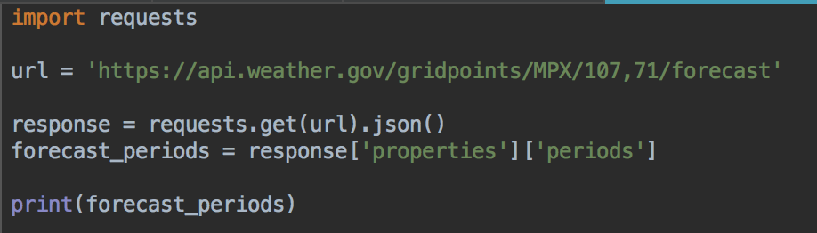
Start of program
Get data, and extract just the forecast data
The properties dictionary, and then the periods list
Should output a long string with forecast data
Plus the rest of the data…

Slide 23
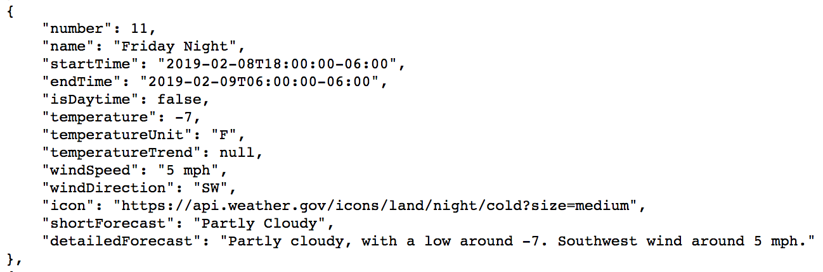
Look at the data from a dictionary in the list
There's a name key, which is the day of the week, and if its day or night
There's a temperature key, for the temperature in F
And a detailedForecast key, text describing the forecast
Example dictionary
from response

Slide 24
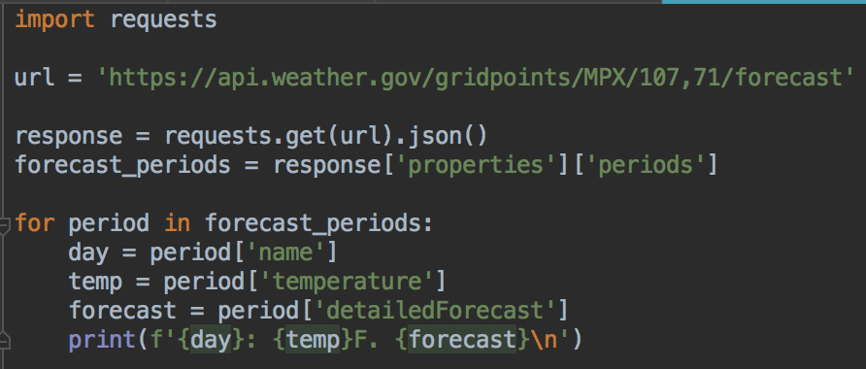
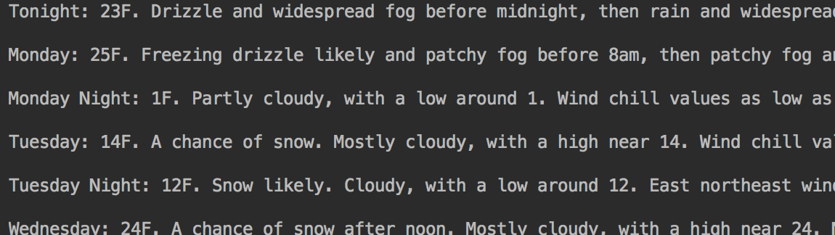
Loop over the list, and get the day, temperature, and forecast for each period Run and test this program

Slide 25
Lab

Slide 26
100's of other APIs
A list https://github.com/public-apis/public-apis
Plus many more

Slide 27
Lab
This week: more API calls

