Slide 1
ITEC 1150 Programming Logic
Functions, Scope of Variables

Slide 2
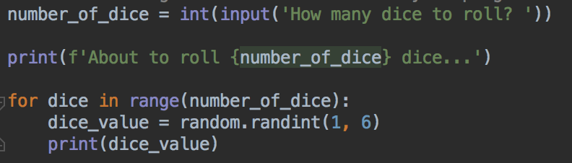
Functions
Good news! You've already used functions
The parenthesis () after a name in your program means that you are calling a function
Some functions take arguments - the data or values in the parenthesis - some functions don't
Some functions return a value to your program, your program can use that value – some functions don't
Can you see the functions in this code?

Slide 3
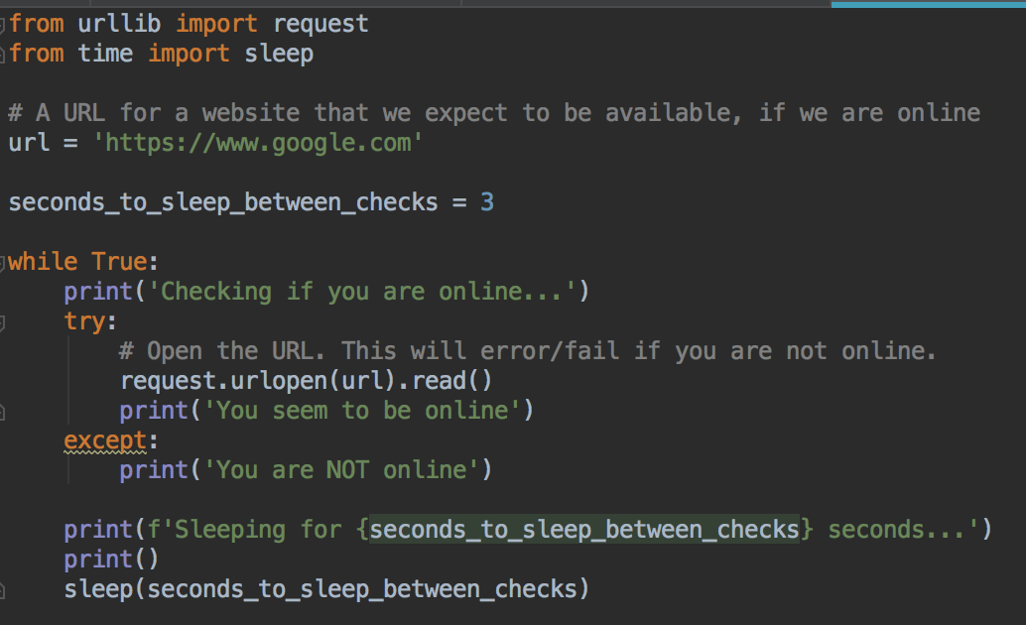
Today
Designing and creating your own functions
Some other library functions you've used

Slide 4
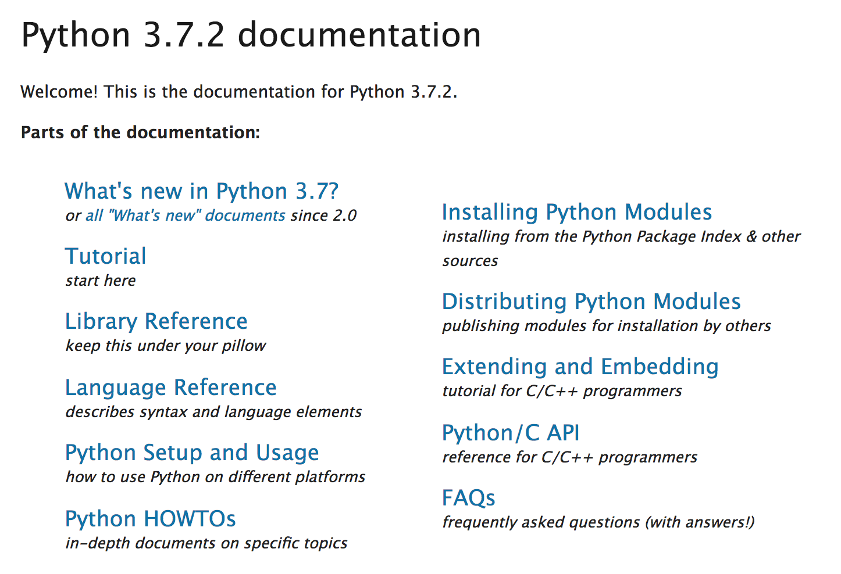
Functions
There are lots of useful built-in Python functions
For tasks that programmers often need to do
The Python Library Reference and Language Reference describe all the built-in functions
https://docs.python.org/3/

Slide 5
Imagine we have some strings, and they all need to be in uppercase
For example, we are writing a program that works with college class codes
The department codes should all be in uppercase, for example,
SPAN 1000, ENGL 1234, WEBI 1400, ITEC 1150
Problem: you have a dataset with some lowercase or mixed case department names,
SpAn 1000, engl 1234, WEbi 1400, Itec 1150
And you want to convert all the class codes to uppercase

Slide 6


We could write our own code to convert to uppercase
It involves looping over the characters in the string, and converting any lowercase letters to its uppercase version
How to do that? We need to know about how computers store characters
Behind the scenes, computers save characters as Unicode
Unicode values are numbers, and each character has a numeric code
Unicode is an international standard - all computers agree on what numbers represent each character
Unicode has a code for almost every character in almost every writing system in the world, and many other commonly used symbols including emojis ⛷☕️🌻🦄
Although not all computers and program know how to draw the character (or glyph) for every single character – so you might see empty boxes or X or ? in their place

Slide 7
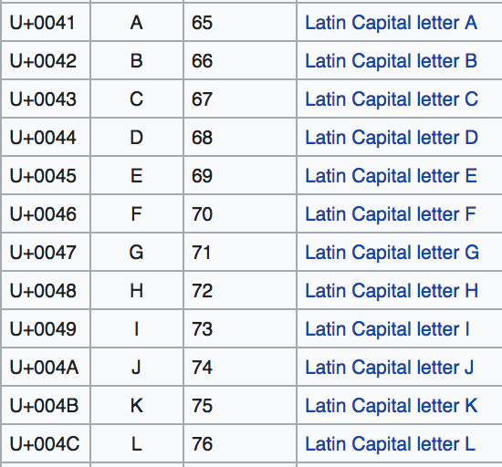
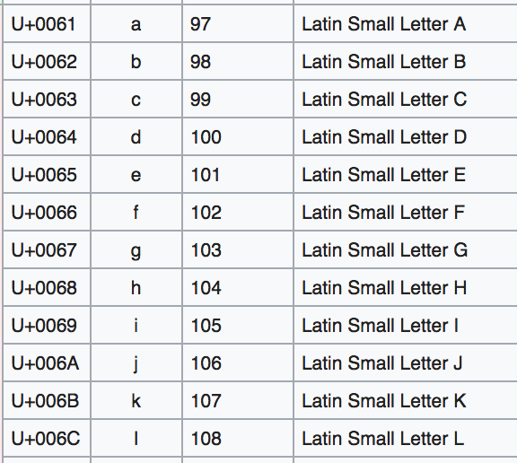
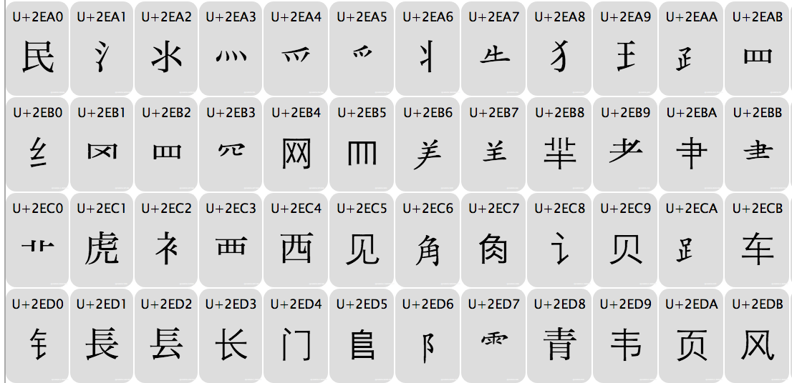
Unicode
Unicode value in decimal. Do you notice a pattern between the uppercase and lowercase letters?
Some Latin characters and their Unicode values
https://en.wikipedia.org/wiki/List_of_Unicode_characters
Section of Chinese radical Unicode values
https://www.key-shortcut.com/en/writing-systems/%E6%96%87%E5%AD%97-chinese-cjk/cjk-characters-1/
Unicode values are actual hexadecimal (the U+0044 or U+2EC9 values) not decimal numbers, but we can work with the decimal numbers for this example

Slide 8
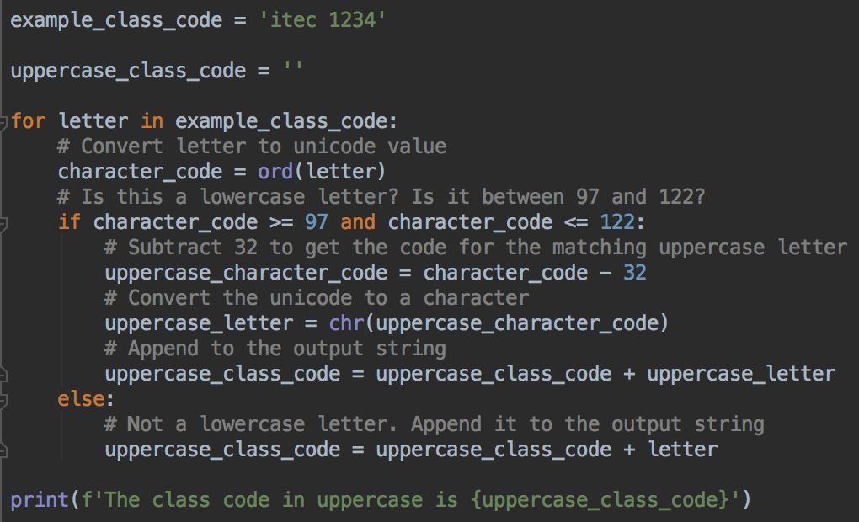
For Latin scripts, the unicode for lowercase letters are 32 more than the uppercase version of that letter
So, we can write something like this to convert a class code to uppercase
You don't need to worry about how this works now
Basically, loop over all the letters. if the letter is lowercase, make it uppercase
Append all letters to an output string
The more important point is: how would you feel about having to write allllll of this code every time you needed to make a string uppercase?
And how do you feel that this only works for letters a-z ? What about other writing systems?

Slide 9
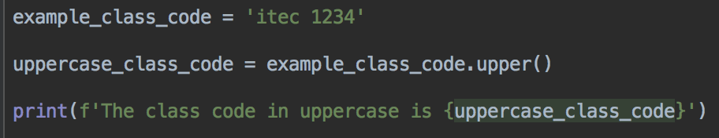
Language and Library Functions: much easier!
Fortunately, Python has a built-in library function called upper() which creates an uppercase version of a string
This code has the same output as the previous slide
But this version is much better
upper and other built-in functions are easy, reliable, readable and general purpose – Python's version will work for almost any language
People already wrote, tested, and debugged the built-in language functions
There are several other language functions (like print, int, len, str)
And hundreds more library functions for all kinds of tasks, for example random.randint, request.urlopen, time.sleep...

Slide 10
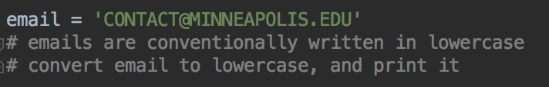
Your Turn
Start with with this code
Convert the email to lowercase and print it out
If upper() makes an uppercase version of a string, what do you think the function to make a lowercase version of a string is called?

Slide 11
Advantages of writing your own functions
As you have seen, functions can gather long code blocks to perform specific tasks like capitalizing a string
Functions help organize your program, and make it more understandable
They help eliminate repetitive code – write a function once, use it many times
Debugging is easier – often you will know which function the error is from, so you can focus on that function instead of the whole program
Testing is easier - can test each function individually
Once you've written a function, you may even be able to reuse (call) it in other programs

Slide 12
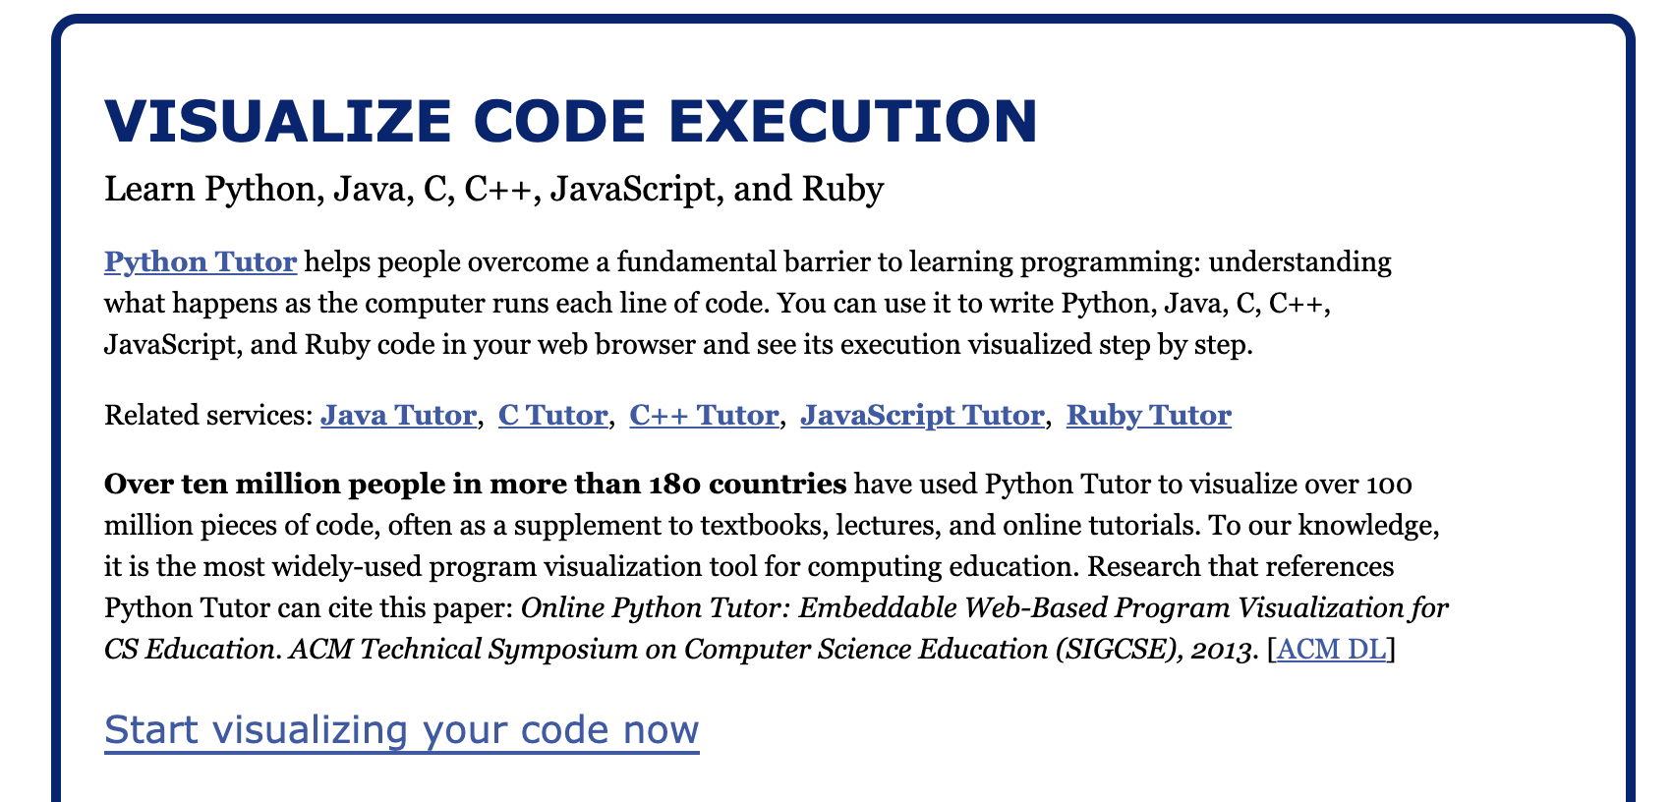
First function
Let's write a function to create a greeting message
We'll use PythonTutor to see how the code runs
http://www.pythontutor.com/
Go to Python Tutor, and Click Start visualizing your code now

Slide 13
Paste this code into Python Tutor Replace any code that's there
def greeting(name):
message = f'Hello {name}!'
return message
def main():
username = 'Zoe'
hello_message = greeting(username)
print(hello_message)
main()

Slide 14
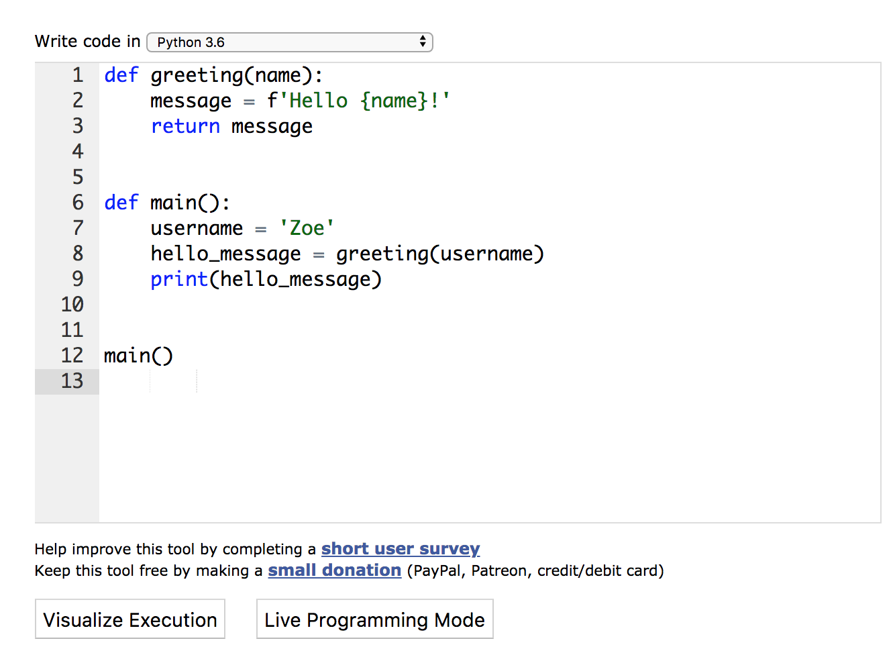
Click the Visualize Execution button

Slide 15
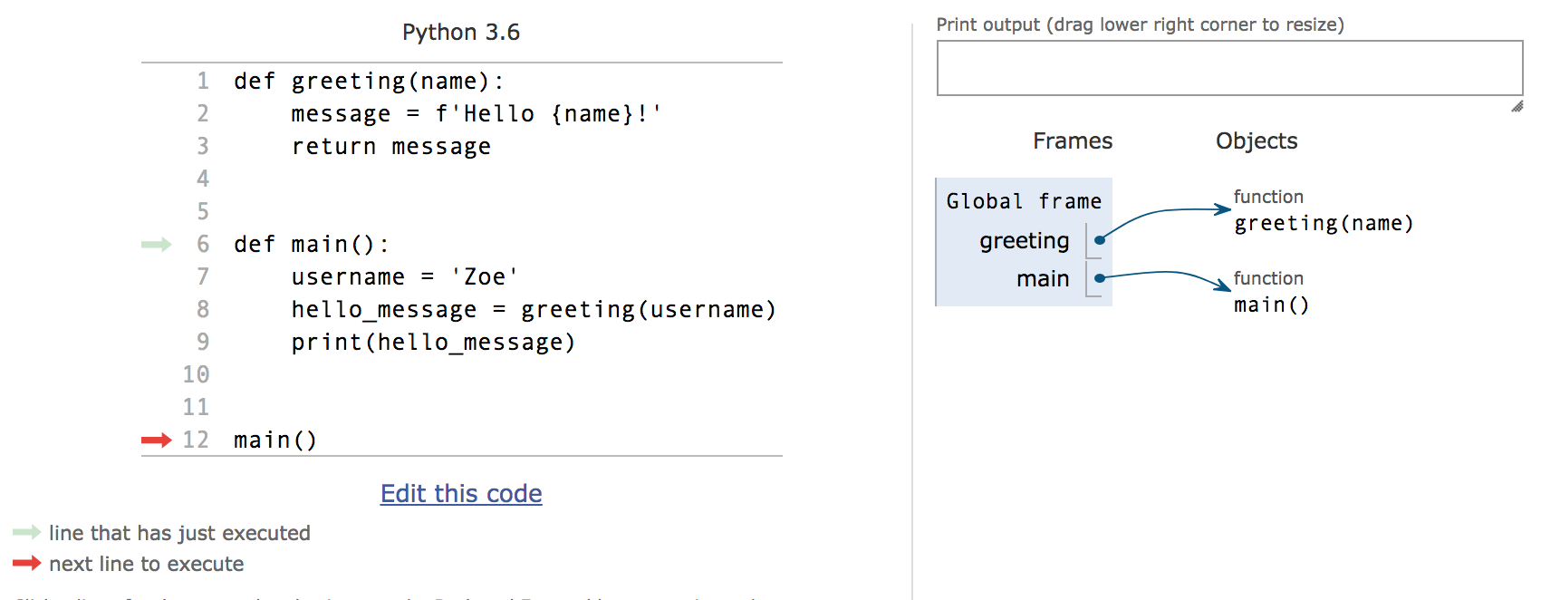
Press the Forward button to execute line by line
Watch the red and green arrows, marking the line that's being executed/about to be executed
Important questions:
What order is this program executed in? In order, or something else?
How are the variables organized (right side of screen)
Did you see the return value from greeting?
What happens to the message variable when the greeting function is done?

Slide 16
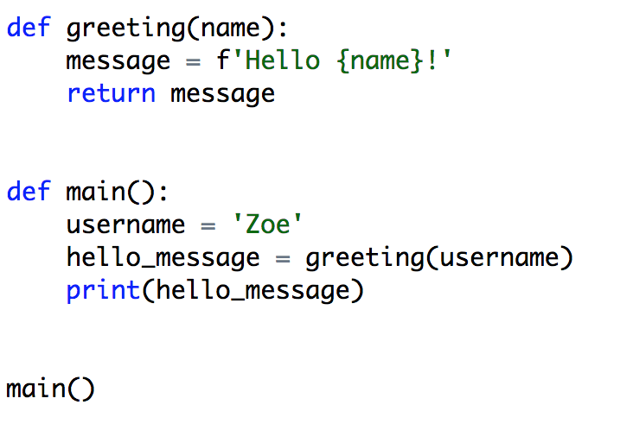
Parts of the program: function definitions, function calls
greeting(message)
calls the greeting function
Defining the greeting function
Defining the main function
main()
calls the main function

Slide 17
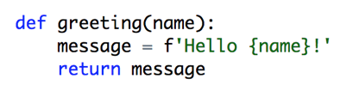
Two steps to using functions
Define the function
Call the function when you need it
Functions don't do anything until they are called
So, you need to call main() to make your program run

Slide 18
main()
By convention, programmers use main() as the name of the first function the program runs
Since everyone does it, it's easy to see where your program starts
The name main() doesn't have any special meaning to Python
Remember that you must call main() to start your program running

Slide 19
Defining Functions
Functions often (but don't have to) have input - parameters
And they often (but don't have to) return some data
The greeting function has one parameter - the name
It returns the greeting message it creates
When the greeting function is called, a variable is provided as an argument - in this example, the username variable
The return value of the greeting function is stored in the hello_message variable

Slide 20

Calling functions with arguments, using return values
You've already done this a lot - for example, using the input function
'Please enter your name: ' is the argument to input()
Whatever the user types is the return value, it's stored in the name variable

Slide 21
Function definition syntax
When writing a function you need
def
Then the function's name - all one word,
Same rules as variable names, so _ are allowed
Then ()
If parameters are needed, put them in the ()
If more than one parameter, separate with commas
Then the colon :
On the next line, indent and write the body of the function
If need to return data, put the return statement on the last line - the word return followed by the variable or value

Slide 22
Calling a function syntax
When the function is called, it expects to receive the parameters specified in the definition
So, when calling the function, the expected arguments must be supplied (which become the parameter values)
If you set a variable to the result of a function call, that variable is equal to the function's return value
name is set to whatever is in username
hello_message contains the return value, the data in the variable message

Slide 23
Parameters and arguments
Data the function needs to receive = parameters
Defined in the function definition
Data you send to the function = arguments
These are the values supplied for a function call
The arguments supplied must be of the data type expected for the parameters, as set forth in the function definition
If you use a string as an argument, if the function expects an int in the parameter, your program will probably crash or not do what you want
Some functions need no parameters – just leave the parentheses empty
Or use 1, 2, or as many parameters as you need
Just take care to match parameters and arguments!
Match the number of arguments needed, AND the order of arguments, AND the type of data expected.

Slide 24
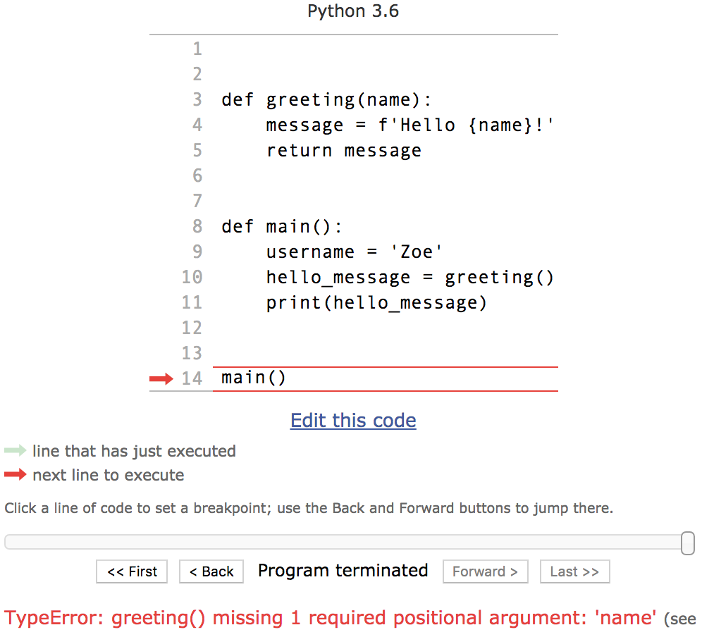
What happens if you don't provide the right arguments?
Try deleting the username from the call to greeting()
What happens?
Missing argument

Slide 25
We will use functions going forward So your code could have this structure
""" doc string/long comment """
# import statements, if any
def main():
# main program code goes here,
# probably calls to other function(s)
# Define any the other functions you need here
main() # Remember to call main at the end,
# otherwise your program will not run.

Slide 26
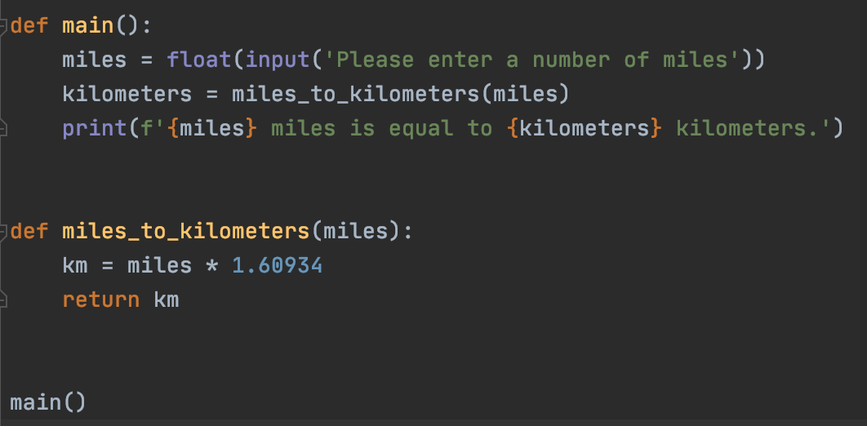
Another example – converting miles to kilometers
Where are the function definitions, where are the function calls?

Slide 27
Your turn – megabytes to bytes
1 megabyte is 1,000,000 bytes.
Write a function that converts a number of megabytes into a number of bytes. So if a user has a 10-megabyte file, that’s equal to 10,000,000 bytes.
Your function should have one parameter, the number of megabytes. It will return the number of bytes. Call your function from main() with some example numbers and print the return values
In other words, your function should multiply the parameter by 1000000 and return that value.

Slide 28
Functions can be written in any order
The main() function definition is important, so we often put it first
If the call to main() is at the very end of the program, the order of the function definitions doesn't matter
This is because the functions don't run until they are called
Another way to say it: order of function CALLS matters
It is important to document your functions
Give them a sensible name that describes what the function does
If it's not clear from the name, write a comment which explains the purpose of the function
Add comments in the function code as appropriate

Slide 29
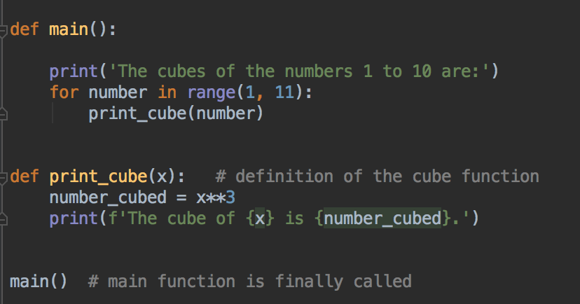

Calling a function many times from a loop
This means multiply x by x by x, or multiply by itself 3 times, or x to the power of 3, or x cubed.

Slide 30
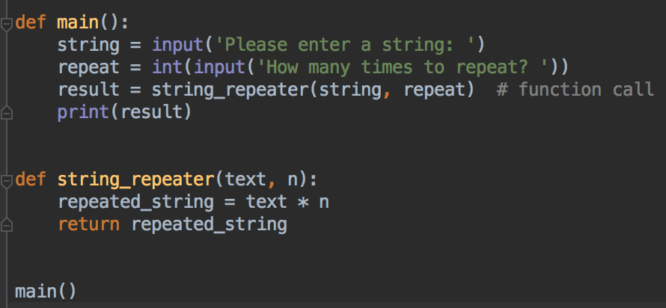
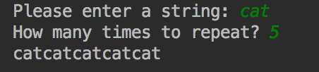
Functions can have more than one parameter – how many does this function have?

Slide 31
Another example – try typing this in Python Tutor and visualize execution
Notice this function has two parameters, so need to provide two arguments when calling it
def rectangle_area(height, width): area = height * width return area def main(): rectangle_height = float(input('Enter height of rectangle: ')) rectangle_width = float(input('Enter width of rectangle: ')) rectangle_area = rectangle_area(rectangle_height, rectangle_width) print(f'The area of this rectangle is {rectangle_area}') main()
two arguments
Don't forget to call main()

Slide 32
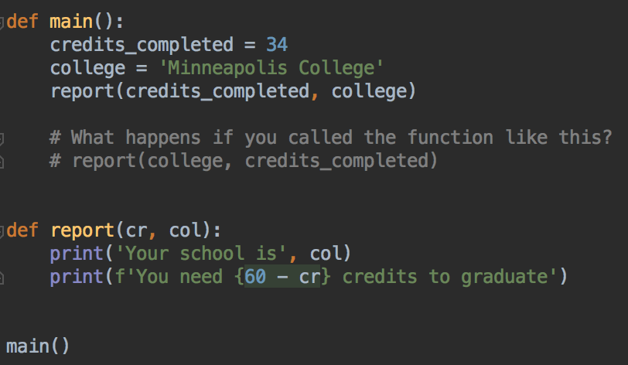
Order of parameters matters What happens if you switch the parameters credits_completed and college?

Slide 33
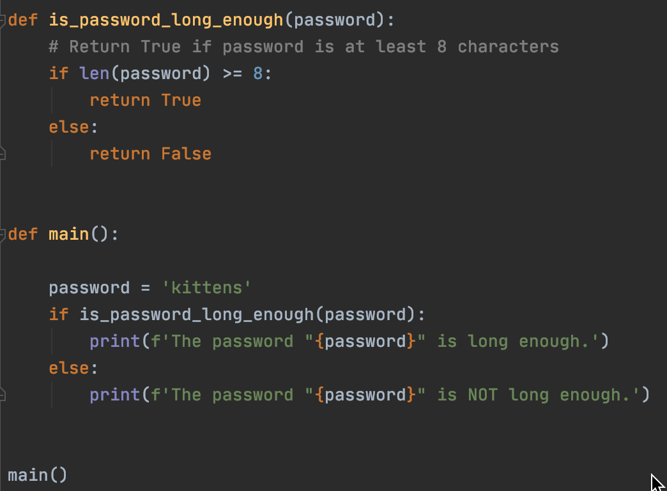
If statements in functions
Notice there are two return statements, one for the if block, and one for the else block
The if function is making a choice, it should return something for all the choices

Slide 34
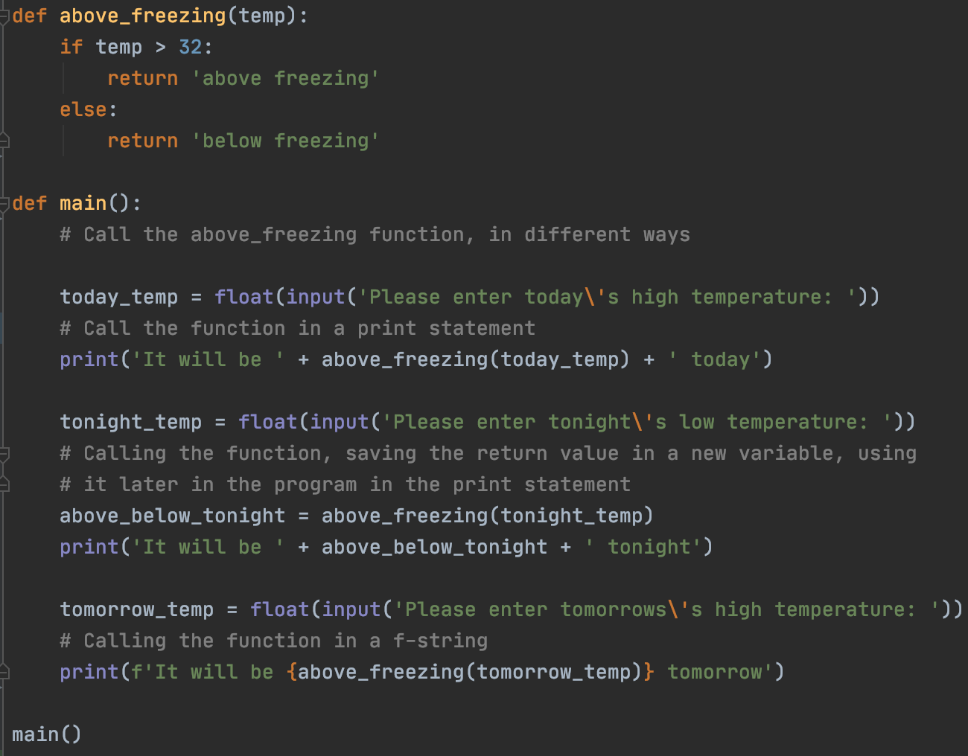
One function called multiple times, different ways to use the return value

Slide 35
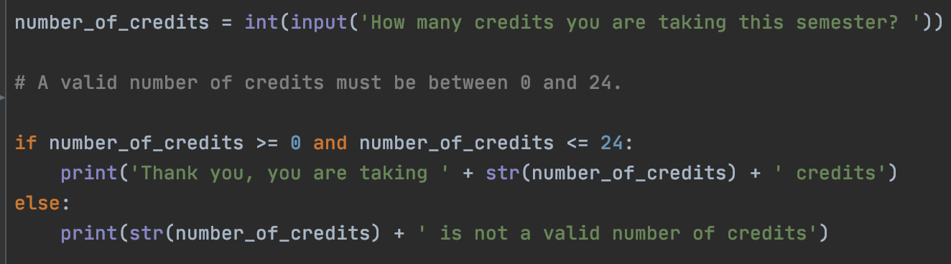
Your turn – first year or second year?
Write a function that decides if a class code is a first year or second year class. The function will
return 'First Year' for class codes that are between 1000 and 1999.
return 'Second Year' for classes that are between 2000 and 2999.
return 'Invalid Code' for all other values.
In the main function, ask the user for a class code that they are taking (1000, or 2525). Call your function and print the returned value.
Hint: here's a program with an if-statement that tests if a number ifs between two other numbers.

Slide 36
Combining loops, functions, if statements
Same as when we wrote an if statement in a loop, can write if statements in functions, and call functions from if statements, and call functions from loops...
Can combine these operations in any way, to solve the problem with our program
We can write as many functions as needed

Slide 37
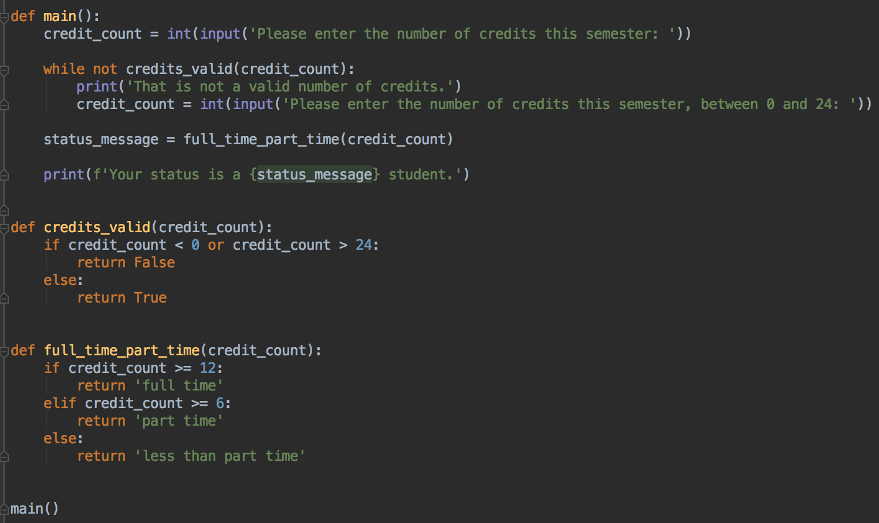
A more complex program - student status with validation
Spot the function definitions, function calls
Can you see the if statements in the functions?
Can you see the function called by the while loop?

Slide 38
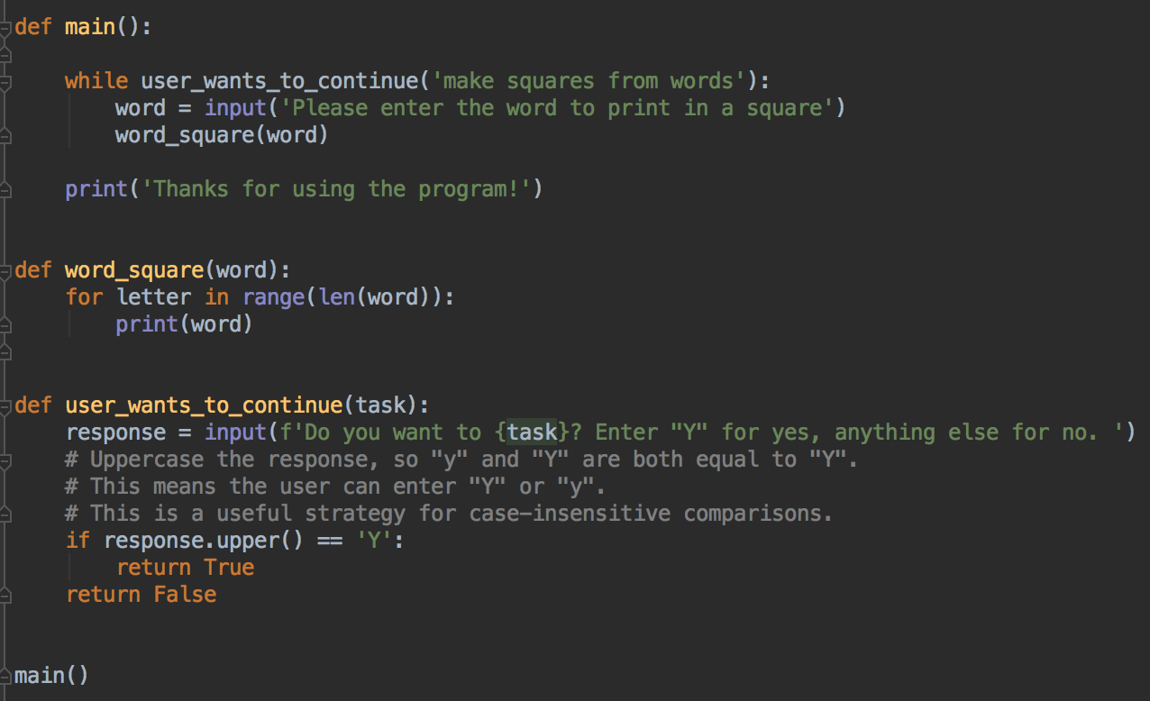
Another more complex program
Spot the function definitions, function calls
Can you see the if statements in the functions?
Can you see the function called by the while loop?
Can you see the for loop in the word_square function?

Slide 39
Review: Why do we write functions?
To logically gather code that performs a certain task
So that your program can re-use the function code many times (even millions)
To make your program easier to read and understand
To make your program easier to test

Slide 40
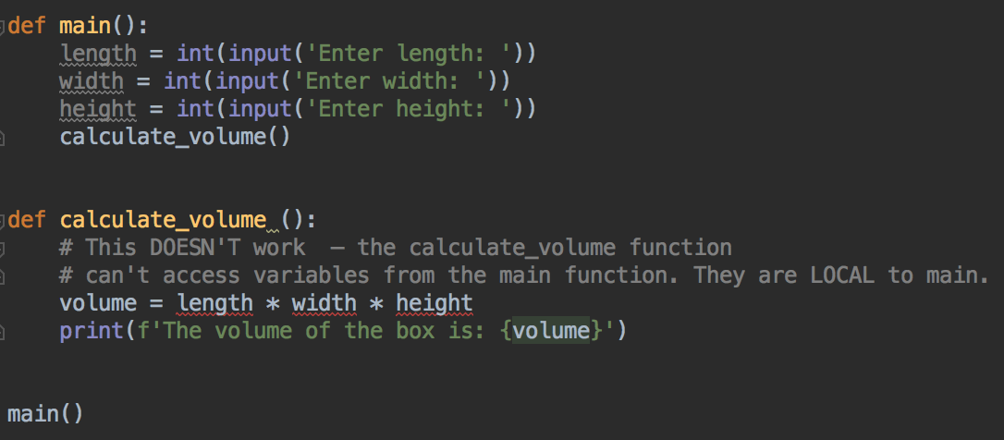
Scope: Local Variables Only Exist within Functions
Notice PyCharm is indicating the length, width, and height variables are unused in main(), and there are errors in calculate_volume

Slide 41
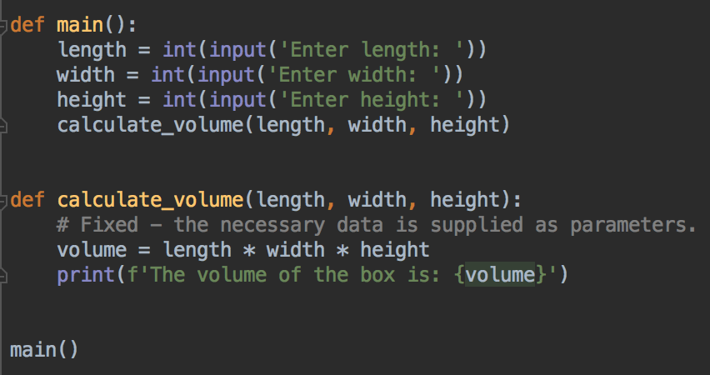
Scope - fixed

Slide 42
Scope and Local Variables
Variable values created inside a function disappear once the function ends
This might seem annoying.... but it's a deliberate design choice
You don't need to use unique variable names throughout your program (helpful if your program is very long)
Data is contained within a function, so it is safe from other parts of your program
Other parts of your program can't create errors by accidentally modifying data in another scope
If you send data in and out of functions using parameters and return values, it's much safer
Your functions variables are probably only needed when the function is running, and then the program doesn't need them any more, so they can be deleted to save memory

Slide 43

Comments
Python comments start with #
Remember to add comments to your program
You don't have to write a comment for every line
Descriptive variable names help document your program, making it more readable and reducing the number of comments you need
Compare these two variables for holding a total. Which one will be more understandable when used in a program?

Slide 44
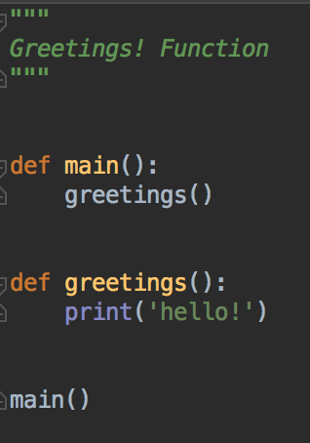
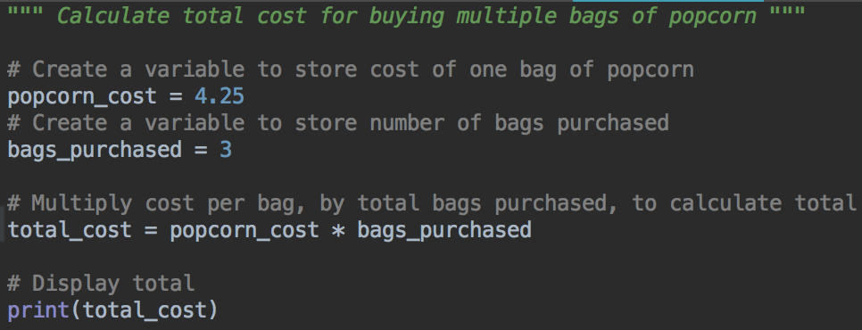
docstrings - comments for documenting (describing) your program
Use triple double quotes to make a docstring
Put a message at the top of every file describing what your program does, inside """ and """
Many examples in the example code repository

Slide 45
Lab 5
In D2L
For every question:
Comment and document your code
Put a docstring at the top of each file
Add comments to your code, as needed
Use descriptive variable names
Use Python Tutor to help debug, if a program isn't working as expected
Questions? Please ask!
Thank you!

