Slide 1
ITEC 1150 Programming Logic
The Dictionary Data Type

Slide 2
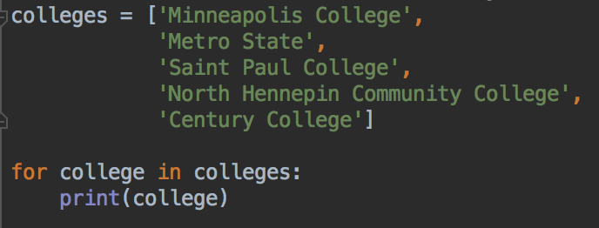
Last week: lists
A collection of things, typically all of the same type
The list has an order, the items are kept in the same order
Can add and remove items
Functions to get the number of items, sort the list, reverse, shuffle
Can loop over lists

Slide 3
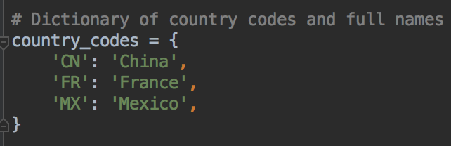
Dictionaries
Lists are a kind of data structure
Another common data structure in Python is the dictionary
Dictionaries store key: value pairs

Slide 4
Dictionaries - key: value pairs
Store unique keys with a paired value
Keys must be unique
Similar to a regular dictionary - unique words are associated with their definitions

Slide 5
Dictionaries - key: value pairs
Syntax: use curly braces { }
Link a key and its value with colons :
Separate key: value pairs with commas ,

Slide 6
Your turn
Think of your 3 favorite movies
Create a dictionary with the movie names as the keys
And your rating for that movie, out of 10, for the values

Slide 7
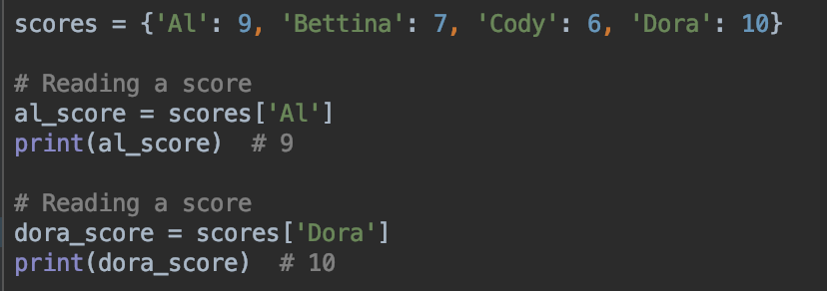
Reading data from a dictionary
Use square brackets
Your turn: Read the rating and print it, for one of your movies

Slide 8
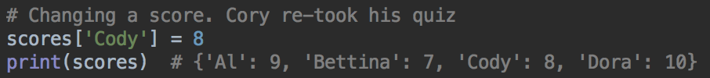
Changing data
Use the square bracket notation
Your turn: can you change the rating for one of your movies? Print the dictionary to confirm

Slide 9
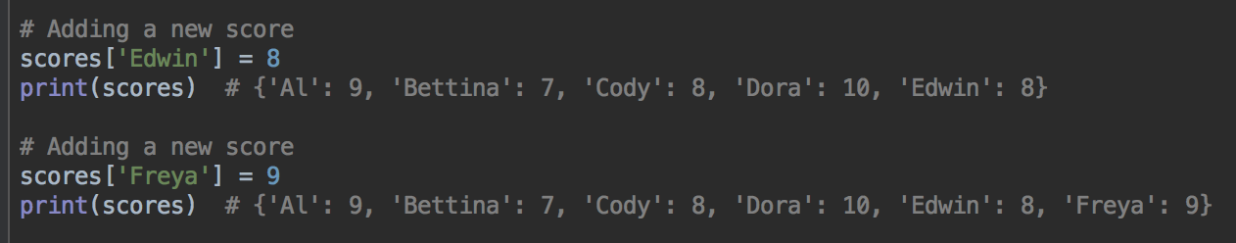
Adding data
Square brackets again
Your turn: add a new movie and rating

Slide 10
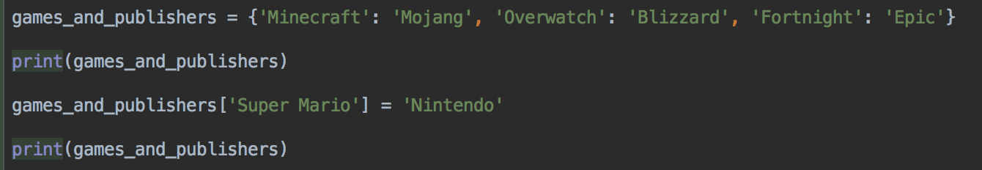
Adding key: values pairs to a dictionary
dictionary[new_key] = new_value

Slide 11
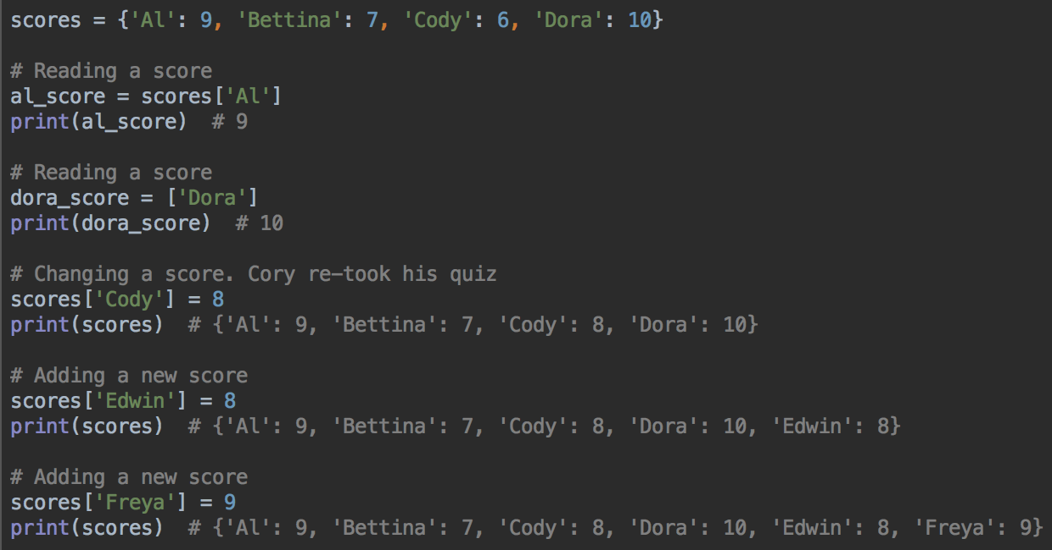
Adding, reading, modifying

Slide 12
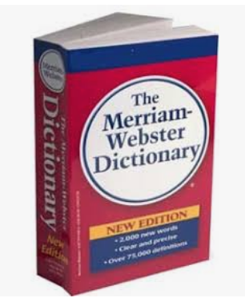
Lists vs. Dictionaries
Lists keep their elements in order. We often want the first element, or the last element, or want to process all the elements in order
Newer versions of Python keep dictionary keys in the order that the keys were added to the dictionary, but older versions don't
And other languages have dictionaries or something very similar, and the order of keys may not be guaranteed - they might be in a different order to the way the key: value pairs were added. And sometimes the order of the keys will change
With a dictionary, what matters most is that the keys are associated with the correct values
In a real dictionary:
We never need to ask for the 100th word in a dictionary.
We do ask for a word (the key) to find its definition (the value).
Dictionaries are designed for data that is retrieved by its key.
When numeric order is most important, you probably need the list data type.
When a certain key must be associated with a certain value, use the dictionary data type.

Slide 13
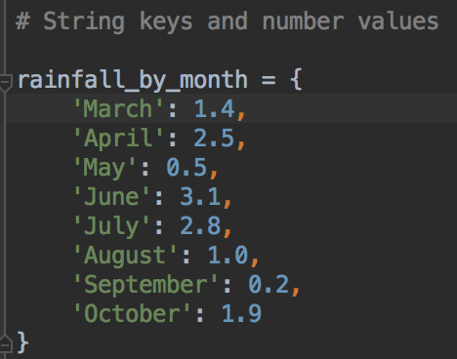
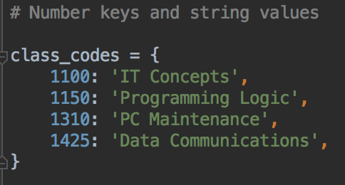
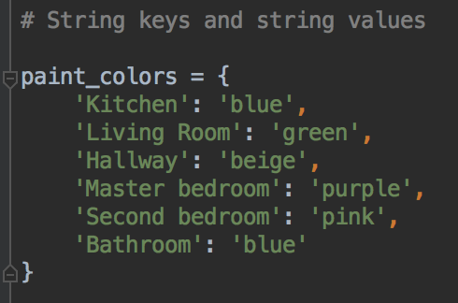
Dictionary Examples
Often, all the keys are the same type
All the values are the same type
Can have string keys and number values, string keys and string values etc...

Slide 14
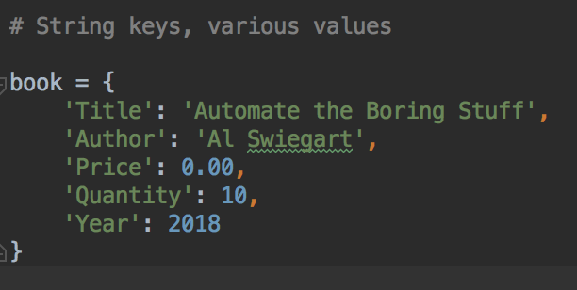
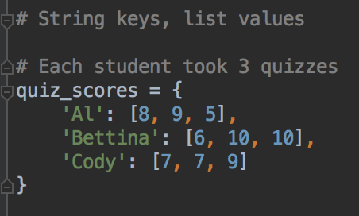
Dictionary Examples
The values can be different data types to represent different data about one object
The values can be lists, or other dictionaries

Slide 15
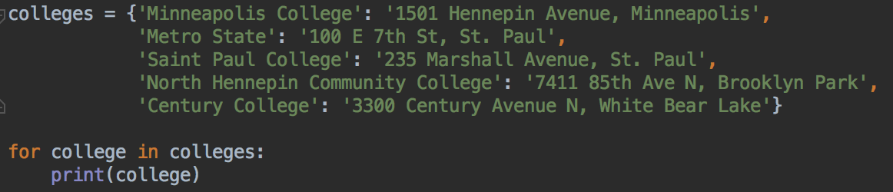
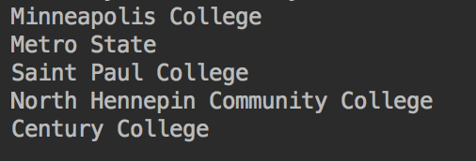
Looping over a dictionary
What does this print?
Just the keys ->

Slide 16
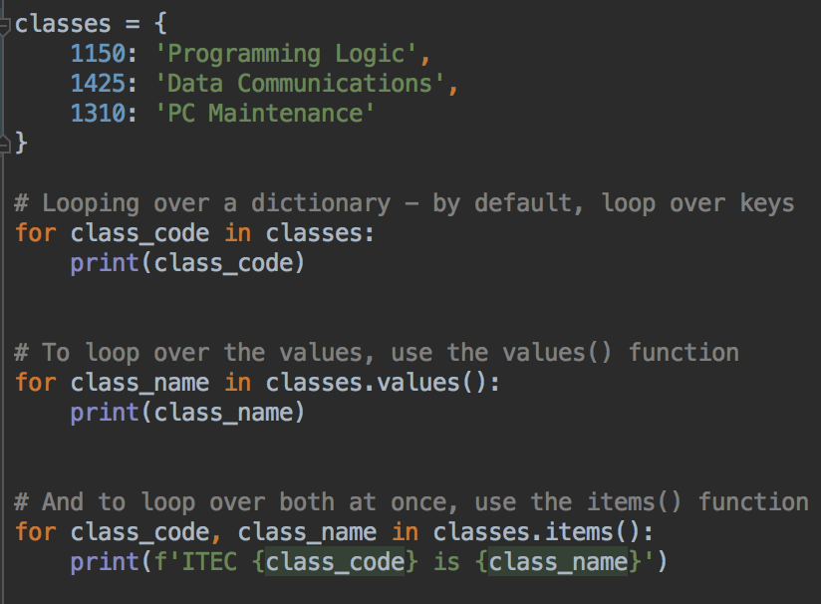


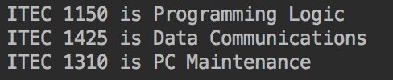
Looping over a dictionary
You can loop over the keys - the default
Or loop over the values with values()
Or loop over both keys and values with items()

Slide 17
Your turn
Can you write a loop to print all the movie names?
Can you write a loop with items() to print all the movies and their ratings?

Slide 18
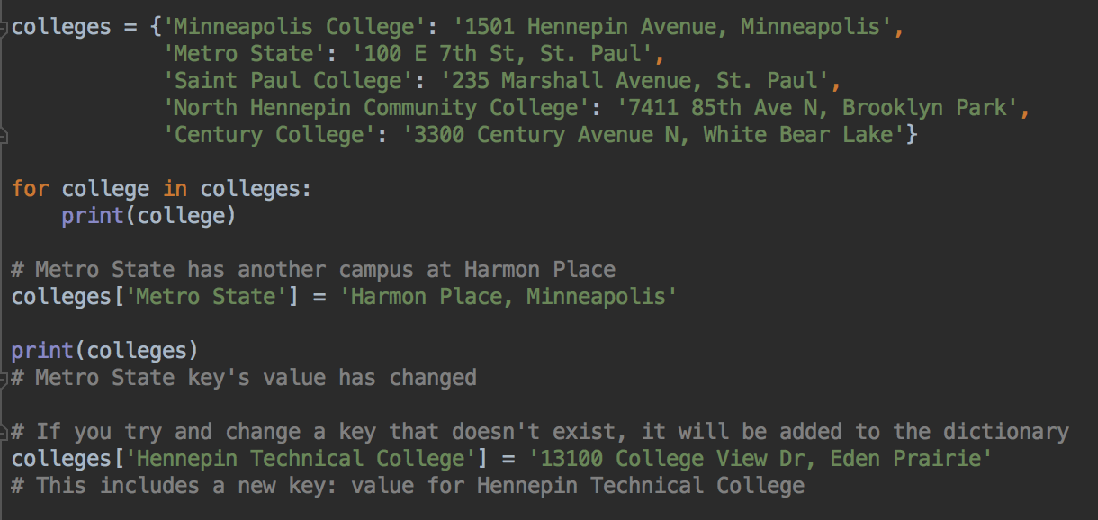
Looping over a dictionary, modifying data Syntax for adding and modifying is the same
Same syntax as adding a new key, value dictionary[key] = new_value
If the key is already in the dictionary, the existing value will be overwritten
Keys must be unique within a dictionary, can't have two keys the same

Slide 19
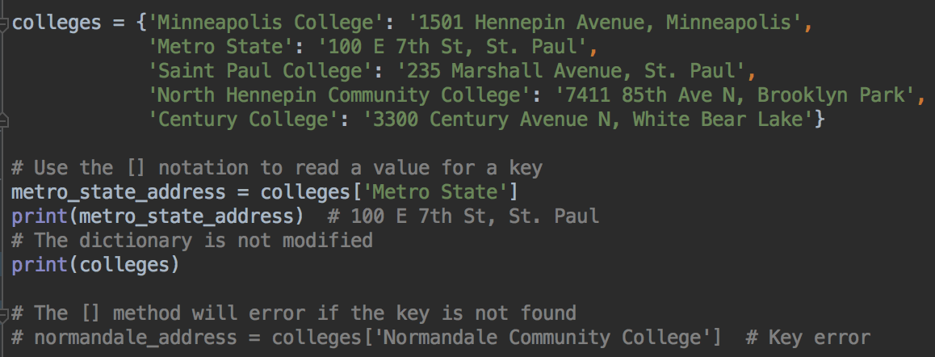
Getting a value for a key from a dictionary
One method - use [] syntax
This will error if the key is not in the dictionary

Slide 20
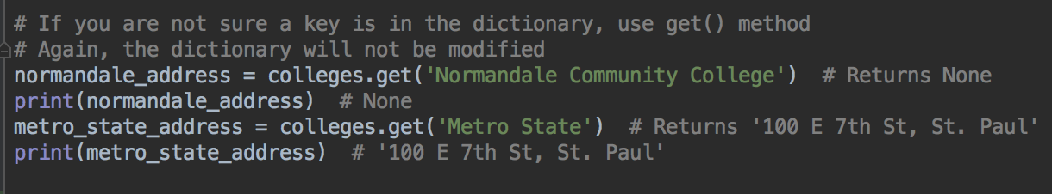
Getting a value for a key from a dictionary
Another way - the get() method
Will not error if the key is not found
get() returns the key's value, if the key is there
get() returns None if the key is not in the dictionary
You should check if the return value is None before you use it

Slide 21
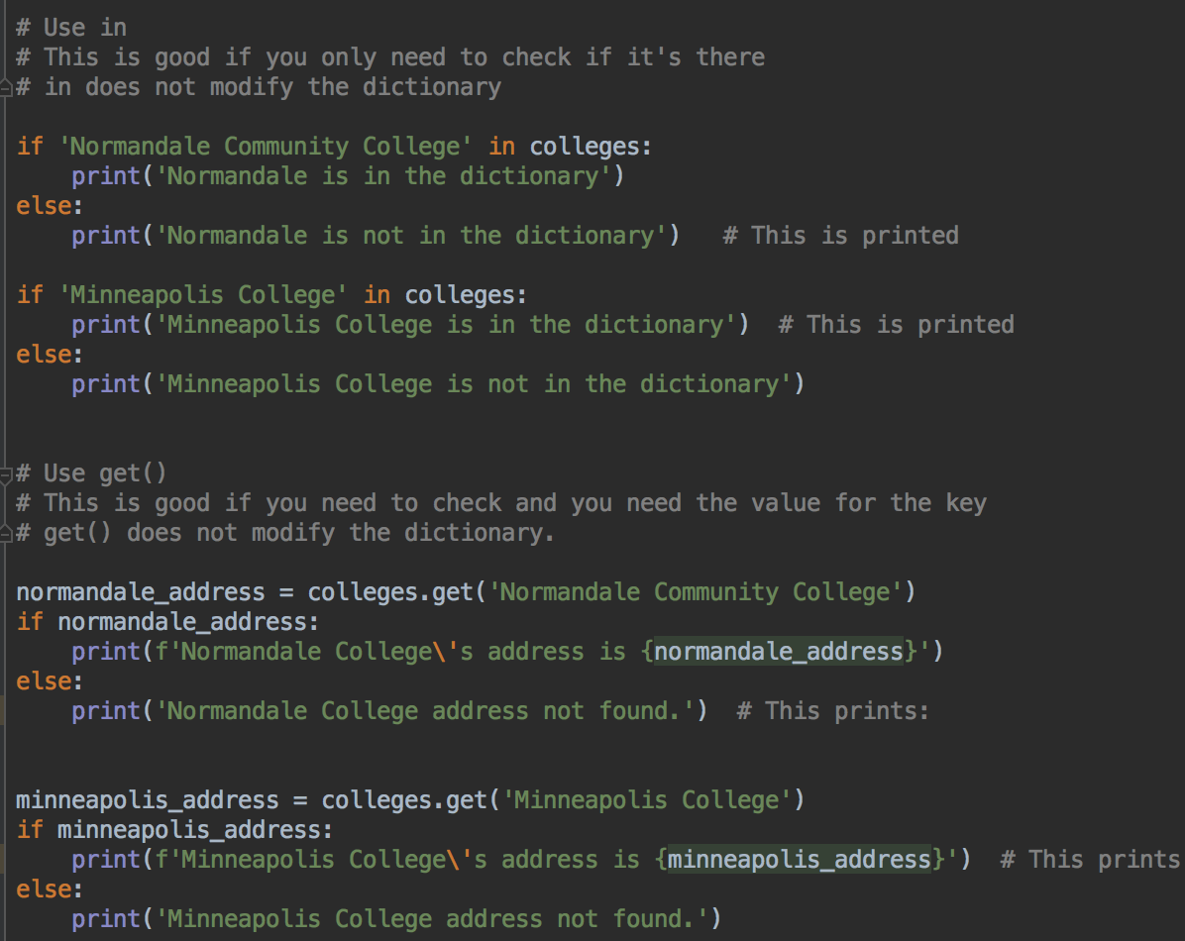
Is a key in the dictionary?
Can use in in the same way as for lists, to check if a key is in the dictionary
Can also use get() to check if a key is in the dictionary, and get the value if it is

Slide 22
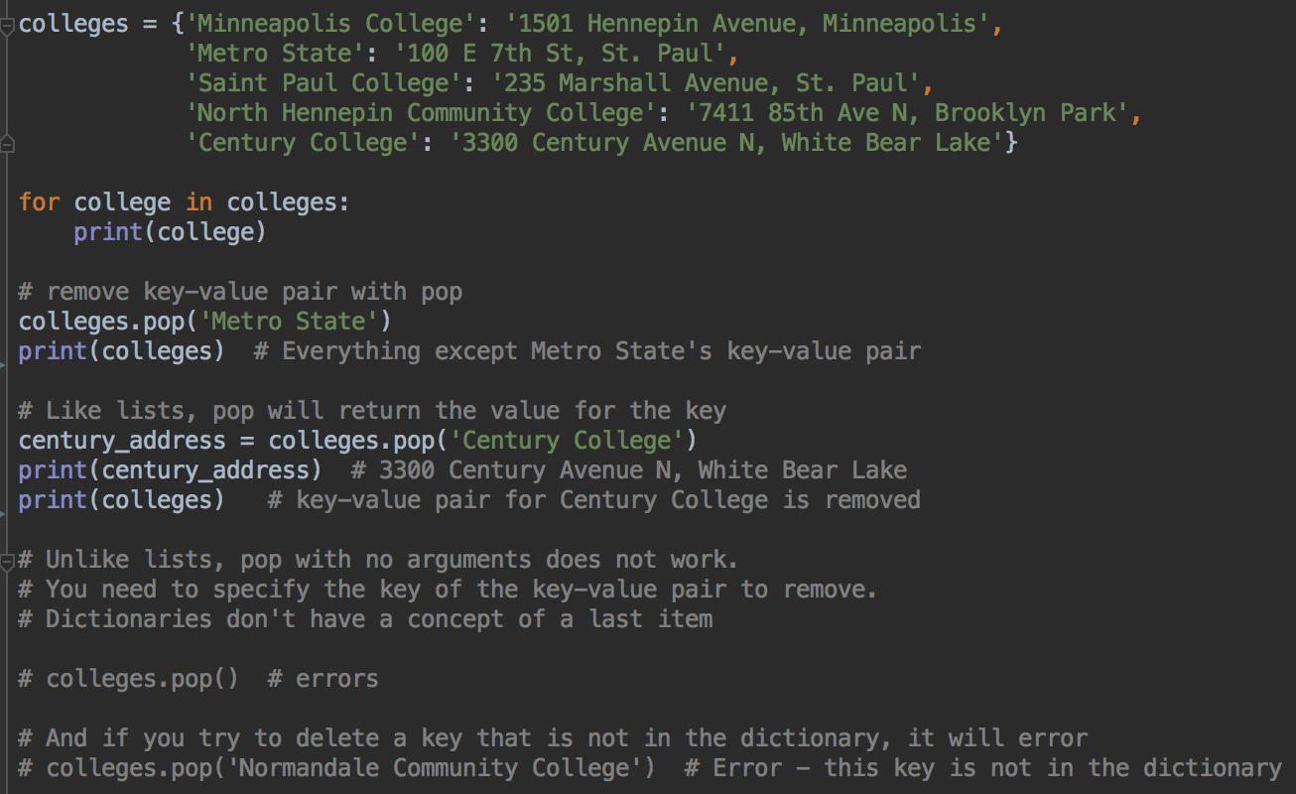
Removing data from a dictionary
Use pop() to remove a key: value pair
pop() will error if the key is not in the dictionary
Your turn: use pop to remove a movie and print the rating

Slide 23
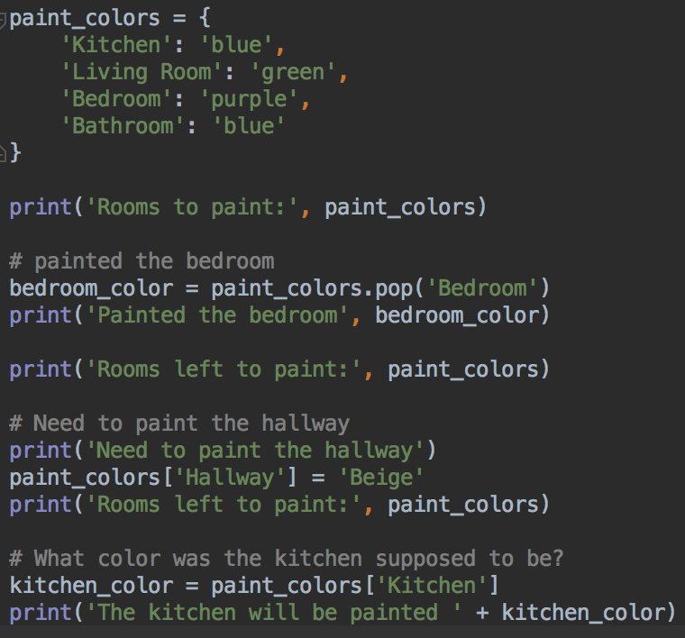
Dictionary Example reading, removing with pop
Create dictionary
Remove a key, return value using pop
Add a key:value pair
Get the value for a key

Slide 24
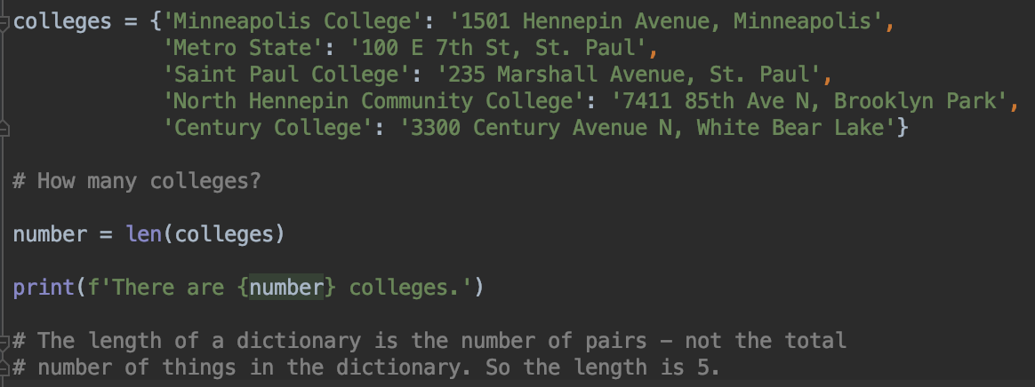
How many things in the dictionary?
Use the len() function to get the number of key-value pairs

Slide 25
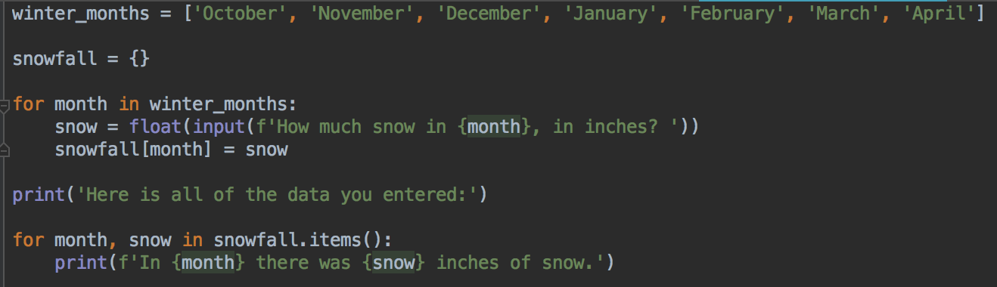
User input for a dictionary: snowfall program
User input for values in the dictionary
The keys come from a list

Slide 26
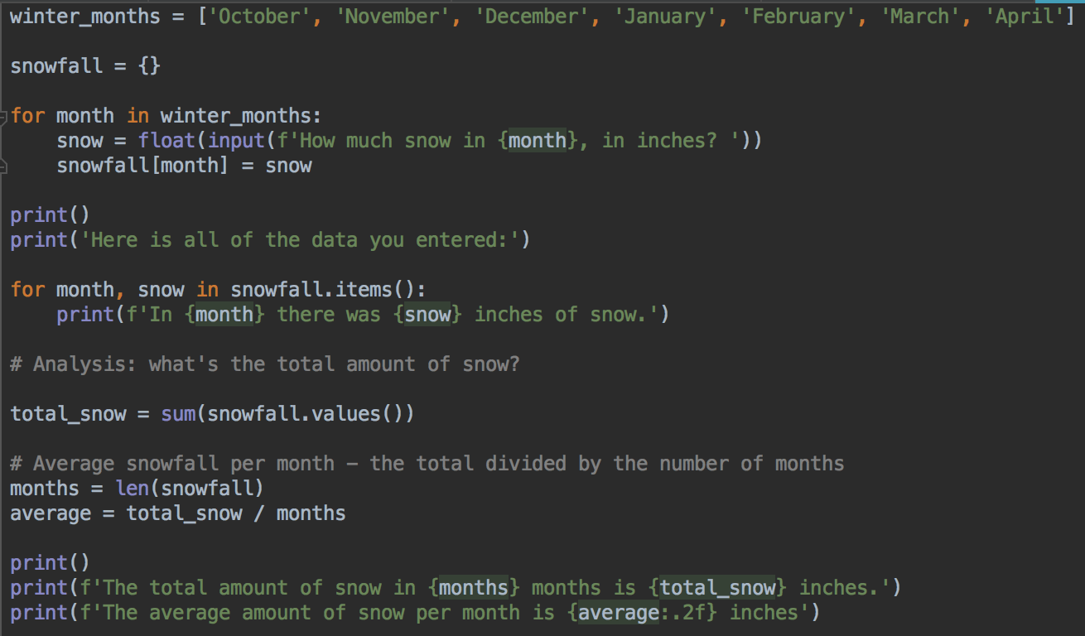
User input for a dictionary plus analysis: snowfall program
Can use sum() and len() on the keys or values
Your turn: your user wants a program that does the same thing, but for rainfall in the three months of June, July and August
Ask for the data, print the total and average

Slide 27
Dictionaries can contain lists, other dictionaries
Dictionaries can contain lists

Slide 28
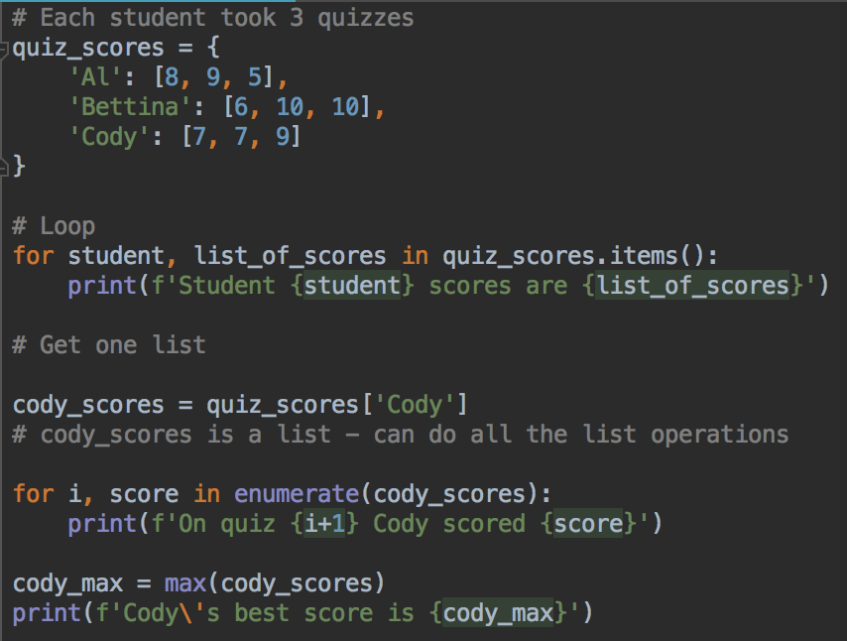
Dictionary containing lists
All the things you know about lists still apply
Your turn: can you print Bettina's lowest score?
Hint: if there's a function called max that returns the maximum value, what would a function that returns a minimum value be called?

Slide 29
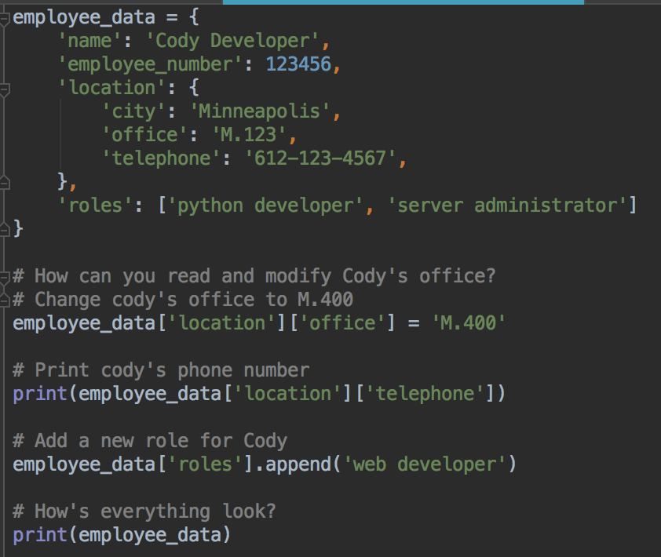
Dictionary containing dictionaries
Things still work
Can do dictionary operations on nested dictionaries
Notice two sets of square brackets used to access nested data - like the telephone number

Slide 30
Summary
Dictionaries are another useful data structure in Python
Store pairs of keys and values
Keys must be unique in one dictionary
Can add, delete, reassign data in a dictionary

