Slide 1
1150 Programming Logic
Manipulating Strings

Slide 2
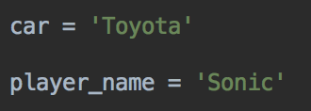
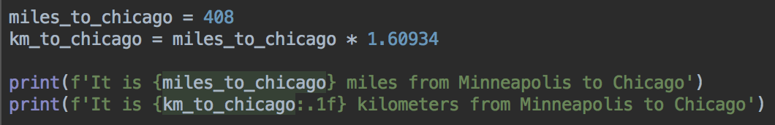
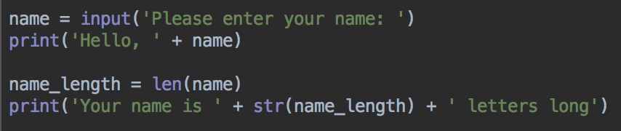
We've met strings already
We can create string variables
And format strings
And figure out how long a string is

Slide 3
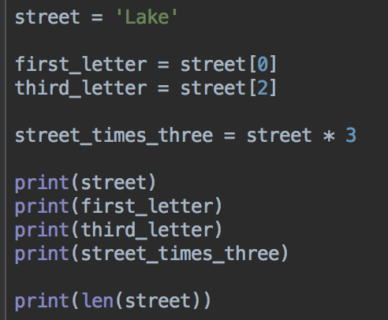
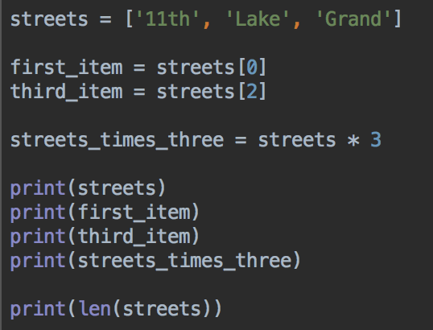
Lists and strings are similar in some ways A lot of the techniques for working with lists, work with strings too
Strings
Lists

Slide 4
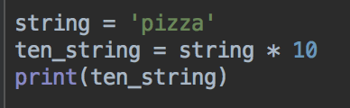
Multiplying strings
Your turn: can you make and print a string with your name 100 times?

Slide 5
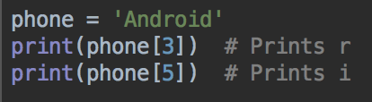
More things you can do with strings
Since humans use strings and text to communicate and convey meaning, it's helpful for computers to be able to process strings in more sophisticated ways
It's helpful to know strings are stored in a computer
Try this code:
Your turn: add a print statement that prints the n from Android

Slide 6
String Characters can be accessed by index
A | n | d | r | o | i | d
0 | 1 | 2 | 3 | 4 | 5 | 6
Like a list, a string is iterable.
Each character can be accessed with a loop.

Slide 7

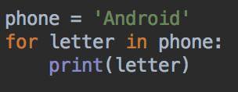
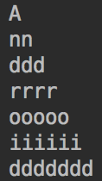
Looping over a string's letters
Your turn: can you print your name vertically, with one letter per line?
Extra question: can you print your name as a triangle, like this? Hint: enumerate() works with strings too

Slide 8
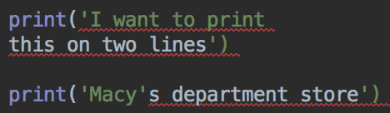
Handling special characters in strings
What if you need a string with a single quote ' in ?
Or a new line?
Or a tab?
These characters have meaning to the Python interpreter so code like this will error

Slide 9
One method - handling quotes
Python lets you use a pair of single quotes, or a pair of double quotes to create strings
So, if your string has one type of quotes in it, use the other type to create the string

Slide 10
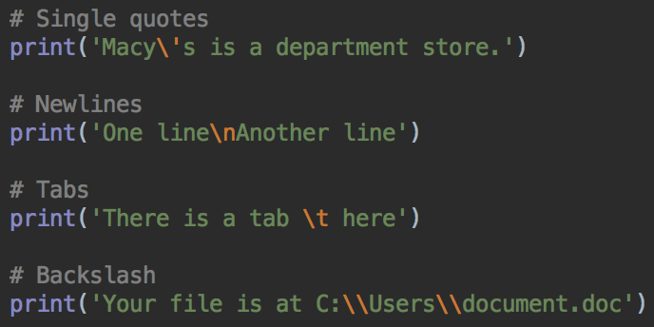
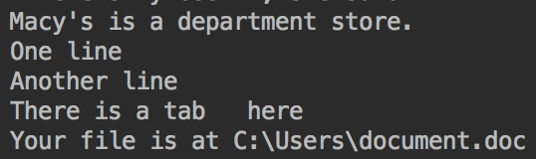
Another approach: Escape Characters
For a newline: write \n
A single quote \'
A tab \t
A backslash quote \\
Tip: remember \n, for a new line. It's probably the most common, and you'll need it when working with files, next time

Slide 11
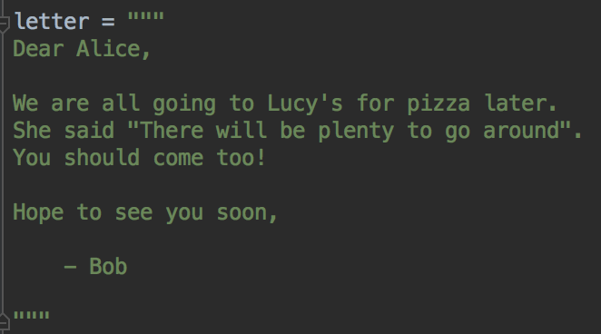
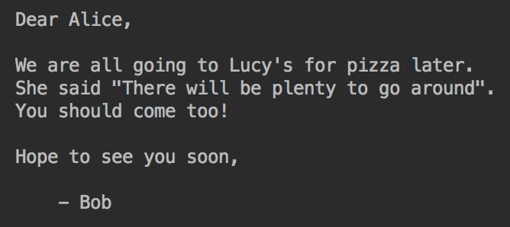
Another approach: multiline strings using triple quotes
Instead of using a lot of escape characters, you can use multiline strings, starting and ending with 3 quotes.
Tabs, newlines, both types of quotes are preserved
You can use triple single quotes instead, but
Python programmers seem to prefer triple double quotes.
a tab

Slide 12
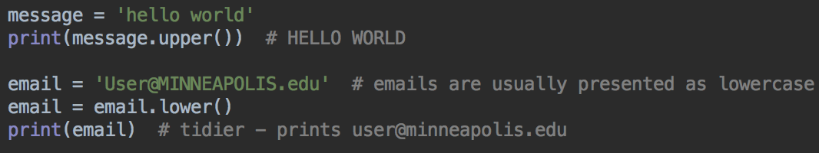
upper() and lower()
Convert text to uppercase or to lowercase
For presentation
To store data in a standard form - for example, emails and web urls are usually written in lowercase

Slide 13
upper() and lower()
For case-insensitive comparisons
When comparing two strings, and case doesn't matter, convert them both to the same case before comparing

Slide 14
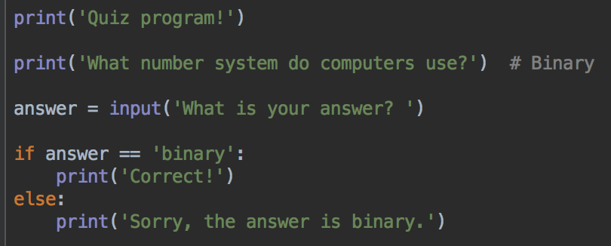
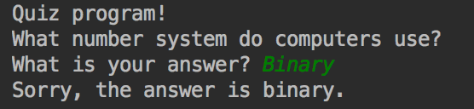
Annoying quiz program

Slide 15
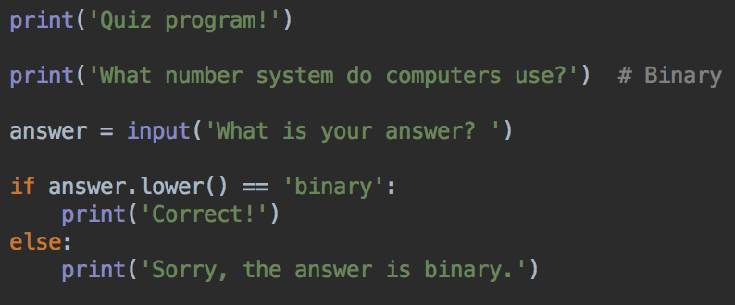
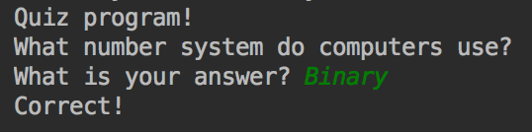
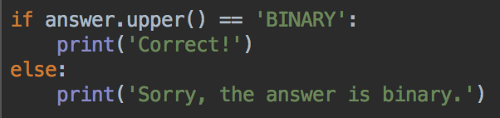
Fix - store the answer in lowercase, convert the user's answer to lowercase before comparing
Converting to uppercase, and comparing the correct answer to the uppercase version of the answer works just as well

Slide 16
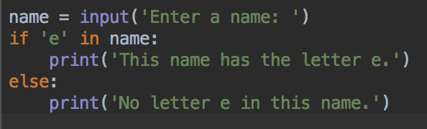
The in operator
Check if a string is part of another string
Do you have an "e" in your name?
Run this code, and test names with and without an "e"
What about names like Edwin or Emily? Does it work?
How can you fix?

Slide 17
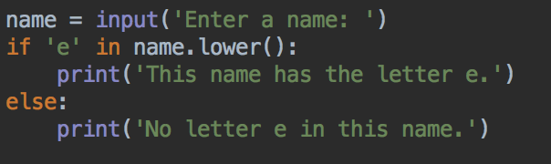
the in operator - case insensitive
Convert the name to lowercase before checking

Slide 18
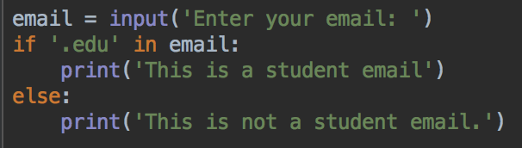
The in operator
Is a particular email address likely to be a school email?
Can you think of an email address that would trick this program?

Slide 19
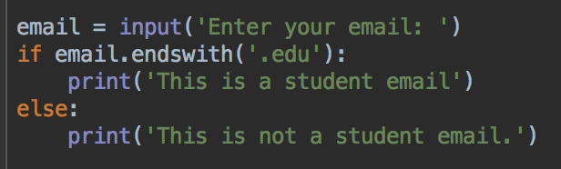
endswith()
Tests if a string ends with another string

Slide 20
Your turn
Write a program that asks the user to enter an ITEC class code, for example "ITEC 1150" or "ITEC 1425" or "itec 2950"
Convert the input to uppercase and then
Check that the code starts with "ITEC"
Check that the user entered 9 characters (ITEC plus a space plus 4 numbers)
Print an error message if either check fails
Print the uppercase version of the class code
Test with different inputs

Slide 21
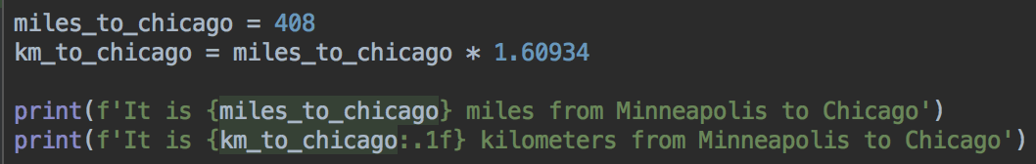
Formatting - rounding
Follow a float variable with :.1f to round to 1 decimal place
Follow a float variable with :.2f to round to 2 decimal places
Replace the number with the number of decimal places

Slide 22
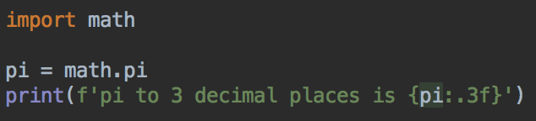
Format strings
Rounding to a specific number of decimal places

Slide 23
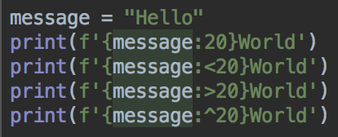
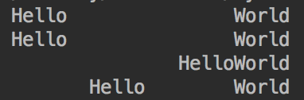
Format Strings: aligning text
Can pad text with spaces or other characters, and make them take up a set amount of space
Follow the variable with < or > or ^ for left, right or center align
Useful for tables, and formatting output

Slide 24
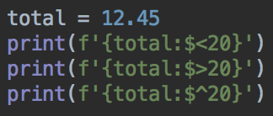
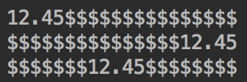
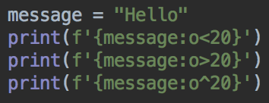
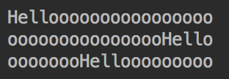
Padding with other characters - put that character between the : and < or > or ^

Slide 25
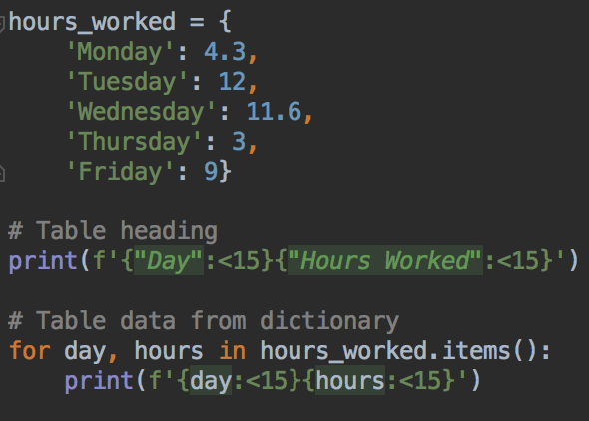
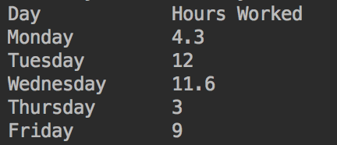
Tabular output

Slide 26
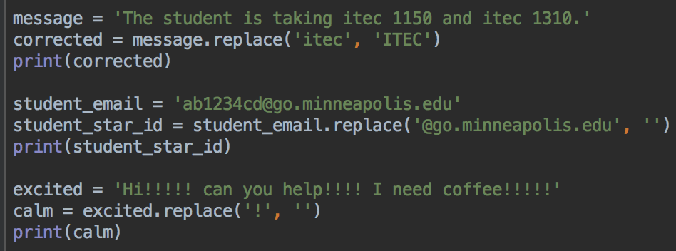
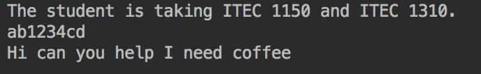
More string methods - replace(str1, str2)
Tip: replacing a string with an empty string '' will remove all instances of str1 from the string.

Slide 27
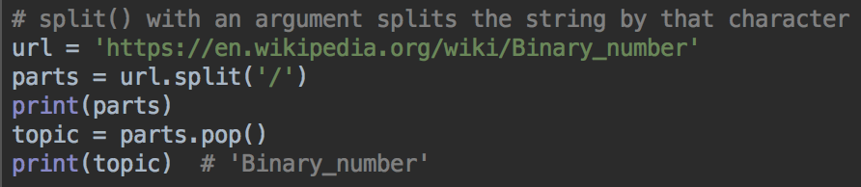
Splitting strings into list of parts
Notice there's an empty string in the list - where does that come from?

Slide 28
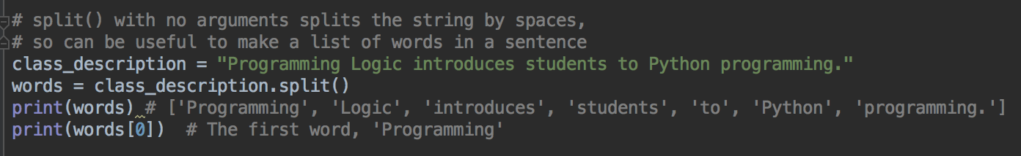
split()
split with no arguments splits the string by spaces

Slide 29
Your turn
Write a program that breaks a student email into parts
Your student email is in the form
ab1234cd@go.minneapolis.edu
Write a program that splits an email into a star ID, and the rest
Print the star ID
So for the example email above, your program would print ab1234cd

Slide 30
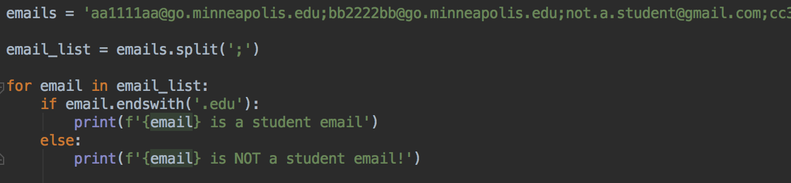
After splitting a string, can do any list operations with the resulting list
Example: a long string made of many email addresses, separated by semicolons
Want to check they are all student emails

Slide 31
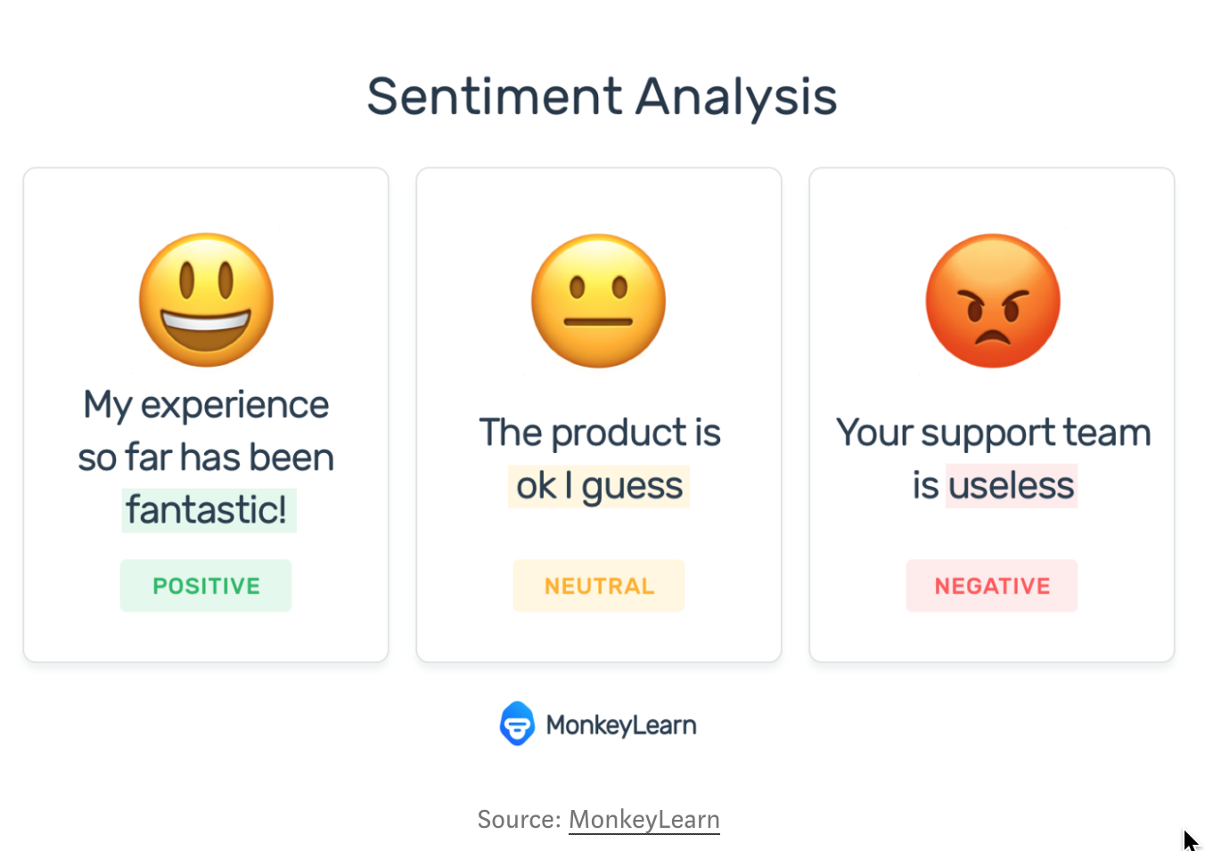
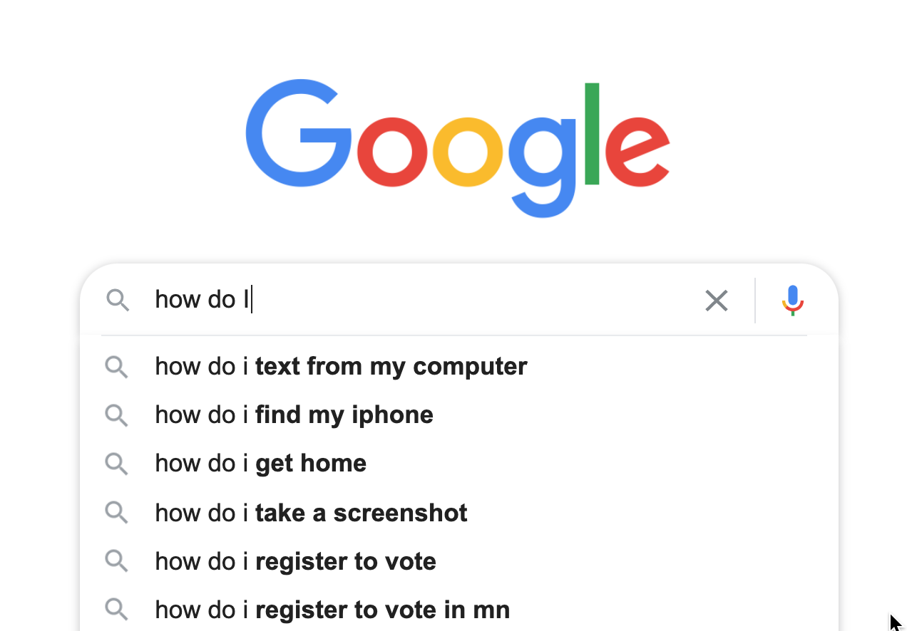

Summary: String Processing
Because humans communicate and store many kinds of data in text form, string processing is very useful in many different fields

