Slide 1

ARDUINO CODING PROJECT
BY WILLIAM SOPER, MONTY VILLEGAS VERSCHOYLE, DANIEL ARANDA, DARNELL FORD

Slide 2

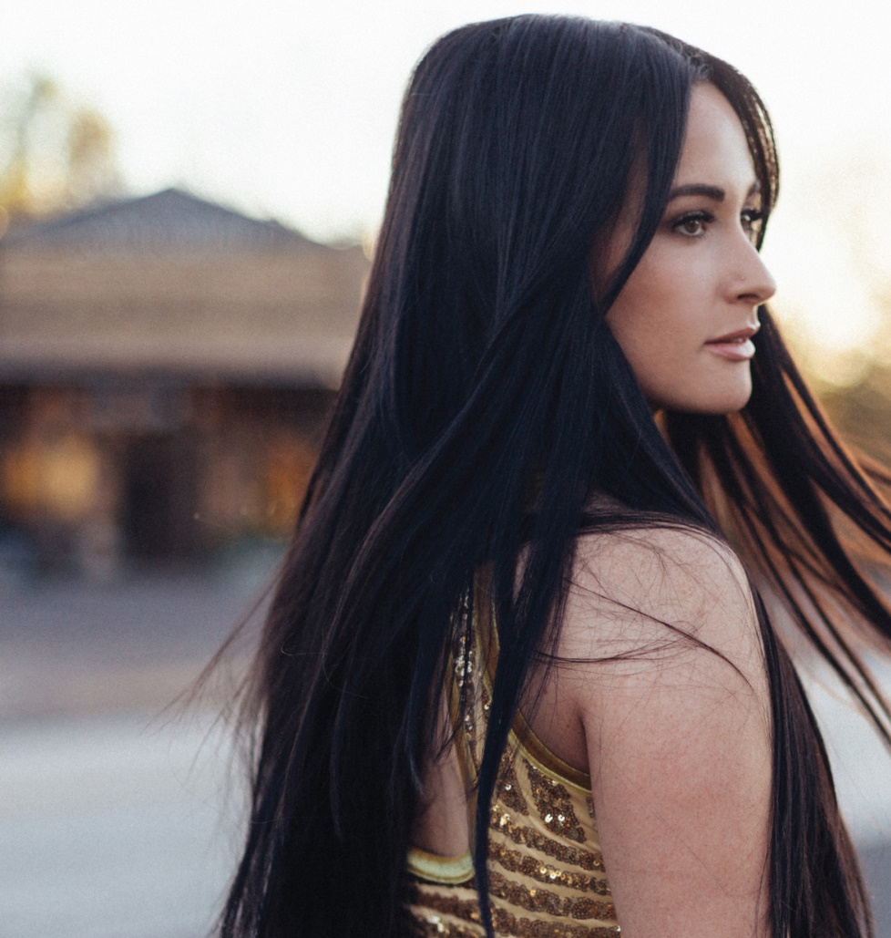
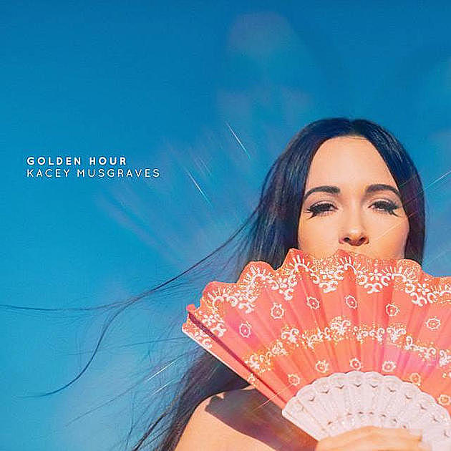
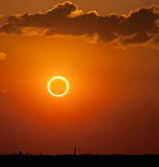
SONG CHOICE

Slide 3

Song Background
Kacey Musgraves inspiration for the song was her recent marriage to Ruston Kelly in October 2017.
On top of that, The album title also happens to be “Golden Hour”, which a total solar eclipse in August 2017 was claimed to be a factor for the inspiration behind that.
Website used as a reference to transcribe the sheet music: “https://musicsheets.org/golden-hour/”
Background information for the song was found on: “https://www.songfacts.com/facts/kacey-musgraves/golden-hour”

Slide 4
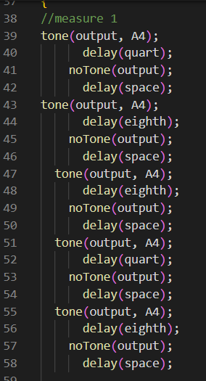
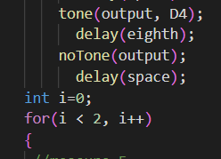
The Code
We wrote the delay to serve as pauses that each note is written with. Instead of typing the delays length for each note, we coded it to allow us to type just the type of rest each note has.
The noTone is being used so none of the note's frequencies play longer than they're written to.
In the fourth measure of the song, a repeat was needed so to do that we coded it to repeat 3 times.

Slide 5

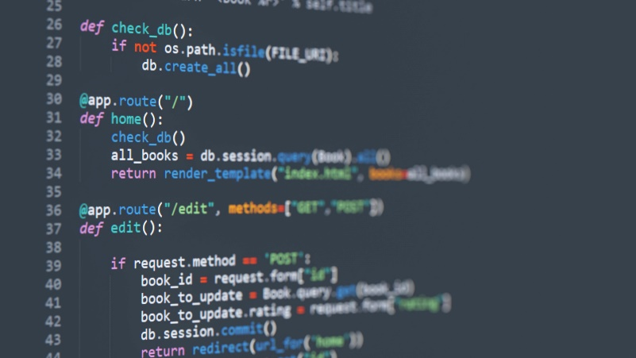

Roles
Monty Villegas Verschoyle: Main Code Builder, Presentation Editor, Quartermaster
William Soper: Presentation Builder, Translator, Presentation editor, Code Editor
Darnell Ford: Translator, Presentation Builder, Code Editor
Daniel Aranda: Presentation Builder, Rehearsal, Translator, Code Builder

Slide 6
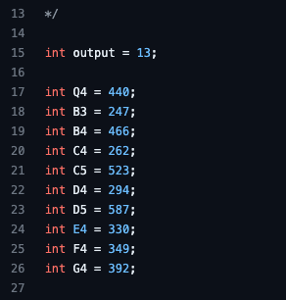
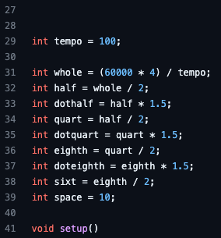
Variables
In the left box, each note is given its tone based on the chart in the next slide.
On the right, the length each note gets played for was given its respected value.

Slide 7
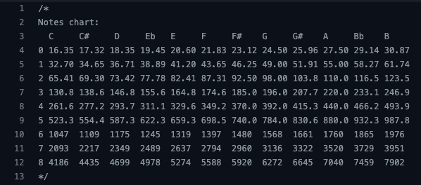
Tones & Frequencies

Slide 8

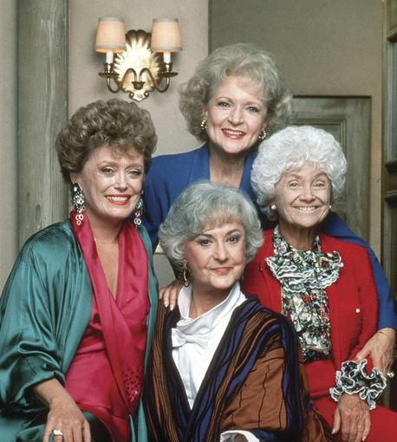

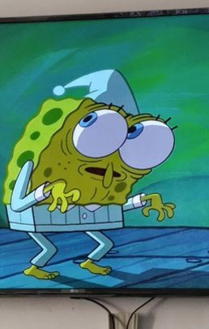
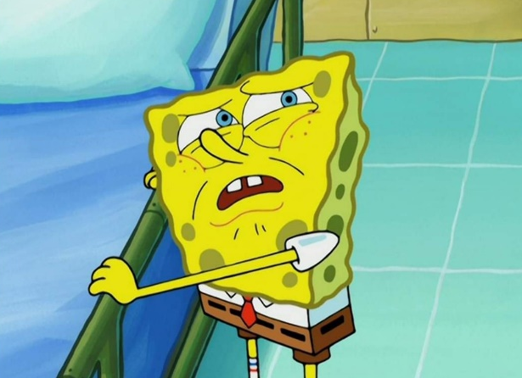
Thank you!!

