Slide 1


The Prevalence and Nature of Social Work Research (2010-2014): A Computational Analysis
Marla Stuart, PhD
Fellow, Guizhou Berkeley Innovation Research Center
Fellow, Berkeley Institute for Data Science
https://github.com/MarlaStuart/Prevalence-and-nature-of-social-work-research
Susan Stone, PhD
Professor, School of Social Welfare
April 10, 2019

Slide 2
Background
Table 1. Summary of previous journal analyses
Study | Period covered |  | Number of journals used |  | Prevalence of research |  | Research Nature
 |  |  |  |  |  |  | Positive progress noted | Analyses lack sophisti-cation | Design choices lack rigor
Taber & Shapiro (1965) | 1920-1963 |  | 3 |  | .06 |  |  | ●
Tripodi (1984) | 1956-1980 |  | 4 |  | .14-.25 |  | ●
Forte (1994) | 1978-1992 |  | 4 |  | .13 |  |  | ● | ●
Klein & Bloom (1994) | 1870-1990 |  | 4 |  | .10-.76 |  |  |  | ●
Tolman & Molidor (1994) | 1980-1990 |  | 9 |  | - |  |  | ●
Glissen (1995) | 1977-1988 |  | 5 |  | .53-.56 |  |  | ●
Rosen, Proctor & Staudt (1999) | 1993-1997 |  | 13 |  | .47 |  |  |  | ●
Jung & Tripodi (2007) | 1995-2004 |  | 7 |  | .41-.51 |  | ●
Holosko (2010) | 2005-2007 |  | 3 |  | .76 |  |  |  | ●
Unick & Stone (2010) | 2000-2006 |  | 20 |  | - |  |  | ●
Guo (2014) | 2012-2013 |  | 5 |  | .45-.66 |  | ● | ● | ●

Slide 3
Aims
(1) Facilitate robust estimation of the prevalence of empirical studies, and
(2) Automatically (versus manually) capture and synthesize methodological and analytic content, drawing on the population of social work journals (see Perron et al., 2016) and including journals from other disciplines that have been identified as important to the field

Slide 4
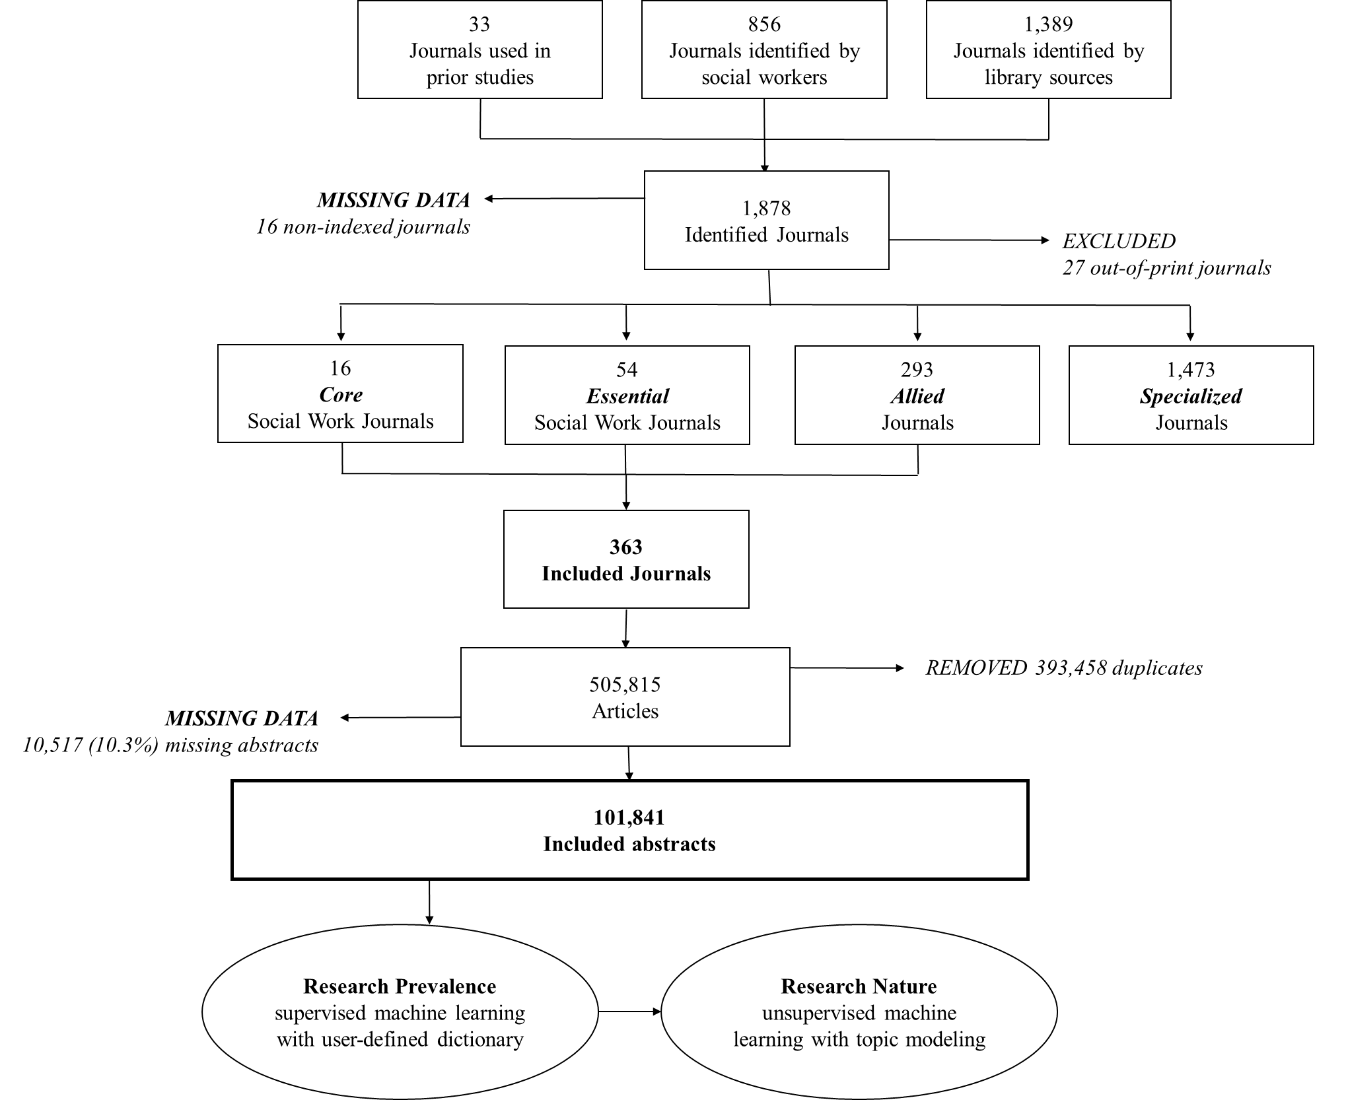
Data
Figure 1. Summary of journal selection
Notes:
Choosing jouranls
Downloaded from ProQuest in 2014
Proquest turned off for University

Slide 5
Methods
(1) Create a dictionary of research terms
Start with The A-Z of Social Research (Miller & Brewer, 2003)
Peer input
(2) Identify which terms are in which abstracts
Natural language processing
(3) Predict whether an abstract is a research study based on the terms
Supervised machine learning Binary discriminant analysis (Gibb & Strimmer, 2015)
(4) Identify types of social work research based on the terms
Unsupervised machine learning Structural topic modeling (Blei, 2012; Robers, Stewart & Tingley, 2014)
Notes:
Won't talk about 1

Slide 6
59
R Demonstration
Notes:
NLP

Slide 7
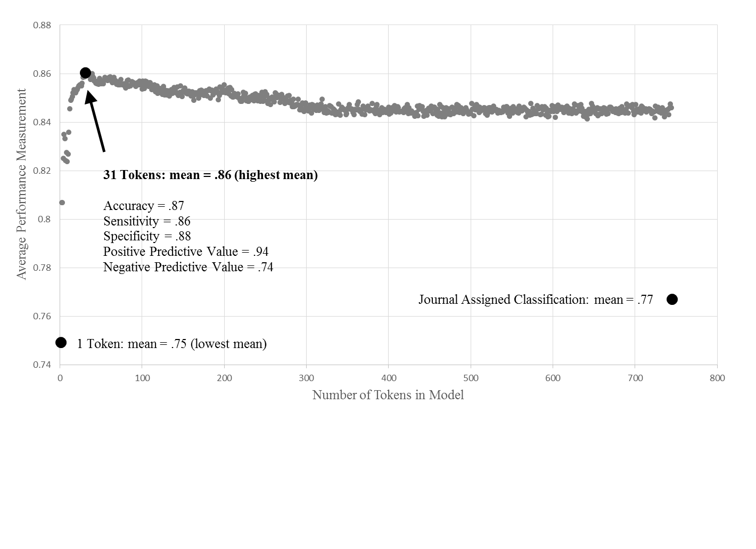
Figure 2. Predictive model performance
59

Slide 8
59
R Demonstration

Slide 9
Figure 3. Cluster model fit statistics
Notes:
Topic modeling

Slide 10
Figure 4. Probability that abstract belongs to each topic

Slide 11
Table 2. Key concepts for each cluster

Slide 12
Table 3. Findings

Slide 13
Limitations
(1) Missing journals and missing abstracts = sampling error
Probably not missing at random
(2) Abstracts are not standardized
All study information probably not in abstract
(3) Interesting details are missed
Previous studies include social prbolems, theory, intervention, outcomes, etc.
(4) Need validation methods that do not require so much human coding
Notes:
Won't talk about 1

Slide 14
Discussion
(1) Prevalence of empirical research in social work jouranls
Has not changed
But what is ideal? What kind of knowledge production do we value?
(2) Range of methods may gave have increased
Still less rigorous than allied journals
(3) Large number of allied journals
294 relevant to social work researchers and practitioners
Relevant in this age of greater inter-disciplinary collaboration
Notes:
Won't talk about 1

Slide 15
Thank you for inviting me!
Marla Stuart, PhD
marlastuart@berkeley.edu
https://github.com/MarlaStuart/Prevalence-and-nature-of-social-work-research

