Slide 1
Draft Quarto document
Your Name

Slide 2
Results
Metabolite | Mean SD
CDCl3 (solvent) | 180 (67)
Cholesterol | 18.6 (11.4)
FA -CH2CH2COO- | 33.6 (7.8)
Lipid -CH2- | 536.6 (61.9)
Lipid CH3- 1 | 98.3 (73.8)
Lipid CH3- 2 | 168.2 (29.2)
MUFA+PUFA | 32.9 (16.1)
PUFA | 30 (24.1)
Phosphatidycholine | 31.7 (20.5)
Phosphatidylethanolamine | 10 (7.6)
Phospholipids | 2.7 (2.6)
TMS (interntal standard) | 123 (130.4)
Descriptive statistics of the metabolites

Slide 3
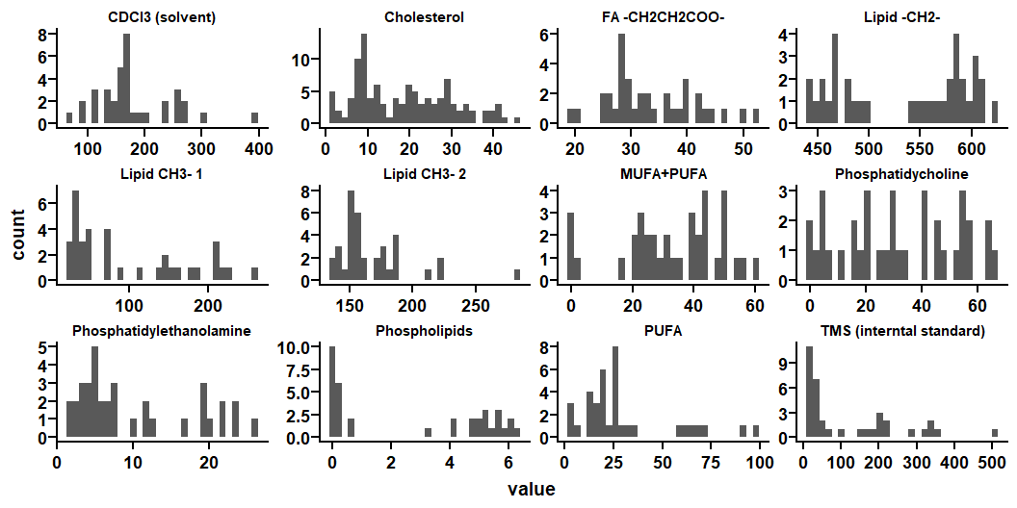

Slide 4
Building the model
Logistic Regression Model Specification (classification)
Computational engine: glm
# A tibble: 36 × 16
code gender age class metabolite_tms_interntal_s…¹ metabolite_cholesterol
<chr> <chr> <dbl> <chr> <dbl> <dbl>
1 ERI109 M 25 CT 208. 18.6
2 ERI111 M 39 CT 219. 20.8
3 ERI163 W 58 CT 57.1 15.5
4 ERI375 M 24 CT 19.2 10.2
5 ERI376 M 26 CT 35.4 13.5
6 ERI391 M 31 CT 30.4 9.53
7 ERI392 M 24 CT 21.7 9.87
8 ERI79 W 26 CT 185. 17.6
9 ERI81 M 52 CT 207. 17.0
10 ERI83 M 25 CT 322. 19.7
# ℹ 26 more rows
# ℹ abbreviated name: ¹​metabolite_tms_interntal_standard
# ℹ 10 more variables: metabolite_lipid_ch_3_1 <dbl>,
# metabolite_lipid_ch_3_2 <dbl>, metabolite_lipid_ch_2 <dbl>,
# metabolite_fa_ch_2_ch_2_coo <dbl>, metabolite_pufa <dbl>,
# metabolite_phosphatidylethanolamine <dbl>,
# metabolite_phosphatidycholine <dbl>, metabolite_phospholipids <dbl>, …

