Slide 1
Data Analytics Project
An unusual approach to Insurance
Marlen Cumbane

Slide 2
Problem Definition
The ability to retain customers in the insurance area has been important for increasing revenue;
The impact of COVID has made it difficult for some individuals to purchase an insurance policy, as well as maintain an existing policy;
Therefore, competition has increased but the population share tends to decrease.

Slide 3
Data Collection
A Dataset called Data analytics Project dataset was given and after collecting and reading this data I’ve observed that it has 139390 rows and 26 columns.
The columns variables that I’ve used for this for this analysis were:
NO_OF_TRXNS202005: Number of transactions within a month 05 of year 2020.
NO_OF_TRXNS202006: Number of transactions within a month 06 of year 2020.
TURNOVER202005: Total Amount of credits within a month 05 of year 2020.
TURNOVER202006: Total Amount of credits within a month 05 of year 2020.
Insur PackName: Insurance product family/group.
Product Status: Product status.
Sub Seg: Customer Segment.

Slide 4
Exploratory Data Analysis (EDA)
There are a some questions that need to be answered by this analysis, those questions will be helpful to understand better the data.
Which customer segment is most prevalent?
Which insurance group is most prevalent?
What is the status of product distribution?
Which customer segment has the most cancellations?

Slide 5
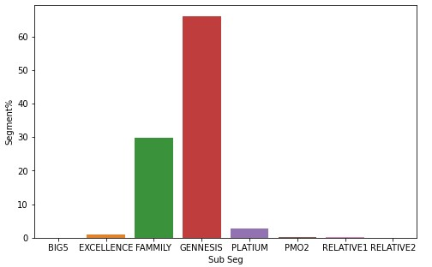
Customer Segment Chart
We can see that we have eight segments in total;
The segment with most customers is GENNESIS, followed by FAMMILY in second place and PLATINUM in third;
RELATIVE 1 and RELATIVE 2 have an extremely low number of customers.

Slide 6
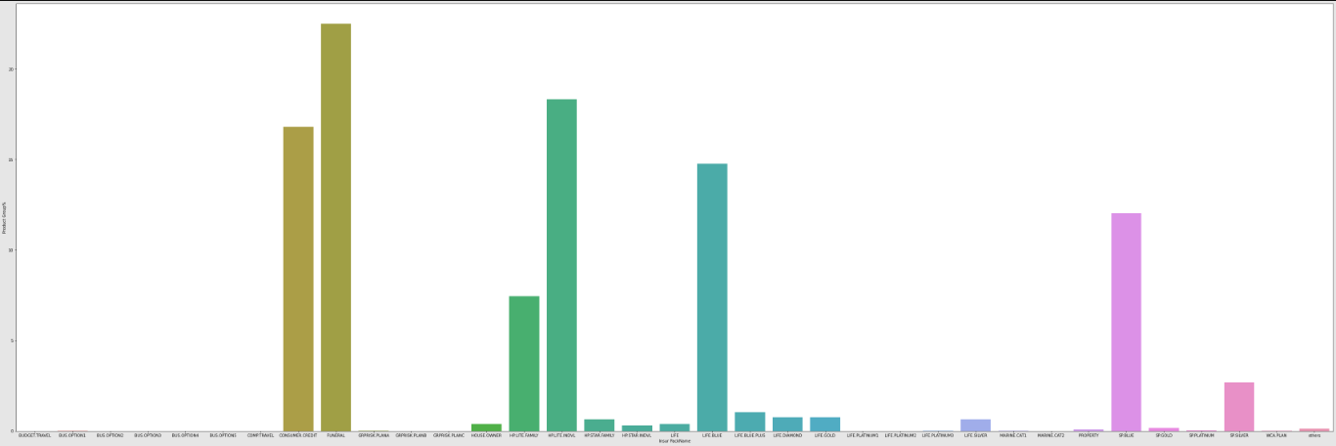
Insurance Group Chart

Slide 7
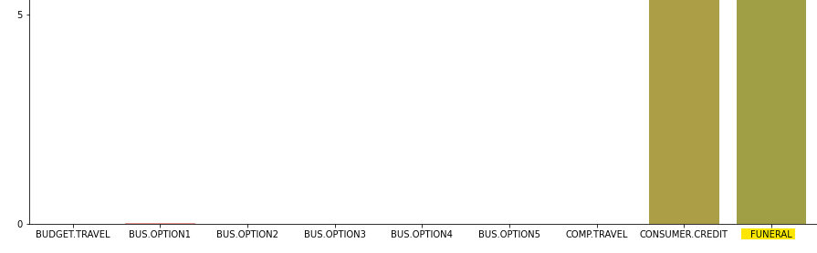
Cont.
Expanding the previous image, it is possible to observe that the insurance group with the most users is the FUNERAL group;
In second place we have the HP.LITE.INDVL and in third the CONSUMER.CREDICT.

Slide 8
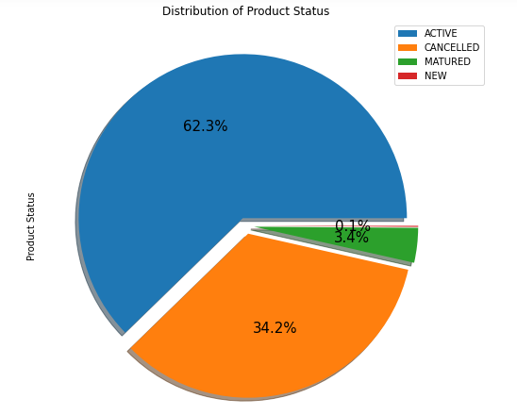
Status of product distribution
We can notice that 62.3 % of the products are active, 34.2% was cancelled and 3.4% matured.

Slide 9
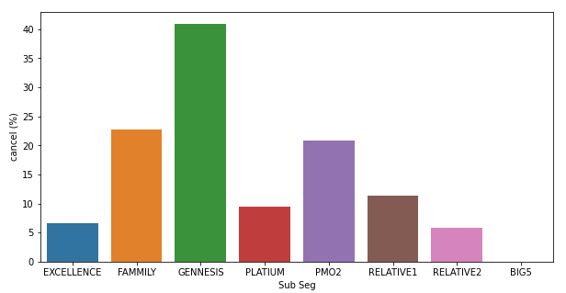
Cancelations By Customer Segment Chart
Based on the graph on the side and the table below, we can see that:
The customer segment that has the most churns is GENNESIS;
With a total of 37663 cancellations in a universe of 91947 customers in this segment;

Slide 10
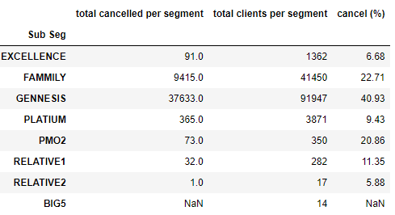
Cont.

Slide 11
Conclusion
It was possible to notice that we have a cancellation rate of approximately 34% taking into account all the products offered;
The segment with the most cancellations is GENNESIS, with an index of approximately 40%. This value is worrying because GENNESIS is the product segment with the most adherence, therefore of the 91947 customers, around 37633 canceled the insurance;
With the facts described above, we can conclude that customers in the GENNESIS segment are more likely to cancel the product in the future;
Looking at the results obtained, the best product is platinum, which occupies the third position in the ranking of most used segments and has a cancellation rate of 9%.

Slide 12
Thank You!

