Slide 1

Magist is Not the company for us
- With Kholeka and Marlen

Slide 2

Is Magist a good partner?
?
?

Slide 3
Who is Magist?
Huge delivery Service market share in Brazil
Centralized order management system linking small & medium sized stores
Offers after sales services

Slide 4
Market
Magist gets an increase in orders every year
(Fake Website Article: Magist is the largest growing delivery service in Brazil!)
Only 17.3% product orders are tech related

Slide 5
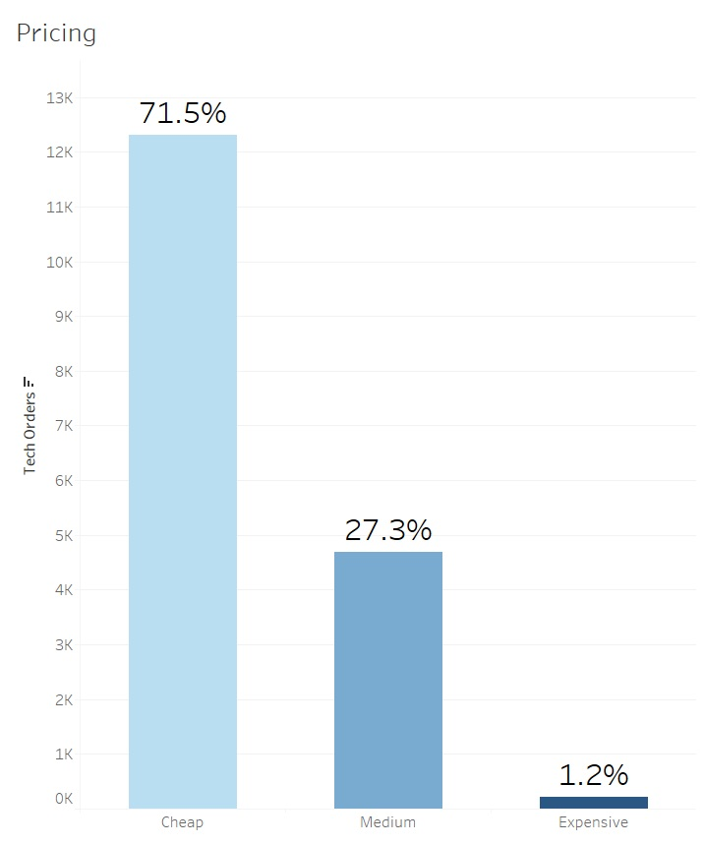
Price
And most of these orders show a preference for cheap goods

Slide 6
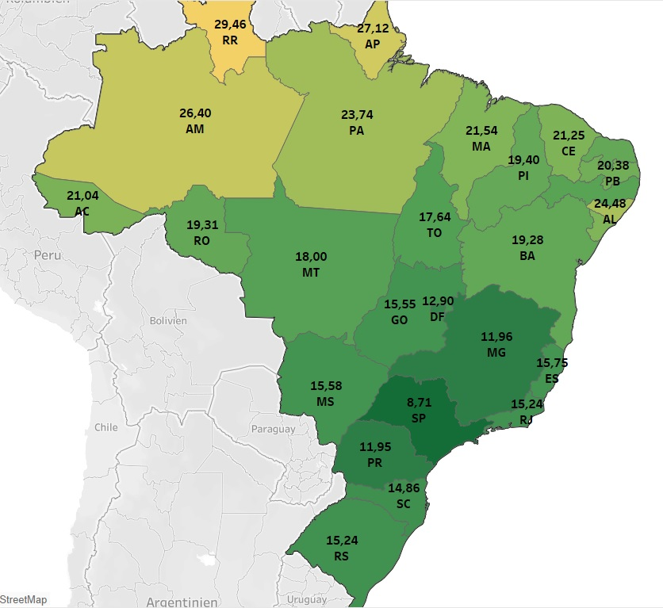
Delivery
Magist can deliver to many places in Brazil
But the delivery time is on average very slow

Slide 7
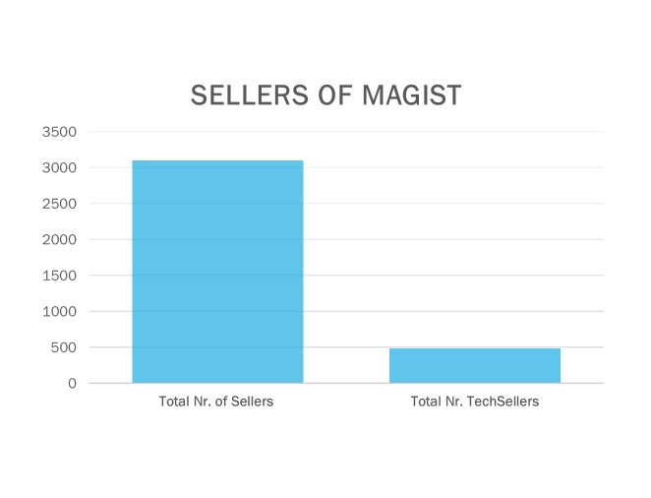
Tech Experience
But ONLY 15.7% of all Sellers are in Tech
Magist has worked with many Tech Sellers in Sao Paulo.
22% of the Brazilian Population lives in Sao Paulo (https://en.wikipedia.org/wiki/São_Paulo_(state))

Slide 8
Summary –> Partnership with Magist is not recommended
Small Tech sector
Unsatisfactory delivery services
Recommendations:
● Reconsider the Brazilian market and offer more affordable products
● Understand the Brazilian market by selling through Amazon online first

