Slide 1

CODE REVIEW AI
A System Built in Four Experiments
Dataset → ML Baseline → LLM Review → Improved LLM → VS Code Extension
Marlen Melis · Student ID 2026140428 · School of Computing
HIT Global Summer School — Intelligent Software Engineering · Instructor Liu Jiakun · July 2026

Slide 2







SYSTEM OVERVIEW
From Dataset to Developer Tool
Six stages, each self-contained — no downstream box was ever redesigned once an upstream one shipped
1
2
3
Mine PR dataset
Features + ML
LLM review (human code)
1,494 PRs · 5 repos
SVM / Random Forest
4 contexts × 4 strategies
4
5
6
LLM review (AI code)
FastAPI backend
VS Code extension
5 contexts × 5 strategies
fast + deep mode
gauge · inline comments
Code Review AI
2

Slide 3
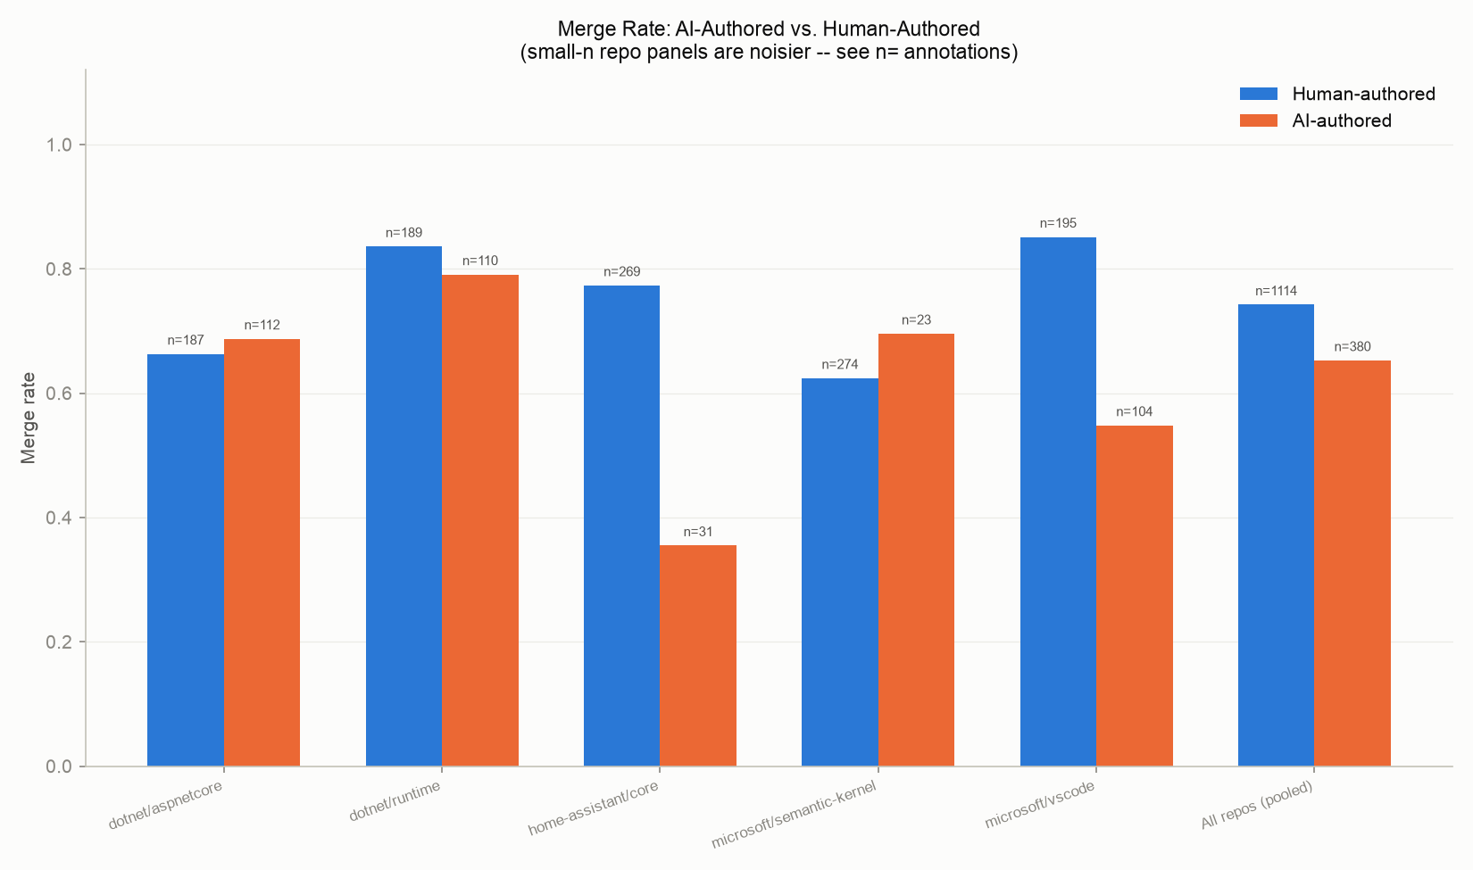
EXPERIMENT 1
The Dataset
1,494 real, closed PRs mined across 5 actively-maintained repositories
1,494
72.0%
PRs mined of 1,500 targeted — 5 excluded on server-side 502s, 1 slot lost to pagination drift
Pooled merge rate — 1,075 merged / 419 not merged; 63.0–81.9% by repo
25.4%
65.3% / 74.2%
380 PRs are AI-authored (Copilot coding agent) — 7.7–37.5% by repo
Merge rate: AI-authored vs. human-authored (pooled) — direction flips in 2 of 5 repos
Detection precision: 0 false positives across 59 manually spot-checked flagged PRs (68 assessments).
Code Review AI
3

Slide 4
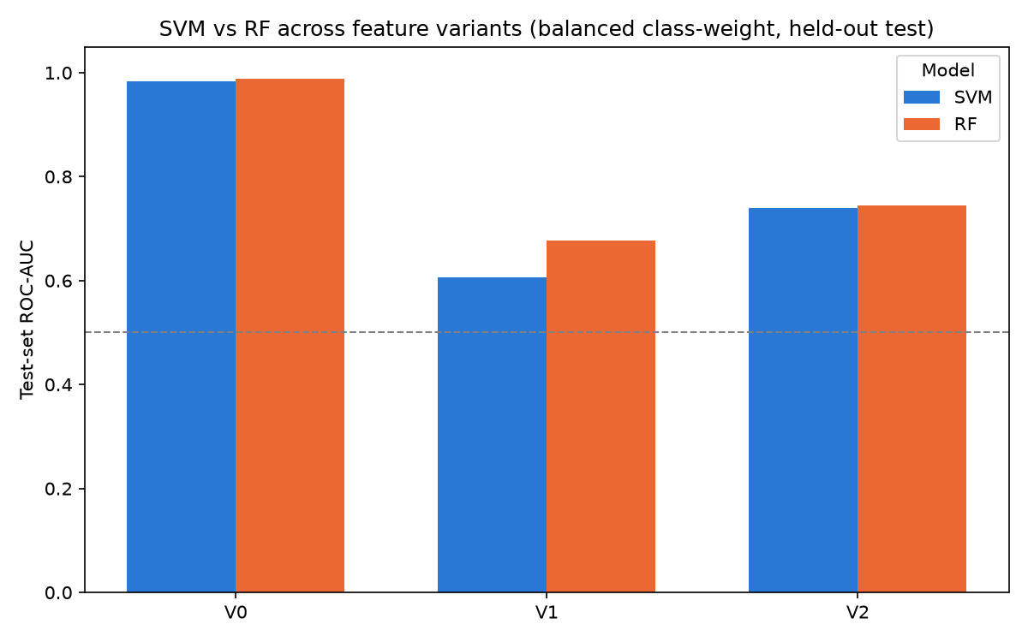
EXPERIMENT 2
Trained ML Models — Human-Written Code
SVM & Random Forest merge prediction under a strict, leakage-free feature contract
76.8% / 42.5%
rf_v1_balanced — accuracy / not-merged recall. Chosen for minority-class recall, not raw accuracy.
Two findings beyond the headline number
The leakage ban is measured, not assumed: the forbidden feature set (V0) reaches 97–99% ROC-AUC, and p_has_approved alone explains 41.6% of its importance.
Stricter beat literal-spec: V2 (pre-review-only + author history) outperforms V1 on every matched model / class-weight config — author_prior_merge_rate becomes its top feature (10.0%).
ROC-AUC by feature variant — the leaky V0 superset (blue/orange, left) vs. the compliant V1/V2 sets (right two groups)
Code Review AI
4

Slide 5
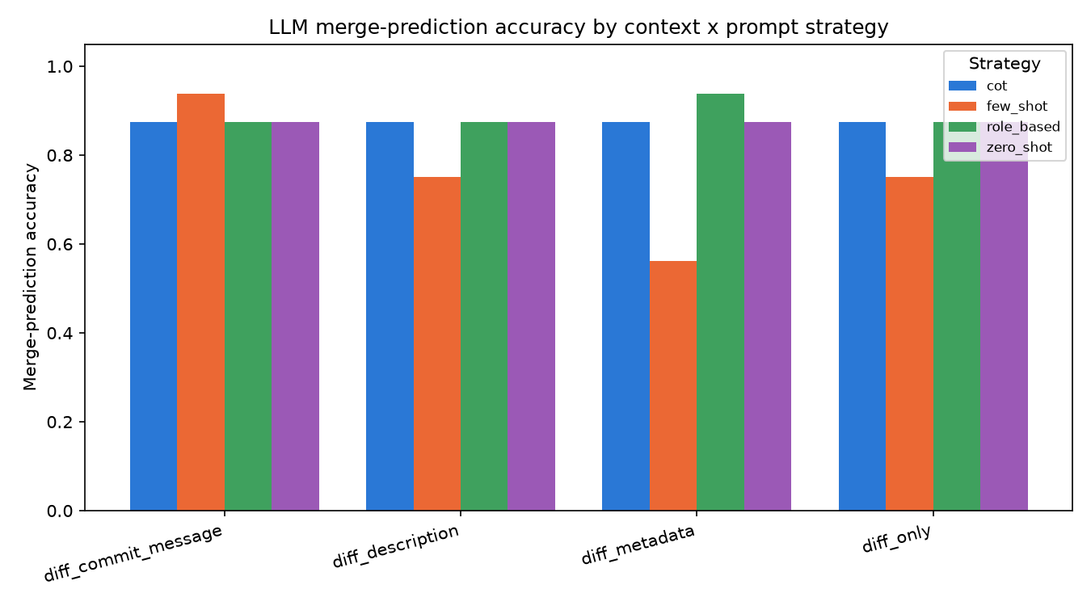
EXPERIMENT 3
LLM Review — Human-Written Code
4 context tiers × 4 prompt strategies, scored on Experiment 2's exact 224-PR held-out test split
93.75% / 0.816
Peak config (few_shot @ diff_commit_message, tied by role_based @ diff_metadata) — an IDENTICAL confusion matrix (14/1/1/0) to Experiment 2's own best model.
0.525
Pooled macro-F1 across all 16 configs — well below the 0.816 peak. 11 of 16 configs never predict CLOSE at all.
Peak parity, not superiority — the LLM matches the trained model only when prompt and context are chosen correctly.
Code Review AI
5

Slide 6
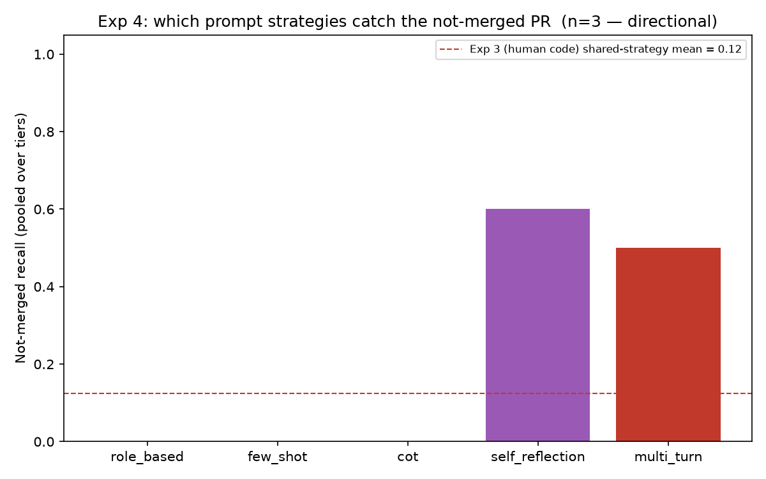
EXPERIMENT 4
Improving Review of AI-Generated Code
5 context tiers × 5 strategies, targeted at the 380 AI-authored PRs — 3 fully-complete PRs, directional
0.0
Not-merged recall for role_based / few_shot / cot — on EVERY context tier, with no exception.
0.60 / 0.50
self_reflection / multi_turn recall — the only two strategies that ever catch a bad AI-authored PR.
Repository context lifts recall 0.0 → 0.4 (macro-F1 peaks there, 0.498) — but complete_se_context, which stacks every source, regresses back to 0.0.
Code Review AI
6

Slide 7
SYNTHESIS
ML vs. LLM vs. Improved LLM
The same cross-experiment table from the final report (Section 7) — patterns, not raw cross-population comparisons
 | Experiment 2 — ML | Experiment 3 — LLM (human code) | Experiment 4 — LLM (AI code)
Best config | rf_v1_balanced | few_shot / role_based (tied) | multi_turn
Accuracy | 76.8% | 93.75% peak / 84.8% pooled | 50.0%
Not-merged recall | 42.5% | 50.0% peak / 9.4% pooled | 50.0%
Macro-F1 | — | 0.816 peak / 0.525 pooled | 0.486 (best strategy)
Training cost | Grid search on 890 PRs | None (prompt only) | None (prompt only)
Inference cost | Milliseconds, free | ~60–1,090 ms/call, API quota | ~120–1,240 ms/call, API quota
For AI-generated code, changing HOW a model reasons matters more than changing WHAT it is shown.
Code Review AI
7

Slide 8
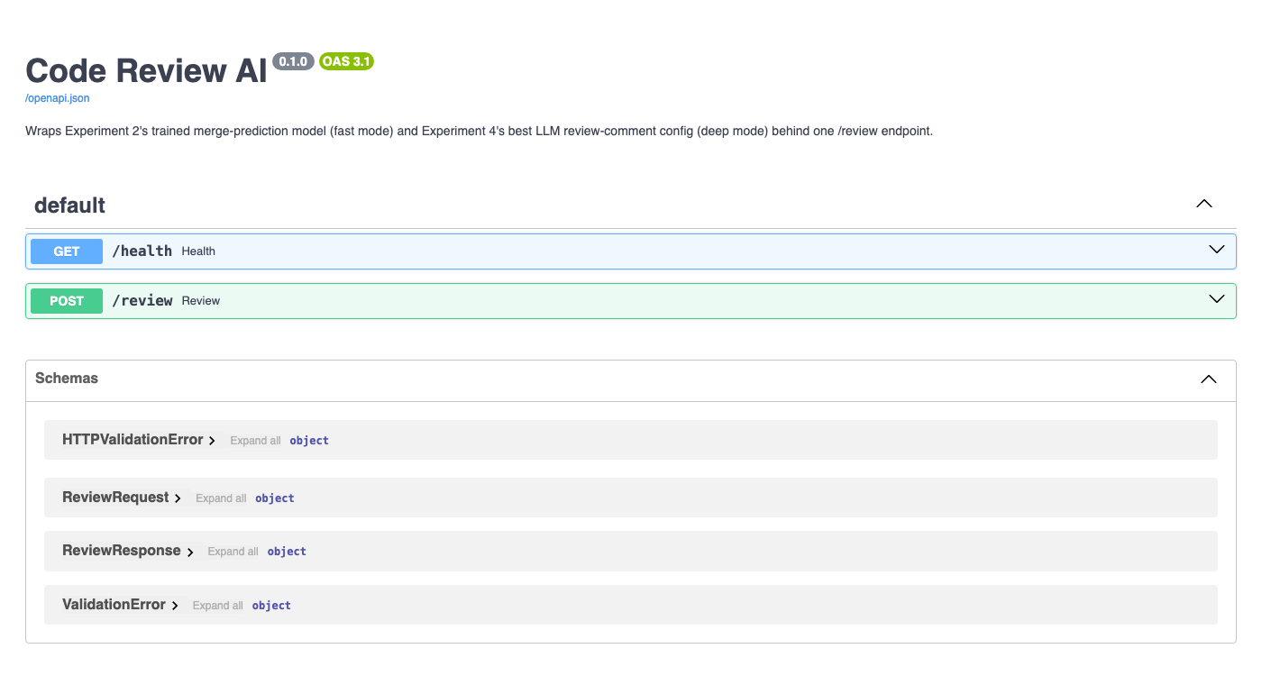
THE SYSTEM
FastAPI Backend — fast vs. deep
One /review endpoint; the mode split encodes what Experiments 2–4 actually found, not a coin flip
FAST mode · default
rf_v1_balanced — instant, free, always runs. The reliable floor: 76.8% accuracy, no API dependency.
DEEP mode · opt-in
multi_turn @ diff_repo_context on Groq (llama-3.1-8b-instant) — Experiment 4's own best-balanced config. Any LLM failure degrades to fast mode + a warning field, never a 500.
Live FastAPI Swagger UI — /health and /review, backed by Experiment 2's exact V1 feature pipeline re-derived from a raw diff.
Code Review AI
8

Slide 9
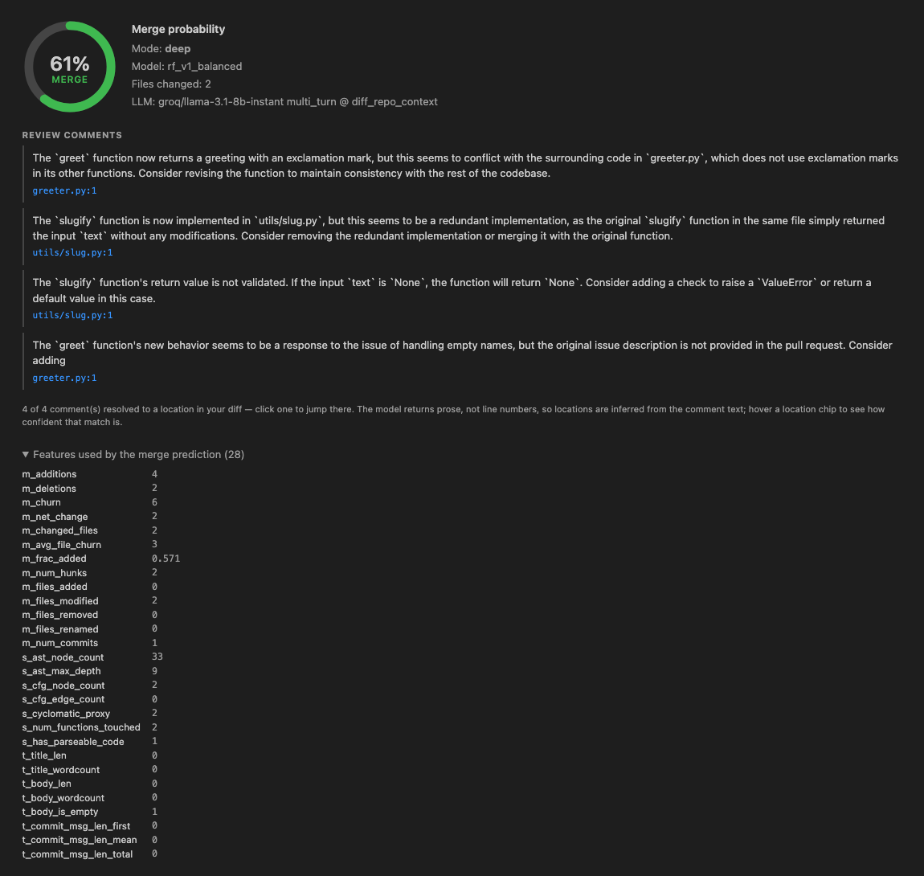

THE SYSTEM
VS Code Extension
"Review Current Changes" · git diff → backend call → results panel
Merge-probability gauge
An SVG arc rendered from the backend's prediction, live in the panel.
Click-to-jump review comments
anchoring.ts resolves prose comments to file:line — the backend returns no location, by design (fixing it would mean re-touching Exp4's LLM prompt contract).
Inline editor highlights
decorations.ts marks the anchored lines directly in the diff.
Verified end-to-end
49 unit tests + 7 tests inside a real, unmodified VS Code instance — real git diff, real backend call, no mocks.
Code Review AI
9

Slide 10

One System, Built in Stages
Four experiments, read in order, tell one story: a real dataset revealed a real class imbalance and a real AI-authored population worth studying separately; a trained model set a concrete, honestly-evaluated bar; an LLM matched that bar exactly — but only when prompt and context were chosen well; and the same prompting that achieved that fragile match on human code failed completely on AI-generated code, until the model was asked to reason differently, not just given more to reason about.
414 Python tests · 49 extension unit tests · 7 real VS Code integration tests · every number in this deck traced to results/tables/*.json
Code Review AI
10

