Slide 1
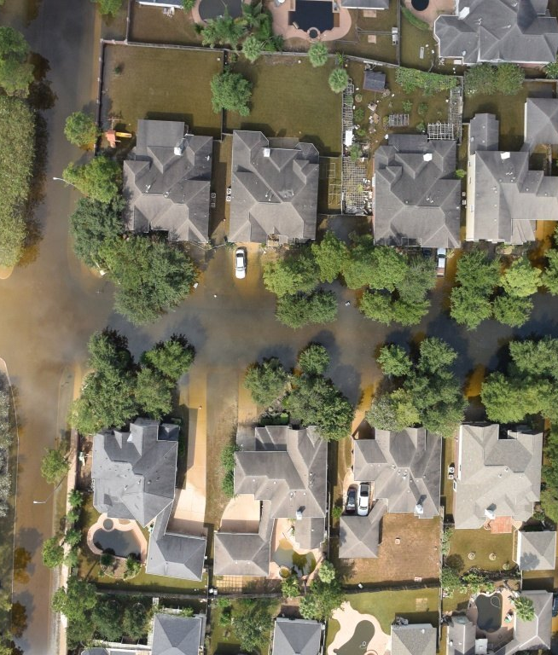
Rescue Router
KAIST AIC200 · MINI-PROJECT
Few-shot flood mapping and rescue routing with Chameleon
Track A + Track B
Marlen Melis · 20260876
Notes:
Hello, I'm Marlen. My project is Rescue Router: I adapted Chameleon to map flooded roads and buildings in drone photos from only a few labelled photos — that's Track A — and built a system on top of the map that plans rescue routes by truck, boat and on foot — that's Track B. Five minutes: the problem and the best numbers, how I set it up, the results, and what I learned.

Slide 2
Which houses can a truck still reach?
Seoul, Aug 2022: 141.5 mm of rain in one hour, the most since 1907. Streets in Gangnam became rivers.
.507 mIoU
Osong, Jul 2023: an underpass flooded in minutes; 17 vehicles trapped, 14 people died.
flood map on all 448 FloodNet test photos, from 50 labelled photos (PSPNet with 1,445: .848)
Drone photos arrive within the hour. Turning them into a map is the slow part: about one hour of labelling per photo, and a standard model wants 1,445 labelled photos.
.752 F1
finding the houses cut off by road
My question: how far do 50 labelled photos get us, and can the map route rescue teams?
100 %
of houses marked “confident: truck” were truly reachable by truck
Rescue Router · Marlen Melis · 20260876
1 / 6
Notes:
In August 2022 Seoul had 141.5 millimetres of rain in one hour, the most since 1907, and Gangnam's streets became rivers. In July 2023 the Osong underpass flooded in minutes and 14 people died. In the first hours, rescue coordinators need one answer per street and per house: can a truck get there, does it need a boat, or is it cut off? Drones deliver photos fast, but labelling one photo takes about an hour, and a normal segmentation model needs over a thousand labelled photos. So my question was: how far do 50 labelled photos get us, and is that map good enough to route rescue teams? The short answer is on the right: .507 mIoU on the whole FloodNet test set, a router that finds cut-off houses with F1 .752, and when the system says "confident: truck", it was right for all 208 such houses in the test photos. Fully supervised PSPNet gets .848, so this is a fast first map, not a replacement.

Slide 3

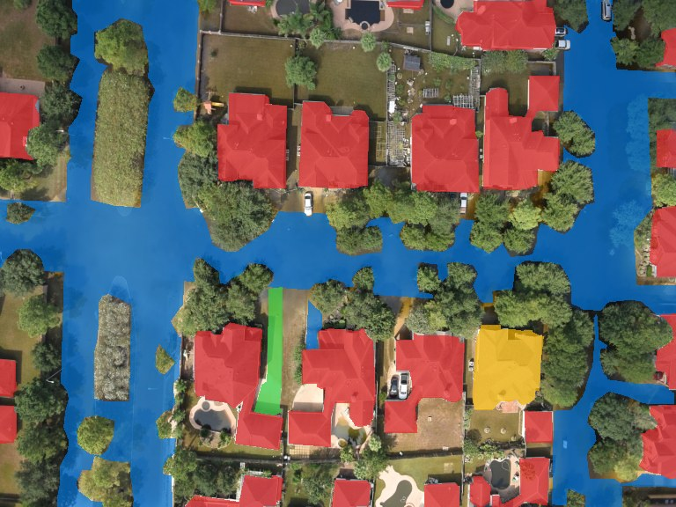
One photo in, five dense channels out
ch | class | for the router
0 | road clear | truck
1 | road flooded | boat only
2 | building flooded | target
3 | building dry | target
4 | water | boat
drone photo (768×576)
label: 5 channels, the rest is “other”
Output: one sigmoid map per channel, decoded with a threshold per channel tuned on 30 validation photos. 384-px tiles, 6 per photo, blended.
Then a router on 4×4-px cells: truck on clear road, boat on water, the last stretch on foot. Its labels: cut off by road or not.
Rejected: all 10 classes (wastes 50 shots), one “passable” channel (no boat leg), a cost map (no labels), trees as obstacles.
Rescue Router · Marlen Melis · 20260876
2 / 6
Notes:
How I encoded it. Every pixel of a 768 by 576 drone photo gets a five-channel label: clear road, flooded road, flooded building, dry building and water. Everything else — trees, grass, cars — is "other". Chameleon predicts one probability map per channel, and I decode it with a per-channel threshold tuned on 30 validation photos. Inference cuts the photo into six overlapping 384-pixel tiles. I chose the channels for the consumer: a router that works on 4-by-4 pixel cells, sends a truck on clear roads, a boat on water, and walks the last stretch. Things I rejected: all ten FloodNet classes, which spends the few labels on trees; a single "passable" channel, which can't plan a boat; and a cost map, for which no labels exist.

Slide 4
Data, weights and training
Data
Weights
Training
FloodNet (Hurricane Harvey, 2017): 1, 5, 10, 20 or 50 labelled photos to adapt; 30 to tune; 448 to test.
The course’s Chameleon meta-trained checkpoint (Kim et al., ECCV 2024), with its BEiT-v2-Large image encoder.
384-px crops, batch 2, Adam, lr 10⁻³ with cosine decay, fp16; 1,000–2,000 steps; best step on the 30 tuning photos.
RescueNet (Hurricane Michael, 2018): a second disaster, 20 or 50 photos.
Fine-tuned: biases, temperature, one LayerNorm (5 MB per model). Plus SAM to redraw building outlines.
28 runs on free Kaggle T4 GPUs, about 29 GPU-hours.
I labelled nothing: all labels are the datasets’.
The notebook reruns everything on a fresh T4 in about 28 minutes; its live 50-shot predictions match the stored ones exactly on Kaggle and on 99.99 % of pixels on Colab.
Rescue Router · Marlen Melis · 20260876
3 / 6
Notes:
Data: FloodNet, from Hurricane Harvey, for the main experiments — I adapt on 1, 5, 10, 20 or 50 labelled photos, tune on 30, and test on all 448 test photos. RescueNet, from Hurricane Michael, is the second disaster. I did not label anything myself; every label is the dataset's own. The main pretrained weights are the course's Chameleon checkpoint, plus SAM to redraw building outlines; fine-tuning only touches the biases, the matching temperature and one LayerNorm, so each model is five megabytes. Same recipe for every run, sized to fit a free 16-gigabyte T4: 384-pixel crops, batch 2, Adam with a cosine schedule, half precision. Seven runs plus 21 improvement runs, about 29 GPU-hours on Kaggle. And the final notebook reruns on a fresh T4 in about 28 minutes. On Kaggle, where the stored predictions were made, the live ones are identical; on Colab, 99.99 percent of pixels come out the same.

Slide 5
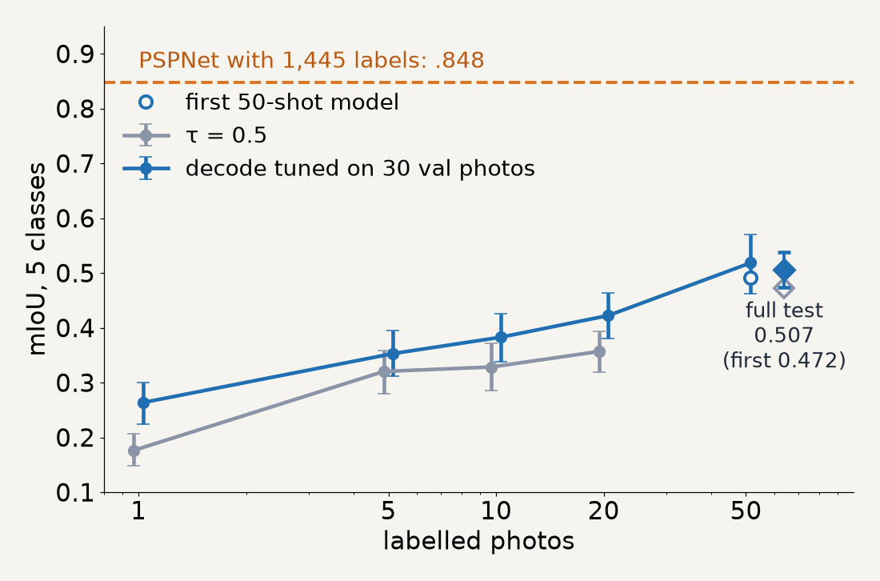
Track A: 50 labels get about halfway
1 → 5 photos: +.14, a real gain (95 % interval above 0).
5 → 10: no measurable gain; 20 → 50: +.10 again.
Flooded roads are the gap: IoU .31 vs .82 for PSPNet. Water and dry roads look alike from above.
A new hurricane needs its own labels: the FloodNet model on RescueNet with 0 labels reaches .32; with 20 RescueNet labels, .63.
Rescue Router · Marlen Melis · 20260876
4 / 6
Notes:
Track A results. The curve shows mIoU against the number of labelled photos, with 95 percent bootstrap intervals. From one to five photos the gain is real, plus .14. Between five and ten I could not measure any gain, and from 20 to 50 it jumps again by .10. On the full test set the final 50-shot model reaches .507, up from .472 for my first model after a round of 36 tested improvements. The dashed line is PSPNet, trained on all 1,445 labelled photos: .848. Most of the gap is flooded roads: .31 against .82 — shallow brown water and a dry road look very similar from above. And transfer: the FloodNet model applied to a different hurricane with zero new labels gets .32 on roads, buildings and water; with just 20 labels from the new disaster it gets .63. So every new disaster needs a few of its own labels — which is exactly the few-shot setting.

Slide 6
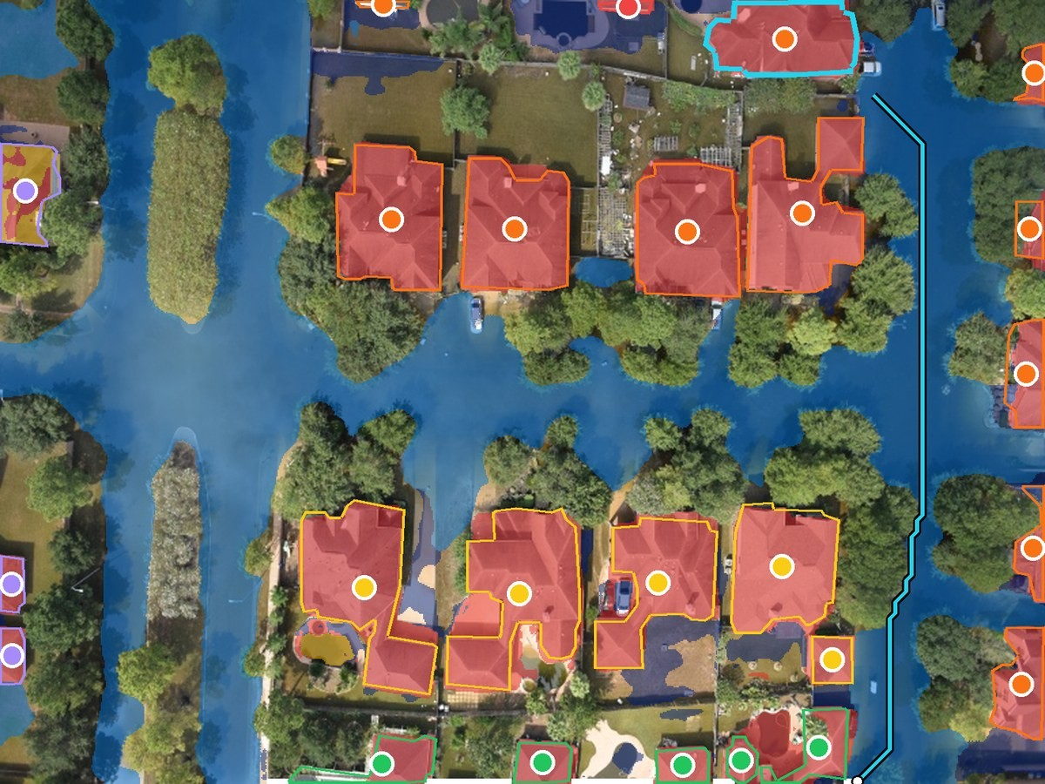
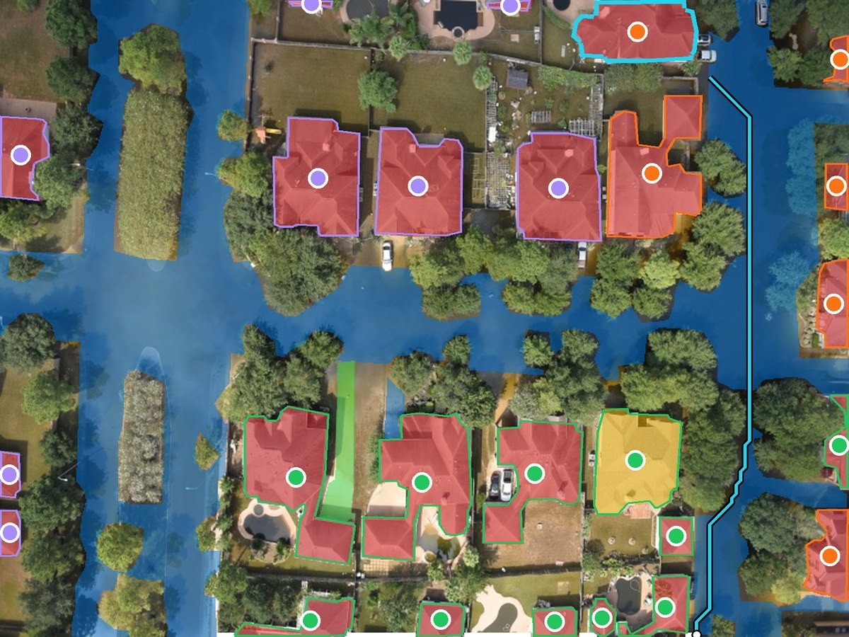
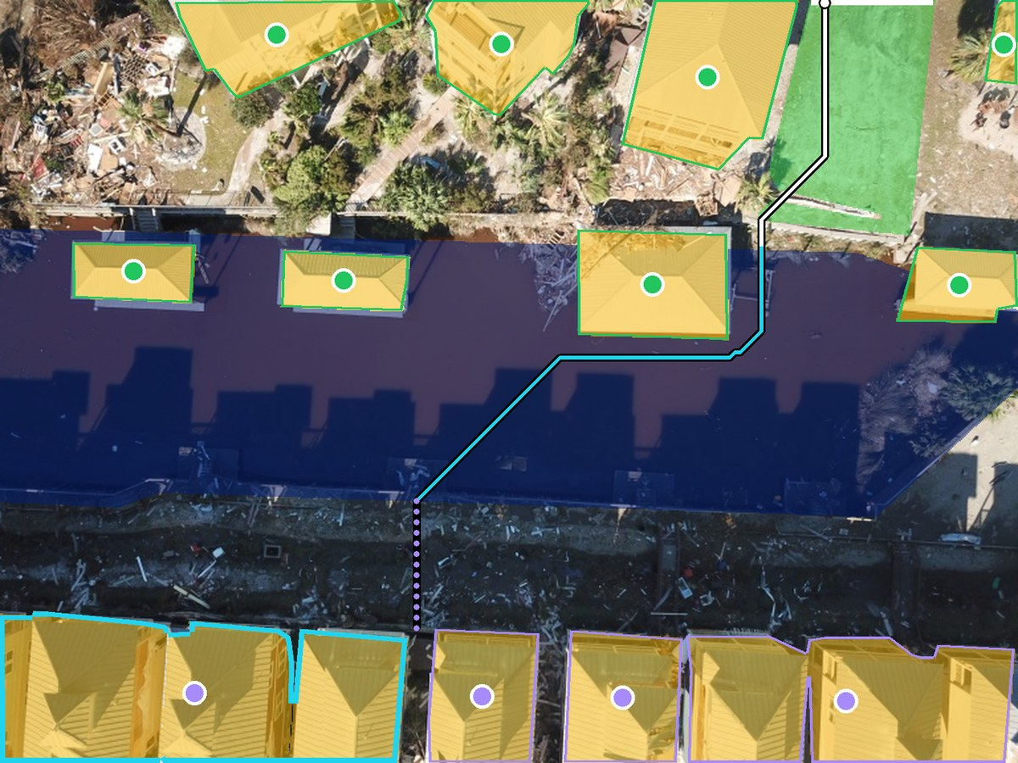
Track B: rescue routes on the predicted map
prediction (50 labels): truck, then boat
labelled map: the same house needs a boat
RescueNet canal: truck → boat → on foot
Cut-off houses found: F1 .752 on 1,232 test houses (.819 on the 100-photo set, .818 RescueNet)
It says how sure it is: “confident: truck” is right 100 %, “check first” 79 %
The system: web map of 200 test photos with live routes; Gradio app runs the model on an upload in 17 s
Rescue Router · Marlen Melis · 20260876
5 / 6
Notes:
Track B is the system around the map. The router finds the cheapest way from the entry point to every house: truck on clear roads, then a boat across water, then on foot — with vehicle widths, parked cars and tree canopy taken into account. Left is the predicted map, middle the same street routed on the human labels — the same house needs a boat on both. Right, the hurricane-Michael canal: truck to the canal, boat across, walk to the house. Against the labelled map the router finds the houses that are cut off by road with F1 .752 on the full test; the better map did not change routing measurably. And it says how sure it is: houses marked "confident: truck" were all right; "check first" 79 percent. Everything runs in a web map of all 200 test photos, and a Gradio app runs the model live on an uploaded photo in 17 seconds. [Live demo here if there is time.]

Slide 7
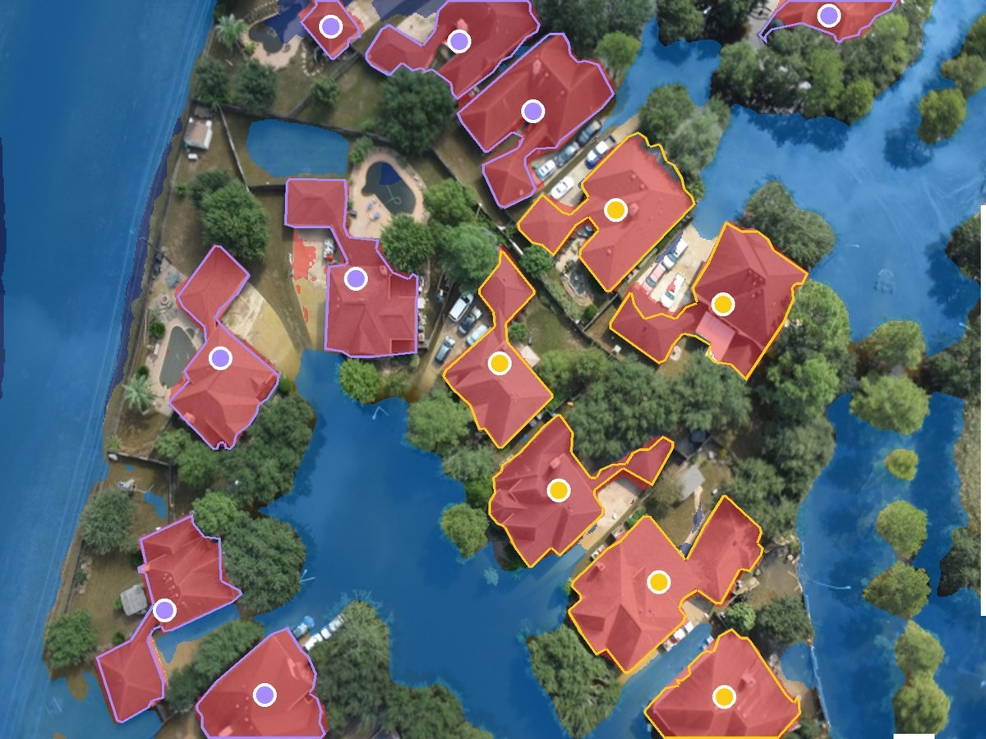
What I tried and what I learned
The dangerous error is shallow water read as dry land. A rule from that analysis (no off-road driving where water is likely) raised cut-off F1 from .74 to .84.
Saying how sure we are helps rescuers more than a few IoU points.
Tried 36 ideas: kept a shorter schedule, weight averaging, an edge-aware decode and SAM (.472 → .507); the rest lost.
Limits: US hurricanes, not Korean city floods; single photos without GPS; the “labelled map” is my router on human labels, not field truth.
Honest failure: shallow water read as land. All 6 wrongly “truck” houses are flagged “check first”.
Rescue Router · Marlen Melis · 20260876
6 / 6
Notes:
What I learned. The most dangerous mistake is shallow water read as dry land: the map then invites a truck into water. Here is that failure, honestly: the model thought this flooded street was land. But the six houses it wrongly calls truck-reachable are all flagged "check first", because the system routes every map twice, once cautiously. A simple rule from the failure analysis — no off-road driving where the water probability is high — raised the cut-off F1 from .74 to .84. So: saying how sure we are matters more than a few IoU points. I also tried 36 improvement ideas on the 50-shot model, each judged only on the 30 tuning photos. Four survived: a shorter training schedule, averaging two snapshots, an edge-aware decode, and SAM to redraw building outlines; together .472 to .507 on the test set. Most others lost, for example pseudo-labels and rare-class losses, and test-time flips looked good on the tuning photos but lost on the test set. Limits: these are US hurricanes, not Korean city floods; single photos without GPS; and the labelled map is my router on human labels, not field-checked access. Thank you.

