Slide 1

Eprashala
Educating India :- modern and vedic.
[Mr. Pramod Shinde]
Incubated and perfected at :- rural schools in Chandrapur )
First-generation computer engineer with 16+ years bridging the digital divide for rural Zila Parishad schools.
Now building a complete AI eco system which covers education, health care, family planning, using modern and vedic tools.

Slide 2





VANDE BHARATAM
The Team
Mr. Narendra Shinde
Mr. Prasad Vaidya
Mr. Arun Shinde
Guided by a collective of grassroots educators, forward-thinking District Collectors, and deep-tech engineers who provide critical on-ground operational insights and policy alignment for rural scaling.
Advisors & Mentors
Who's guiding you, and the value they bring.
Mr. Pramod Shinde
[CEO & Co-founder]
A social entrepreneur , striving day and night for the upliftment of Bharat using modern and ancient technologies.

Slide 3

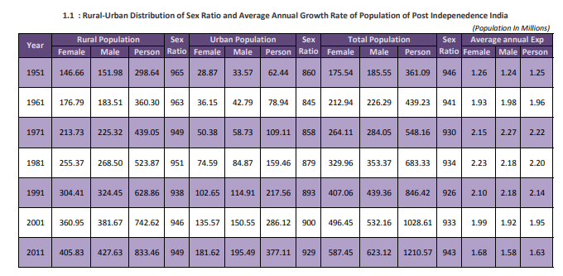


VANDE BHARATAM
The Problem
India suffers from a severe rural-to-urban "brain drain" and relies heavily on foreign AI hardware/software, leaving our grassroots talent and ancient knowledge disconnected from modern technological infrastructure.
1
KEY STAT
Students in rural (Zila Parishad) schools lacking internet access, mid-career professionals facing job insecurity, and rural teachers burdened with non-academic duties.
2
3. Why it matters: If left unsolved, millions of grassroots talents remain untapped, and India remains a mere consumer of foreign AI rather than an innovator and preserver of its own heritage.
3
Source: Office of the Registrar General, India.

Slide 4
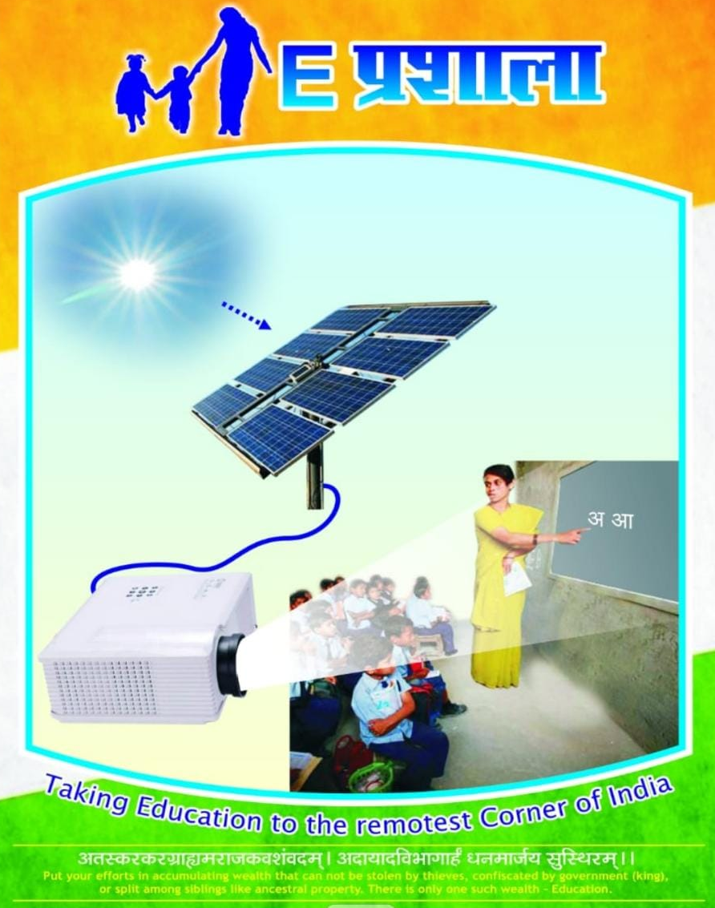



VANDE BHARATAM
The Solution
ePrashala AI Ecosystem
A complete, offline-compatible AI ecosystem integrating modern tech with ancient Vedic wisdom. It allows rural students to access advanced career counseling, health diagnostics, and digital literacy directly on low-cost devices without needing high-speed internet.
Benefit 1 (Zero-Cost Access): Empowers rural youth with premium tools like time-tracked cognitive aptitude tests and VR lazy-eye therapy completely free of cost.
Paste a screenshot, mockup
or product photo here
Benefit 2 (Absolute Privacy & Offline AI): All AI processing happens locally on-device via IndexedDB and local caching, ensuring zero data exploitation or internet dependency for history retrival..
Benefit 3 (Hardware Innovation): Drastically reduces infrastructure costs by utilizing refurbished e-waste (extracting PCBAs, RAM, and CPUs from discarded smartphones) to power local servers. Our AI tools run on 10 year old hardware and basic stable 2g connection.
CURRENT STAGE:
Revenue Stage

Slide 5
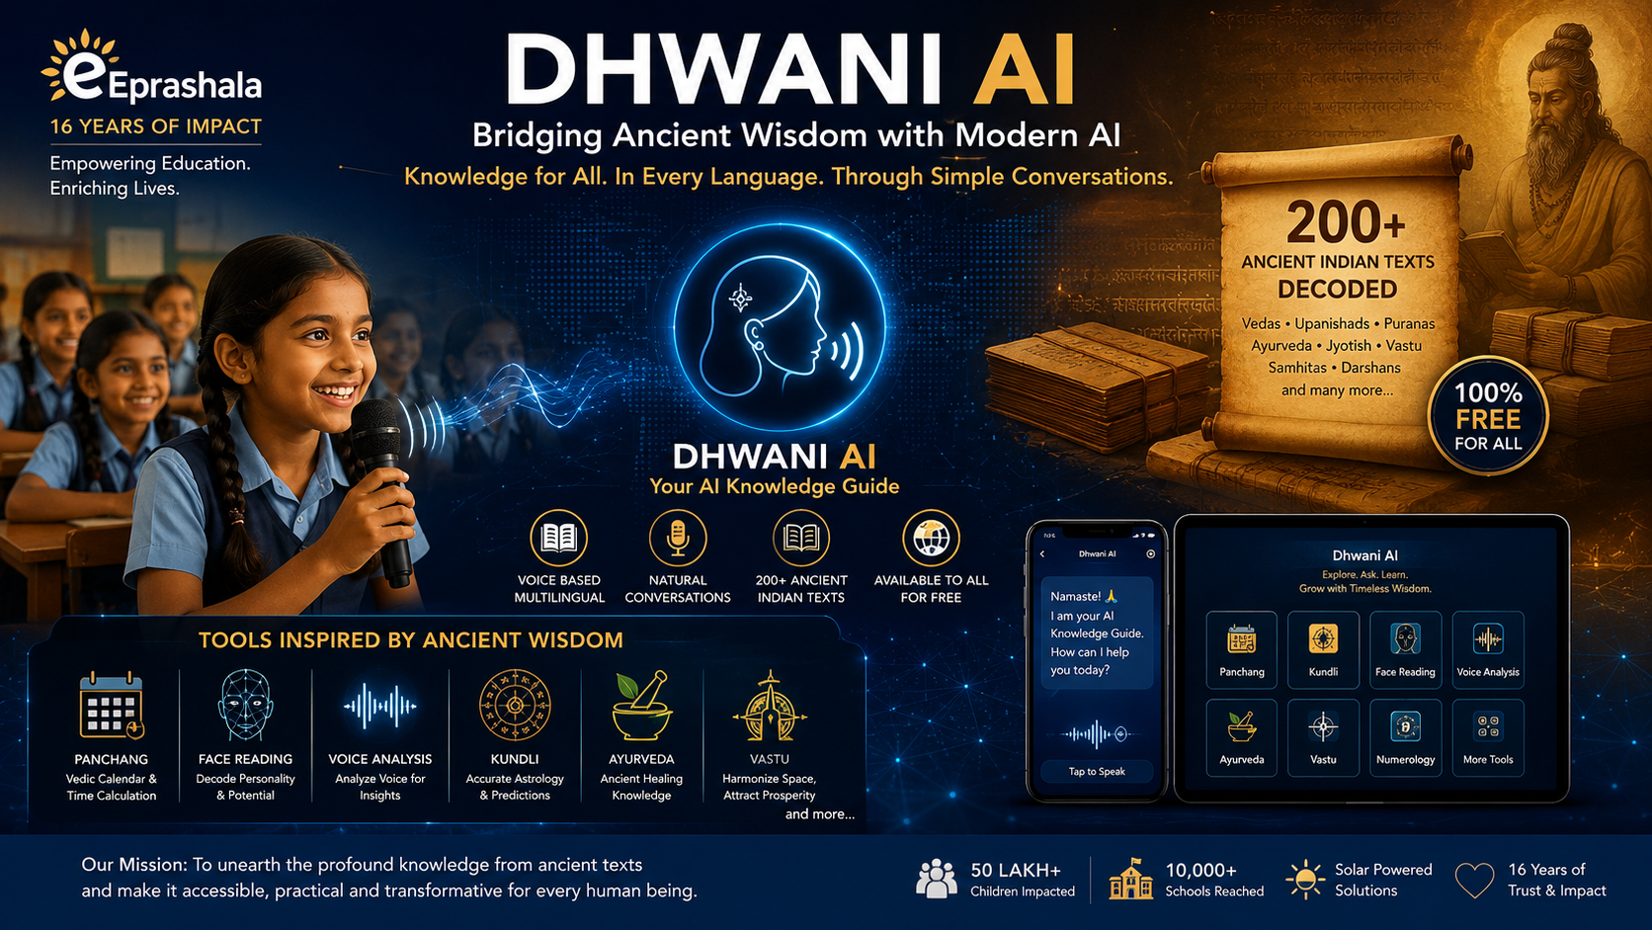

VANDE BHARATAM
Product / Service – How It Works
HOW IT WORKS
1
Eprashala Ai powered digital teaching device:- runs on solar energy, requires 1 power cord, turns any surface to touch screen. Neglible maintaince cost & running cost. Made for harsh Indian climatic conditions.
Eprashala Ai tools for all. A perfect blend of ancient wisdom and modern technology. Runs of 10 year old phones on 2g connection. Covers overall education including school, ancient and beyond.
Add a demo (image/video) or a short flow diagram
showing how it works
2
.
3
40 crore children if educated in the best way ( both modern and vedic ) will take India to the next level. Bridging the rural and urban gap. Overall progress awaits us.

Slide 6






VANDE BHARATAM
Market Opportunity
[ ₹ 50,000+ Cr ] - Overall EdTech, Digital Wellness, & DeepTech market in India.
Why now?
[ ₹ 10,000+ Cr ] - Rural EdTech, localized AI tools,
and grassroots skill development.
Why now? India is digitizing, yet e-waste is peaking and foreign AI dominates. The convergence of Atmanirbhar Bharat, NLP for local languages, and refurbished hardware processing makes this the perfect time to build a "Digital Nalanda.“
SOM [ ₹ 500+ Cr ] - State-level Zila Parishad schools and regional CSR tech implementations achievable in 3-5 years.
(Sizing based on the vast population of rural students in India
transitioning to digital learning, combined with the rapidly expanding refurbished hardware market).
Your early adopters?
Early adopters: Zila Parishad schools, rural parents, localized healthcare providers, and grassroots educators looking for offline-first solutions.

Slide 7







VANDE BHARATAM
Business Model
Who pays?
How they pay?
Revenue per customer?
CSR Initiatives, Government/District Collector tech funds, Philanthropists, and B2B/B2G enterprise clients. (The tools remain free for the rural end-user/student).
Bulk licensing for school implementations, hardware setup fees, and project-based CSR & government grants.
₹ [Variable based on district/school size] per deployment.
Unit economics
Revenue streams
Extremely low CAC due to grassroots word-of-mouth. High gross margin on software. Hardware costs are minimized by upcycling discarded smartphone components into educational tech.
1> B2G School Digitalization Contracts (Primary today)
2> CSR-funded rural deployments
3> Future: Enterprise API licensing for AI tools (Swara Forensics, Face Reading AI)

Slide 8


VANDE BHARATAM
Roadmap & Milestones
1
2
3
4
TODAY
+12 MONTHS
+2 YEARS
+5 YEARS
Where you are today
Next milestone
Scaling milestone
Expansion milestone
TODAY (Scaling Phase): Serving 5 million+ children across 5,000+ rural schools with the core ePrashala offline hardware & LMS. Launching specialized AI tools (Sanjeevani, free Aptitude Tests).
+12 MONTHS (Next Milestone): Rollout of the "Dhwani" voice-interactive AI and "Swara Forensics" to 6lakh schools. Establishing the first refurbished hardware micro-data center using discarded smartphone PCBAs.
+2 YEARS (Scaling Milestone): Pan-India adoption of the offline AI Aptitude and Sanjeevani portals. Achieving 10+ million active users relying on localized, on-device AI processing without high-speed internet.
+5 YEARS (Expansion Milestone): "Project Aatma" (Digital Twin technology) and full realization of the "Digital Nalanda"—transitioning India into a global exporter of culturally-rooted, deep-tech AI solutions.
Phrase each milestone relative to where you are today

Slide 9



VANDE BHARATAM
Key Risks & Mitigation
RISK 1
HOW WE'LL TACKLE IT
Scalability and cost of hardware manufacturing in India compared to global hubs (like China)
Bypassing new manufacturing by pioneering an e-waste refurbishing model—extracting CPUs/RAM from old phones to build high-power, low-cost educational devices.
RISK 2
HOW WE'LL TACKLE IT
Hesitancy among rural populations to adopt advanced, unfamiliar AI tech.
Packaging AI in highly familiar, culturally resonant formats (e.g., native language voice bots, Ayurvedic coaches, and Vedic interfaces).
RISK 3
HOW WE'LL TACKLE IT
Sustaining a "free for the end-user" model at a massive national scale.
Leveraging robust B2G partnerships, CSR funding, and ultra-low server maintenance costs achieved specifically through our offline-first computing architecture.

Slide 10




VANDE BHARATAM
Competition & Your Advantage
Feature / Advantage
Eprashala
Western AI/EdTech Giants
Traditional Schooling
[Status Quo]
Solar powered offline Hardware
Localized modern / Vedic Integration
Hardware Cost Efficiency
User Data Privacy
YOUR ADVANTAGE
16 years of deeply rooted grassroots experience and trust, a patented offline delivery technology, and an un-copyable integration of India's ancient Shastras with cutting-edge on-device AI algorithms. .

Slide 11



VANDE BHARATAM
Financials & The Ask
3-YEAR SNAPSHOT
WE WANT TO RAISE
₹100 cr
Year 1
Year 2
Year 3
[ ₹ 100]
[ ₹200 ]
[ ₹ 300]
USE OF FUNDS
Revenue or core-metric trajectory — keep it high-level. Detailed model → Annexure.
40% → Product / Tech (R&D for Project Dhwani & Project Aatma)
30% → Operations (Sourcing and scaling refurbished e-waste hardware)
20% → Team / Salaries
10% → Marketing / GTM (Grassroots awareness and deployment)
What non-monetary support would you like from Vande Bharatam?
Mentorship for scaling refurbished hardware supply chains within India, direct connections with national CSR heads, and strategic backing to implement tech that relieves rural teachers of non-academic duties.

Slide 12
VANDE BHARATAM
ANY ADDITIONAL INFORMATION YOU WOULD LIKE US TO KNOW
At Eprashala, we have always believed that the years between 4 and 12 are the most formative period in a child's life. During the first six years, children naturally idolize superheroes and fictional characters they see on television or mobile devices. As they grow older, their aspirations begin to be shaped by the authority figures around them—teachers, parents, coaches, and mentors. This is the critical stage when both their minds and their character are being formed.
If we can engage children during this defining phase and inspire them through the lives of the men and women who built our nation, we have the opportunity to create a transformational societal impact. This is where Artificial Intelligence becomes a truly powerful educational tool. Imagine a seven-year-old learning about Dr. A.P.J. Abdul Kalam, Chhatrapati Shivaji Maharaj, or Ratan Tata—not by memorizing facts and dates, but by holding an interactive conversation with their AI-powered digital avatars. Instead of passively reading history, children experience it through meaningful dialogue with the very personalities who shaped it.
Children need role models they can relate to and learn from. When an AI avatar of Sachin Tendulkar speaks directly to a child about discipline, perseverance, setbacks, and the journey to excellence, the learning becomes deeply personal and emotionally memorable. This goes far beyond conventional classroom education; it nurtures values, ambition, resilience, and purpose.
Our vision is simple yet transformative: if every child, including those in the most remote villages of India, can regularly interact with inspiring AI mentors modeled after our nation's greatest leaders, scientists, entrepreneurs, sportspersons, and social reformers, we can ignite a new generation of dreamers, innovators, and nation-builders. Such an ecosystem has the potential to inspire countless future Abdul Kalams, Ratan Tatas, Sachin Tendulkars, and many other extraordinary Indians who will shape the nation's future.

Slide 13
VANDE BHARATAM
ANY ADDITIONAL INFORMATION YOU WOULD LIKE US TO KNOW
Annexure 2
Former Prime Minister Shri Atal Bihari Vajpayee once said, "Azaadi abhi adhuri hai" ("Our freedom is still incomplete"). I believe that, in the 21st century, true freedom also means freedom from illiteracy and technological dependence. Artificial Intelligence is often viewed as a threat to jobs, but I see it as India's greatest opportunity to become a global technology leader. As our Hon'ble Prime Minister Shri Narendra Modi has often emphasized, the greatest opportunities are often hidden within the greatest challenges.
Today, the global AI ecosystem is dominated by a handful of nations and corporations. Much of the world's AI software, cloud infrastructure, semiconductor technology, and advanced hardware originates outside India. This concentration creates strategic dependencies that every nation must carefully consider.
Recent global technology disruptions have demonstrated how dependent modern economies have become on digital infrastructure. Banking, transportation, healthcare, education, governance, and communication all rely on technology platforms that are increasingly global in nature. As India accelerates its digital transformation, strengthening indigenous AI capabilities is not merely an economic opportunity—it is a matter of technological resilience and national preparedness.
Rather than fearing that Artificial Intelligence will replace jobs, this is the moment for India to build the next generation of globally respected technology companies. Just as previous generations built India's strengths in software and digital services, this generation has the opportunity to build world-class AI platforms, computing infrastructure, and intelligent products designed in India, built in India, and serving the world.
The hardware challenge, however, is equally important. During my sixteen years of visiting manufacturing ecosystems in China, where I even maintained a residence for an extended period, I observed an important principle behind their scale: refurbishment, repair, reuse, and component recovery are deeply embedded within their industrial ecosystem. Extending the life of electronics dramatically reduces costs while maximizing the value extracted from existing technology.
Establishing a completely new semiconductor and hardware manufacturing ecosystem requires enormous investments and many years of sustained effort. While India continues to build those long-term capabilities, we also have an immediate and highly practical opportunity: large-scale refurbishment and component reuse.
Consider a smartphone. Most consumers replace their devices every two or three years, even though many of the internal components—the processor, memory, storage, power management circuits, and other electronic modules—remain fully functional. Instead of allowing these valuable resources to become electronic waste, they can be recovered, tested, and repurposed into new technology products.
Recovered computing components can power affordable educational laptops, AI-enabled learning devices, smart set-top boxes, networking equipment, edge-computing systems, robotics controllers, and distributed computing clusters that support AI workloads. This circular approach not only reduces costs but also creates skilled employment, strengthens India's electronics ecosystem, reduces e-waste, and makes advanced technology accessible to millions.
India's AI future should not be built solely by consuming imported technologies. It should be built through innovation, self-reliance, sustainable manufacturing, and intelligent reuse of existing resources. By combining world-class AI software with affordable, refurbished computing infrastructure, India can democratize access to Artificial Intelligence while creating a resilient, scalable, and environmentally responsible digital ecosystem for the next billion users.

Slide 14
VANDE BHARATAM
ANY ADDITIONAL INFORMATION YOU WOULD LIKE US TO KNOW
Annexure 3
If I were to speak about the innovations that lie ahead, I would say that we have only just begun. By decoding the knowledge embedded in India's ancient texts and combining it with modern Artificial Intelligence, we already have a pipeline of more than one hundred innovation projects. However, if you ask me which innovation I believe has the potential to become a global benchmark over the next decade, my answer is clear: the next phase of our Dhwani platform—Project Aatma.
The first milestone of Dhwani is a module we call Parmatma, where users can engage in immersive, AI-powered conversations inspired by the teachings and philosophies of revered spiritual figures. It demonstrates how AI can make timeless wisdom more accessible and engaging.
Our next and far more ambitious vision is Project Aatma.
Project Aatma is our vision for creating a Digital Twin of Human Wisdom. Our goal is to build an AI system that learns an individual's knowledge, experiences, communication style, values, and decision-making patterns over time. Rather than merely storing information, it preserves a person's intellectual legacy in an interactive form, allowing future generations to learn from their insights long into the future.
Imagine a child, decades from now, being able to have a meaningful conversation with the AI representation of a grandparent or great-grandparent—learning family history, hearing life lessons, understanding values, and receiving guidance based on that person's recorded knowledge and personality. Today, most families preserve memories through photographs and videos. Project Aatma aims to preserve something even more valuable: wisdom, experience, and human connection.
This is not simply about technology—it is about preserving civilization's most precious asset: human knowledge.
The impact, however, extends far beyond preserving legacy. Project Aatma has the potential to become a powerful productivity platform for the living.
Consider an entrepreneur, scientist, educator, physician, or CEO who makes hundreds of decisions every day. Over time, Project Aatma can learn their working style, priorities, and decision frameworks to function as an intelligent digital assistant. Routine decisions can be organized, filtered, and prioritized—distinguishing between low-impact tasks, important operational matters, and decisions that require personal attention. By reducing cognitive overload and automating repetitive decision support, leaders can devote more of their time and mental energy to creativity, innovation, strategy, and solving humanity's most important challenges.
Our long-term vision is not to replace human intelligence, but to amplify it.
Just as libraries preserve books and museums preserve history, Project Aatma aspires to preserve human wisdom—making it accessible, interactive, and valuable for generations to come. We believe this represents one of the next great frontiers of Artificial Intelligence: technology that not only serves humanity today but also safeguards its collective knowledge for tomorrow.

Slide 15
VANDE BHARATAM
ANY ADDITIONAL INFORMATION YOU WOULD LIKE US TO KNOW
Annexure 4
Empowering Women through AI, Ayurveda, and India's Knowledge Heritage
No nation can achieve sustainable progress without empowering its women. An educated, healthy, confident, and economically independent woman strengthens not only her family but also the nation's economy. At Eprashala, we believe that the future of India is inseparable from the future of its daughters.
During our work in rural India, we observed a deeply concerning challenge: the dropout rate among adolescent girls rises significantly after the age of fourteen. A major reason is the lack of access to trusted, confidential guidance on health, menstruation, nutrition, emotional well-being, and adolescence. Many girls hesitate to discuss these sensitive issues even with parents, teachers, or healthcare professionals due to fear, embarrassment, or social stigma.
To address this challenge, we developed Dr. Pihu, an AI-powered women's health mentor created under the guidance of experienced Ayurvedic gynecologists. Dr. Pihu provides a private, judgment-free environment where girls and women can ask questions they may otherwise hesitate to ask. Drawing upon classical Ayurvedic literature, traditional Indian health practices, and evidence-informed wellness guidance, Dr. Pihu offers personalized educational support, lifestyle recommendations, nutrition advice, and home-based wellness practices using ingredients commonly found in Indian kitchens. By making trusted guidance accessible at any time, we hope to improve awareness, confidence, and well-being, thereby supporting girls in continuing their education.
Women's safety is another critical pillar of empowerment. Inspired by the ancient Indian science of Mukha Samudrika Shastra, we have developed an AI-based facial analysis platform for educational and self-awareness purposes. The system provides personality insights based on traditional principles and is intended to encourage thoughtful decision-making and greater awareness in personal and professional interactions. While such insights should never replace human judgment, they can serve as an additional tool to promote caution, self-reflection, and informed choices.
Beyond education and safety, we envision AI as a catalyst for women's entrepreneurship.
India possesses thousands of years of documented knowledge in Ayurveda, natural wellness, and traditional beauty practices. Our AI platform enables women entrepreneurs to explore these classical formulations, understand natural ingredients, and innovate responsibly using India's rich botanical heritage. By combining ancient wisdom with modern AI, women can create high-quality, sustainable, and nature-inspired wellness and cosmetic products rooted in traditional Indian knowledge.
Our long-term vision is to enable thousands of women to build successful homegrown wellness enterprises that create employment, promote sustainable living, and showcase India's ancient scientific heritage to the world.
At Eprashala, we believe that Artificial Intelligence should not merely automate work—it should unlock human potential. By empowering women with knowledge, confidence, entrepreneurship, and access to India's timeless wisdom, we aspire to build a future where every girl can learn without fear, every woman can lead with confidence, and every family can contribute to a stronger, healthier, and more self-reliant India.

