Slide 1
BioMart
A Federated Query Architecture
Arek Kasprzyk
European Bioinformatics Institute
26 April 2004

Slide 2
Changing Research Focus
The increase in high-throughput technologies
Growing sophistication of the user
Research question involving big datasets
  Multispecies
  Multiexperiments
  Multidatsets
Data sources distributed

Slide 3
Use cases
Upstream sequences for all kinases upregulated in brain and associated with known diseases
Name, chromosome position, description of all genes located on chromosome 1, expressed in lung, associated with mouse homologues, and non-synonymous snp changes

Slide 4
Solutions
Bioinformatics support
  Processing data files
  Use third party software
  In house processing
No bioinformatics?
One-stop shop for biological data

Slide 5
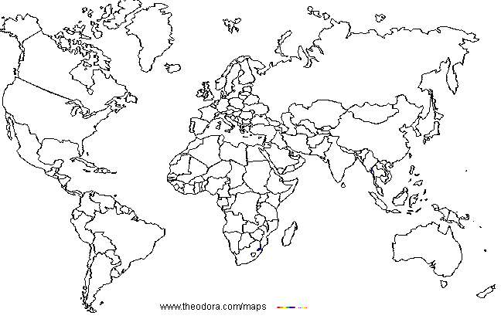

Slide 6
CORBA
SOAP

Slide 7
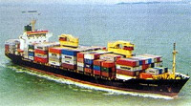


A Container ‘Revolution’

Slide 8
BIOMART

Slide 9
System Overview

Slide 10
Key features
Generic
  Universal BioMart data model
  Query-based interface
  No data dependent abstractions
Network scalability
  Query optimised schema
Platform portability
  Automatic, simple SQL

Slide 11
BioMart – a generic system
Key abstractions
  Dataset
  Filter
  Attribute

Slide 12
Use cases
Upstream sequences
for all kinases
up-regulated in brain and associated with known diseases
Name, chromosome position, description
of all genes
located on chromosome 1, expressed in lung, associated with mouse homologues and non-synonymous snp changes

Slide 13
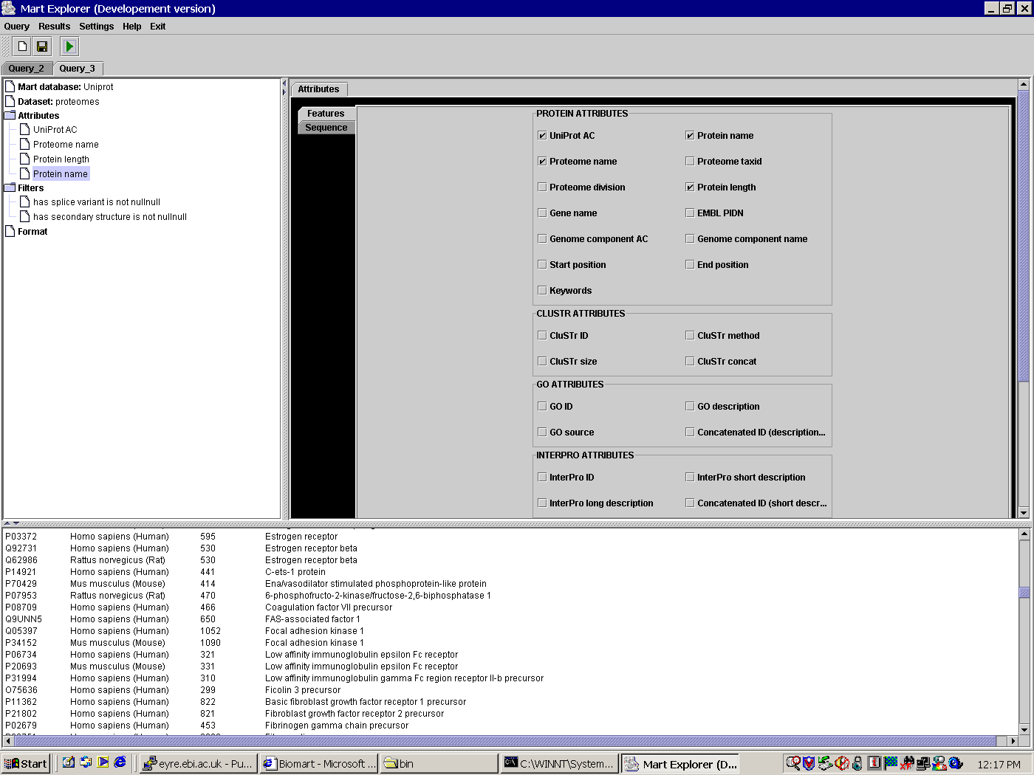
Key Abstractions
Mart
Dataset
Attribute
GENE CENTRAL
gene_id(PK)
gene_stable_id
gene_start
gene_chrom_end
chromosome
gene_display_id
description
Filter

Slide 14
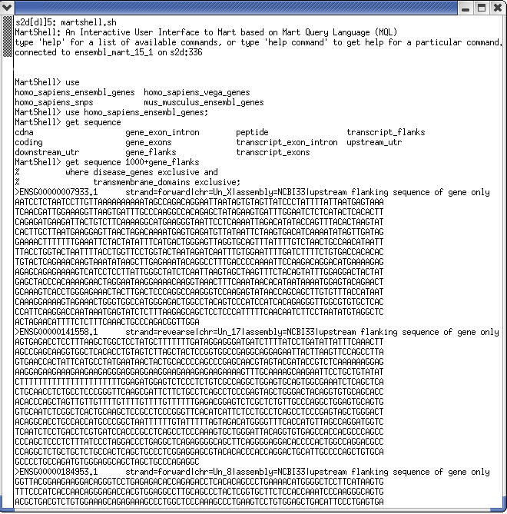
Mart Query Language (MQL)
Using = dataset
Get = attribute
Where = filter

Slide 15
BioMart
Schema specification
XML-based configuration
Admin tools
  Configuration/Building
Data access
  Libraries and interfaces (Perl, Java)

Slide 16
‘Reversed Star’ Schema
PFAM SATELLITE
GENE CENTRAL
DISEASE SATELLITE
gene_id (FK)
transcript_id(FK)
translation_id
pfam_id
etc.
gene_id(PK)
gene_stable_id
gene_chrom_start
gene_chrom_end
chromosome
gene_display_id
band
description
etc
gene_id (FK)
disease
omim_id
etc.
TRANSCRIPT CENTRAL
SNP SATELLITE
transcript_id (PK)
gene_id
gene_stable_id
gene_chrom_start
gene_chrom_end
chromosome
gene_display_id
band
description
etc
REFSEQ SATELLITE
gene_id (FK)
transcript_id(FK)
snp_id
snp_external_id
snp_chrom_start
etc.
gene_id (FK)
transcript_id(FK)
db_primary_id
display_id
etc.

Slide 17
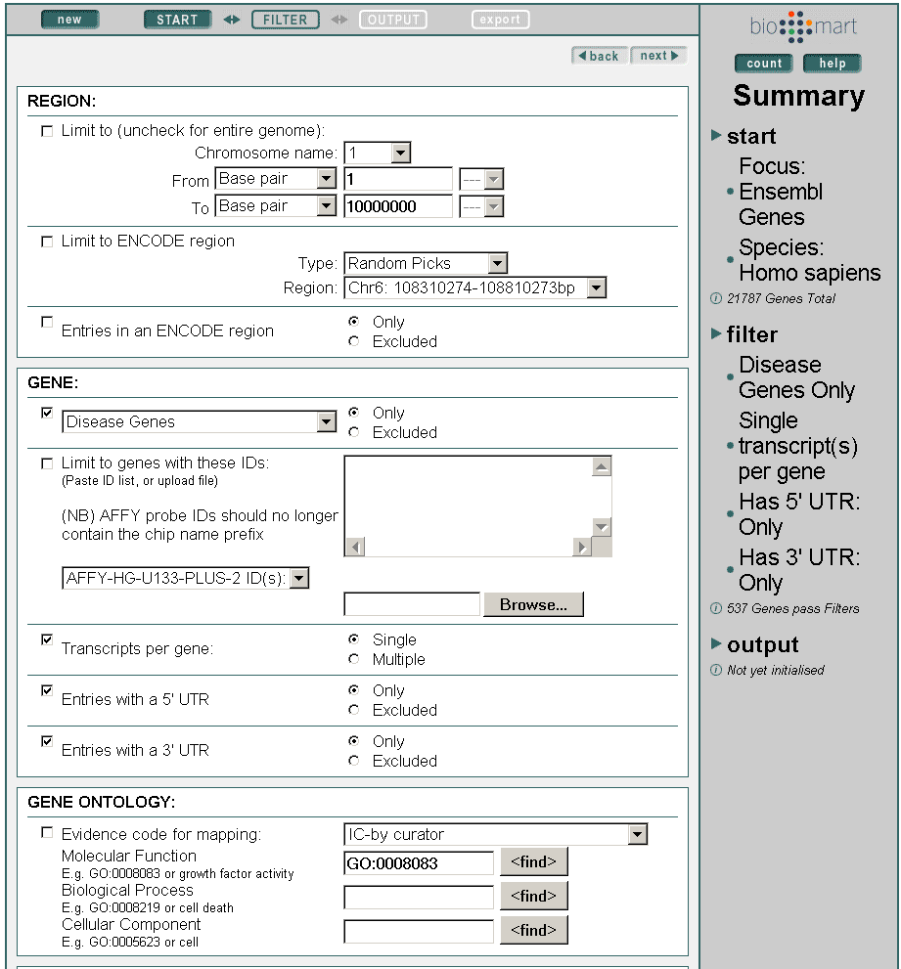
XML-based Configuration
XML
XML
XML

Slide 18
Admin Tools
MartEditor
  XML editor with build-in system logic
  Configure existing interfaces
  Automatically create new, ‘naive’ configuration
MartBuilder
  Transforms source -> mart schema
  A set of SQL commands (mart-build)
  An automatic schema transformation

Slide 19
Deploying BioMart
Transformation
Configuration
Source
databases
Mart
XML
MartBuilder
MartEditor

Slide 20
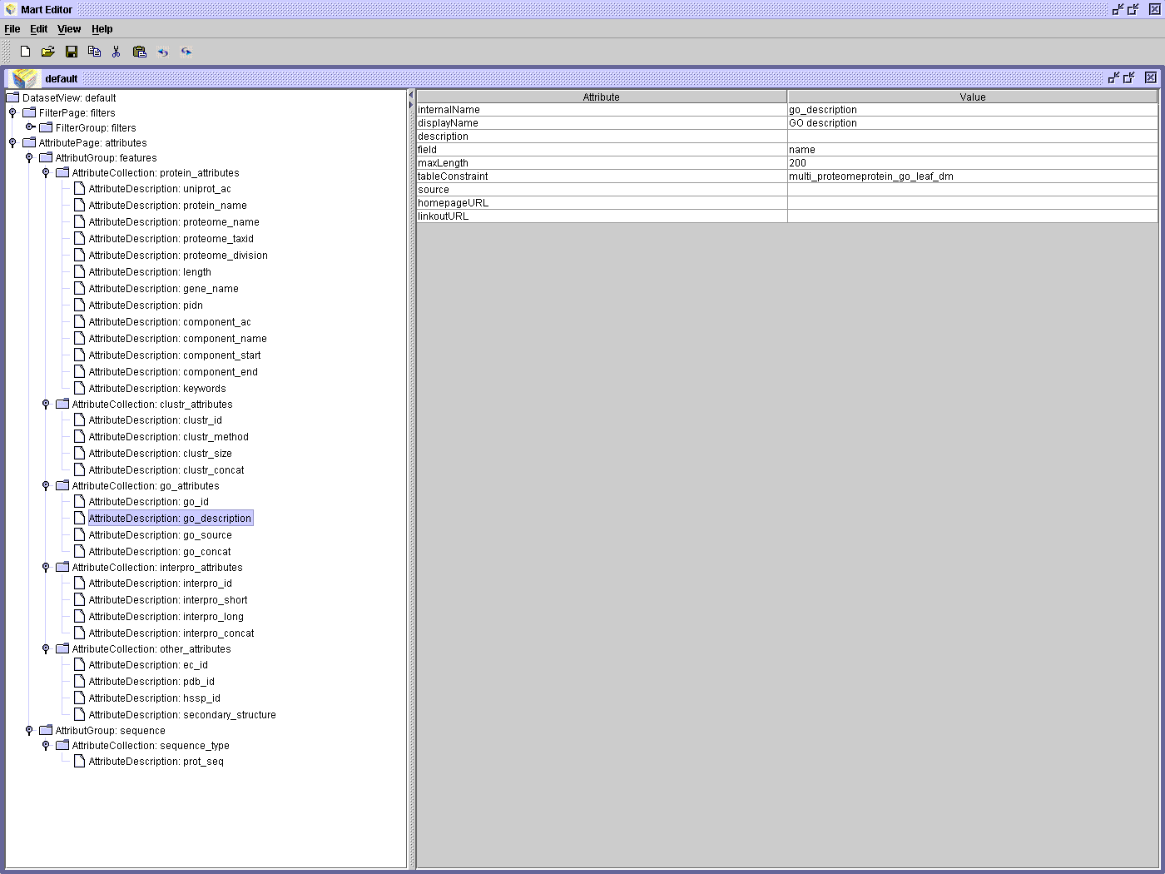
MartEditor

Slide 21
Data access
Libraries and interfaces
  MartLib (API)
  MartView (Web)
  MartShell (Text)
  MartExplorer (GUI)

Slide 22
MartLib
GUI
Query Chaining
Engine
Filter Handler F
Look up Tables
File
Query Runner
Compile
Execute
Results

Slide 23
MartView

Slide 24
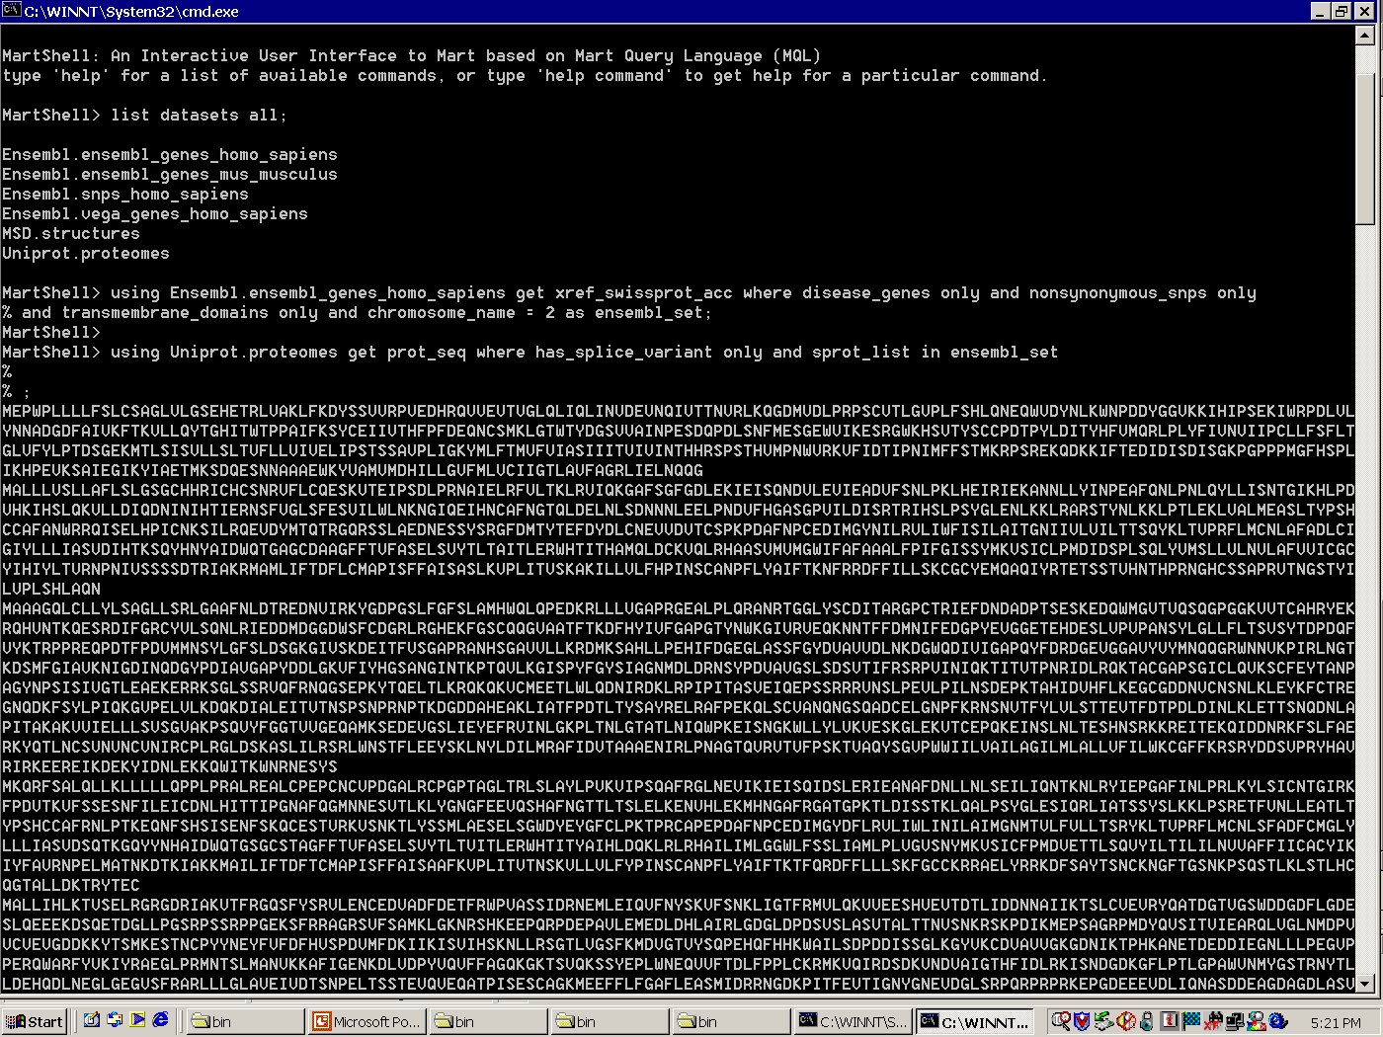
MartShell

Slide 25
MartExplorer

Slide 26
Distributed Architecture

Slide 27
Query-chaining
Dataset 1
Dataset 2
Dataset 3
F
A
F
A
F
A
using Dataset1 get Attribute1 where Filter1=var1 as q;
using Dataset2 get Attribute2 where Filter2=var2 and filter3 in q

Slide 28
BioMart – A Distributed Architecture
MySQL
ORACLE
PostgreSQL
XML
XML
XML
XML
XML
XML
ANSI SQL
XML
XML
XML

Slide 29
BioMart – User Perspective
STANDALONE CLIENT
XML
MartShell
MartLib
MartExplorer
XML
XML
WWW SERVER
MartView
MartLib
XML

Slide 30
Distributed Model Benefits
Each group retains full control over their data source
  Data content
  Data updates
  Data presentation (interface)
  Deployment platform
  Security

Slide 31
Requirements
Mart-spec database
  ‘Mart-compatible’ star schema
  Table naming convention (dataset__content__type)
  XML configuration file
RDBMS server outside firewall

Slide 32
What Do You Get?
Flexible interfaces configurable according to your spec
‘Performance-assured’ data retrieval
Query chaining across data sources
Administrator tools for modifying and deploying the system

Slide 33
Future

Slide 34
July
Alpha release of the BioMart suite
  Specification
    Schema naming convention
    DTD for XML config
Administration Tools
  Configure
Data access (Perl/Java)
  Lib
  Interfaces
Tested on MySQL 4/Oracle 9i ‘mixture’

Slide 35
After July …
MartBuilder
  Automatically build marts from existing 3NF with predefined PK/FK
  Fixed schema data transformation function
    SQL collection
  Collaboration
    Laboratory for the Foundation of Computer Science
    Bell Labs

Slide 36
BioMart – an Open Project
All code and data freely available
  Website
    www.ebi.ac.uk/biomart
    www.ebi.ac.uk/biomart/martview
  Public MySQL server
    martdb.ebi.ac.uk
  Ftp
    ftp.ebi.ac.uk
Mailing lists
  mart-dev
  mart-announce

Slide 37
Summary
If you need …
  Scalable and flexible search interfaces for an existing database
  Single ‘integrated’ search interface to many in house databases
  ‘Connect’ your databases to other databases on the internet
BioMart

Slide 38
BioMart and GMOD
Points for discussion
  Schema transformation for Chado
    Populated and stable?
    Schema transformation for current schemas of member databases?
  Testing it in PostgreSQL?

Slide 40
Credits
Damian Smedley
Damian Keefe
Andreas Kahari
Craig Melsopp
Will Spooner
Darin London
Katerina Tzouvara

