Slide 1
COSMIC GBrowse
Visualising cancer mutations in genomic context
Dave Beare
dmb@sanger.ac.uk
Cancer Genome Project
Wellcome Trust Sanger Institute, Hinxton, Cambridge, UK

Slide 2
Introduction
2000: Cancer Genome Project (CGP)
2004: Catalogue Of Somatic Mutations In Cancer - COSMIC
Oracle database and website
http://www.sanger.ac.uk/genetics/CGP/cosmic
Sources of mutation data
1. Literature (curators)
2. Other database(s) eg TP53 (IARC)
International Agency for Research on Cancer
3. Sequencing/mutation detection
2010: COSMIC GBrowse (22nd September??)
http://www.sanger.ac.uk/fgb2/gbrowse/cosmic x

Slide 3
GBrowse and CGP
Q. How could we visualise the data deluge from next generation sequencing?
A. Gbrowse
[Keiran Raine GMOD presentation in January 2010]
A near instant solution to the problem (days/weeks, rather than months/years for an in house solution).
Q. COSMIC was designed to be gene centric but what about sequencing whole cancer genomes and visualising mutations in genomic context?
A. Gbrowse
Again!

Slide 4
GBrowse: Setup
Hardware
-- 5 Virtual Machines [Debian Linux, 2G RAM) ]
dev + master + renderfarm slaves (2) + PostgreSQL
Software
-- apache 2.2.9
-- mod_fastcgi 2.4.6
-- gbrowse 2.13 [perl 5.10.0 + bioperl 1.61 + bio::graphics 2.11]
Databases
-- PostgreSQL
2 databases: ‘Reference’ and ‘Cosmic’
-- scripts to query/format/populate these databases

Slide 5
GBrowse: Data
Reference
-- Reference genome (GRCh37) + cytogenetic bands
-- Ensembl annotations (e! 58)
-- Cosmic Transcripts
Cosmic
-- Mutations (subsitutions, insertions/deletions)
    -- Rearrangements
    -- Copy Number Profiles
    analysis of SNP6 microarray data over 800 cell lines
    % samples which have copy number features
    (amplification, homozygous deletion, LOH, change)

Slide 6
GBrowse: Configuration
cosmic css/theme
perl callbacks
-- glyphs
-- colours
-- hyperlinks
-- popups/tooltips
renderfarm enabled

Slide 7

GBrowse: Render Farm
_x0016_
Master
Slave 1
Slave 2
Referencedb
Mutationsdb

Slide 8
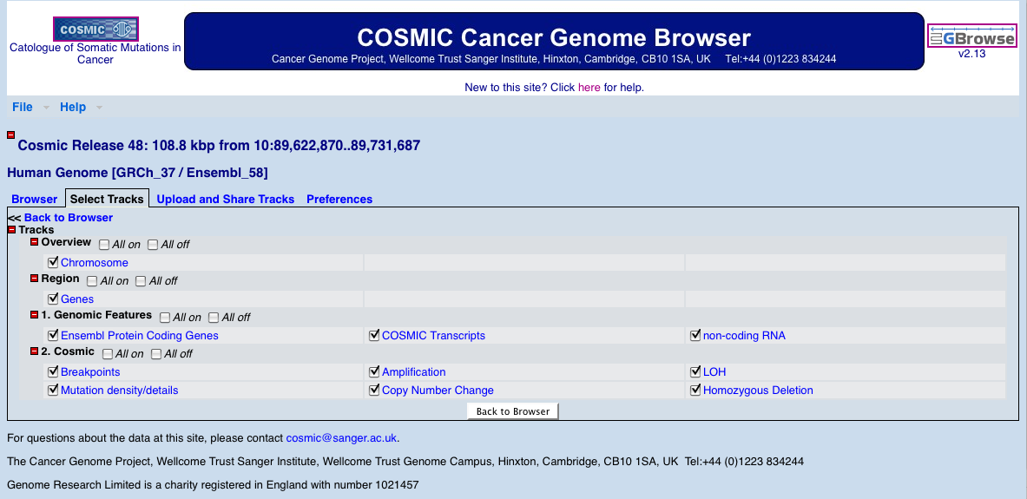
GBrowse: Select Tracks http://www.sanger.ac.uk/fgb2/gbrowse/cosmic

Slide 9
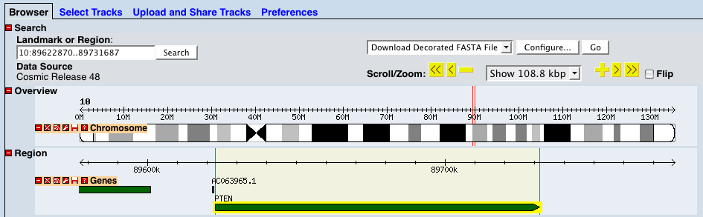
GBrowse: Overview http://www.sanger.ac.uk/fgb2/gbrowse/cosmic

Slide 10
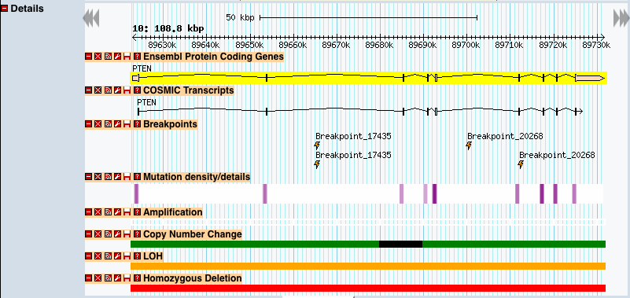
GBrowse: Details http://www.sanger.ac.uk/fgb2/gbrowse/cosmic

Slide 11
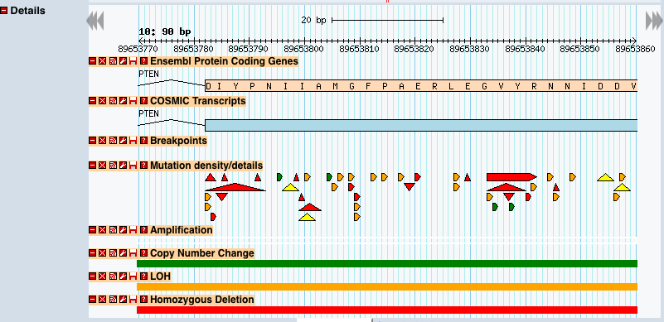
GBrowse: Zoom http://www.sanger.ac.uk/fgb2/gbrowse/cosmic

Slide 12
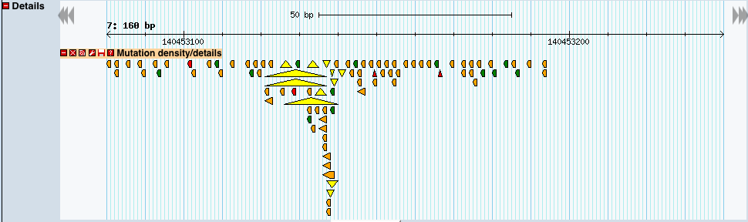
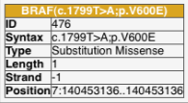
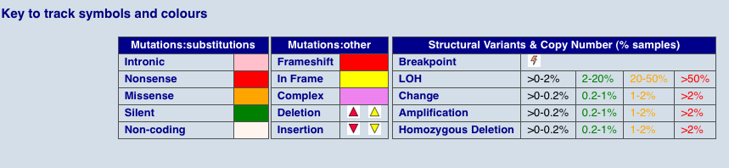
GBrowse: Mutation Details http://www.sanger.ac.uk/fgb2/gbrowse/cosmic

Slide 13
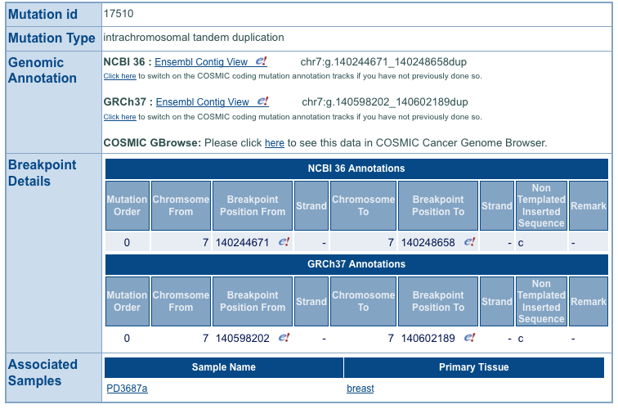

Cosmic: Breakpoints

Slide 14
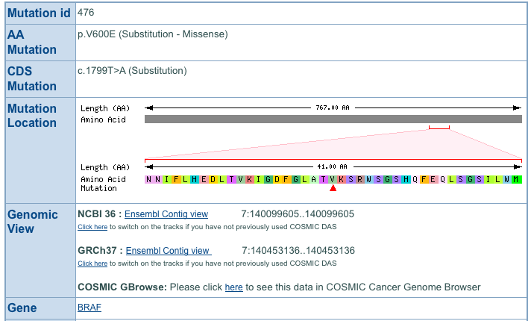
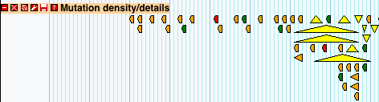
Cosmic: Mutations

Slide 15
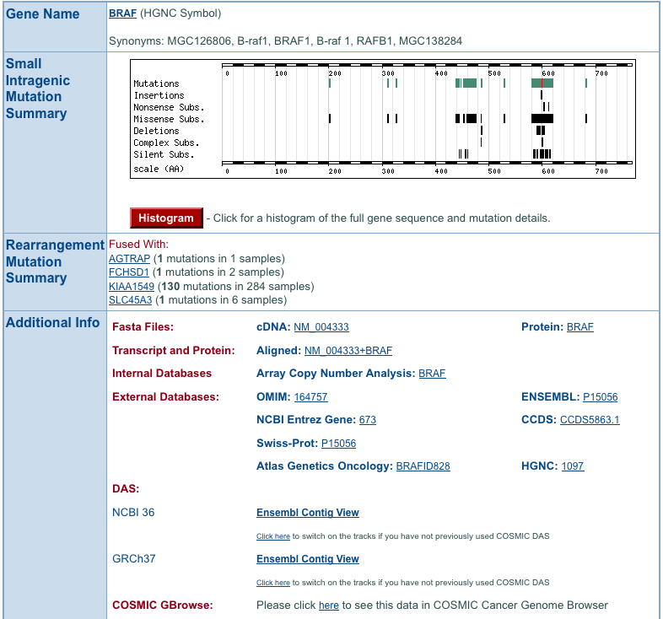

Cosmic: Genes

Slide 16
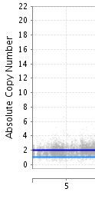
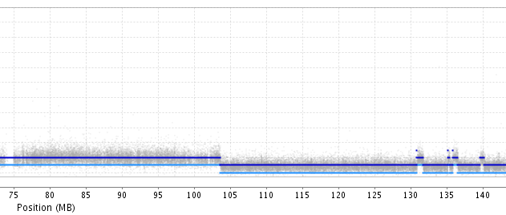
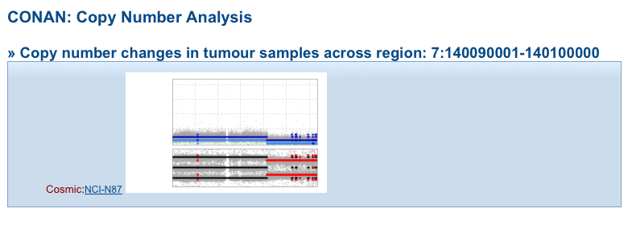
Copy Number Profiles

Slide 17
Future Development
Embed cosmic gbrowse in some cosmic web pages
-- replace old and slow drawing code
-- extend functionality
Current version is a summarised view of whole cosmic dataset
but we need to be able to display subsets of data
How can we display all mutations for a specific sample or group of samples, or from a specific tissue or tumour type?
Too many for a static list of data sources, but there is a neat trick ..
Define data source in the URL, eg sample COLO-829
http://www.sanger.ac.uk/fgb2/gbrowse/sample_COLO-829

Slide 18
Future Development
GBrowse.conf … _x0019_(need atleast 2.09)
see http://gmod.org/wiki/GBrowse_2.0_HOWTO
"Using Pipes in the GBrowse.conf Data Source Name"
[=~sample_.+]
description = Cosmic Database v48 (sample filtered)
path = /gbrowse/bin/source_config.pl -sample $1 |
# path points to a script which generates the config
# sample name ‘COLO-829’ is passed to the script from regular expression
# track configuration generated for data source COLO-829 …
[Mutations]
remote feature = http://…/cosmic_export.cgi?sample=COLO-829
# cgi script returns COLO-829 mutation data from COSMIC

Slide 19
GBrowse fixes/enhancements
remote feature
  perl callbacks cannot be used until Safe::World is fixed
init_code
  perl callbacks defined with init_code not accessible from slaves
BAM/SAM read sorting by similarity to reference
GC plots can give >100% values

Slide 20
Summary
CGP committed to using GBrowse
-- internal browser for next gen sequencing data
-- external browser for COSMIC data
genomic view of mutations, breakpoints and copy number data
COSMIC GBrowse to be released soon - 22/9/2010 ?
CGP involvement in GBrowse development
  -- new developer recruited
-- details still being discussed

Slide 21
Credits
Sanger: COSMIC Group
db - Simon Forbes, Mingming Jia, Rebecca Shepherd
web - Nidhi Bindal, [Prasad Gunasekaran]
Cancer IT Group:
Kairan Raine, Jon Teague, Adam Butler
Systems Support Group: Tim Cutts
DBA team: Tony Webb
Web Team: James Smith, Paul Bevan
GMOD: Gmod-gbrowse list

