Slide 1

Textpresso
Application and Extensibility
Eimear Kenny
GMOD Meeting, April 2004

Slide 2
Textpresso Advances
Application:
Advanced lit. search tool for curators
Semi-automated curation tasks
Automated curation tasks
Extensibility:
Implementation of Textpresso for yeast lit.

Slide 3
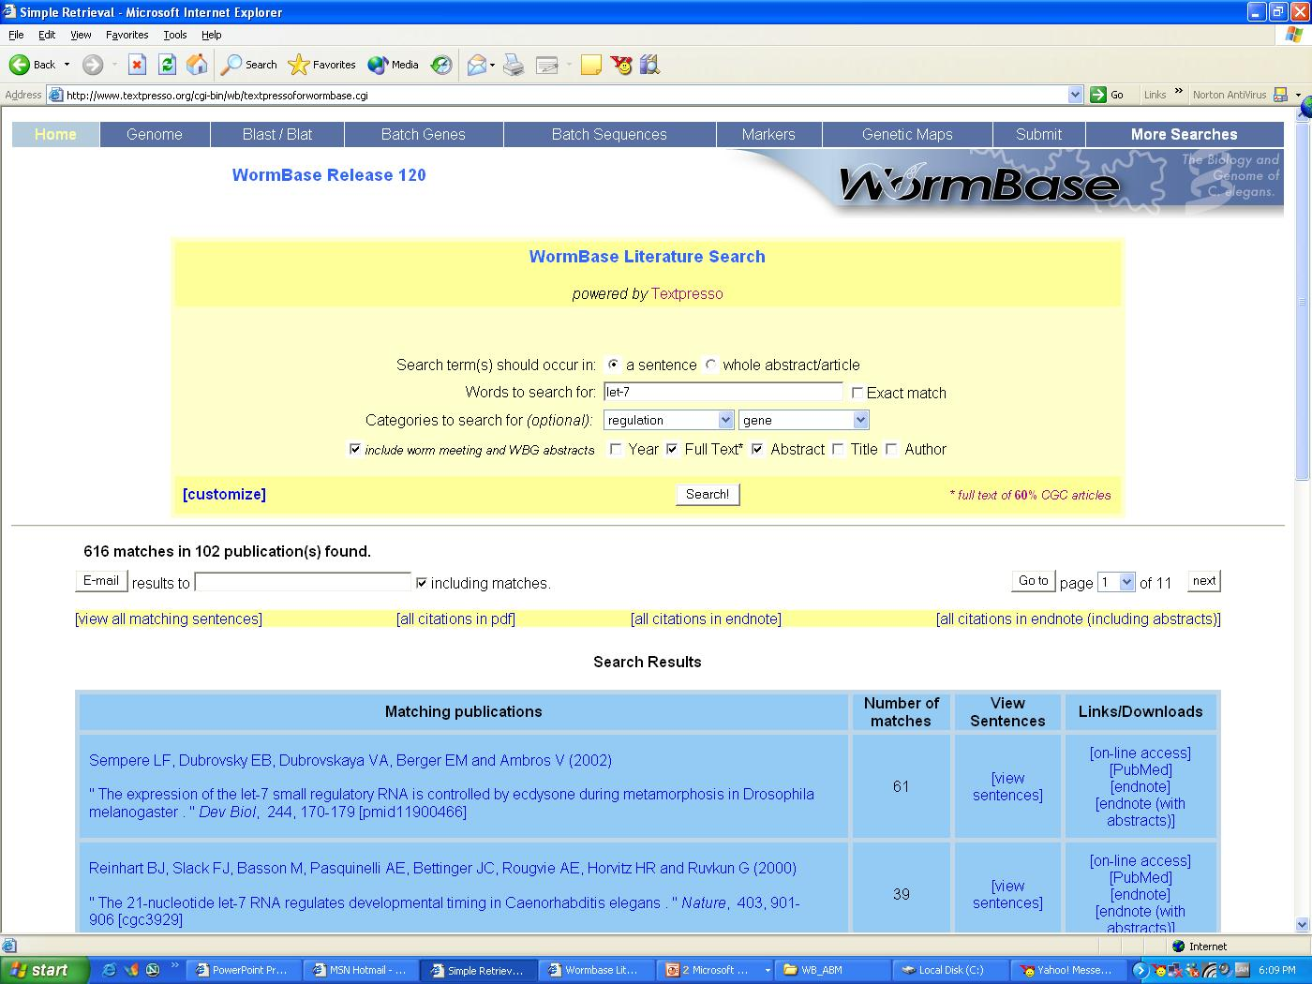
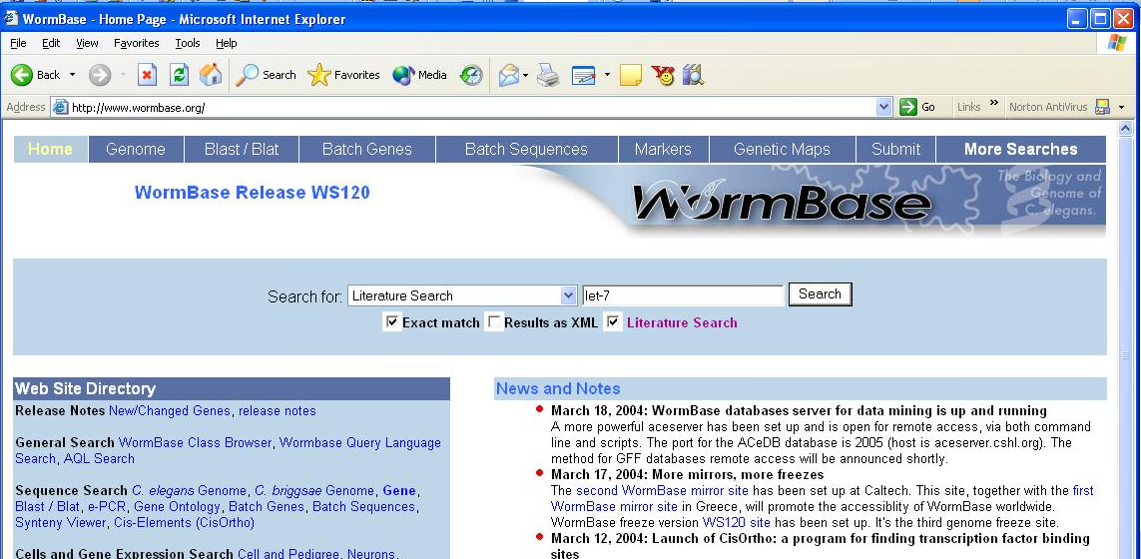

Slide 4
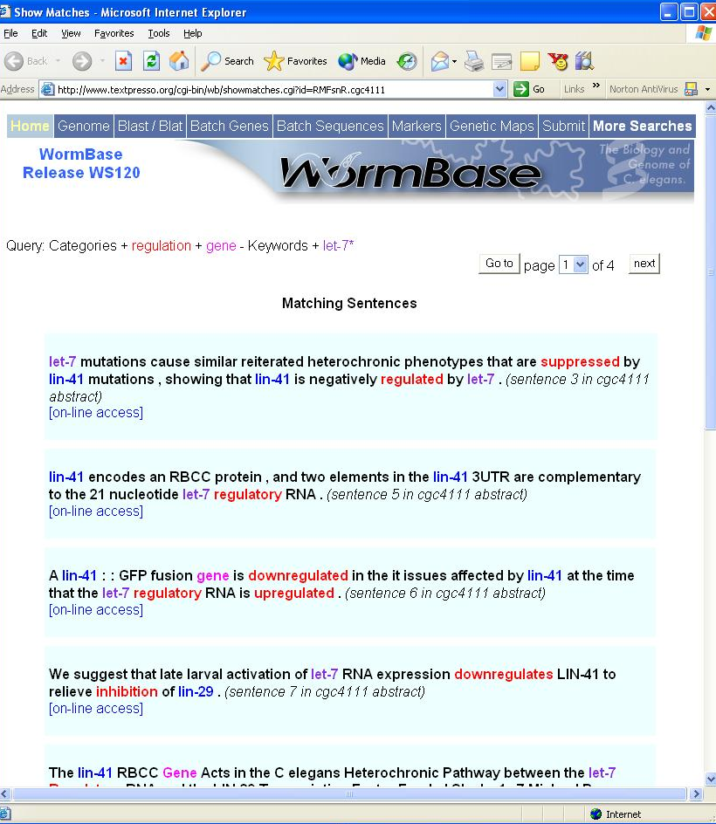

Slide 5
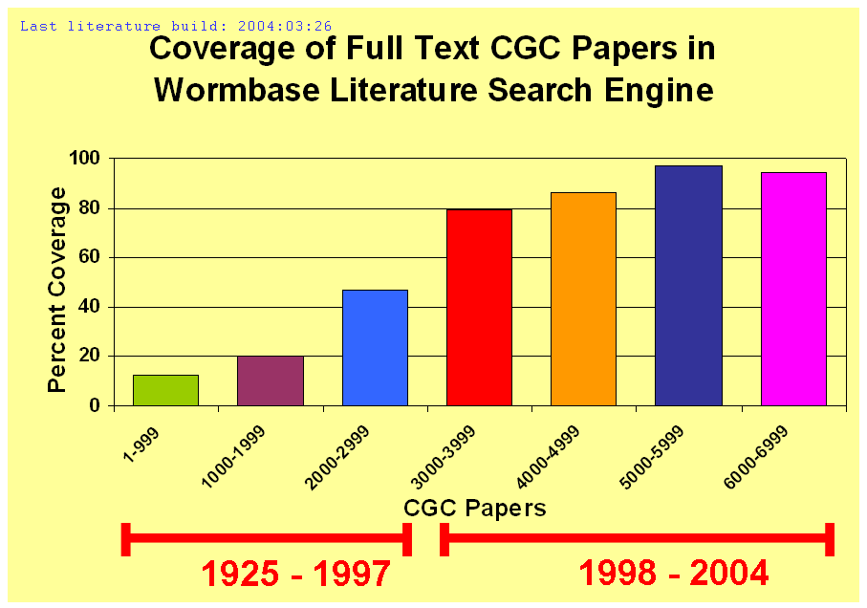

Slide 6
 |  |  | ABSTRACT |  |  |  | FULL TEXT
Datatype | Human | Search term | True hits | Total hits | Recall | Precision | True hits | Total hits | Recall | Precision
Expression data | 327 | express* | 221 | 398 | 67.6% | 55.5% | 327 | 901 | 100% | 36.3%
Mapping data | 36 | map* | 0 | 51 | 0% | 0% | 31 | 482 | 86.1% | 6.4%
RNAi data | 220 | rnai | 60 | 84 | 27.3% | 71.4% | 210 | 353 | 95.5% | 59.5%
Transgenes | 95 | transgenes* | 8 | 23 | 8.4% | 34.8% | 69 | 381 | 72.6% | 21.7%
TOTAL | 678 |  | 289 | 556 | 42.6% | 52% | 637 | 2,117 | 94% | 30.1%
Notes:
965 journal articles were read by human curators at Wormbase and flagged for different types of information. For example, 163 of the 965 papers contains data on antibodies and 327 of the 965 contained information on gene expression. Simple keywords where used to search both abstracts and full text and the returned hits were compared to the human curated papers. Recall is the percentage of correct papers returned by the searches that were flagged by humans (the recall column). Precision is the percentage of correct papers returned by the searches compared to the total number of papers returned by the searches (the precision column). Using automatic keyword searches on the abstracts of the papers in the test set, only ~45% of the papers for the different data types were retrieved overall. The same keyword search on the full text of the papers retrieves > 90% of papers for the different data types. For some data types such as Antibody data, Mapping data and Transgenes, information is rarely contained in the abstracts (0% - 9% instance), therefore, full text is required to automatically retrieve this data. Unfortunately, the precision of the return decreases when full text (~30%) is searched compared to abstract (~52%).

Slide 7




Gene
Transgene
“eat-4”
Allele
Cell or Cell Group
“necessary for”
Cellular Component
“Nomarski”
Biological Concepts
Nucleic Acid
Organism
“epipstasis”
Entity Feature
“co-expressed with”
Life Stage
Phenotype
“homologue of”
Strain
Sex
“not”
Clone
Molecular Function
“ZK512.6”
Drugs and Sml Mols
Mutant
“anti-rabbit IgG polyclonal antibody”
Textpresso
Ontology
Association
Consort
Effect
Purpose
Pathway
Regulation
Relationships
Comparison
Spatial Relation
Time Relation
Bracket
Semantic
Involvement
Determiner
Punctuation
Characterization
Method
Conjunction
Pronoun
Biological Process
Action
Conjecture
Preposition
Negation

Slide 8
Gene
“eat-4”,
“ZK512.6”
Transgene
Allele
Cell or Cell Group
Cellular Component
Biological Concepts
Nucleic Acid
Organism
Entity Feature
Life Stage
Phenotype
Strain
Sex
Clone
Molecular Function
Drugs and Sml Mols
“anti-rabbit IgG polyclonal antibody”
Mutant
Textpresso
Ontology
Association
“epipstasis”
Consort
Effect
Characterization
“homologue of”
Pathway
Regulation
Relationships
Comparison
Spatial Relation
Time Relation
Bracket
Semantic
Involvement
“necessary for”
Determiner
Punctuation
Purpose
Action
Method
“Nomarski”
Conjunction
Pronoun
Biological Process
“co-expressed with”
Conjecture
Preposition
Negation
“not”

Slide 9
Gene
Regulation
Regulation
Biological
Process
Biological
Process
Molecular
Function
Gene
….. activation of let-7 RNA expression downregulates LIN-4 to relieve inhibition of lin-29.
<?xml version="1.0" encoding="ISO-8859-1" standalone="no" ?>
<!DOCTYPE article SYSTEM "/var/www/html/textpresso.dtd">
<article> //
<sentence id='s7'> //
<process grammar ='NN' source='textpresso' type='general' biosynthesis='no'> activation</process>
<pposition grammar ='IN' type='of'> of </pposition>
<gene grammar ='JJ' reference='direct'> let-7 </gene>
<text>RNA</text>
<process grammar ='NN' source='textpresso' type='molecular' biosynthesis='expression'> expression</process>
<regulation grammar ='NNS' type='negative'> down regulates</regulation>
<function grammar ='NNP' reference='direct' source='textpresso' protein='yes'> LIN-41 </function>
<pposition grammar ='TO' type='to'>to </pposition>
<text>relieve</text>
<regulation grammar ='NNS' type='negative'> inhibition </regulation>
<pposition grammar ='IN' type='of'> of</pposition>
<gene grammar ='NNP' reference='direct'> lin-29 </gene>
<text>. </text>
</sentence> //
</article>
© Textpresso, 2004
Notes:
The word categories work by recognizing words and phrases in the text and labeling them appropriately.
The underlying data is marked up in xml.

Slide 10
Using Textpresso to expediate curation
Find sentences from the literature that
describe genetic interaction!
>= 2 named “Gene”
&&
(>= 1 “Association”
||
>= 1 “Regulation”)

Slide 11
Interaction Type | A | B | C
Genetic Interactions | 1(0.5%) | 13(6.5%) | 39(19.5%)
Possible Genetic Interaction | 3(1.5%) | 6(3%) | 14(7%)
Non-genetic Interactions | 4(2%) | 6(3%) | 12(6%)
No Interaction | 192(96%) | 175(87.5%) | 135(67.5%)

Slide 12
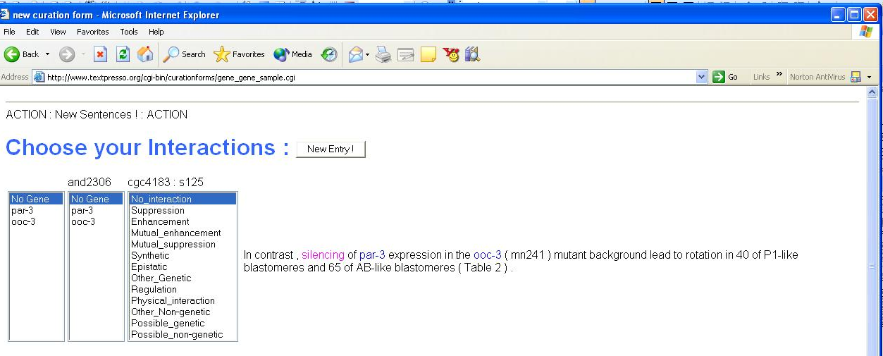

100 sentences per hour!
Notes:
Wormbase curator interface for expediated extraction of gene-gene interaction from the sentences returned by Textpresso.

Slide 13
1,986 articles ➔ 17,851 sentences
1,224 Regulation 6.5%
127 Physical Inxn 0.7%
31.4% Interaction Information
1,825 Possible Inxn 9.8%
3,702 Genetic Inxn 19.8%
68.6% NO Interaction Information
Notes:
Column A = 200 randomly chosen sentences
Column B = 200 randomly chosen sentences that mention 2 or more gene names
Column C = 200 randomly chosen sentences that were returned by the textpresso query on the previous slide (i.e. that mention 2 or more named genes and at least one term from either the association or regulation categories)
Genetic Interaction = a sentence where one or more named genes were described as effecting the phenotype of another named gene or genes by suppression, enhancement, epipstasis, complementation or some other genetic method.
Possible Genetic Interaction = a sentence that strongly suggests genetic interaction as defined above, but did not quite meet the criteria (i.e. if no phenotype was mentioned or it was unclear exactly which genes where participating.
Non-genetic Interaction = a sentence that discussed interaction, but not genetic interaction as defined above, i.e. a sentence that described genetic regulation or physical interaction
No Interaction = a sentence that only vaguely discussed interaction or had nothing to do with genetic interaction.

Slide 14
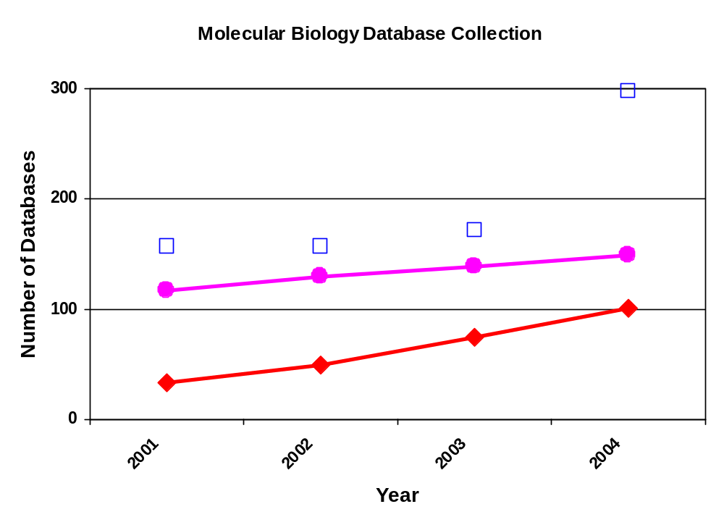
Did you know ?
Seqn/Str
Disease/Expr/Mut/Other
MOD’s
“The Molecular Database Collection” (NAR - 2001, 2002, 2003, 2004)

Slide 15


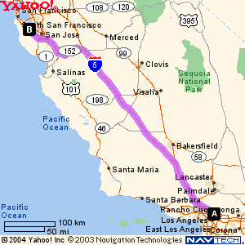

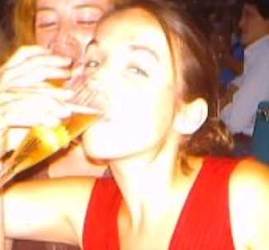


Textpresso goes to Stanford ……
Rob Nash
Stan Dong
Rama Balakrishnan
Christopher Lane
Eurie Hong
Mike Cherry
Eimear Kenny

Slide 16
Implementing Textpresso for Yeast
Worm Build
Yeast Build
>6,000 Papers
(~4,000 full text)
1 week build
- add papers (~24 h)
- change ontology (rebuild)
8G database
Linux
>60,000 Journal Article
(~15,000 full text)
>2 week build
-add papers (~3d)
-change ontology
(rebuild)
30G database?
Solaris

Slide 17
Adapting Textpresso Ontology for Yeast
Worm biology →→ Yeast biology
Gene →→ Gene
Allele →→ Allele
Transgene →→ Transgene
Clone →→ Clone
Strain →→ Strain ??
Phenotype →→ Phenotype
Method →→ Method
Cell Cycle
Life Stage
Life Cycle
Cell Name or Group
Sex

Slide 18
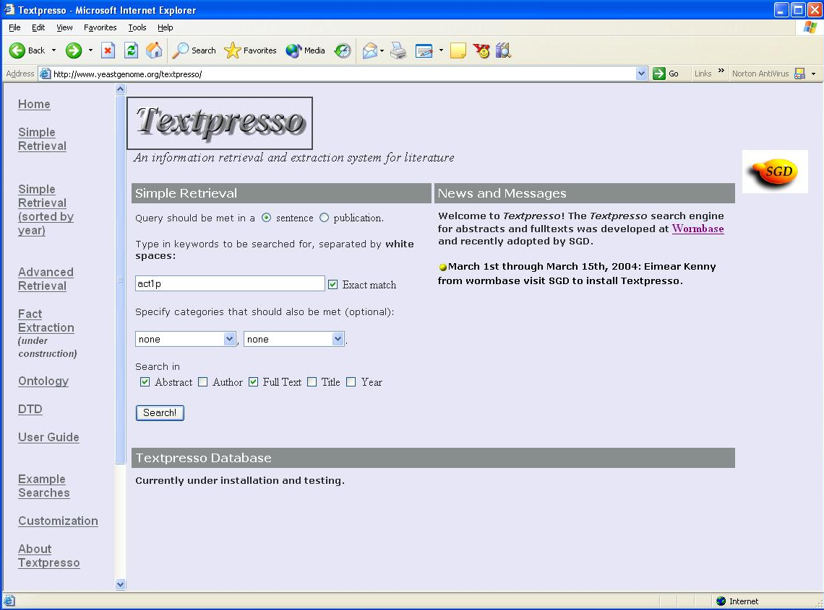

Slide 19
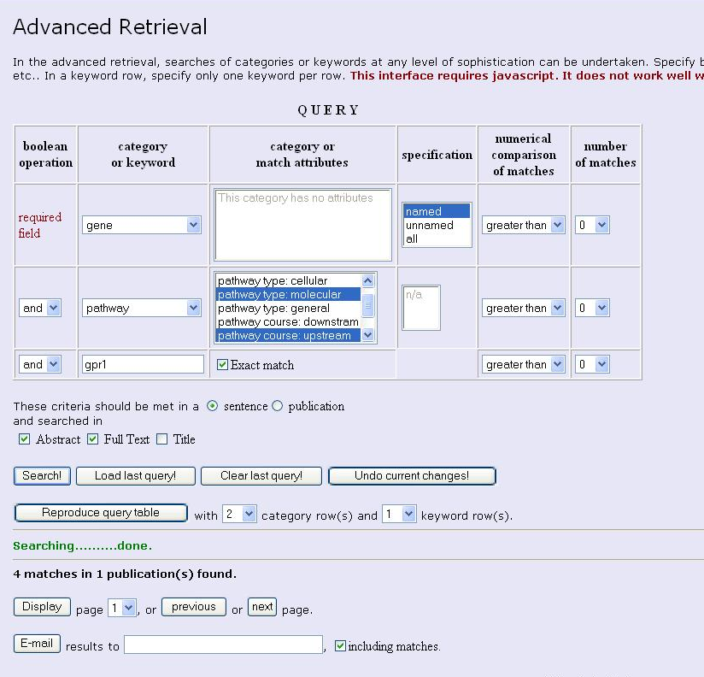
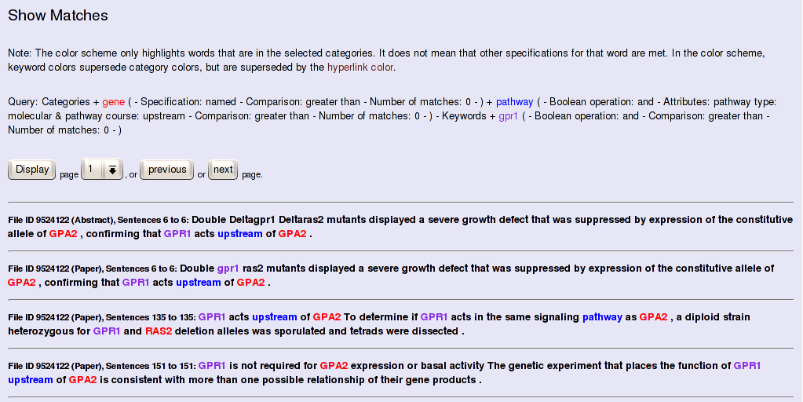

Slide 20
Implementing Textpresso for MODS
Worm Build
Yeast Build
Fly Build
>6,000 Papers
(~4,000 full text)
1 week build
- add papers (~24 h)
- change ontology (rebuild)
8G database
Linux
>60,000 Journal Article
(~15,000 full text)
>2 week build
-add papers (~3d)
-change ontology
(rebuild)
30G database?
Solaris
>140,000 Journal Article
(? full text)
? build
-add papers (?)
-change ontology
(rebuild)
?G database
Solaris

Slide 21
Gene
Transgene
Allele
Cell or Cell Group
Anatomy
Cellular Component
Biological Concepts
Nucleic Acid
Organism
Entity Feature
Life Stage
Life Cycle
Phenotype
Strain
Sex
Clone
Molecular Function
Drugs and Sml Mols
Mutant
1. Chromosomal aberrations?
(inversion, polytene, substitution,
deletion, balancers, p elements,
hypomorphs, hypermorphs)
Textpresso
Ontology
Association
2. Stresses?
(nutrition, temperature, sleep)
Consort
Effect
Purpose
Pathway
Regulation
Relationships
Comparison
Spatial Relation
Time Relation
Bracket
Semantic
Involvement
Determiner
Punctuation
Characterization
Method
Conjunction
Pronoun
Biological Process
FOR FLY
Action
Conjecture
Preposition
Negation

