Slide 1
PubSearch
Pub* Tools Website: http://pubsearch.org
Literature Curaotors’ Website: http://biocurator.org
Danny Yoo, Iris Xu, Behzad Mahini

Slide 2
Literature Curation
Capturing biological information and knowledge from the literature into databases
All model organism databases do it
Time-consuming and susceptible to inconsistencies
Will become more and more necessary as the amount of computationally derived information increases (more need for bench-mark information)

Slide 3
Some Literature Curation Use Cases
Get relevant papers according to X
Group papers according to X (primary triage)
Find all relevant data to curate in a paper
Find all relevant papers to curator for a data object (e.g. gene)
Find all genes that are described in new papers since the last curation
Find the status of a paper or a gene in the curation pipeline
Summarize the description of biological object X from a list of papers that describe it
Associate to relevant attributes of object X from a list of papers that describe it
Associate relevant database objects and their attributes from paper X

Slide 4
Some Literature Curation Issues
A lot of papers
Papers outside the domain of expertise of a curator
Badly written papers and bad data
Consistency and transparency of annotation methods/rules/guidelines

Slide 5
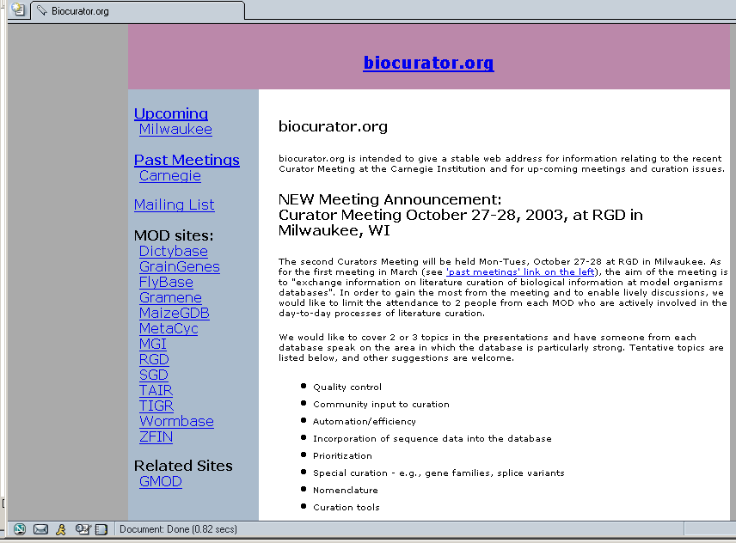
Literature Curaotors’ Website: http://biocurator.org

Slide 6
2nd Literature Curation Meeting!!!!
Monday-Tuesday,October 27-28
at
Rat Genome Database, Milwaukee, WI
Possible Topics for Discussion
Quality control
Community input to curation
Automation/efficiency
Incorporation of sequence data
Prioritization
Special curation - e.g., gene families, splice variants
Nomenclature
Curation tools
for more information go to bioucurator.org
or email sbromber@mcw.edu

Slide 7
Pub Suite
PubSearch is part of the Pub Suite of programs
PubFetch for literature download (RGD)
PubSearch for literature annotation (TAIR)
PubTrack for curation tracking (RGD)

Slide 8
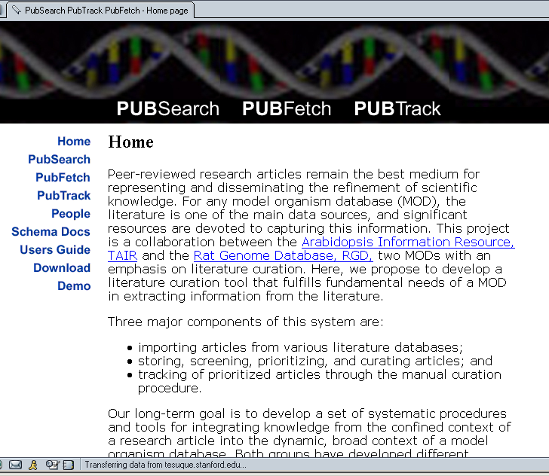
Pub* Tools Website: http://pubsearch.org

Slide 9
What is PubSearch?
A web application and database for literature curation
Stores complete literature information
  References, abstracts, full text articles (pdf)
Stores biological information
  Genes, proteins, descriptions
Stores ontologies (GO Terms)
Links literature, GO terms and biological information.
Assists manual curation with fast, automatic matching (using suffix trees indicer)
Is password-protected, and easy to set up and use.

Slide 10
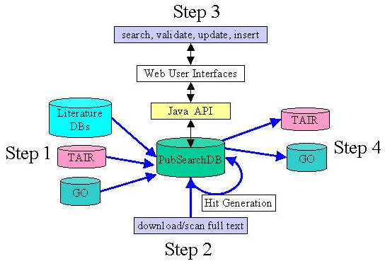
PubSesarch System Architecture

Slide 11
Underlying Logic of PubSearch DB
Binds to
Involved in
Functionas as
Expressed in
Is subunit of
Related to
Required fo
Located in
Interacts with
Regulates
More…
molecular object
descriptive vocabulary
molecular object
Subject term
Object term
manual
automatic
automatic
Paper

Slide 12
Some Recently Added Features
Binary installation package (0.5) that includes Java Swing-based installer, bulk XML loaders for CVs, articles, and genes, stand-alone db schema, sample data
Simplified user interfaces and rehauled underlying software (Java classes and servlets) for searching
Full-text search engine (Apache’s Lucene engine)
Allele, germplasm, and phenotype curation function
Propagate annotation function
~10 new relationship types (now ~30 in total) handling Gene-to-Gene and Gene-to-Term annotations.
  e.g. protein modified with, has protein-RNA interaction with
Generic schema implemented in MySQL4.0
Lots of bug fixes, code-clean up, and unit tests

Slide 13
PubSearch Usage at TAIR
Curation of data objects from the literature
Curation done in data-object centric manner
Current data objects handled: genes (at the transcript level), alleles, germplasms.
Current relationships handled: gene2term, gene2gene
Curation of new terms
Curation of papers

Slide 14
TAIR Installation Statistics (9/12/03)
20,272 literature references
14,920 research papers with abstracts
8,642 full-text papers (58%)
16,956 controlled vocabulary terms
105,671 hits between terms and articles (2359 terms)
38,010 gene names
29,841 hits between genes and articles (4268 genes)
14,943 hits validated
  (70% valid, 29% not valid, 0.5% maybe)
11,497 manual annotations to 5981 genes from 2113 articles
38 relationship types for gene2term and gene2gene
103 evidence types

Slide 15
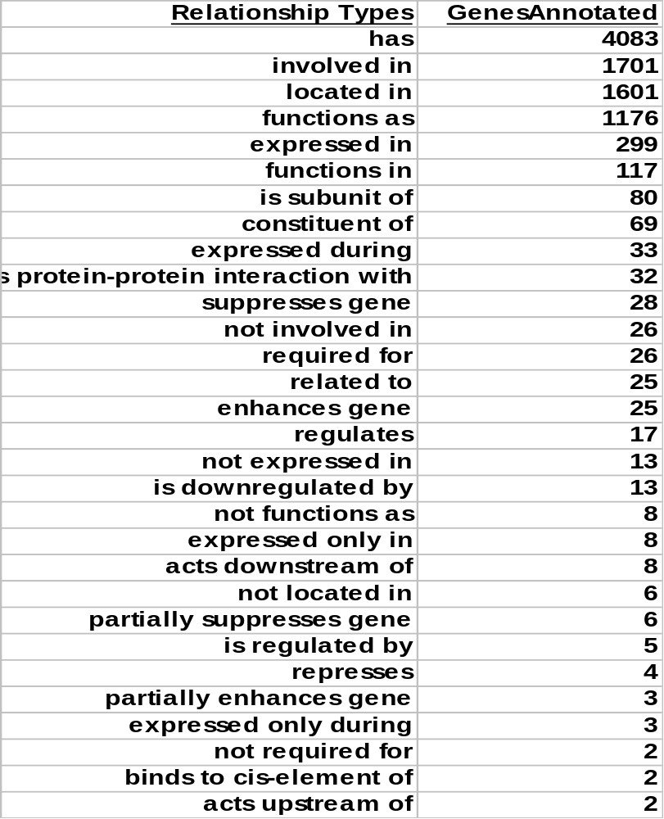

Slide 16
PubSearch Status from RGD
Installed on Mac OS X
Genes, Literature loaded from RGD
  Highlighted certain dependencies on TAIR data
  New generic loading scripts developed by TAIR
Hit generation between articles and ontology terms (GO) functioning, still resolving Gene-Article matching and certain user interface issues related to loading non-TAIR data.
Upcoming work:
Implementing new Generic PubSearch and loading scripts then testing with RGD curation staff.
Connect PubFetch BioMOBY webservice to PubSearch
Test PubSearch on Oracle

Slide 17
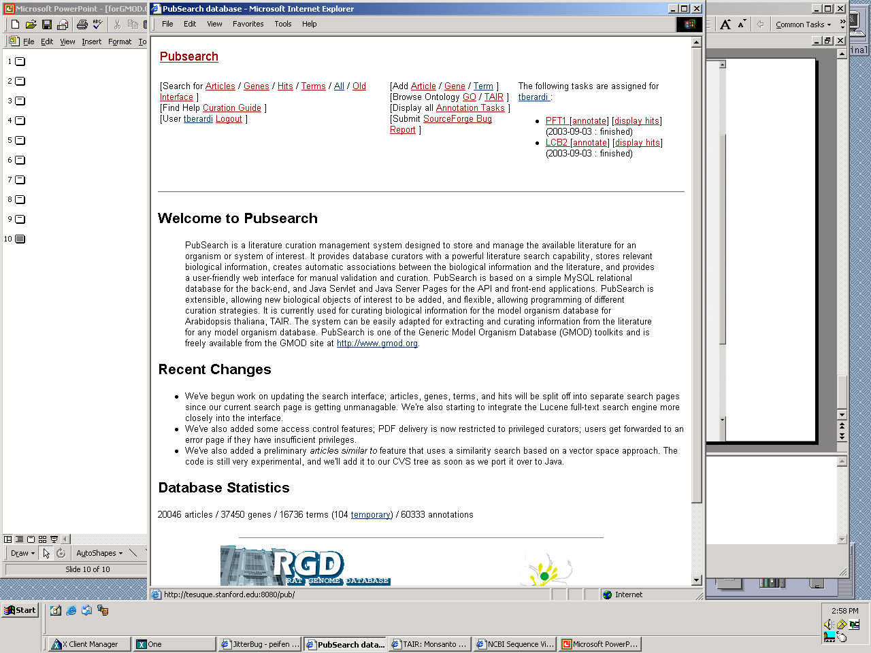
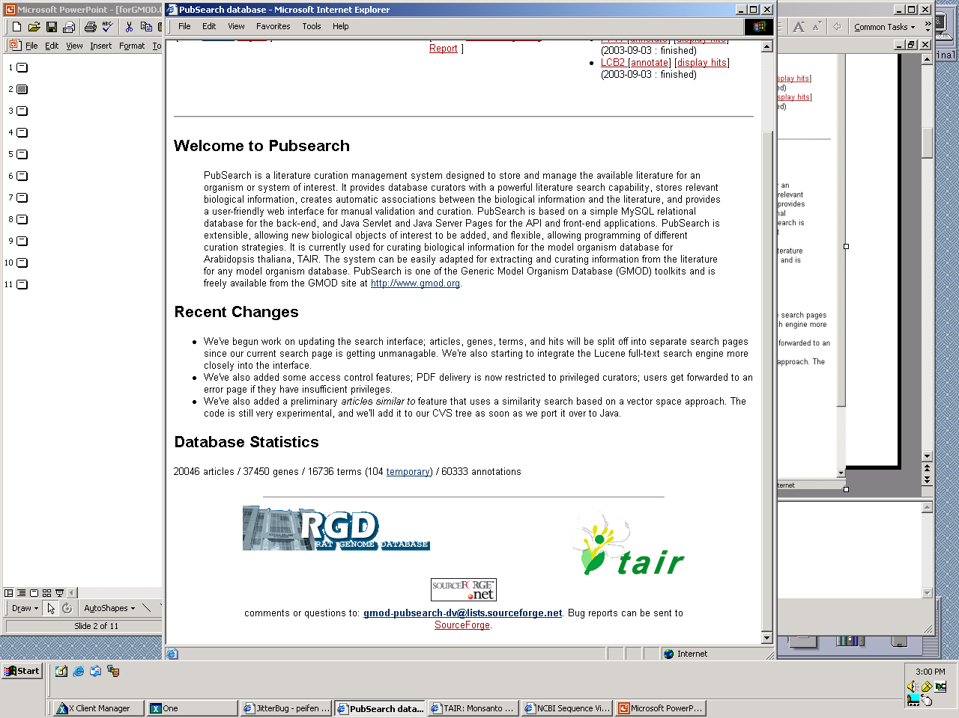

Slide 18
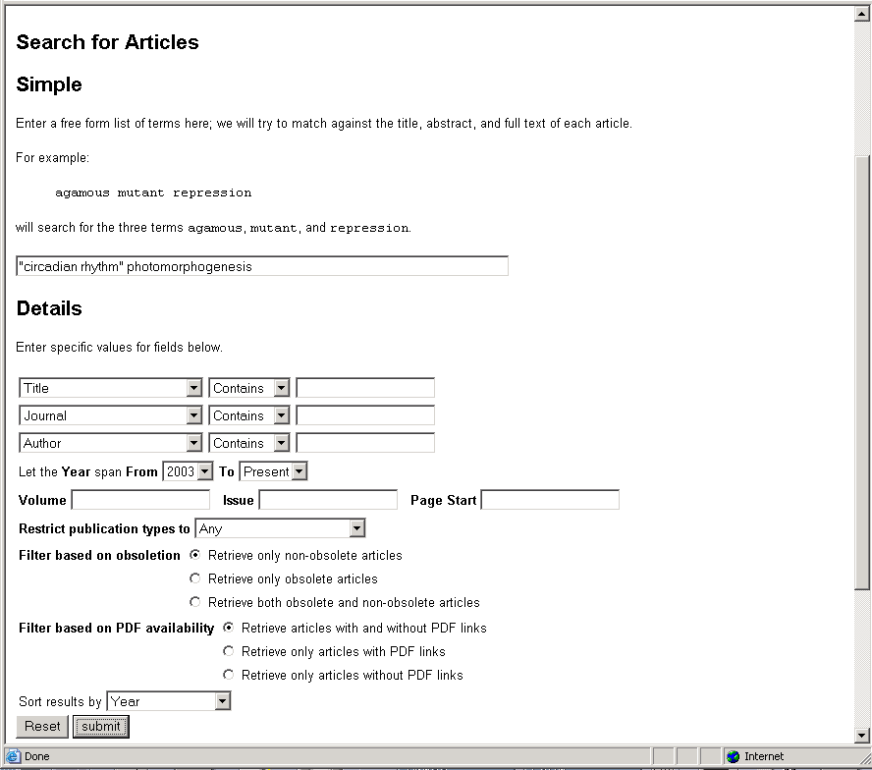
Notes:
Full text searching in combination with other parameters makes finding papers much easier.

Slide 19
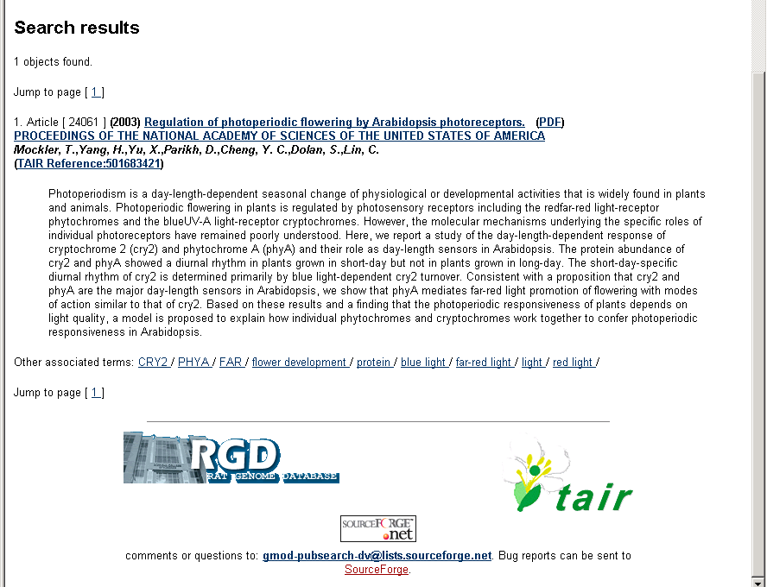
Notes:
Neither ‘circadian rhythm’ nor ‘photomorphogenesis’ is in title or abstract, they are in the full text. This is a powerful way to search.

Slide 20
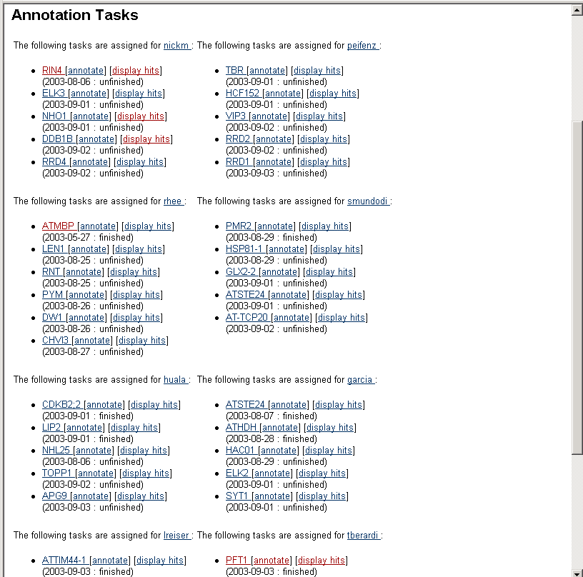
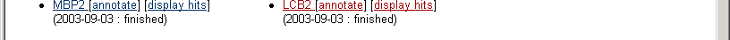

Slide 21
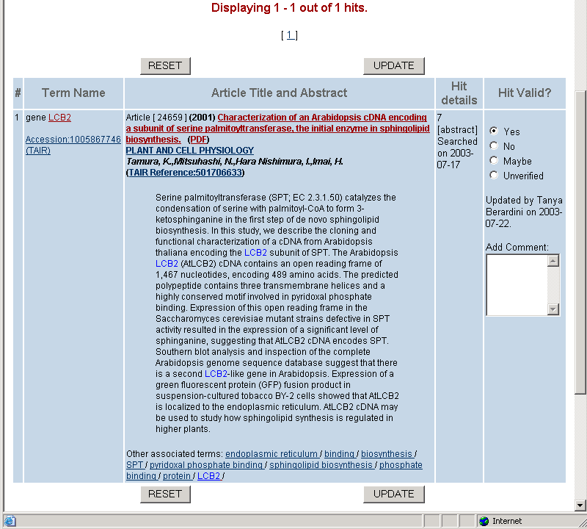

Slide 22
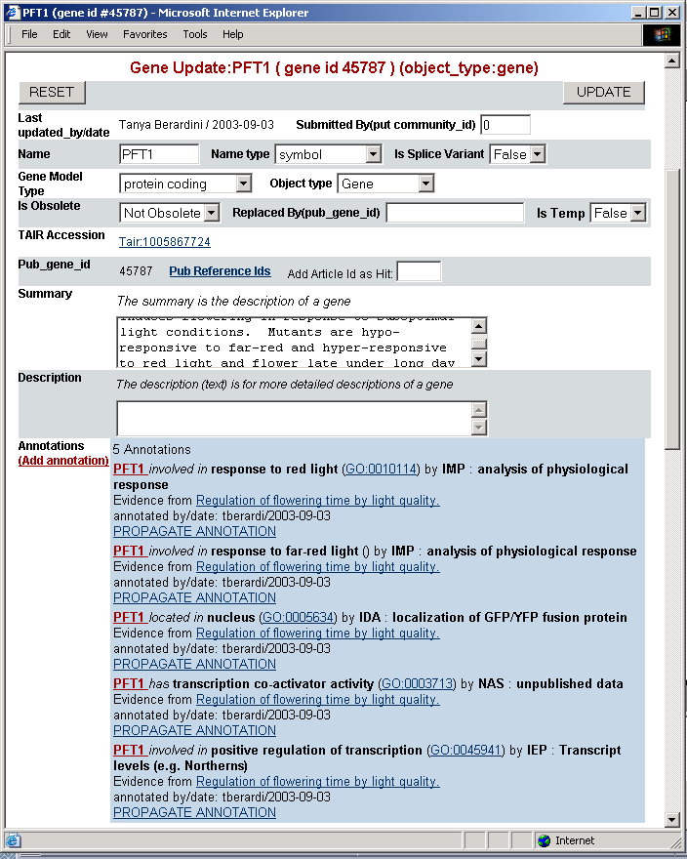

Slide 23
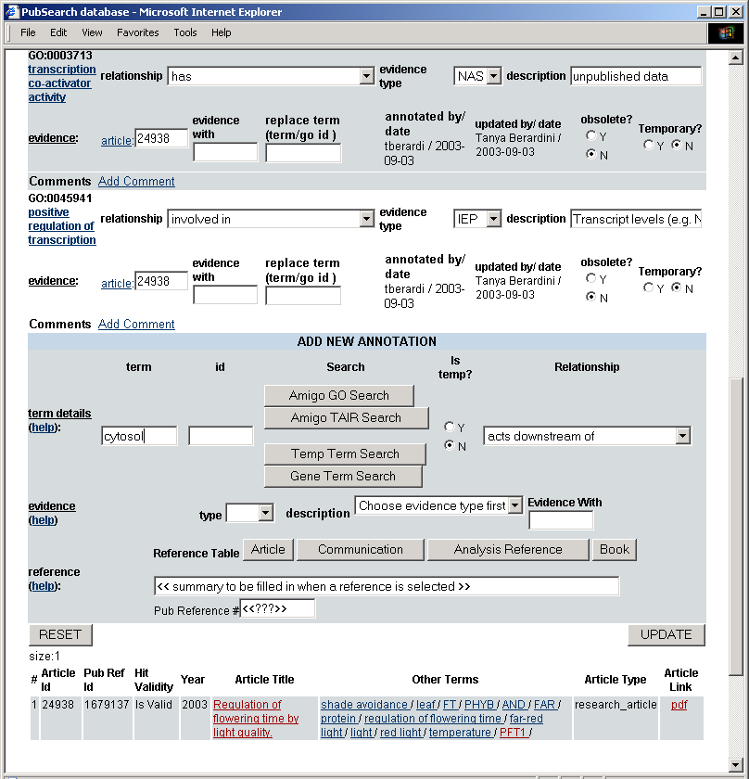

Slide 24
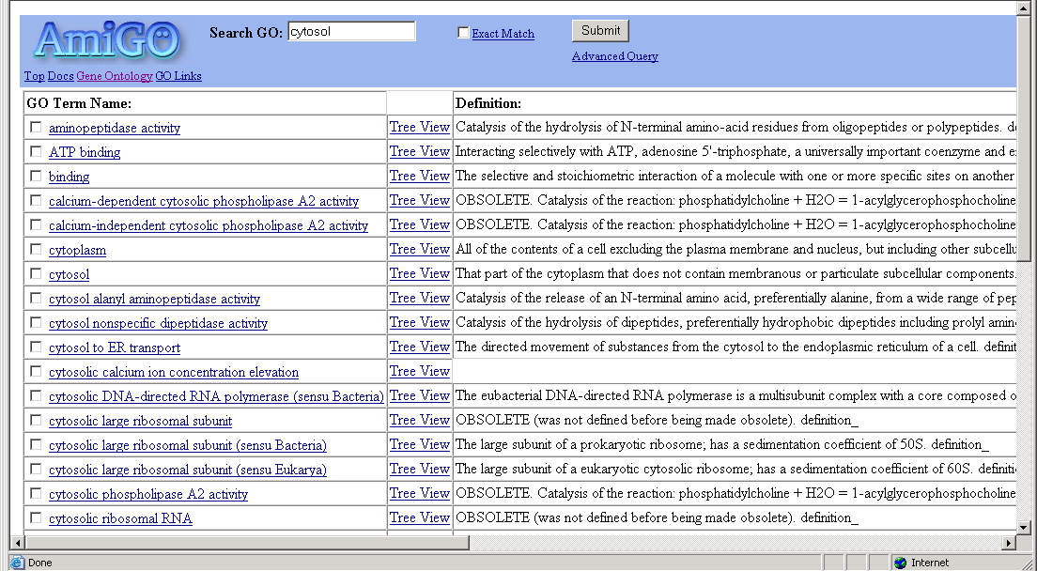

Slide 25
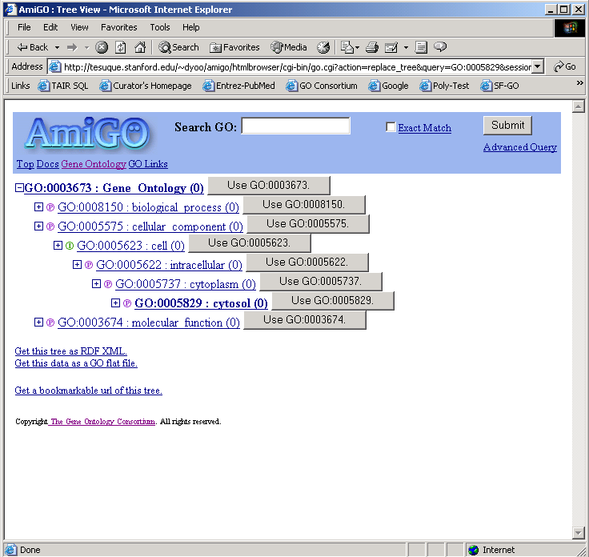

Slide 26
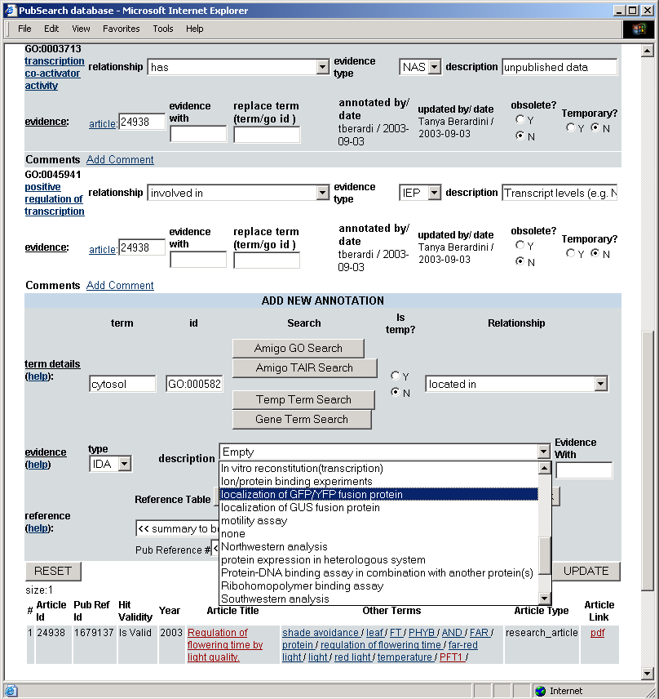

Slide 27
Future directions
Update software to the generic_pub schema
Migrate DB to PostgreSQL
Implement HistoryTracking
DB Admin Web User Interface
Implement compound annotation function (using multiple terms)
Investigate approximate searching for term-article hit generation

Slide 28
Acknowledgements
Programmers:
Iris Xu
Danny Yoo
Behzad Mahini
Curators
Eva Huala
Lukas Mueller
Leonore Reiser
Peifen Zhang
Marga Garcia-Hernandez
Tanya Berardini
Suparna Mundodi
Nick Moseyko
Brandon Zoeckler
Webmaster:
Julie Tacklind
RGD:
Simon Twigger
Jing Li
Vijay Narayanasamy
Susan Bromberg
Norie de la Cruz

