Slide 1
Human Annotation @ the JGI
Astrid Terry
Automated annotation
&
Manual Curation

Slide 2
Mandate
Responsible for human chromosomes 5, 16, and 19
Roughly 4500 gene loci
Strategy: seek best automated models using a hierarchy of evidence. Manually review high quality evidence (human mRNAs) for which no faithful models can be created automatically
As fast as possible!

Slide 3
Automated Pipeline Hardware
can run multiple non-dependent steps in parallel
broken into commands of varying length
~ 100000s-1,000,000 cmds/jobs issued

Slide 4
Automated Pipeline Analysis

Slide 5
Methods
Map all human mRNAs in Genbank with BLAT against sequence scaffold.
  Attempt to turn these mRNAs into faithful gene models
  Respect coding sequence declared in Genbank, or use longest ORF.
  allow canonical splices
    GT…AG 99.6%
    GC…AG 0.4%
    AT…AC 0.01%
  Flag for review evidence for any single base indels (helps correct finishing errors)
Blastx alignments of known protein Dbs, seed GeneWise models
Ab inito model predictions using FgenesH++ and Genscan

Slide 6
useful datasets & analysis
RefSeq & Human cDNA
Mouse cDNA set is large, and more Rat data every day
Mouse & Rat IPI
  Build model using blastx alignments to seed GeneWise
Extend with partial human mRNAs (ESTs)
Vertebrate mRNA is also a useful dataset for validation/confirmation but not essential (Primate data until recently has not been available in useful quantities)
First EF: First Exon Finder (M Zhang) vs CpG Islands
Evolutionary conservation (Vista, dcode, in-house tools)

Slide 7
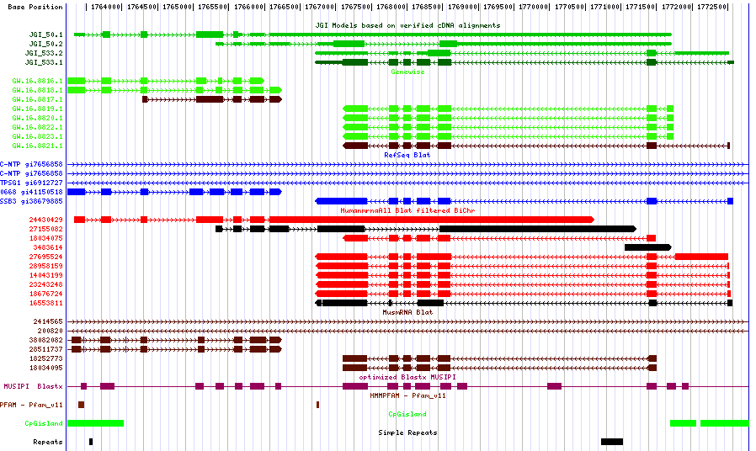
Annotation Browser

Slide 8
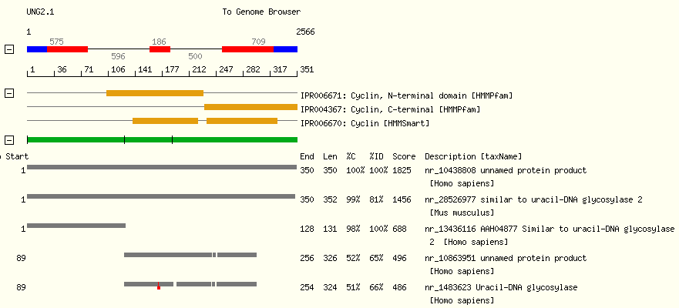
Functional annotation
Precomputed alignments and domain finders allow easy viewing of predicted peptide’s properties
Web interfaces for assigning putative functions based on homology, domains

Slide 9
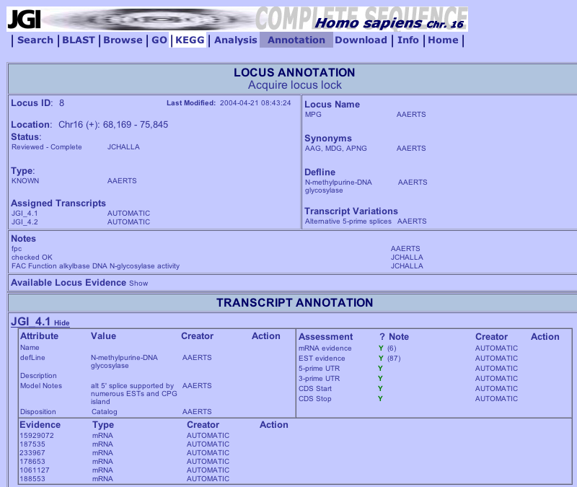
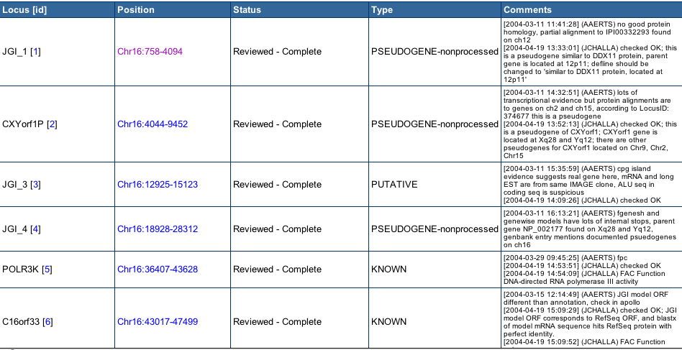
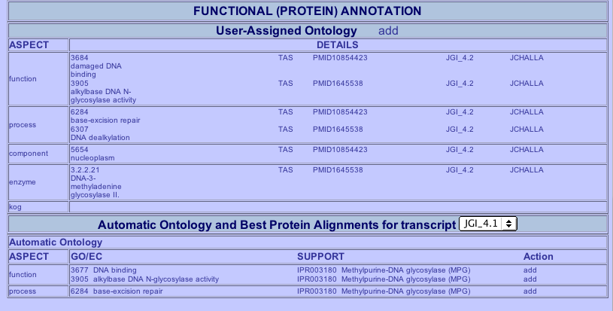
Tracking Evidence

Slide 10
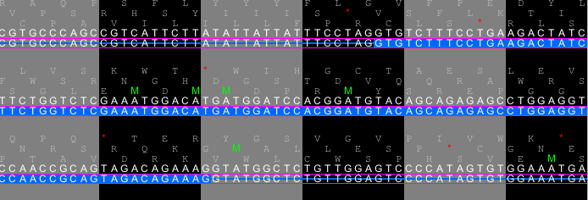
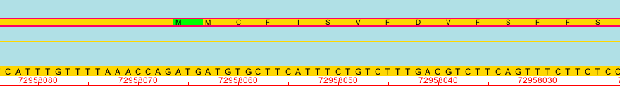
Picky details
Allows manual curation of problematic gene models
View DNA sequence, splice sites and all 6 frames of translation
Change errors propagated by automated pipeline or error in dataset
Check Start, Stop and ORF

Slide 11
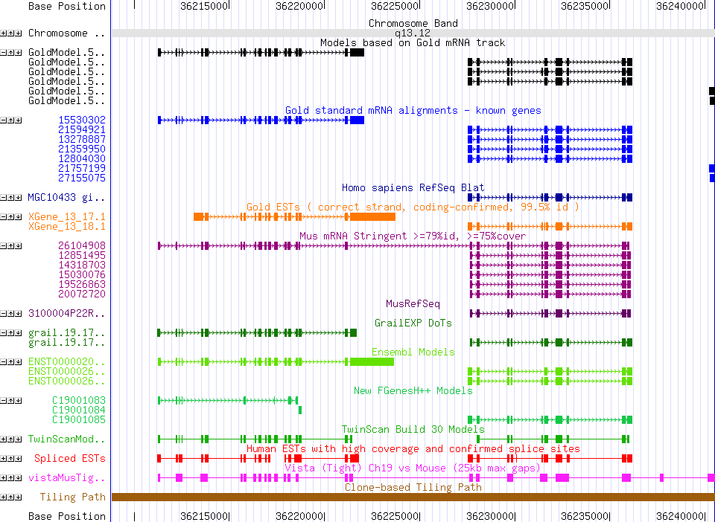
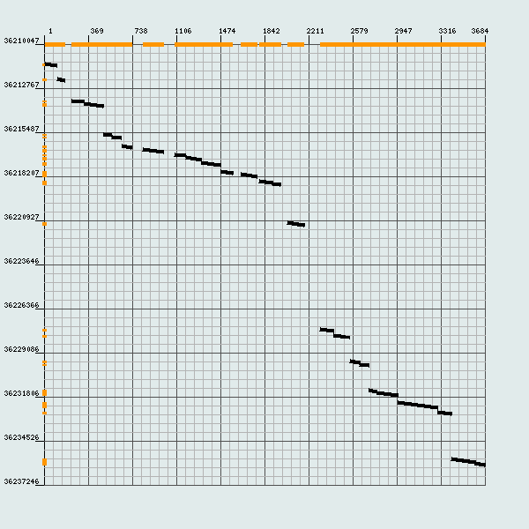
Two or one?
Riken mouse cDNA suggests that the human models in this region belong to a single locus
Mouse mRNA (tblastx)

Slide 12
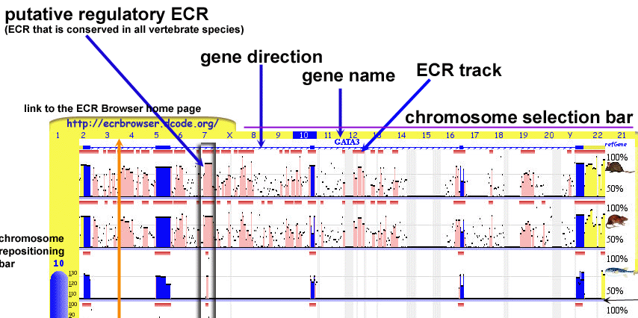
www.dcode.org
Evolutionary conservation profile of the human, mouse, rat, chicken, frog, fugu, tetraodon, zebrafish, and drosophila genomes.

Slide 13
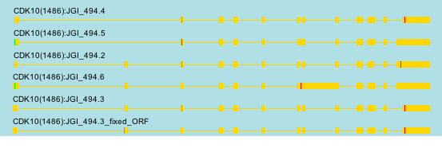

Alternate CTG start
Sometimes CTG is used as the start instead of ATG
CDK10 has 2 isoforms in RefSeq
Fixed ORF most closely matches RefSeq

Slide 14
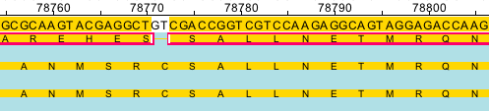
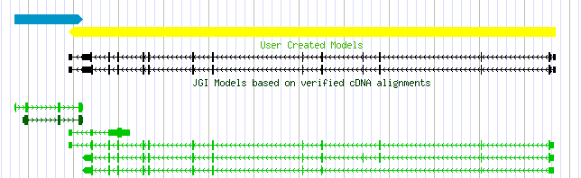
Frameshift Deletion
A frame shift deletion in the genomic sequence results in poor matches to known proteins
  Match the known protein exactly
  show the actual translation
Depends on support for each scenario

Slide 15
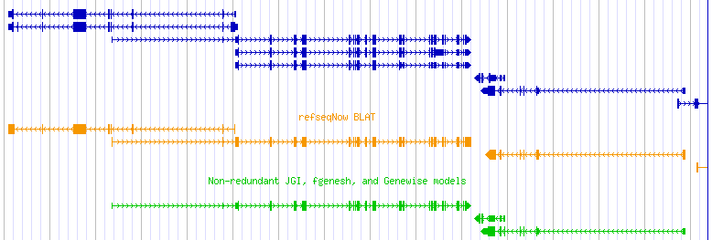
Overlapping divergent transcripts
Only partially overlapping transcripts have very different CDS but share common exons
RefSeq is extended
Chr19 genes are densely packed on both strands

Slide 16
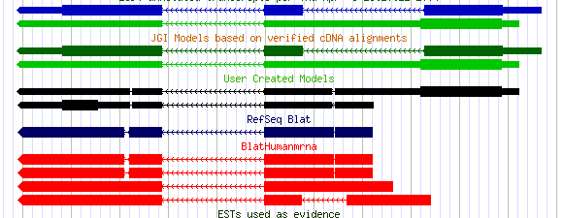
Alternate splicing
distinguishing incompletely processed mRNAs from splice variants.
Retained intron interupts ORF
Differences with RefSeq, possibly due to variation in population.

Slide 17
Pseudogenes
Disabled gene that has an insult- stop or frameshift that interrupts or changes the ORF from the parent gene
Polymorphic sites or transcripts indicate that locus activity may vary between individuals
Processed
  Due to retro transposition of RNA into genomic DNA.
  Single exon, polyA, lacks promotor/CpG, degraded condition
Non-processed
  Due to duplication, subsequently disabled, possible to find parent region
  Generally multi exon, promotor/CpG present

Slide 18
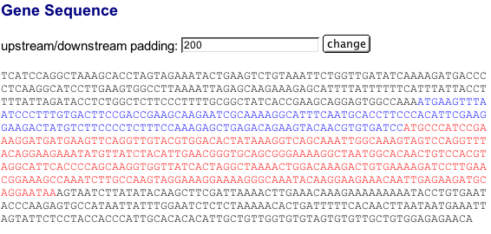
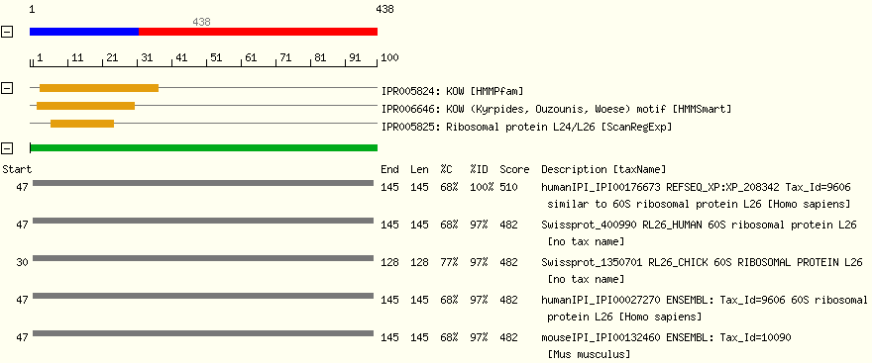
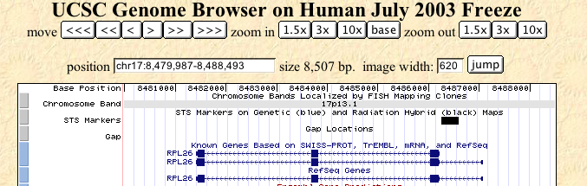
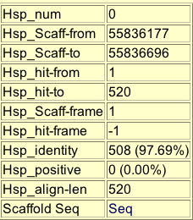
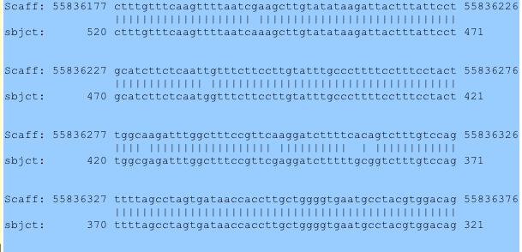
Processed Pseudogenes

Slide 19
JGI Human Chromosome Annotation
Responsible for human chromosomes 5, 16, and 19
Roughly 3,100-4,400 gene loci
size Known Novel Total Pseudo
Ch19 60 Mbp 1320 141 1461 321
Ch5 181 Mbp 825 99 924 556
Ch16 82 Mbp 516 193 709 429
Chr19-published
Chr5 - complete. Paper in progress
Chr16-completed First Pass, should be done in the next month

Slide 20
Acknowledgements
Annotators
Andrea Aerts
Steve Lowry
Joel Martin
Laurie Gordon
Mary Tran-Gyamfi
Gary Xie
Michael Altherr
Jean Challacombe
Cathy Cleland
Nina Thayer
Jeremy Schmutz
Yee Man Chan
Uffe Helsten,
Wayne Huang,
David Goodstein,
Igor Grigoriev
Sam Rash,
Sean Caenapeel
Asaf Salamov
Isaac Ho,
Leila Hornick
Annette Greiner
Victor Solovyev,
Ivan Ovcharenko
Olivier Couronne,
Paramvir Dehal,
Inna Dubchak,
Lisa Stubbs,
and Dan Rokhsar

Slide 21
Gene families
Many gene families have known gene structures but lack extensive mRNA/EST evidence in human
  Olfactory receptors (approximately 40 genes, as many as 150 pseudogenes) -- single exon, seven transmembrane receptors
  KRAB-containing Zn fingers -- single KRAB domain near amino terminal, followed by typically one exon with multiple zinc fingers
  and several other families
Build custom models using expected gene structure using automated methods.
Automatically identify pseudogenes, which are common in tandem gene families.
Such tandem families are hard to model ab initio, easy to run genes together.

Slide 22
Difficult Scenarios
RNAi non-coding locus
Single exon gene.
Encodes 136 aa ORF.
Locus supported by multiple mRNA and EST evidence.
Antisense to TRAP1
No similarities to known proteins.

Slide 23
Human Annotation @ the JGI
Astrid Terry
Automated annotation
&
Manual Curation

