Slide 1


GMOD Meeting
August 6-7, 2009
Oxford, UK
Scott Cain, PhD.
GMOD Project Coordinator
Ontario Institute for
Cancer Research
scott@scottcain.net
Notes:
Background?
Mosquito from poster? GMOD gears? GMOD Gears + GMOD?

Slide 2
What is GMOD?
Set of interoperable tools for managing, annotating, and viewing genomic data:
  GBrowse - genome viewer
  Apollo - genome annotation editor
  CMap - comparative mapping viewer
  Sybil and GBrowse_syn - comparative genomics viewers
  plus many other tools.
Active community of users and developers
  Mailing lists, semi-annual meetings

Slide 3
What's New
Gbrowse2
GBrowse_syn
JBrowse (formerly GBrowse 3)‏
NextGen sequencing support for GBrowse
Tripal/Drupal

Slide 4
GBrowse2
Backend rearchitecture, including:
  Distributed databases and render servers
  AJAX track loading
  Improved configuration management

Slide 5
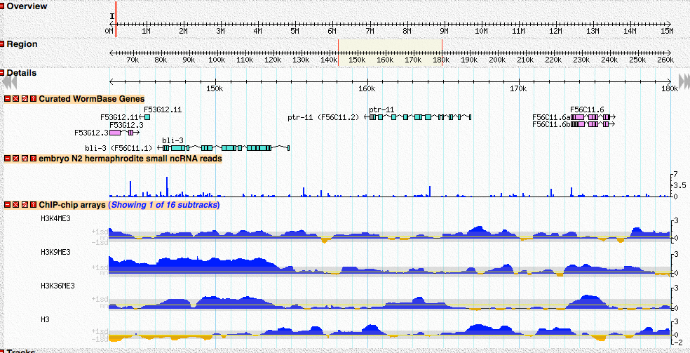
GBrowse2

Slide 6
JBrowse
Another complete rearchitecture
Uses AJAX for client side rendering, Google Maps style
http://gmod.org/wiki/JBrowse

Slide 7
GBrowse_syn
Distributed with GBrowse 1.70
Makes use of data adaptors/databases that GBrowse uses

Slide 8
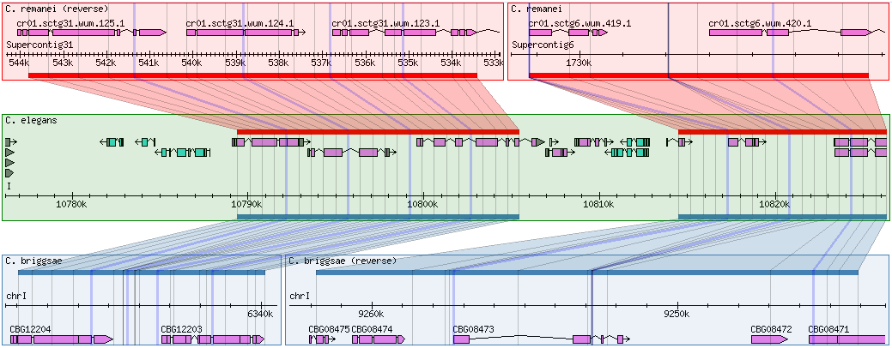
GBrowse_syn

Slide 9
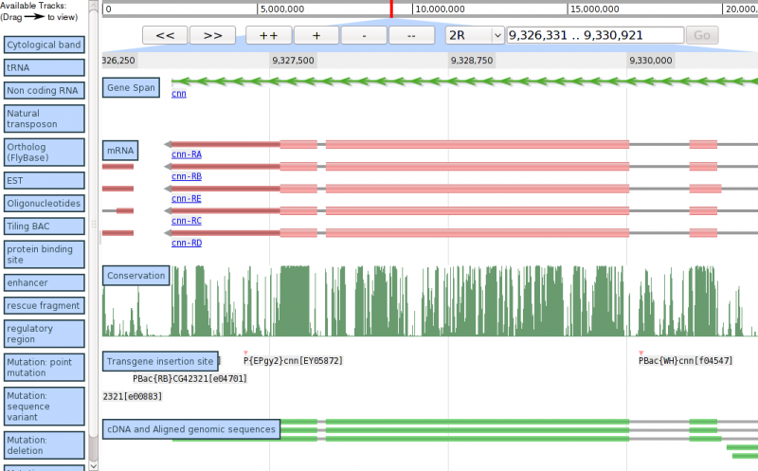
JBrowse

Slide 10
NextGen Sequencing
Supported in GBrowse2; GBrowse1 may work with some finagling.
Support for SAM/BAM databases
  http://samtools.sourceforge.net/
Coverage XY-plot
Confidence density plot
Individual alignments
Paired reads

Slide 11
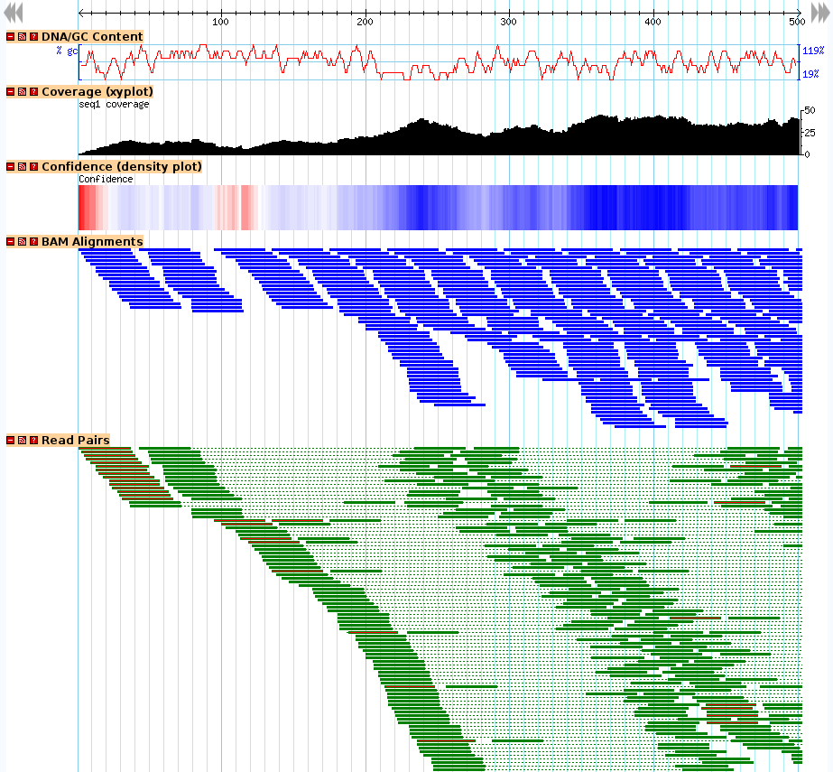
BAM/SAM

Slide 12
Drupal/Tripal
Drupal: Widely used CMS, very extensible
Tripal is a set of modules for Drupal to interact with a Chado database.
Can integrate GBrowse/CMap
Modules for:
  organism
  library
  sequence

Slide 13
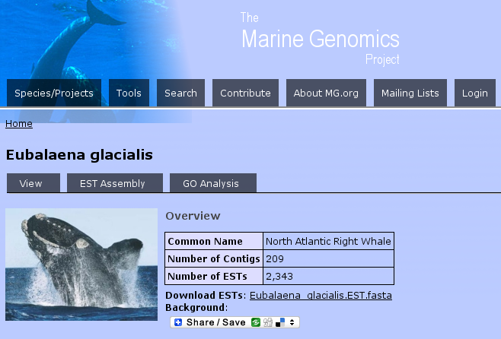
Drupal/Tripal

Slide 14
Acknowledgements
CSHL/OICR
Lincoln Stein
Sheldon McKay
Cal
Ian Holmes
Mitch Skinner
Clemson U
Stephen Ficklin
Notes:
Patrick Phillips donates office space for the help desk

