Slide 1
Comparative Genomics with GBrowse_syn
Sheldon McKay

Slide 2
How to get comparative genomics data
How to view the data with GBrowse_syn
Example uses

Slide 3
Hierarchical Genome Alignment Strategy
Raw genomic sequences
Mask repeats
(RepeatMasker [97] and Tandem Repeats Finder, nmerge, etc
Identify orthologous regions
(MERCATOR, orthocluster, etc)
Gbrowse_syn
Nucleotide-level alignment
(PECAN, MAVID, etc)
Gbrowse_syn
Further processing (GERT)
GBrowse

Slide 4
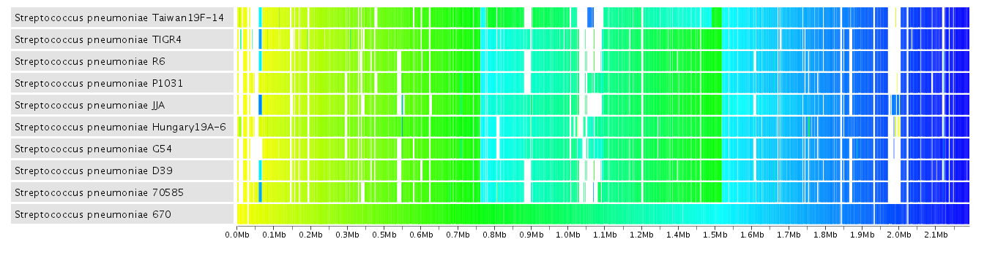
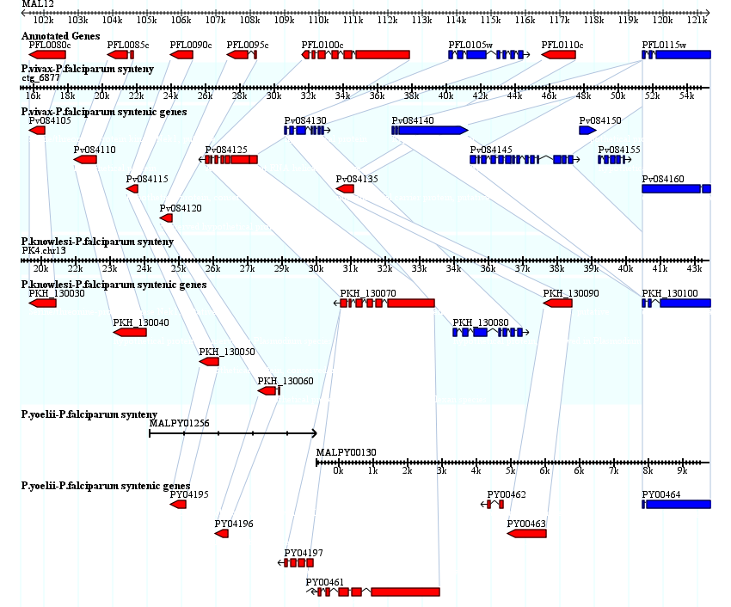
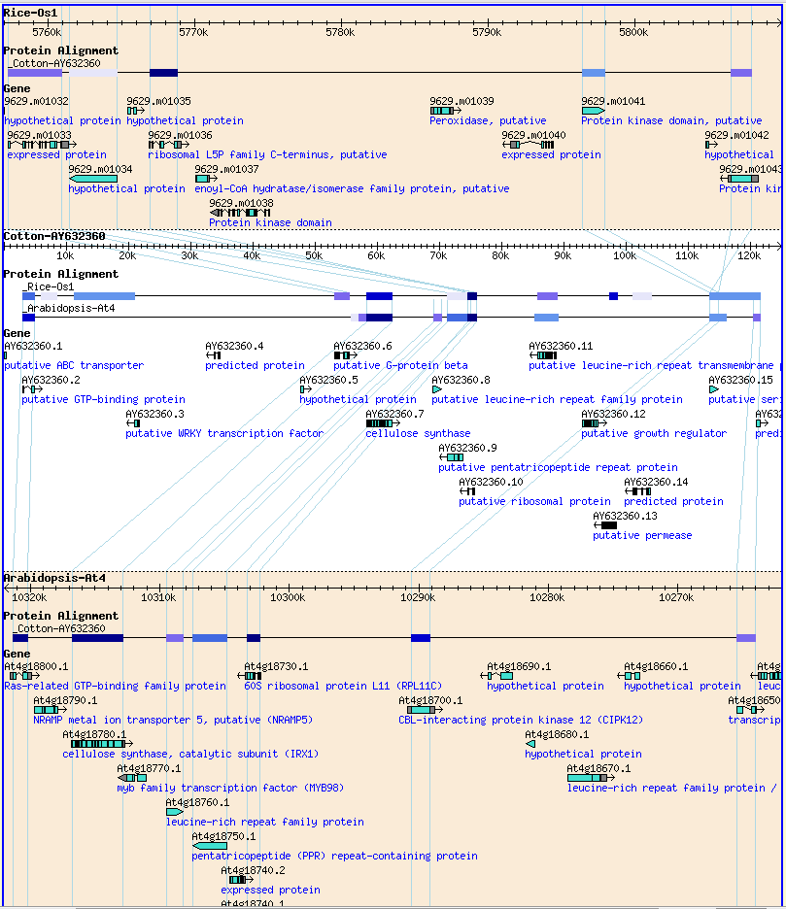
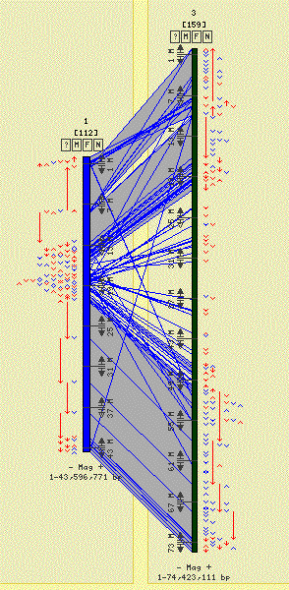
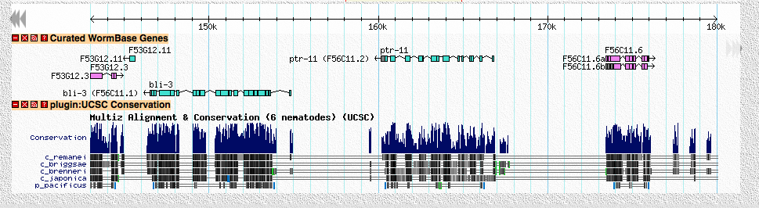
Sybil
SynView
SynBrowse
CMAP
GBrowse UCSC-style conservation tracks

Slide 5
What is GBrowse_syn?
Part of the Generic Genome Browser Package (GBrowse)
A graphical multiple sequence alignment viewer
Superimposes sequence alignment data on genes and other sequence features
Compares two or more species to a central reference species

Slide 6
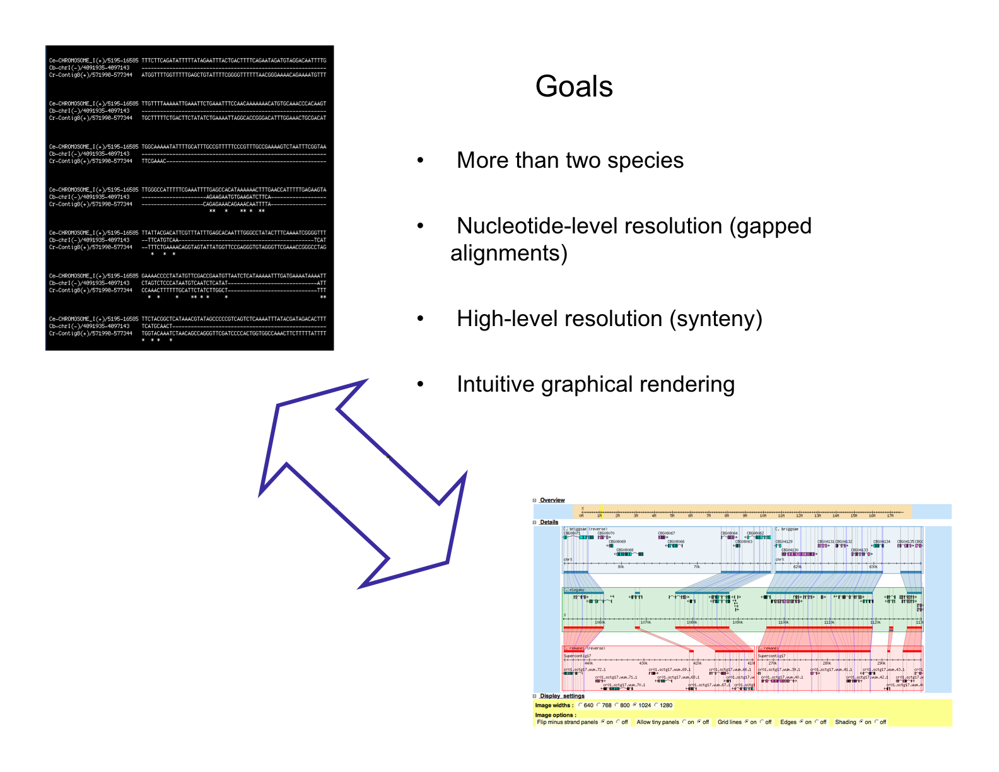

Slide 7
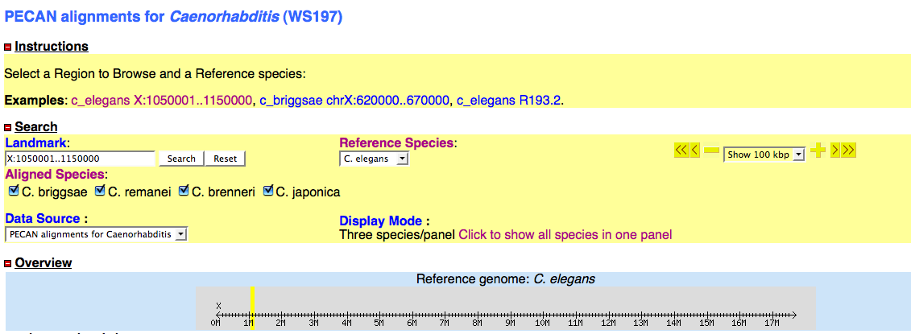
GBrowse-like interface

Slide 8
GBrowse_syn
GBrowse
Databases*
GBrowse_syn
alignment
database
*.syn
or
*.conf
*.synconf
Species config. Master config.

Slide 9
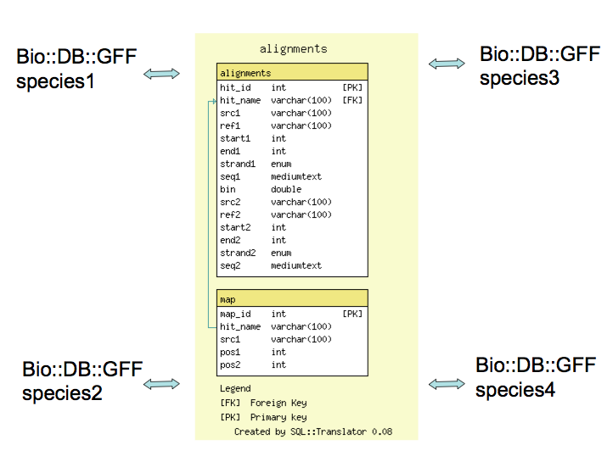
GBrowse_syn Architecture
[GBrowse]
[GBrowse]
[GBrowse]
[GBrowse]

Slide 10
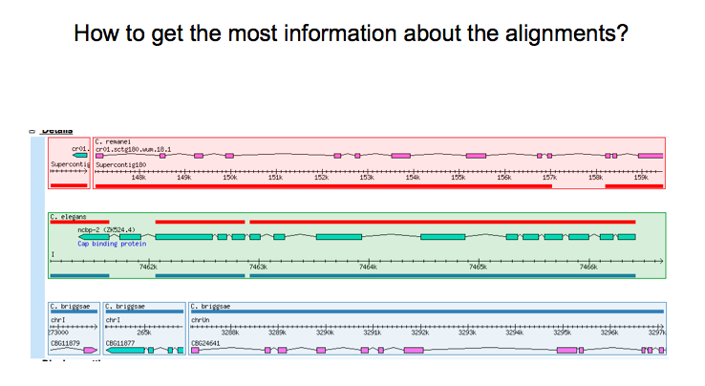

Slide 11
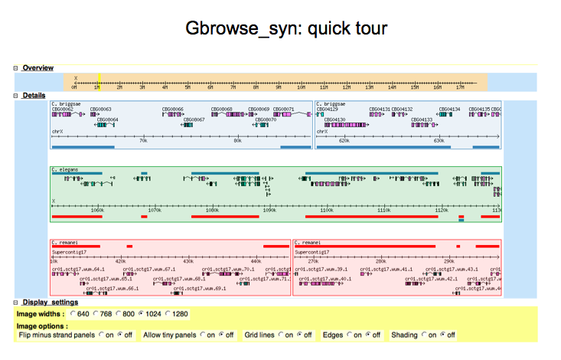

Slide 12
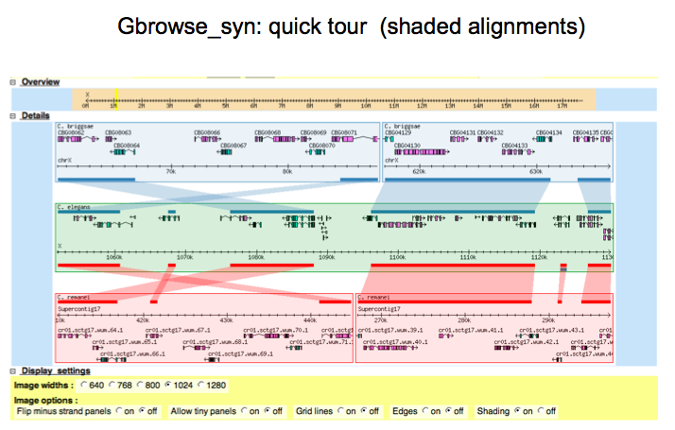

Slide 13
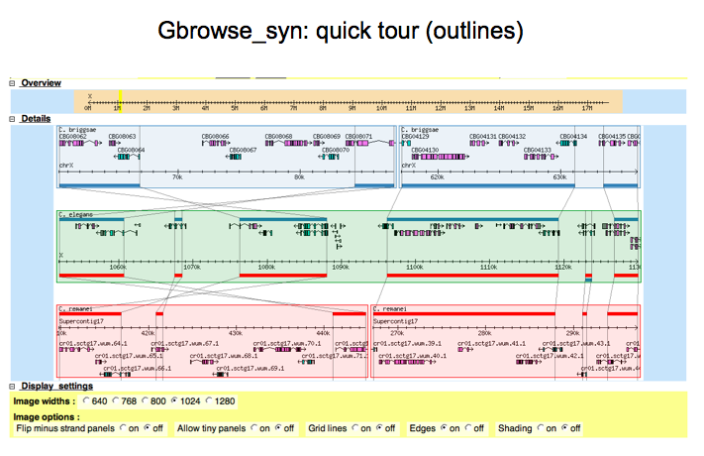

Slide 14
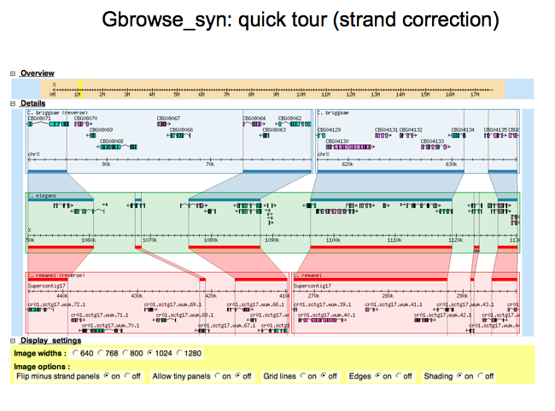

Slide 15
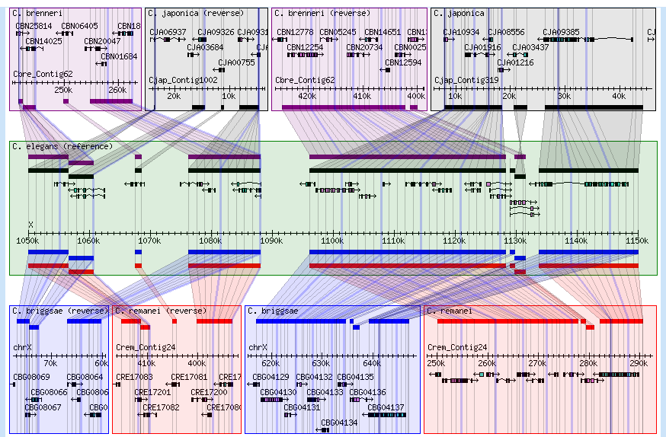
All in one view

Slide 16
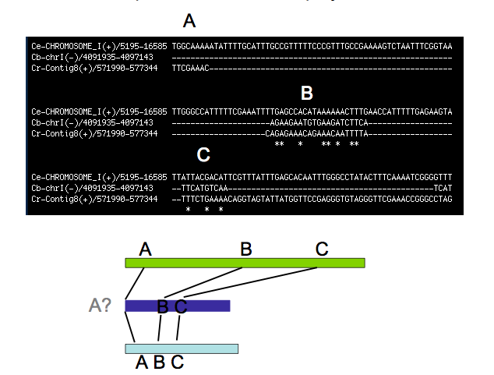
How to use Insertions/Deletion data

Slide 17
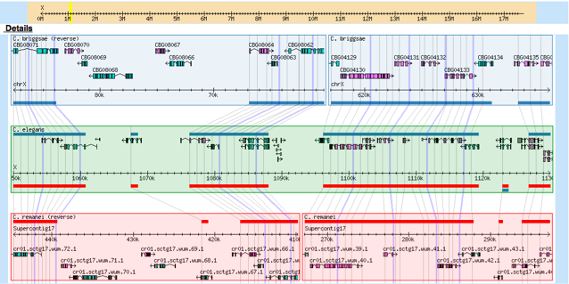
Tracking Indels with grid lines

Slide 18
Evolution of Gene Structure

Slide 19
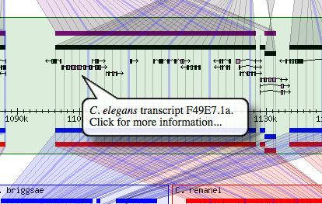
Very (un)popular popup balloons

Slide 20
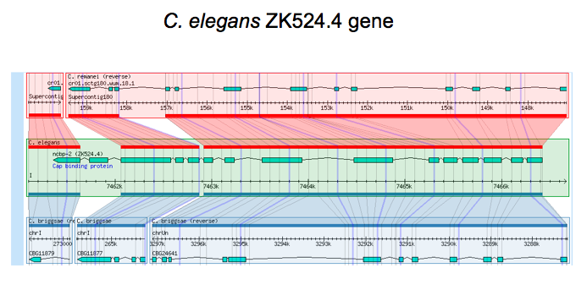
Comparing gene annotations:

Slide 21
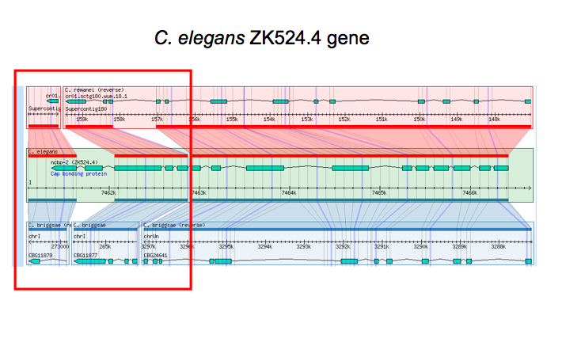

Slide 22
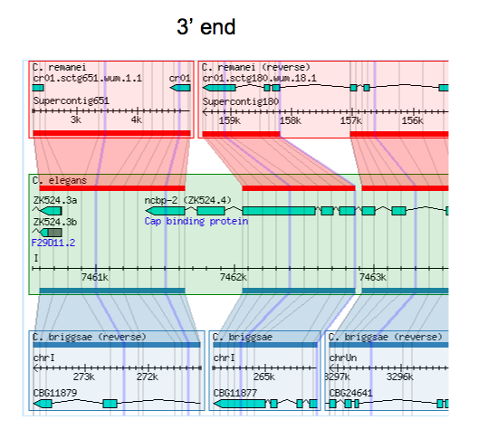

Slide 23
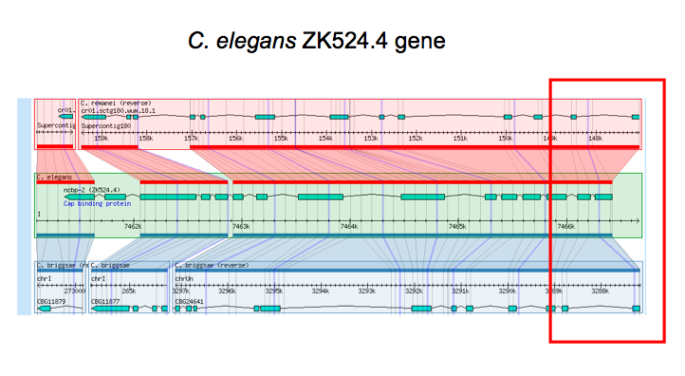

Slide 24
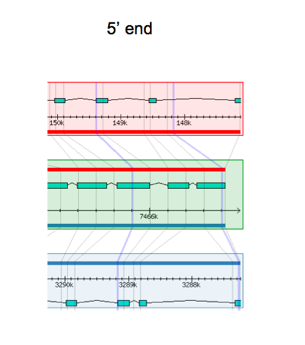

Slide 25
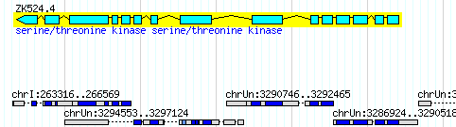

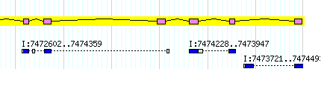
C. elegans
C. briggsae
C. remanei

Slide 26
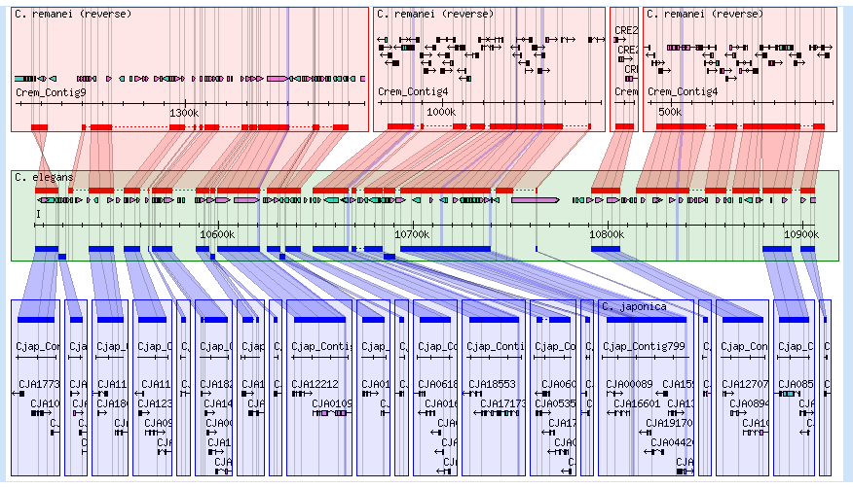
Visual inspection of an assembly
Not bad
Done
Needs work

Slide 27
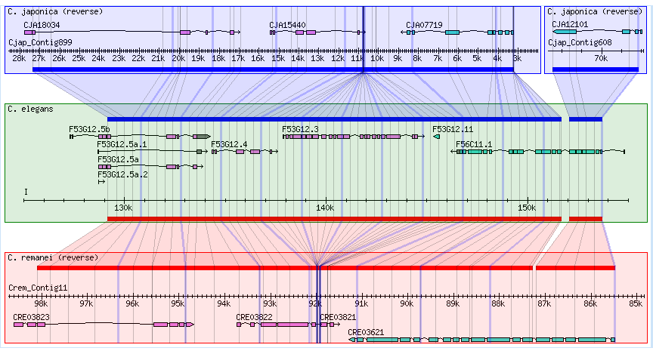
Putative gene loss

Slide 28
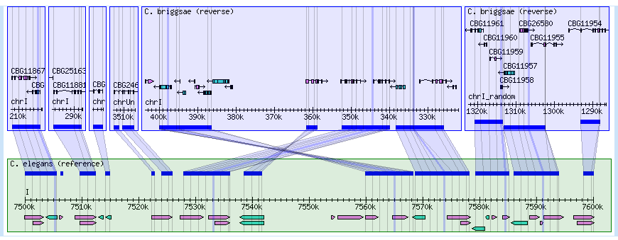
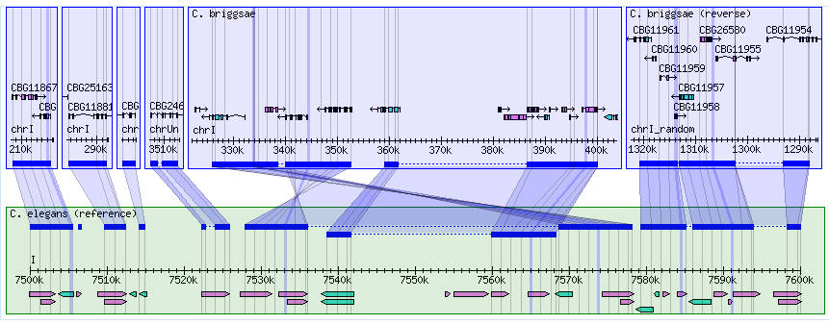
Chaining Alignments

Slide 29
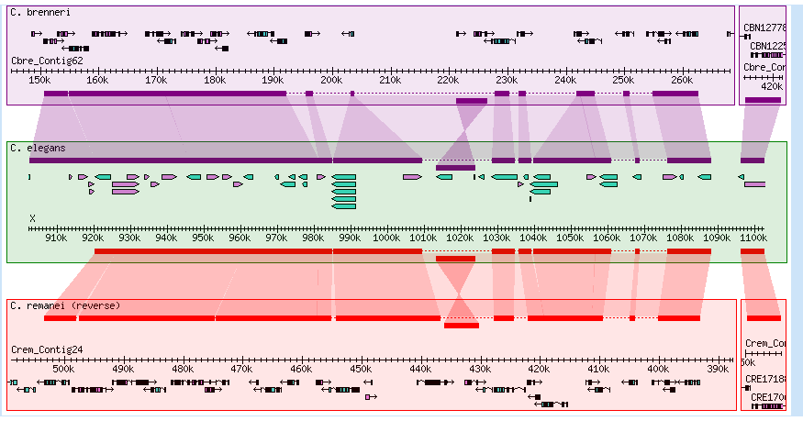
Small inversions

Slide 30
Small inversions

Slide 31
Future Improvements
“On the fly” sequence alignment view (definitely)
AJAX-based image configuration (probably)
3D image rendering? (maybe)
Suggestions?

Slide 32
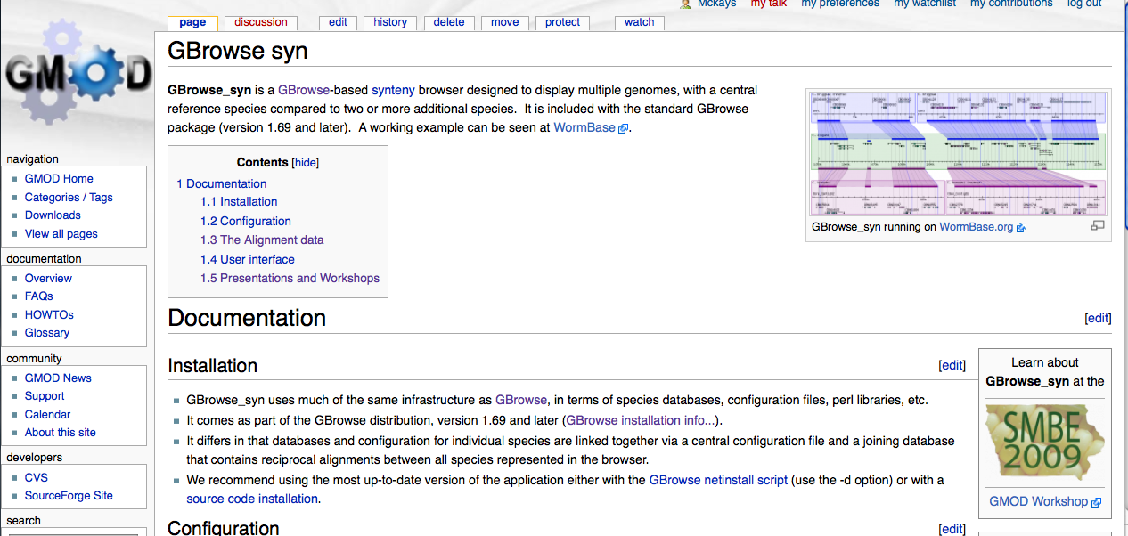
Documentation: http://gmod.org/wiki/GBrowse_syn

Slide 33
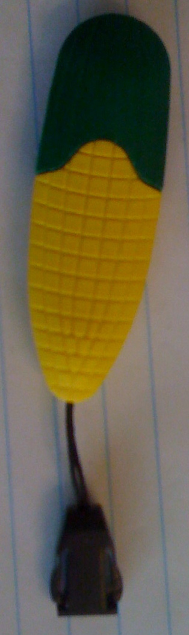


Acknowledgements
Lincoln Stein
Todd Vision
Dave Clements
Scott Cain
Jason Stajich
Michael Han
WormBase Curators
Washington University Genome Sequencing Center
http://www.eecs.berkeley.edu/Pubs/TechRpts/2006/EECS-2006-104.html

