Slide 1
Development of tools for the analysis and visualisation of second generation sequencing data for Brassica species
Chris Duran
University of Queensland, Australia
C.Duran@uq.edu.au

Slide 2
Outline
Brassica gene and promoter discovery: TAGdb
Brassica genome sequencing and annotation
Linking genetic and genomic data using CMap3D

Slide 3
Paired-end short reads
Insert size
Illumina GAIIx
Read length (35bp – 75bp)
Insert size up to 10Kbp
  ~ Normal distribution
  Standard deviation ~ 10% mean

Slide 4
Gene finding and extension
Primer
Gene/EST
PCR
genomic sequence
Known
Unknown
(Arabidopsis)
(Brassica)

Slide 5
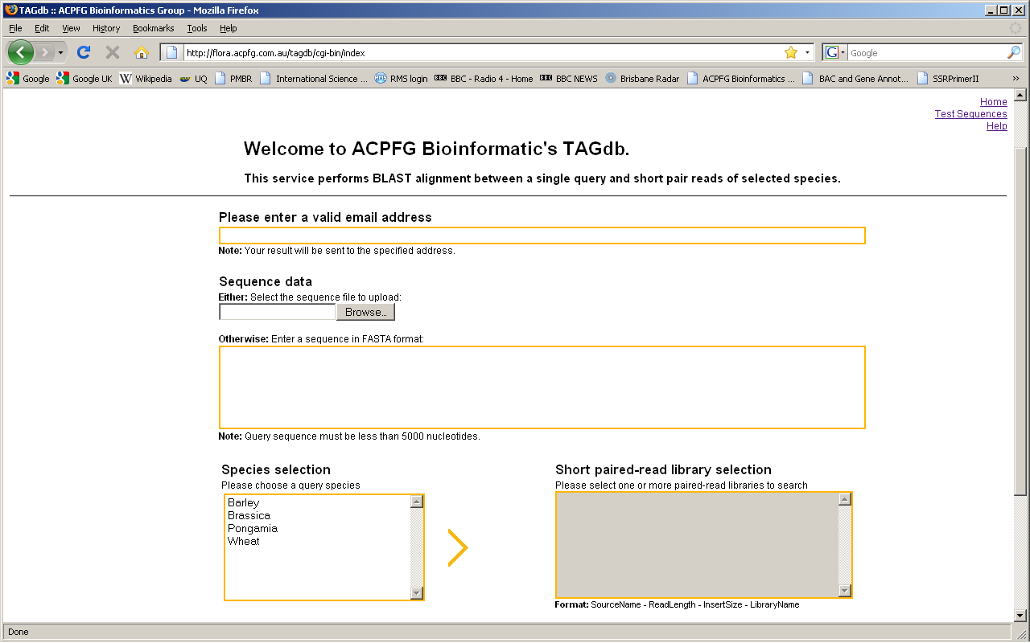

Slide 6
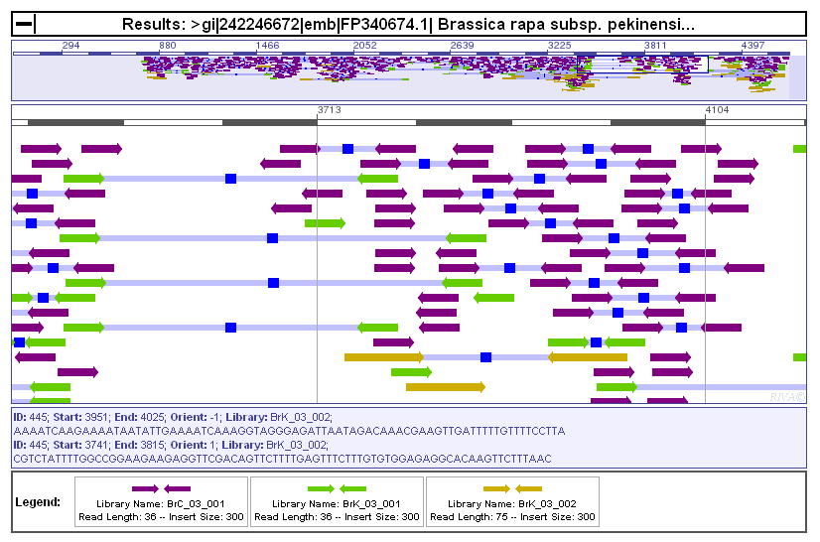
TAGdb
http://flora.acpfg.com.au/tagdb/cgi-bin/results?jobID=bK85Lk10fVzMlw5e33FSuYBYr

Slide 7
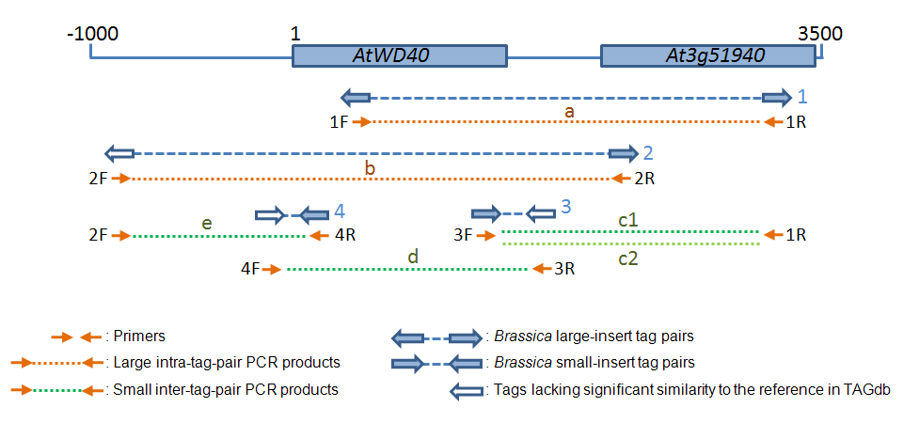
Example: AtWD40

Slide 8
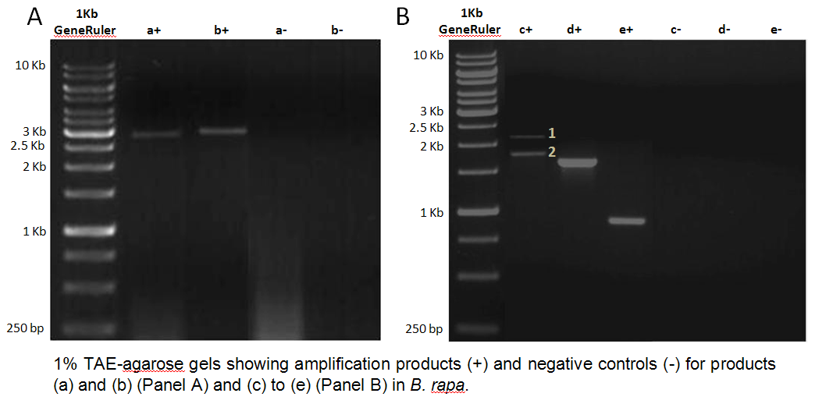
Example: AtWD40

Slide 9
Data
Brassica rapa 5 Gbp
Brassica oleracea 1 Gbp
Brassica nigra 1 Gbp
Wheat 2.3 Gbp
Wheat 7DS 4.2 Gbp
Barley 2.9 Gbp
Pongamia 0.45 Gbp
Nicotiana 10.2 Gbp

Slide 10
TagDB
Web-based tool for short read comparison
  Short reads stored on server
  User uploads query sequence
http://flora.acpfg.com.au/tagdb

Slide 11
Visualising read pairs for comparative genomics
d
d
d
d
genomic sequence

Slide 12
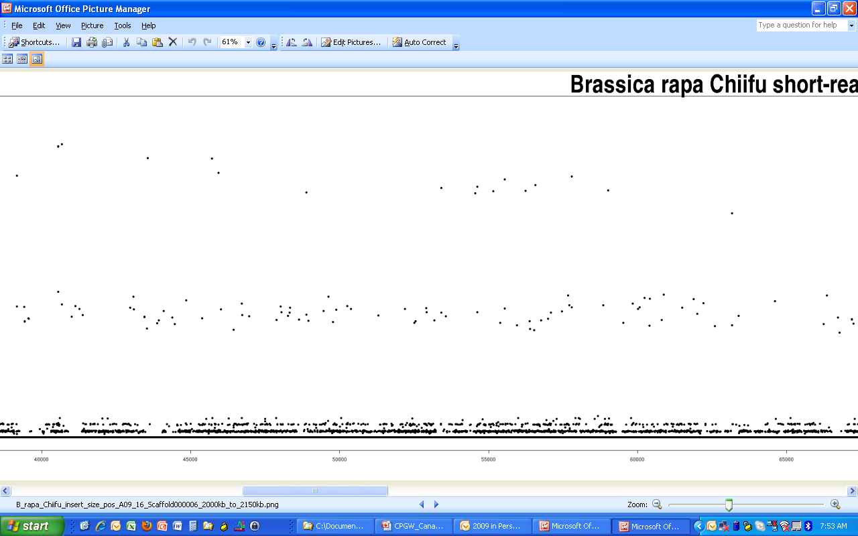
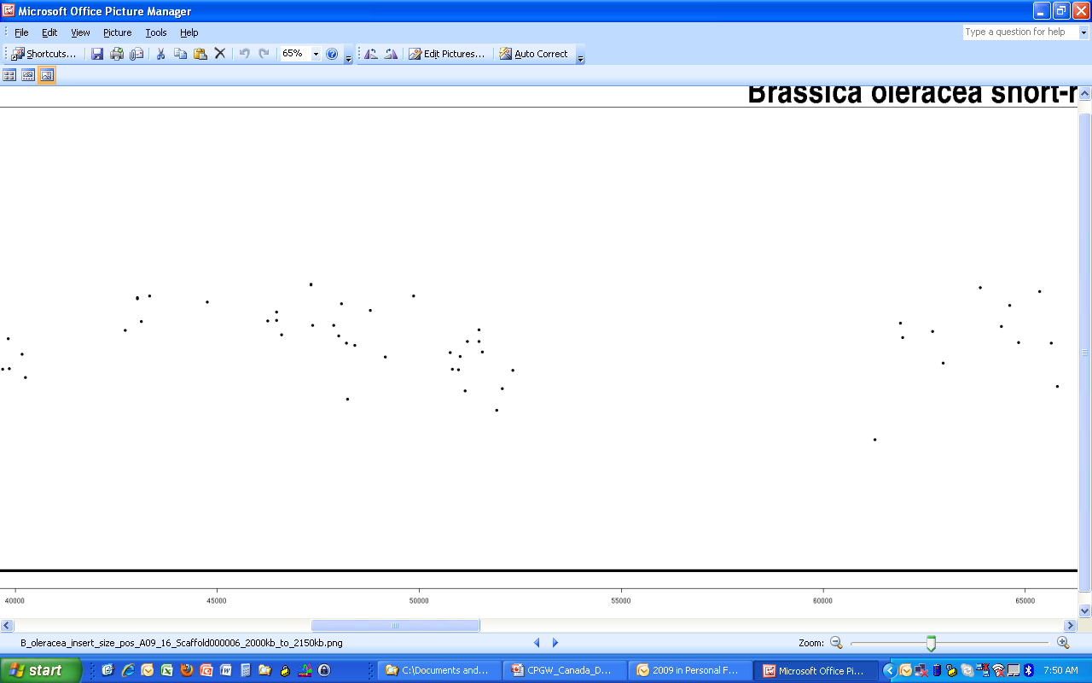
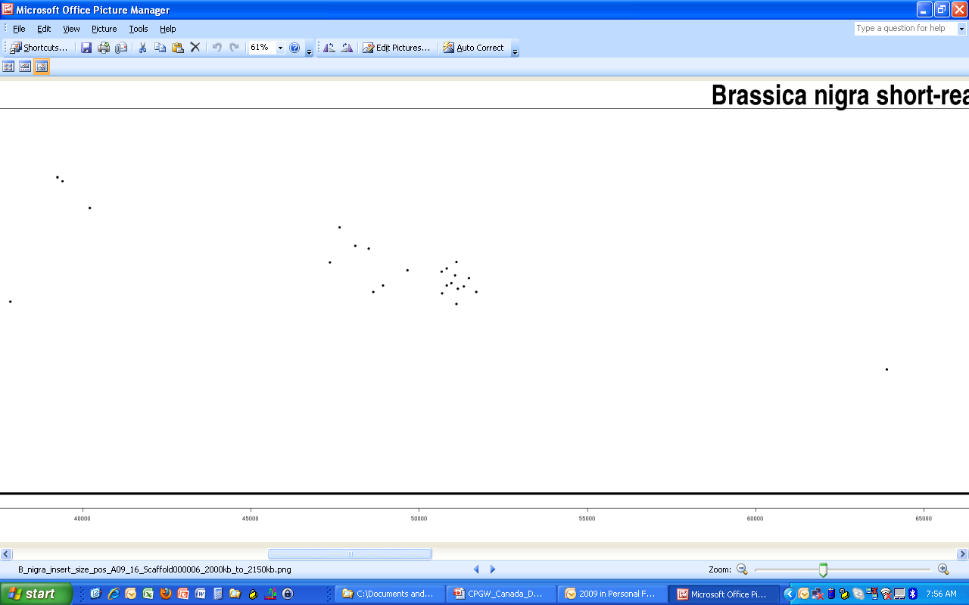
B. rapa Chiifu
B. oleracea
B. nigra

Slide 13
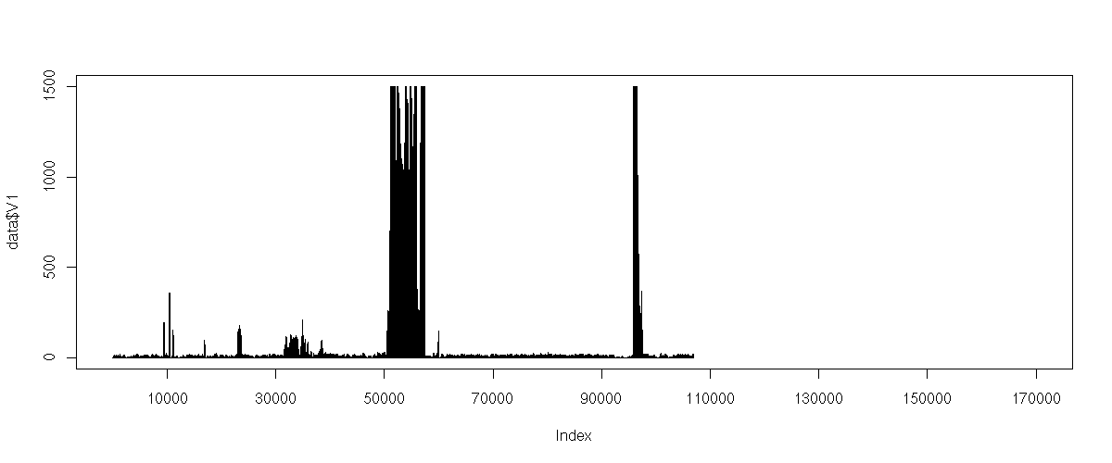
Genome annotation
1500
1000
No. of aligned reads
500
0
1
10,000
30,000
50,000
70,000
90,000
107,001
Base pair (bp)
αα
α
TIR-NBS-LRR
Repeats
MuDR
Athila
C/T-rich
region
Athila solo LTR
(AT)₃₆
Genes
Predicted genic region
High-covered regions of short reads and their corresponding annotation in a B. rapa BAC.

Slide 14
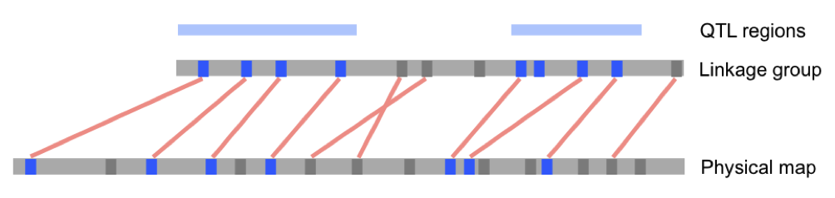
CMap3D
  Finding the genes for the traits
  Integration of genetic data with genomic data
    Mapping of QTL regions to genomic data
...
Annotation

Slide 15
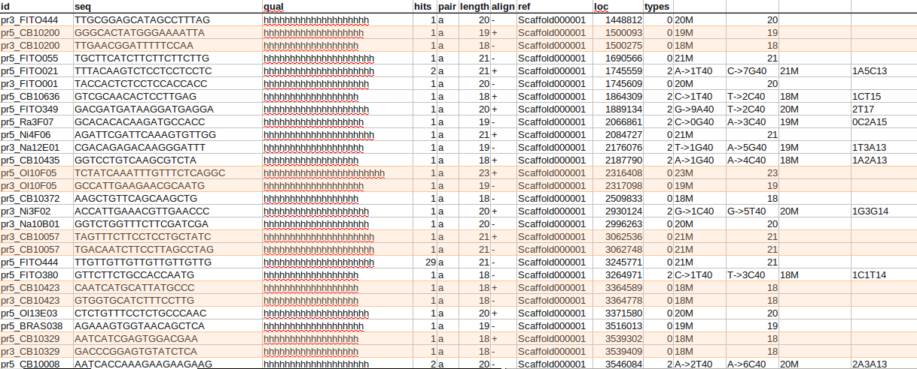
From genetic to physical maps
B. rapa scaffold
1448800
3546100
Ordered subset of SOAP2 output, with matching primer pairs highlighted

Slide 16
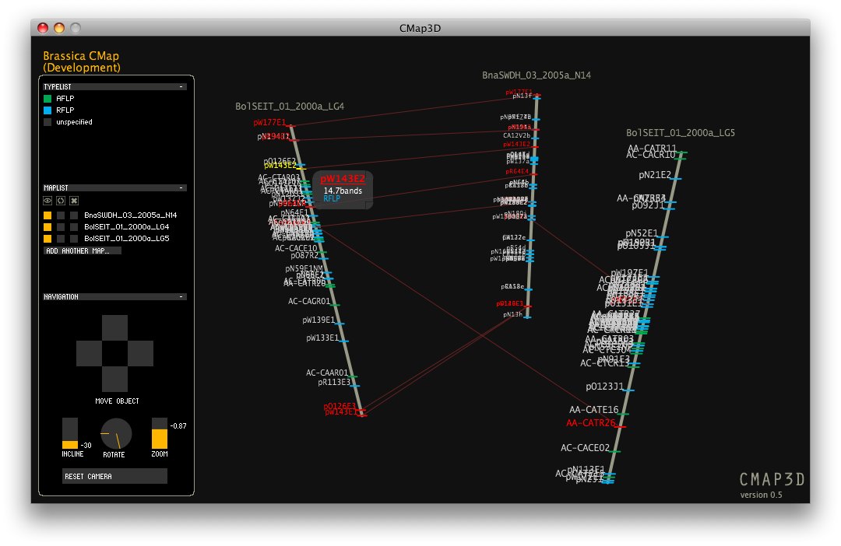
Brassica CMap3D

Slide 17
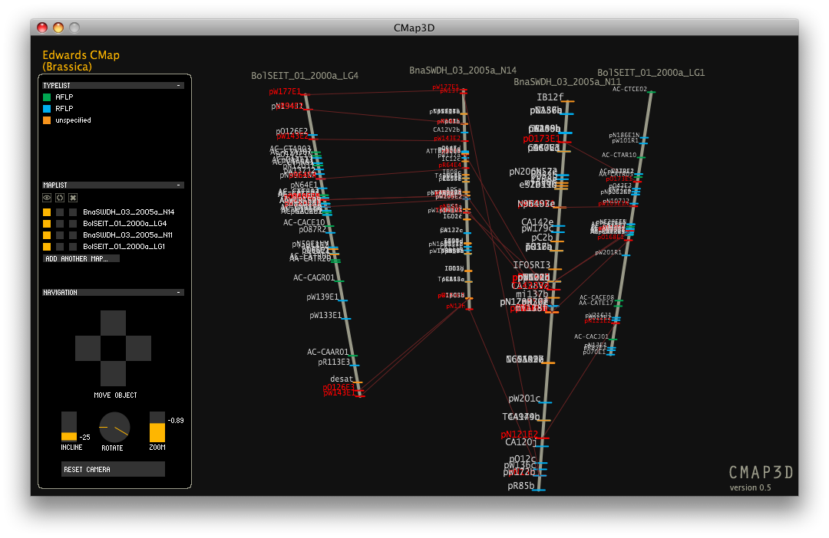
Brassica CMap3D

Slide 18
Brassica CMap
23 map sets
318 linkage groups
4899 markers

Slide 19
Summary
There are a lot of useful things you can do with short paired read sequence data
Use CMap3D to link Brassica genetics and genomics
Tools available at: http://flora.acpfg.com.au/
(or type ACPFG bioinformatics into Google)

Slide 20









Acknowledgements
Paul Berkman
Lauren Bragg
Terry Clark
Dominic Eales
Chang Pyo Hong
Michael Imelfort
Edmund Ling
Megan McKenzie
Jiri Stiller
David Edwards
Jacqueline Batley
Xiaowu Wang
Harsh Raman
Kaye Basford
Daniel Marshall
Nikki Appleby
Ping Zhang
Zoran Boskovic

