Slide 1
New Developments in the
Pathway Tools Software and
EcoCyc Database
Peter D. Karp, Ph.D.
Bioinformatics Research Group
SRI International
pkarp@ai.sri.com
BioCyc.org
EcoCyc.org
MetaCyc.org
HumanCyc.org

Slide 2
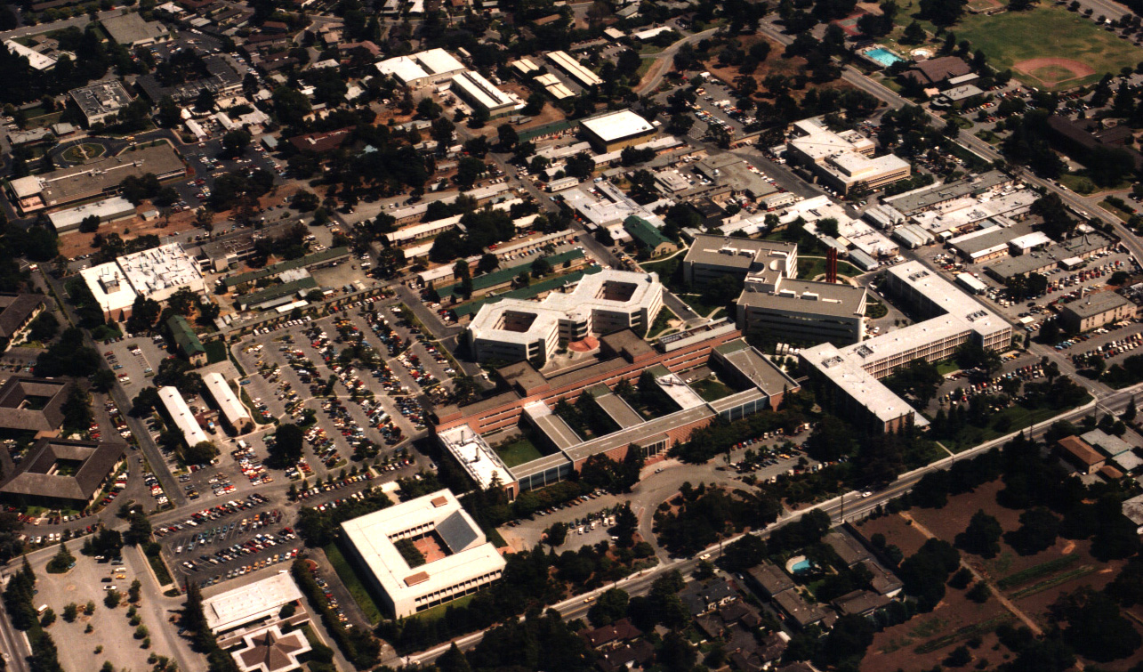
SRI International
Private nonprofit research institute
No permanent funding sources
1200 staff in Menlo Park
Multidisciplinary
  Founded in 1946 as Stanford Research Institute
  Separated from Stanford University in 1970
  Name changed to SRI International in 1977
  David Sarnoff Research Center acquired in 1987

Slide 3
SRI Organization
Information and
Computing Sciences
BioSciences
Engineering Systems
And Sciences
Education
and
Policy
Physical
Sciences

Slide 4
Overview
Motivations and terminology
  Refine rationale for MODs
Overview of Pathway Tools
New Developments in Pathway Tools and EcoCyc

Slide 5
Model Organism Databases
DBs that describe the genome and other information about an organism
Every sequenced organism with an active experimental community requires a MOD
  Integrate genome data with information about the biochemical and genetic network of the organism
  Integrate literature-based information with computational predictions
Curated by experts for that organism
  No one group can curate all the world’s genomes
  Distribute workload across a community of experts to create a community resource

Slide 6
Rationale for MODs
Each “complete” genome is incomplete in several respects:
  40%-60% of genes have no assigned function
  Roughly 7% of those assigned functions are incorrect
  Many assigned functions are non-specific
Need continuous updating of annotations with respect to new experimental data and computational predictions
  Gene positions, sequence, gene functions, regulatory sites, pathways
MODs are platforms for global analyses of an organism
  Interpret omics data in a pathway context
  In silico prediction of essential genes
  Characterize systems properties of metabolic and genetic networks

Slide 7
Potential MOD Authors
Sequencing center that sequenced genome
Experimentalists that work with that organism
Computational biologists who want to perform global and/or comparative analyses

Slide 8
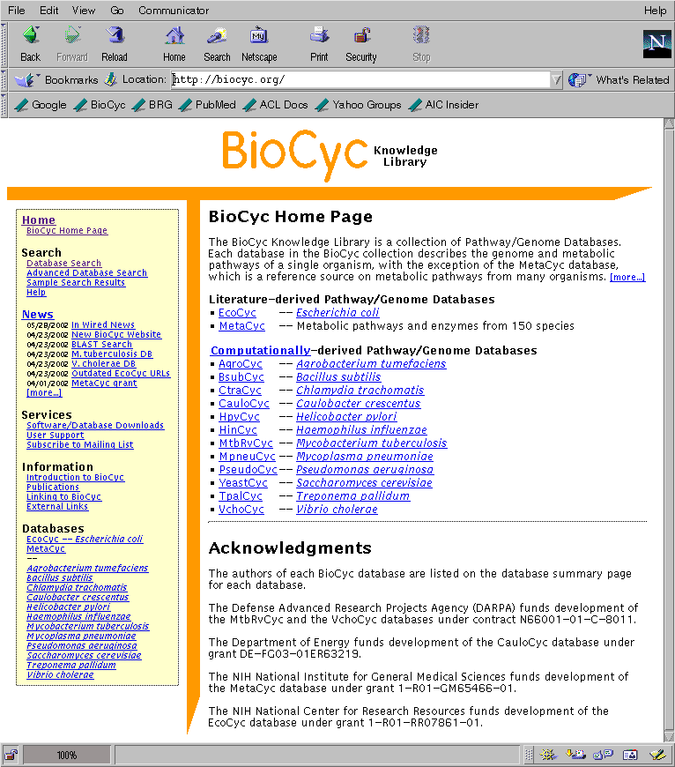
BioCyc Collection of
Pathway/Genome Databases
Pathway/Genome Database (PGDB) – combines information about
  Pathways, reactions, substrates
  Enzymes, transporters
  Genes, replicons
  Transcription factors/sites, promoters, operons
Tier 1: Literature-Derived PGDBs
  MetaCyc
  EcoCyc -- Escherichia coli K-12
  BioCyc Open Chemical Database
Tier 2: Computationally-derived DBs, Some Curation -- 18 PGDBs
  HumanCyc
  Mycobacterium tuberculosis
Tier 3: Computationally-derived DBs, No Curation -- 145 DBs

Slide 9
BioCyc Tier 3
145 PGDBs
  130 prokaryotic PGDBs created by SRI
    Source: CMR database
  15 prokaryotic and eukaryotic PGDBs created by EBI
    Source: UniProt
Automated processing by PathoLogic
  Pathway prediction
  Operon prediction (bacteria)

Slide 10
Pathway/Genome Database
Pathways
Reactions
Compounds
Proteins
Operons,
Promoters,
DNA Binding Sites
Genes
Chromosomes,
Plasmids
CELL

Slide 11
Pathway Tools Software
Pathway/Genome
Navigator
Pathway/
Genome
Databases
PathoLogic Pathway Predictor
Pathway/
Genome
Editors

Slide 12
Pathway Tools Modes of Use
Majority of MOD services provided by Pathway Tools
Pathway Tools provides a pathway module as an add-on to existing MOD

Slide 13
Pathway Tools Software: PathoLogic
Computational creation of new Pathway/Genome Databases
Transforms genome into Pathway Tools schema and layers inferred information about the genome
Predicts operons
Predicts metabolic network
Predicts pathway hole fillers
Bioinformatics 18:S225 2002

Slide 14
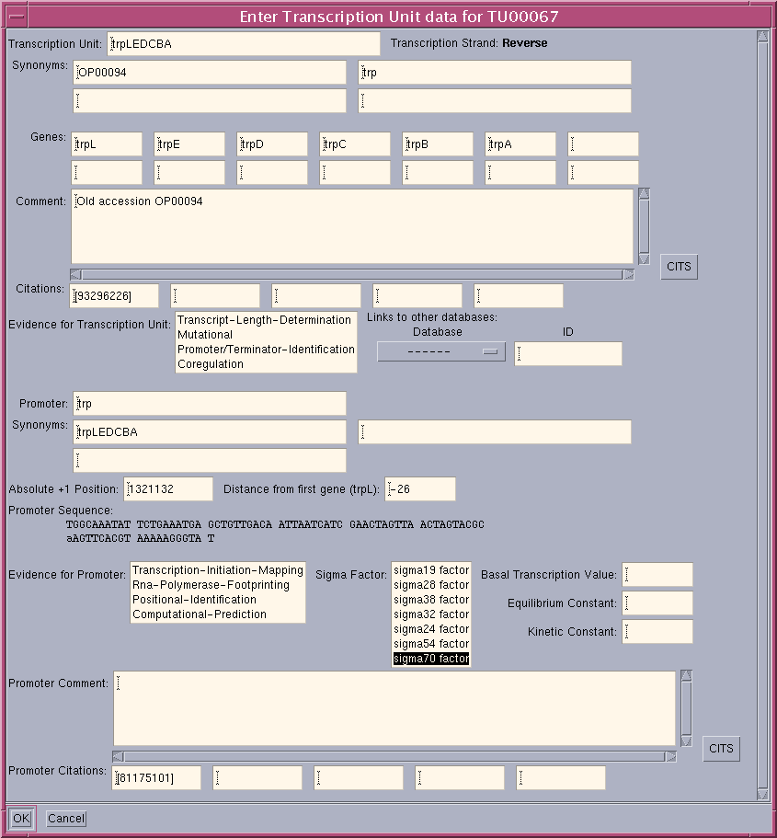
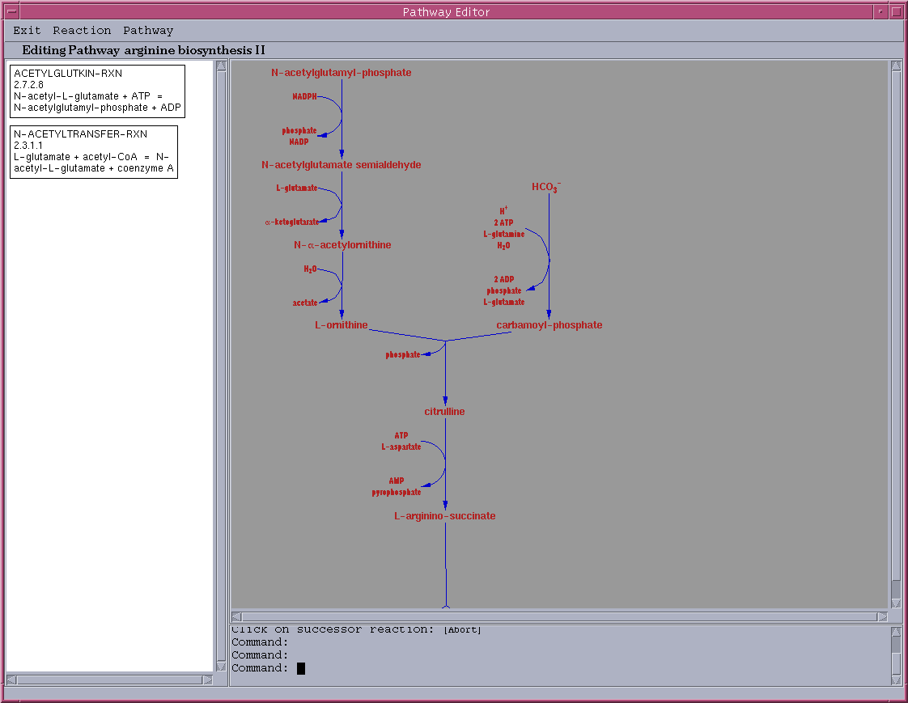
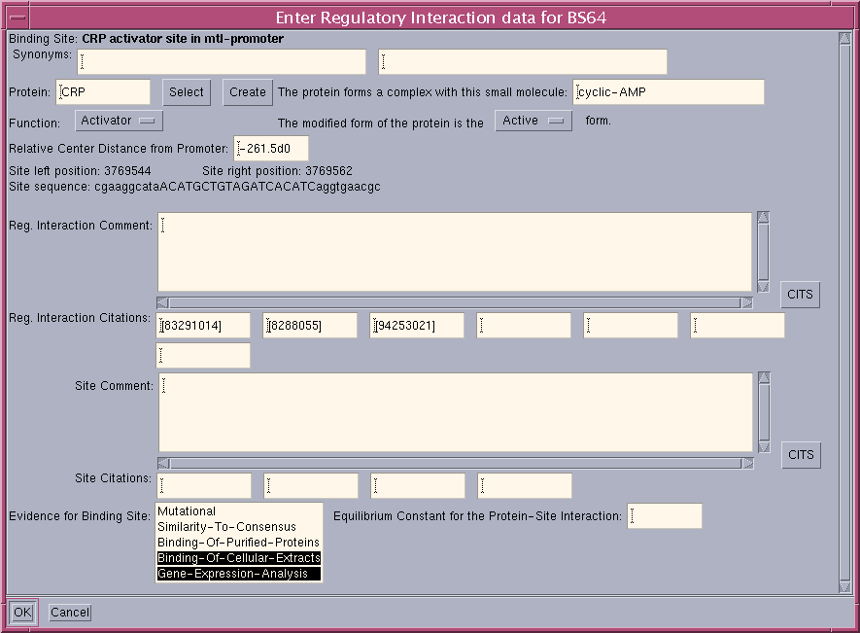
Pathway Tools Software:
Pathway/Genome Editors
Support interactive updating of PGDBs with graphical editors
Support geographically distributed teams of curators with object database system
Gene editor
Protein editor
Reaction editor
Compound editor
Pathway editor
Operon editor
Publication editor

Slide 15
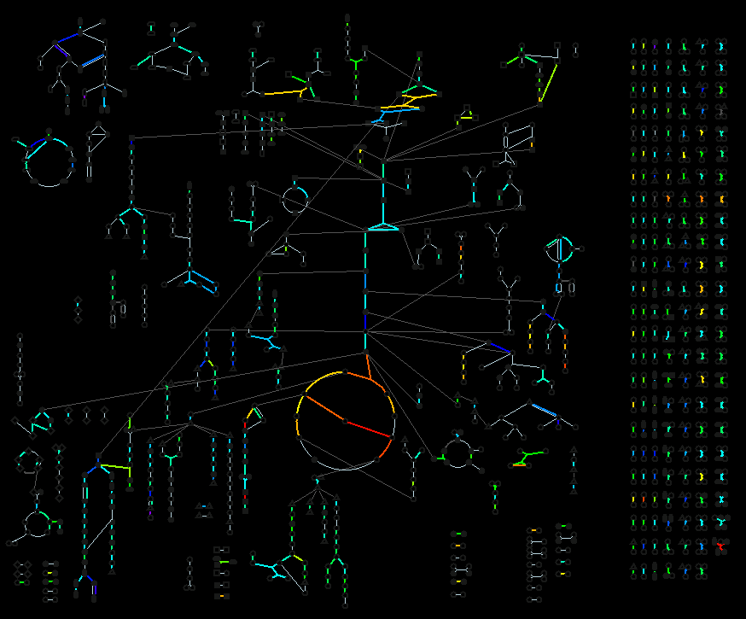
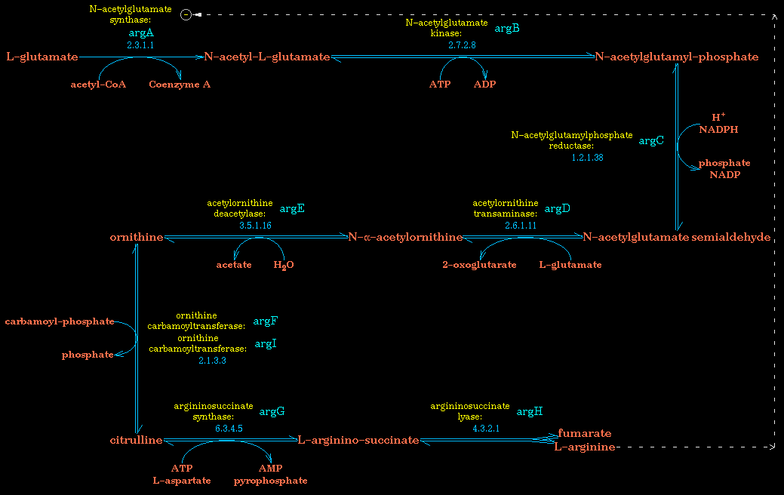
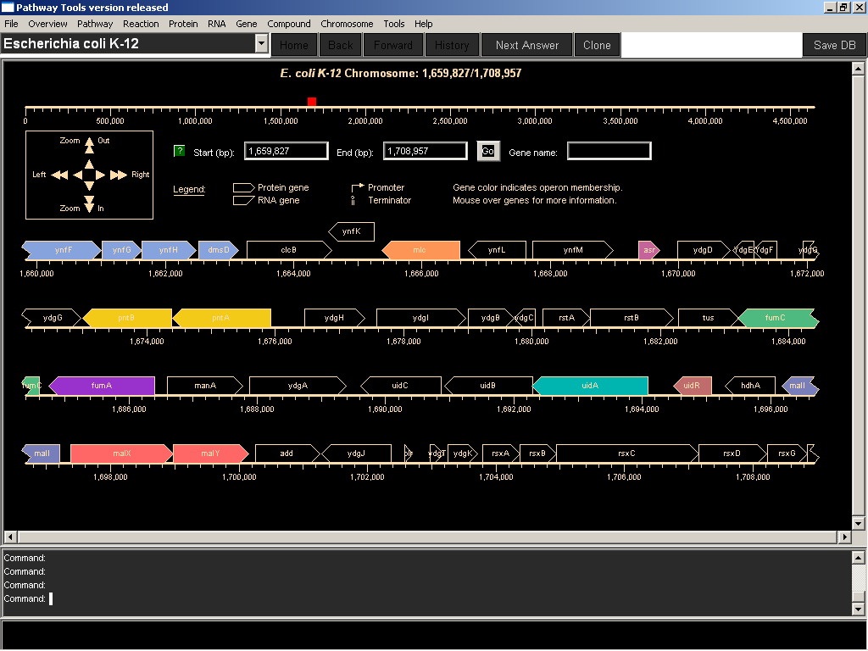
Pathway Tools Software:
Pathway/Genome Navigator
Querying, visualization of pathways, chromosomes, operons
Analysis operations
  Pathway visualization of gene-expression data
  Global comparisons of metabolic networks
  Comparative genomics
WWW publishing of PGDBs
Desktop operation

Slide 16
Pathway/Genome DBs Created by
External Users
50 groups applying the software to more than 80 organisms
Software freely available to academics; Each PGDB owned by its creator
Saccharomyces cerevisiae, SGD project, Stanford University
  pathway.yeastgenome.org/biocyc/
TAIR, Carnegie Institution of Washington Arabidopsis.org:1555
dictyBase, Northwestern University
GrameneDB, Cold Spring Harbor Laboratory
Planned:
  CGD (Candida albicans), Stanford University
  MGD (Mouse), Jackson Laboratory
  RGD (Rat), Medical College of Wisconsin
  WormBase (C. elegans), Caltech
DOE Genomes to Life contractors:
  G. Church, Harvard, Prochlorococcus marinus MED4
  E. Kolker, BIATECH, Shewanella onedensis
  J. Keasling, UC Berkeley, Desulfovibrio vulgaris
Plasmodium falciparum, Stanford University
  plasmocyc.stanford.edu
Fiona Brinkman, Simon Fraser Univ, Pseudomonas aeruginosa
Methanococcus janaschii, EBI maine.ebi.ac.uk:1555

Slide 17
Computing with the
Metabolic Network
Comparative analysis of metabolic networks
Visualization of omics data
Correlation of metabolism and transport
Connectivity analysis of metabolic network
Forward propagation of metabolites
Verification of known growth media with metabolic network
(Future) Infer growth-media requirements

Slide 18
Pathway Tools Implementation Details
Platforms:
  Sun, PC/Linux, and PC/Windows platforms
Same binary can run as desktop app or Web server
Production-quality software
  Version control
  Two regular releases per year
  Extensive quality assurance
  Extensive documentation
  Auto-patch
  Automatic DB-upgrade
300,000 lines of code

Slide 19
Pathway Tools Architecture
Pathway
Genome
Navigator
WWW
Server
X-Windows
Graphics
Object Editor
Pathway Editor
Reaction Editor
GFP API
Object DBMS
Oracle

Slide 20
Ocelot Knowledge Server
Architecture
Frame data model
  Classes, instances, inheritance
  Frames have slots that define their properties, attributes, relationships
  A slot has one or more values
    Datatypes include numbers, strings, etc.
Transaction logging facility
Slot units define metadata about slots:
  Domain, range, inverse
  Collection type, number of values, value constraints

Slide 21
Ocelot Storage System Architecture
Persistent storage via disk files, Oracle DBMS
  Concurrent development: Oracle
  Single-user development: disk files
Oracle storage
  Oracle is submerged within Ocelot, invisible to users
  Frames transferred from DBMS to Ocelot
    On demand
    By background prefetcher
    Memory cache
    Persistent disk cache to speed performance via Internet
Transaction logging facility

Slide 22
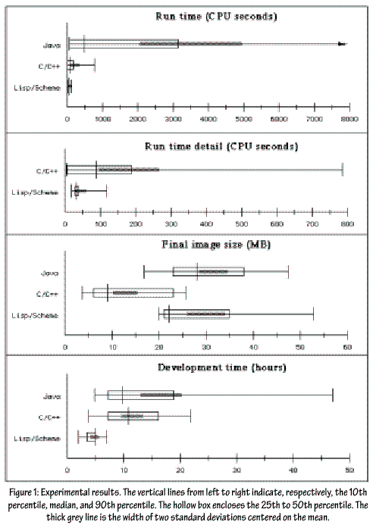
The Common Lisp Programming
Environment
Gatt studied Lisp and Java implementation of 16 programs by 14 programmers (Intelligence 11:21 2000)

Slide 23
Peter Norvig’s Solution
“I wrote my version in Lisp. It took me about 2 hours (compared to a range of 2-8.5 hours for the other Lisp programmers in the study, 3-25 for C/C++ and 4-63 for Java) and I ended up with 45 non-comment non-blank lines (compared with a range of 51-182 for Lisp, and 107-614 for the other languages). (That means that some Java programmer was spending 13 lines and 84 minutes to provide the functionality of each line of my Lisp program.)”
http://www.norvig.com/java-lisp.html

Slide 24
Common Lisp Programming
Environment
Interpreted and/or compiled execution
Fabulous debugging environment
High-level language
Interactive data exploration
Extensive built-in libraries
Dynamic redefinition
Find out more!
  See ALU.org or
  http://www.international-lisp-conference.org/

Slide 25
PathoLogic Processing of a Genome

Slide 26
PathoLogic Inference of Metabolic Pathways
Annotated Genomic
Sequence
Pathway/Genome
Database
Gene Products
Pathways
Genes/ORFs
Reactions
DNA Sequences
PathoLogic Software
Integrates genome and pathway data to identify putative metabolic networks
Compounds
Multi-organism Pathway
Database (MetaCyc)
Gene Products
Pathways
Genes
Reactions
Genomic Map
Compounds

Slide 27
PathoLogic:
Predict Metabolic Pathways
Computationally match enzymes in source genome to the MetaCyc reactions that they catalyze
  Match enzyme names and EC numbers to MetaCyc
  Support user in manually matching additional enzymes
Computationally predict which MetaCyc metabolic pathways are present in the organism
  Import MetaCyc pathways based on fraction of enzymes present, and presence of enzymes unique to that pathway
Generate report of predicted pathways and the supporting evidence; mark predicted pathways with computational evidence code
Generate metabolic overview diagram

Slide 28
HumanCyc Results
2709 enzymes identified in the human genome (9.5%)
  1653 metabolic enzymes
  Plus 203 pathway holes -> 6.5% of genome
  622 of metabolic enzymes assigned to a metabolic pathway
135 predicted metabolic pathways
  203 pathway holes present in 99 pathways
  88 candidate hole fillers found, of which 25 appear solid
  Average pathway length: 5.4 reaction steps
  428 of 896 reactions have multiple isozymes

Slide 29
PathoLogic Step 3:
Identify Pathway Hole Fillers
Definition: Pathway Holes are reactions in metabolic pathways for which no enzyme is identified
1.4.3.-
quinolinate synthetase
nadA
L-aspartate
iminoaspartate
quinolinate
NAD+ synthetase, NH3 -dependent
CC3619
holes
n.n. pyrophosphorylase
nadC
deamido-NAD
nicotinate nucleotide
2.7.7.18
6.3.5.1
NAD

Slide 30
Step 1: collect query isozymes of function A based on EC#
Step 2: BLAST against target genome
Step 3 & 4: Consolidate hits and evaluate evidence
gene X
organism 1 enzyme A
organism 2 enzyme A
organism 3 enzyme A
organism 4 enzyme A
7 queries have high-scoring hits to sequence Y
organism 5 enzyme A
gene Y
organism 6 enzyme A
organism 7 enzyme A
organism 8 enzyme A
gene Z

Slide 31
Bayes Classifier
P(protein has function X|
E-value, avg. rank, aln. length, etc.)
protein has function X
best
E-value
pwy directon
avg. rank in BLAST output
adjacent rxns
Number of queries
% of query aligned

Slide 32
Pathway Hole Filler
Why should hole filler find things beyond the original genome annotation?
Reverse BLAST searches more sensitive
Reverse BLAST searches find second domains
Integration of multiple evidence types

Slide 33
Example Pathway
CC2913, P=0.99
1.4.3.-
quinolinate synthetase
nadA (CC2912)
L-aspartate
iminoaspartate
quinolinate
NAD+ synthetase, NH3 -dependent
CC3619
holes
n.n. pyrophosphorylase
nadC (CC2915)
deamido-NAD
nicotinate nucleotide
2.7.7.18
CC3431*, P=0.90
6.3.5.1
NAD
CC3619, P=0.99
CC2913 L-aspartate oxidase (wrong EC# on rxn)
CC3431 ORF
CC3619 put. NAD(+)-synthetase (multidomain)

Slide 34
HumanCyc Pathway Holes
Fill holes by predicting the probability that a gene has a particular function
135 pathways containing 538 reactions
99 pathways w/ at least 1 missing reaction
203 reactions have missing enzymes
HumanCyc holes filled:
No candidates found for 115 of the 203 holes
25 of 88 candidates judged to have strong evidence:
  6 ORFs
  9 multifunctional enzymes
  3 enzymes with different functional assignments
  7 enzymes with imprecise functional assignments

Slide 35
PathoLogic Step 4:
Predict Operons
Predict adjacent genes A and B in same operon based on:
  Intragenic distance
  Functional relatedness of A and B
Tests for functional relatedness:
  A and B in same gene functional class (MultiFun)
  A and B in same metabolic pathway
  A codes for enzyme in a pathway and B codes for transporter involving a substrate in that pathway
  A and B are monomers in same protein complex
Correctly predicts 80% of E. coli transcription units
Marks predicted operons with computational evidence codes
Bioinformatics 20:709-17 2004

Slide 36
Pathway Tools APIs and
Semantic Inference Layer
APIs
  Generic Frame Protocol (Lisp)
    Database query and update operations
    Get-class-all-instances, Get-slot-values, Add-slot-value
  PerlCyc
  JavaCyc
Semantic inference layer
  Encode commonly used queries that compute indirect DB relationships
    Genes-Of-Pathway, Substrates-Of-Pathway
    All-Transcription-Factors, Regulon-Of-Protein

Slide 37
Other Capabilities
Evidence code ontology
  34 codes that can be attached to many object types
  Pacific Symposium on Biocomputing pp190-201 2004
APIs
  JavaCyc, PerlCyc, Lisp
Extensive data import/export tools
  Export select objects and attributes to column-delimited files
Easy to define Web links from PGDB objects
Extensive user support services through SRI
  Auto-patch
  200 pages of documentation available: User’s Guide, Schema, Curator’s Guide
Active community of contributors
  JavaCyc, PerlCyc
  SBML and BioPAX export tools

Slide 38
Pathway Tools Recent Developments
Two releases per year in Feb and Aug
Version 8.0
  Pathway hole filler
  Protein features: schema, query, visualization, editing
  Navigator main menu redesigned
Version 8.5
  Licensing completely online
  Cellular Overview and Omics Viewer Improved
    Users can create combined displays of gene expression, proteomics, metabolomics, and reaction flux measurements on the Omics Viewer
    Drawing speed is improved
    Metabolic pathways in the Overview are now grouped by pathway class
    Zooming of the diagram is supported (desktop version only)
    The periplasm and outer membrane have been added to the diagram, as have those proteins present in the periplasm and outer membrane
    The layout of the Cellular Overview can be computed completely automatically by PathoLogic in a new PGDB
  Compound stereochemistry supported
  Support for JME chemical editor, molfile import/export

Slide 39
Pathway Tools Recent Developments
Version 9.0
  New genome browser
  More compact pathway diagrams

Slide 40
EcoCyc Project – EcoCyc.org
E. coli Encyclopedia
  Model-Organism Database for E. coli
  Computational symbolic theory of E. coli
  Electronic review article for E. coli
    10,500 literature citations
    3600 protein comments
  Tracks the evolving annotation of the E. coli genome
  Resource for microbial genome annotation
Collaborative development via Internet
  John Ingraham (UC Davis)
  Paulsen (TIGR) – Transport, flagella, DNA repair
  Collado (UNAM) -- Regulation of gene expression
  Keseler, Shearer (SRI) -- Metabolic pathways, cell division, proteases, RNAses
  Karp (SRI) -- Bioinformatics
Nuc. Acids. Res. 33:D334 2005 ASM News 70:25 2004 Science 293:2040

Slide 41
EcoCyc Mission
Provide a review-level resource on E. coli genomics and biochemical networks
  Combine parts list with computable functions of parts
  Ongoing literature-based curation effort for all E. coli genes
  Curate metabolic pathways
  Curate transcriptional regulatory network
  Provide a comprehensive, up-to-date collection of data and knowledge
High-fidelity knowledge representation provides computable information
Finely crafted graphical interface speeds comprehension
Provide powerful bioinformatics tools for query, visualization, analysis, and curation of these data

Slide 42
EcoCyc = E.coli Dataset + Pathway/Genome Navigator
Pathways: 182
Reactions: 3,600
Metabolic: 822
Transport: 202
Compounds: 934
Citations: 8,900
Proteins: 4,273
Gene Regulation:
Operons: 956
Trans Factors: 133
Promoters: 1015
Genes: 4,479
http://EcoCyc.org/

Slide 43
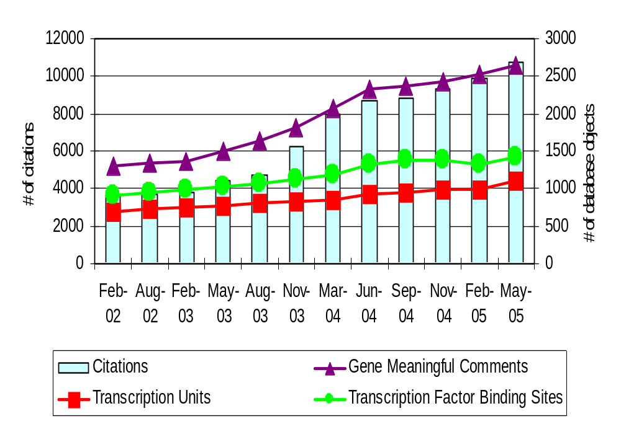
EcoCyc Statistics

Slide 44
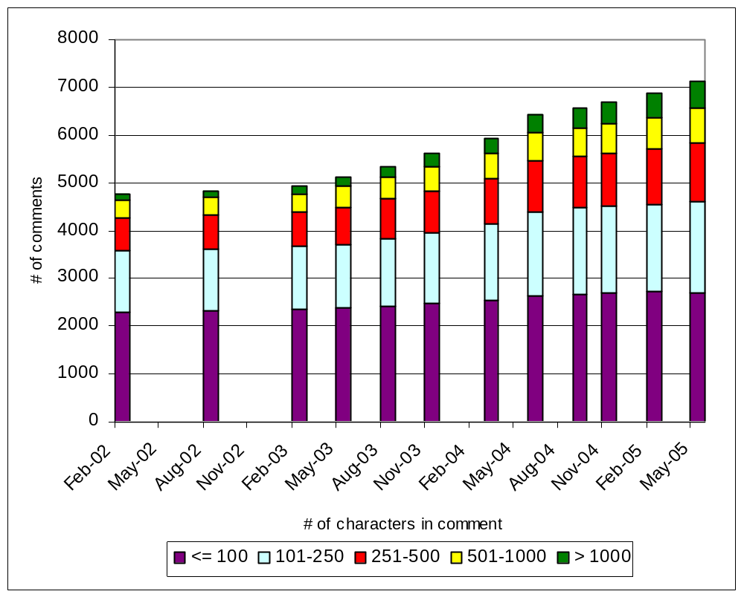
Comments in Proteins, Pathways,
Operons, etc.

Slide 45
EcoCyc Statistics
The metabolic network
Several possible definitions of “metabolic network”:
All biochemical reactions
  Exclude signaling
    Exclude transport
      Exclude macromolecule pathways
        Reactions for which all substrates are small molecules
Preferred definition: Small-Molecule Metabolism
  Reactions in pathways of small-molecule metabolism plus reactions for which all substrates are small molecules

Slide 46
EcoCyc Statistics – Version 9.0
Metabolic network:
  Reactions: 925
    904 have an associated enzyme
    109 are used in more than one metabolic pathway
    139 have isozymes
  Enzymes: 871
    168 are multifunctional
    450 are monomers; 421 are multimers; 81 are heteromultimers
  Substrates: 963

Slide 47
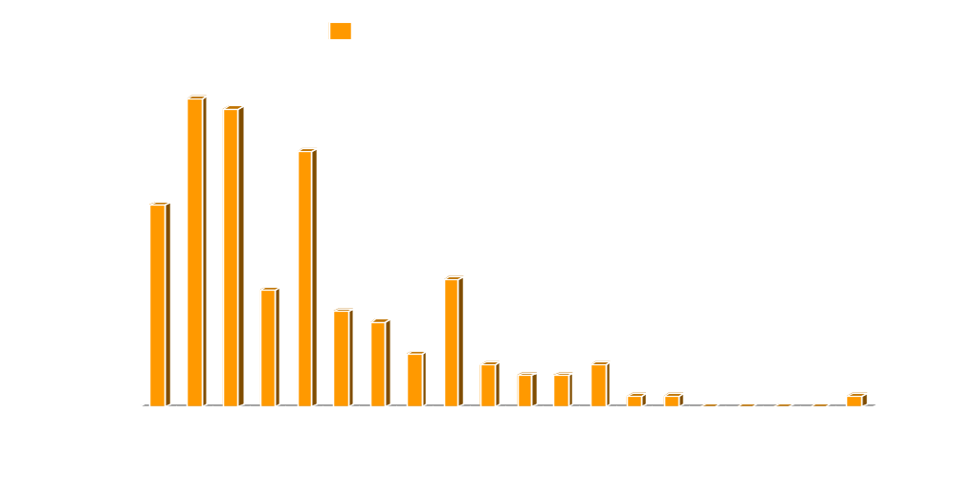
EcoCyc Pathway Length Distributions

Slide 48
EcoCyc Procedures
DB updates performed by 5 staff curators
  Information gathered from biomedical literature
  Corrections submitted by E. coli researchers
Review-level database (knowledge base)
Four releases per year
Quality assurance of data and software:
  Evaluate database consistency constraints
  Perform element balancing of reactions
  Run other checking programs
  Display every DB object

Slide 49
Scientists Served by EcoCyc
Experimentalists
  E. coli experimentalists
  Experimentalists working with other microbes
  Analysis of expression data
Computational biologists
  Biological research using computational methods
  Genome annotation
    “As part of a set of tools used to annotate the Rhodococcus sp. RHA1 genome”
  Global or systematic studies
Bioinformaticists
  Training and validation of new bioinformatics algorithms
Metabolic engineers
  “Design of organisms for the production of organic acids, amino acids, ethanol, hydrogen, and solvents “
Educators

Slide 50
EcoCyc Accelerates Science
Computational biology research using EcoCyc
  Microbial genome annotation
  Study topological organization of E. coli metabolic network
  Study organization of E. coli metabolic enzymes into structural protein families
  Study phylogentic extent of metabolic pathways and enzymes in all domains of life
Bioinformatics research using EcoCyc as gold standard
  Predict operons
  Predict promoters
  Predict protein functional linkages
  Predict protein-protein interactions and protein-fusion events
  Predict protein functions and interactions

Slide 51
MetaCyc: Metabolic Encyclopedia
Nonredundant metabolic pathway database
Describe a representative sample of every experimentally determined metabolic pathway
Literature-based DB with extensive references and commentary
Pathways, reactions, enzymes, substrates
Jointly developed by SRI and Carnegie Institution
Nucleic Acids Research 32:D438-442 2004

Slide 52
MetaCyc Curation
DB updates by 4 staff curators
  Information gathered from biomedical literature
  Emphasis on microbial and plant pathways
  More prevalent pathways given higher priority
  Curator’s Guide lists curation conventions
Review-level database
Four releases per year
Quality assurance of data and software:
  Evaluate database consistency constraints
  Perform element balancing of reactions
  Run other checking programs
  Display every DB object

Slide 53
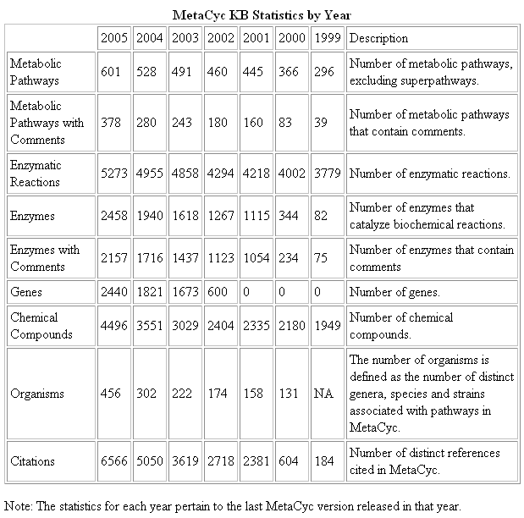
MetaCyc Data

Slide 54
BioWarehouse:
The Bio-SPICE Bioinformatics
Database Warehouse
Peter D. Karp, Tom J. Lee,
Valerie Wagner, Yannick Pouliot
BioCyc
UniProt
Taxonomy
BioWarehouse
ENZYME
[Oracle or
MySQL]
CMR
Genbank
KEGG
UniProt
BioCyc
Taxonomy
ENZYME
BioWarehouse
Oracle or
MySQL
CMR
= C-based Loader
= Java-based Loader
Genbank
KEGG

Slide 55
Technical Approach
Multi-platform support: Oracle (10G) and MySQL (3.23.58 )
Schema support for multitude of bioinformatics datatypes
Create loaders for public bioinformatics DBs
  Parse file format of the source DB
  Semantic transformations
  Insert DB contents into warehouse tables
Provide Warehouse query access mechanisms
  SQL queries via ODBC, JDBC, OAA

Slide 56
BioWarehouse Loaders
Loader | Language | Data Set
genbank-loader | JAVA | All bacterial sequences in the GenBank DB
uniprot-loader | JAVA | Swiss-Prot and TrEMBL protein DBs (XML)
biocyc-loader | C | BioCyc open PGDBs (e.g., B. anthracis, M. tuberculosis, V. cholerae)
cmr-loader | C | TIGR's Comprehensive Microbial Resource (CMR) DB of bacterial data
enumerations-loader | JAVA | BioWarehouse’s controlled nomenclature
ncbi-taxonomy-loader | C | NCBI's Taxonomy DB
enzyme-loader | JAVA | ENZYME DB of enzymatic reactions
KEGG-loader | C | KEGG DB of pathways
Miami-express | PERL | Loads microarray gene expression data in MIAMI format

Slide 57
Summary
Pathway/Genome Databases
  MetaCyc non-redundant DB of literature-derived pathways
  165 organism-specific PGDBs available through SRI at BioCyc.org
  Computational theories of biochemical machinery
Pathway Tools software
  Extract pathways from genomes
  Morph annotated genome into structured ontology
  Distributed curation tools for MODs
  Query, visualization, WWW publishing

Slide 58
BioCyc and Pathway Tools
Availability
WWW BioCyc freely available to all
  BioCyc.org
Most BioCyc DBs openly available
  Flatfiles downloadable from BioCyc.org
Pathway Tools freely available to non-profits
  PC/Windows, PC/Linux, SUN

Slide 59
Acknowledgements
SRI
  Suzanne Paley, Michelle Green, Ron Caspi, Ingrid Keseler, John Pick, Carol Fulcher, Markus Krummenacker, Alex Shearer
EcoCyc Project Collaborators
  Julio Collado-Vides, John Ingraham, Ian Paulsen
MetaCyc Project Collaborators
  Sue Rhee, Peifen Zhang, Hartmut Foerster
And
  Harley McAdams
Funding sources:
  NIH National Center for Research Resources
  NIH National Institute of General Medical Sciences
  NIH National Human Genome Research Institute
  Department of Energy Microbial Cell Project
  DARPA BioSpice, UPC
BioCyc.org

