Slide 1


Slide 2
gmod update
Gmod-0.003-RC2 last week
New for 0.003:
  Generic triggers for Apollo
  Greatly enhanced gff3 bulk loading:
    Doesn’t depend on Class::DBI
    All tags but Gap supported
    Loads refseqs/srcfeatures/chromosomes
    Loads sequence
  Better support for multiple databases

Slide 3
TODO for gmod-0.01
Modify the bulk loader to allow 'mixed' GFF3 files (that is, containing both analysis results and annotations). See perldoc gmod_bulk_load_gff3.pl for more info
Modify the bulk loader to optionally spit INSERT statements in the the files rather than the COPY FROM STDIN format as a fall back for really big files
Modify the bulk loader to (optionally) make gene (foster) parents for orphan transcript types.
Deprecate the use of gmod_load_gff3.pl in favor of the bulk loader
Migrate ontology loading to use go-perl (instead of Class::DBI--which may completely eliminate the need for having Class::DBI installed (except for turnkey))
Flesh out Apollo stuff to be more transparent to the person doing the installation
Make a decision on sequence shredding and implement appropriate views and functions

Slide 4


Setting up ParameciumDB
(or my trip to France)
Scott Cain
GMOD Meeting,
May 16-17, 2005

Slide 5
Background
Paramecium community is fairly small and largely European.
Hosted at CNRS, Gif-sur-Yvette
ParameciumDB is has two developers:
  Linda Sperling, Centre de Genetique Moleculaire faculty member with an interest in bioinformatics
  Olivier Arnaiz, MS Bioinformatics

Slide 6
Why use GMOD tools
The green paper (Nov. ’01) that said that the target was ‘small’ MODs, with the goal of having reusable components
Active developers on the main projects
“If Michael Ashburner and Lincoln Stein are involved, that’s the project for me”

Slide 7
Initial Goals
Install (much of this was accomplished before my arrival in France):
  Chado
  GBrowse
  Turnkey
  XORT
Populate with the megabase (a one megabase section of the genome hand assembled and curated); complete genome to come later this year.

Slide 8
Issues they faced
Content control, both for versioning and rolling out to staging and production servers
  cvs
Incorporation of custom module
  stock
Getting turnkey ‘to work’
  Hand editing of perl modules and templates from gmod-web-RC1 (about 6 months old)

Slide 9
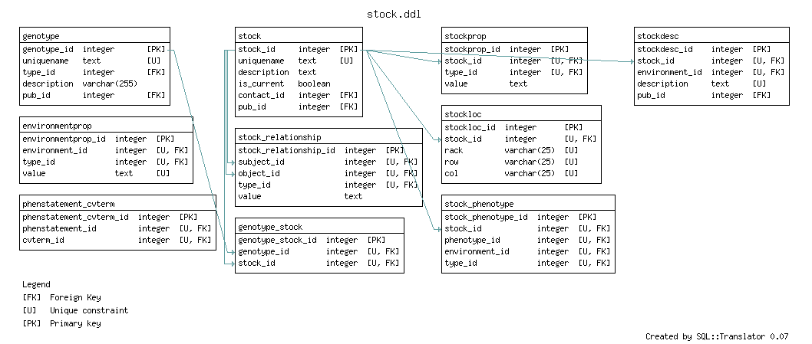
ParameciumDB stock module

Slide 10
Other ‘Problems’
Making all features ‘part_of’ chromosome (redundant with srcfeature_id in featureloc)
Making analysis results children of genes
GBrowse chado adaptor bugs (all squashed now :-)
Little stuff—getting parsers and loaders bug free

Slide 11
Future plans
Transition to new release of turnkey
Expansion of genotype and stock data to include RNAi data
Roll out of full genome in Fall ’05
Possibly, community reannotation using Apollo with chado and direct read/write (I set up a proof of concept in one of their chado databases with the Apollo functions and triggers and demonstrated that the chado adaptor worked (although it named the new genes ‘RICE000001’, etc))

Slide 12
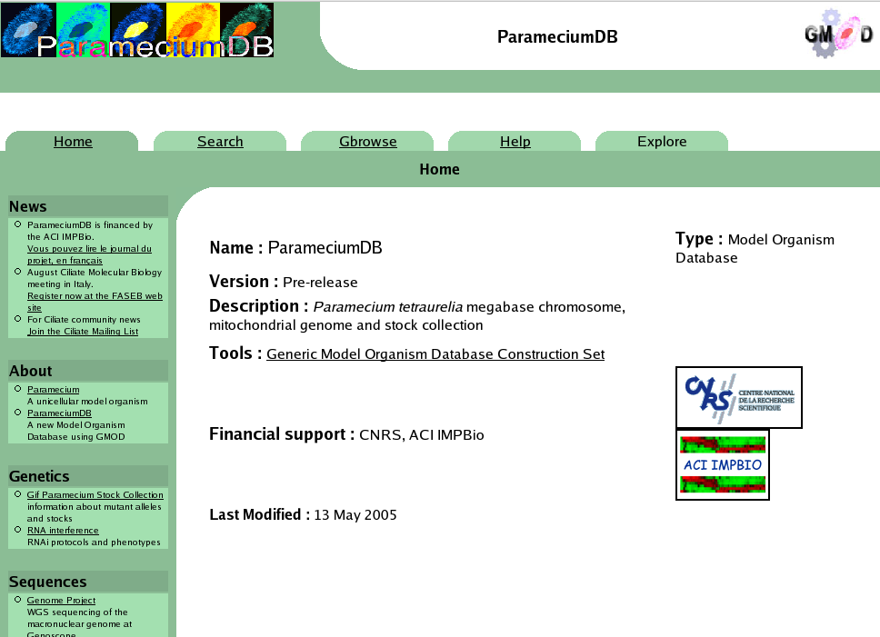

Slide 13
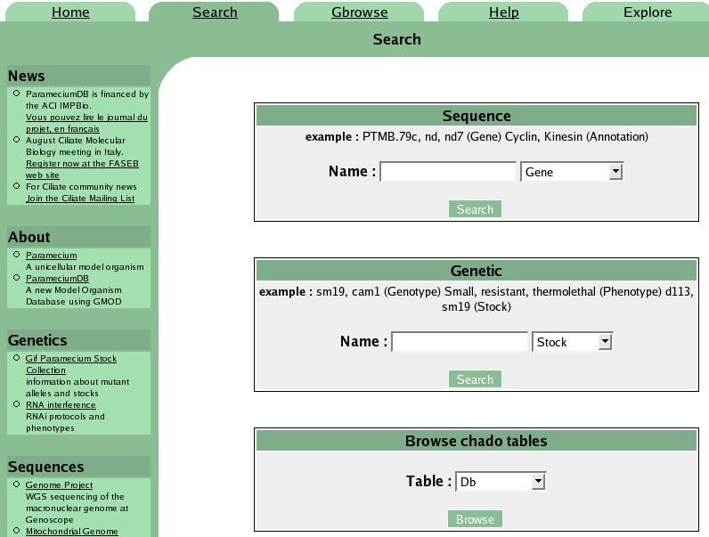

Slide 14
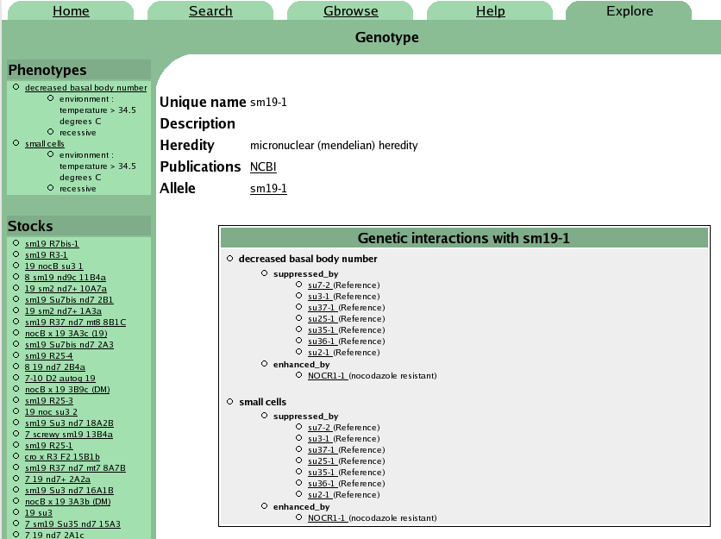

Slide 15
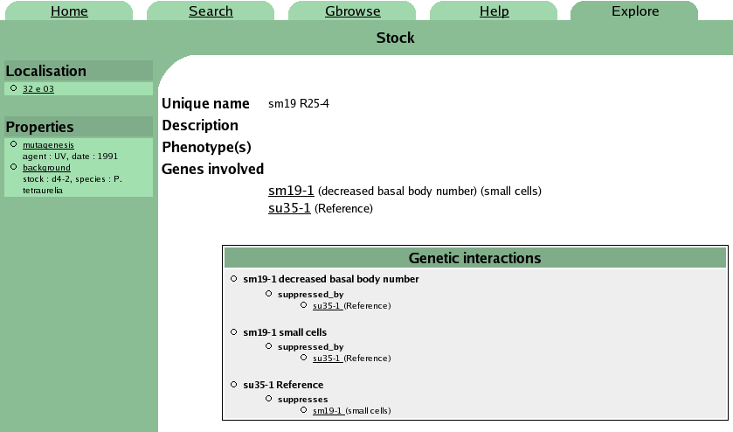

Slide 16
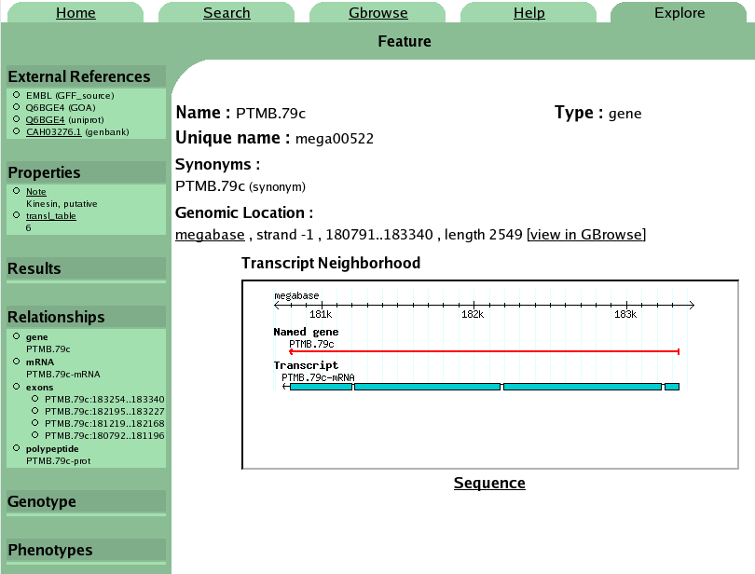

Slide 17
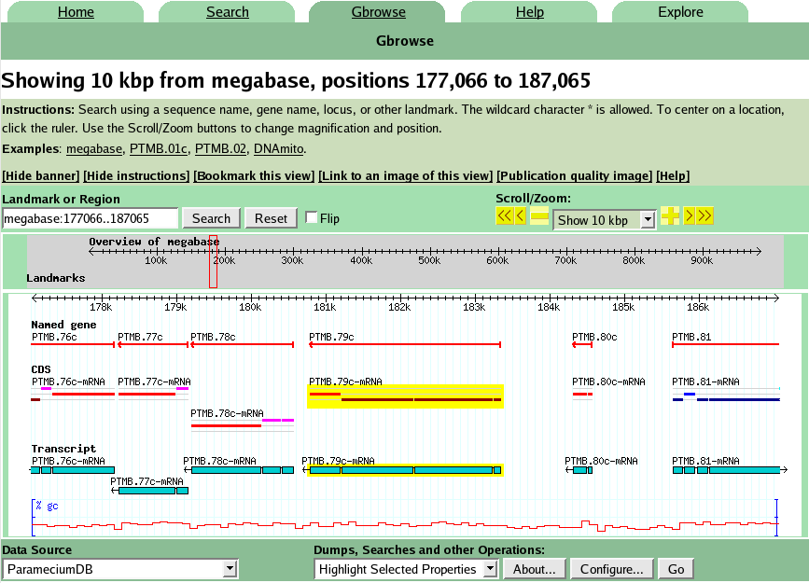

Slide 18
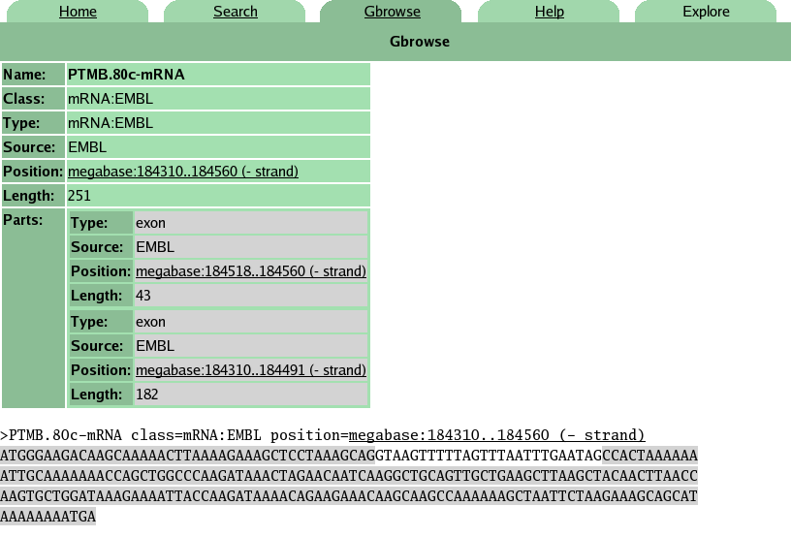

Slide 19
Conclusion
Linda and Olivier are both very happy with the GMOD tools they’ve used so far.
Documentation of GBrowse is quite good, chado’s is not bad (at least for installation), and turnkey’s, well, is coming along.
The goal of having it installable by a biologist and a sysadmin working together is largely realized for the core GMOD apps, though improvements to user interface are always welcomed.

Slide 20
Next GMOD meeting
CSHL Advanced bioioniformatics, Oct 12-25
GMOD Meeting, Oct 26-27?
CSHL Genome Informatics, Oct 28-Nov 1
OR
During the Biocurator meeting?

