Slide 1
GBrowse:
What’s New?
Lincoln Stein
GMOD Meeting, Toronto
October 2011

Slide 2
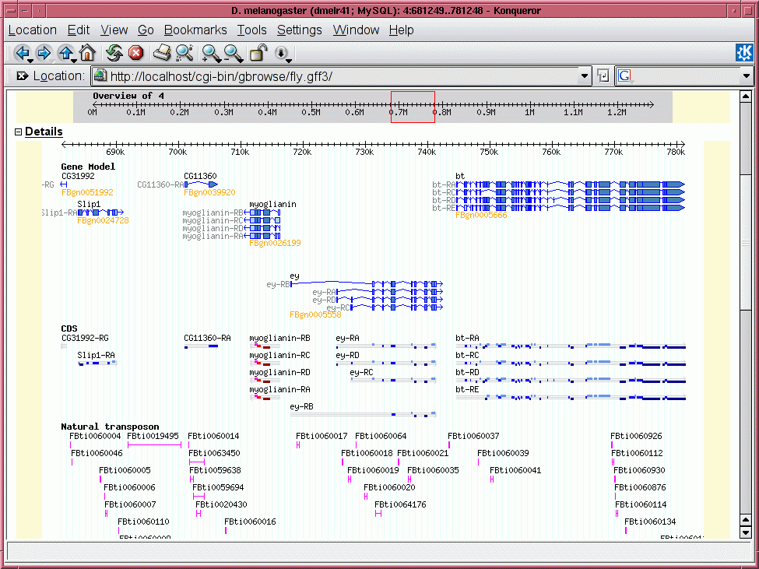
Open source web-based genome browser used by model organism Dbs and many other groups.
Adaptors for flat files, indexed files and many relational databases.
Highly customizable.
Large user and support community.
Part of the GMOD suite of integrated genome database applications

Slide 3
Features Added in 2011
v2.20 (1/2011) -> v2.41 (10/2011)
User Interface
  Horizontal dragging of tracks
  Floating ruler
  Track favorites
  Snapshots & user accounts
  iPad support
Internals
  Authentication plugin architecture (PAM, LDAP)
  Performance improvements
  EC2 cloud image (in progress)

Slide 4
Live Demo Time
Horizontal Scrolling
Floating Ruler
Track Filtering and Favorites
User Accounts
Track Sharing
Snapshots

Slide 5
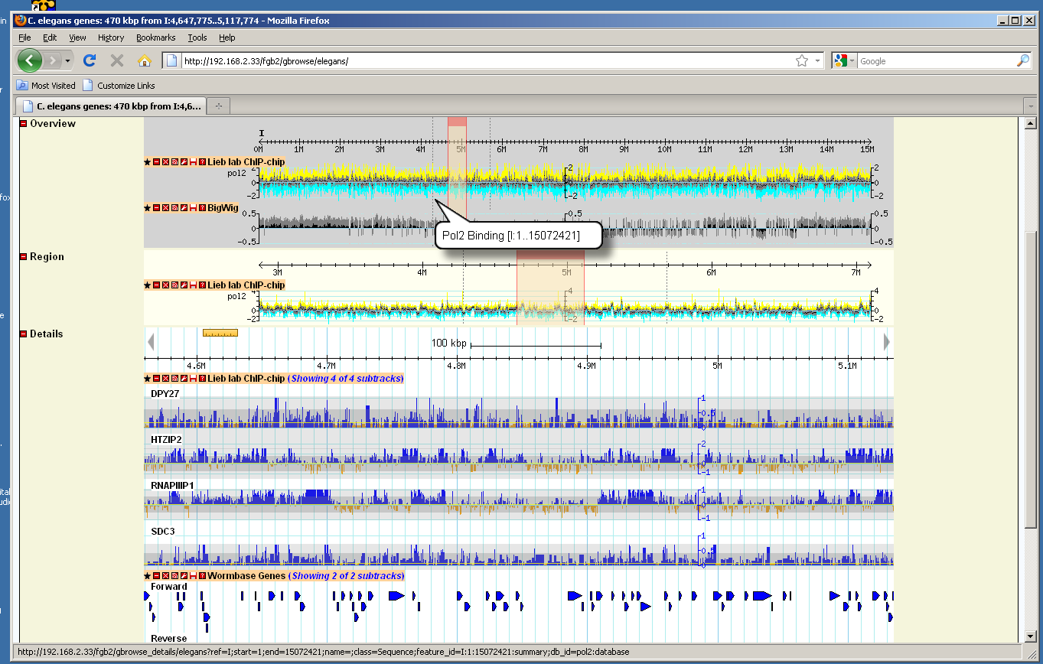
Horizontal Scrolling

Slide 6
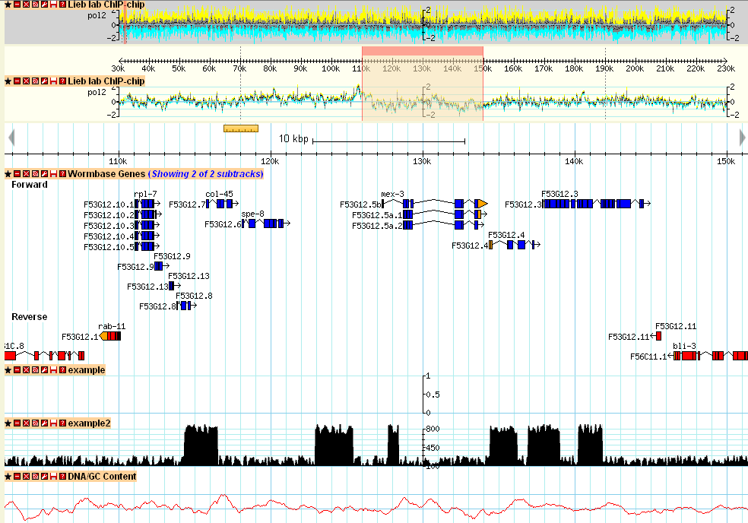
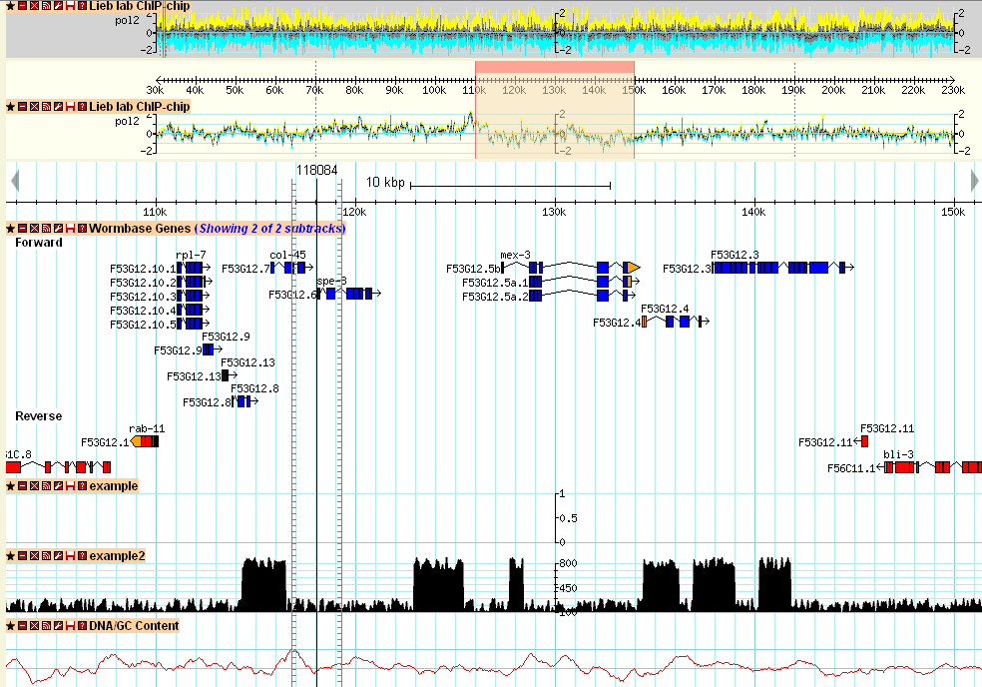
Floating Ruler

Slide 7
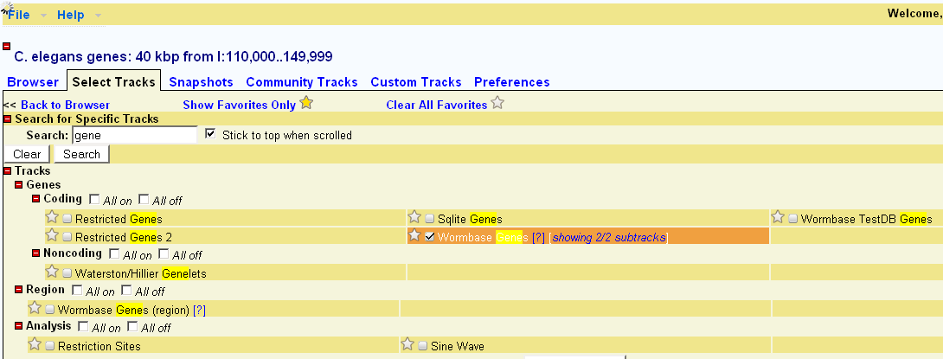
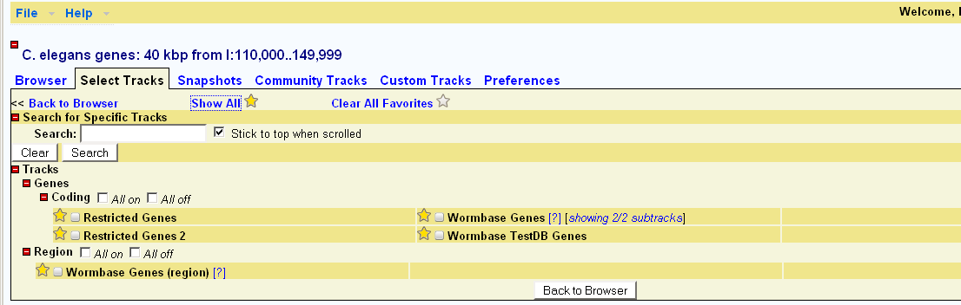
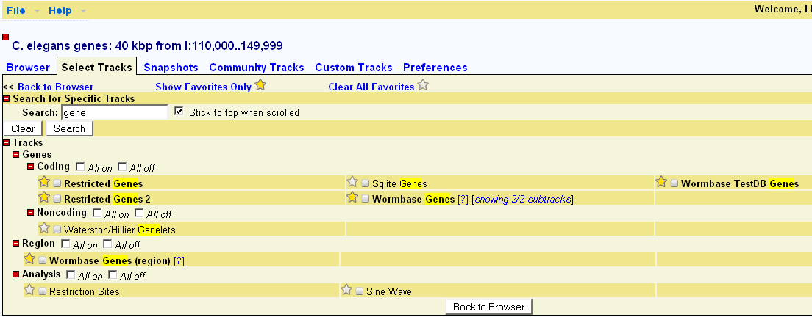
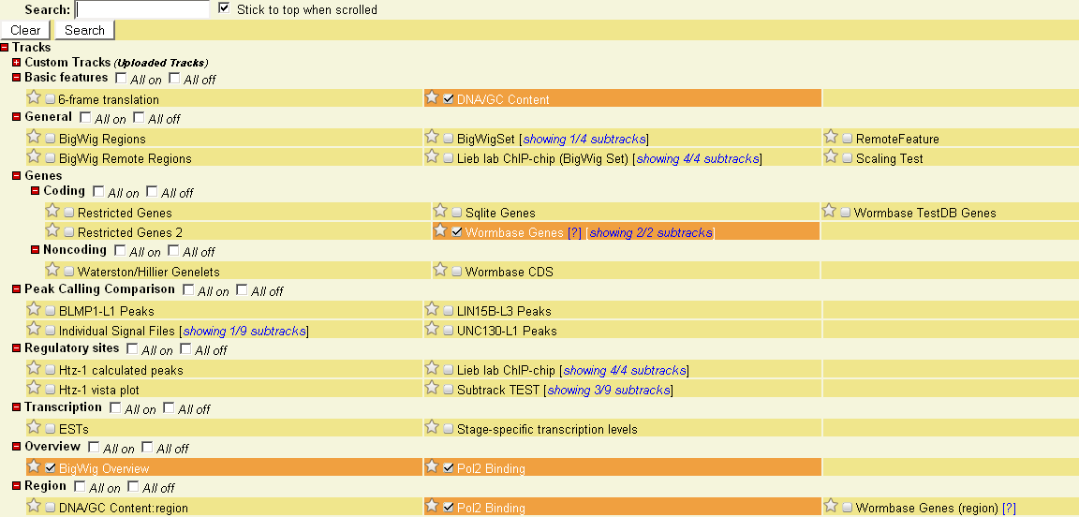
Track Filtering and Favorites

Slide 8
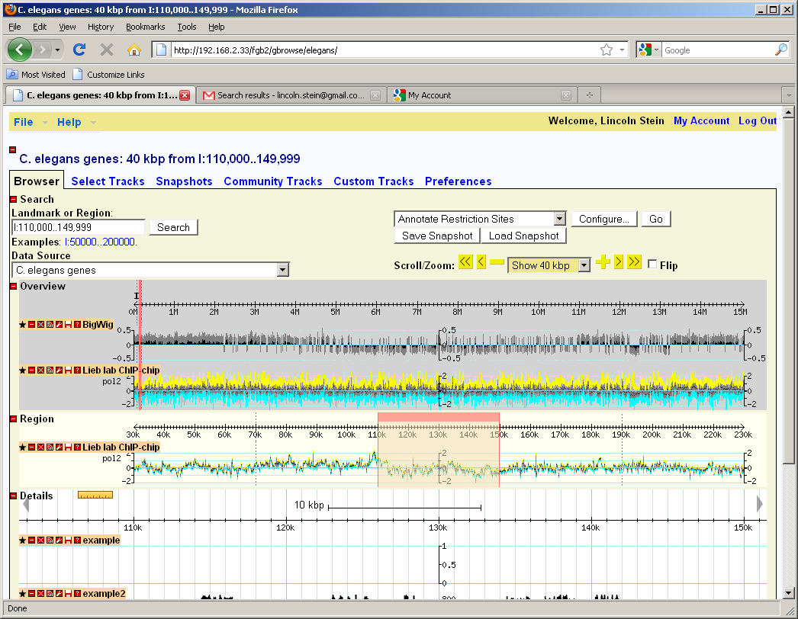
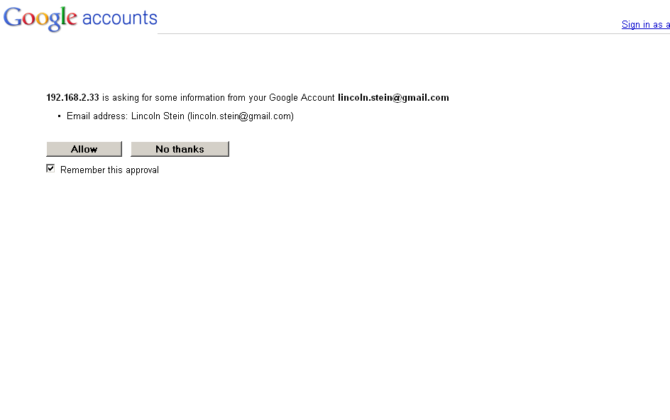
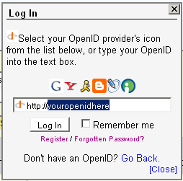
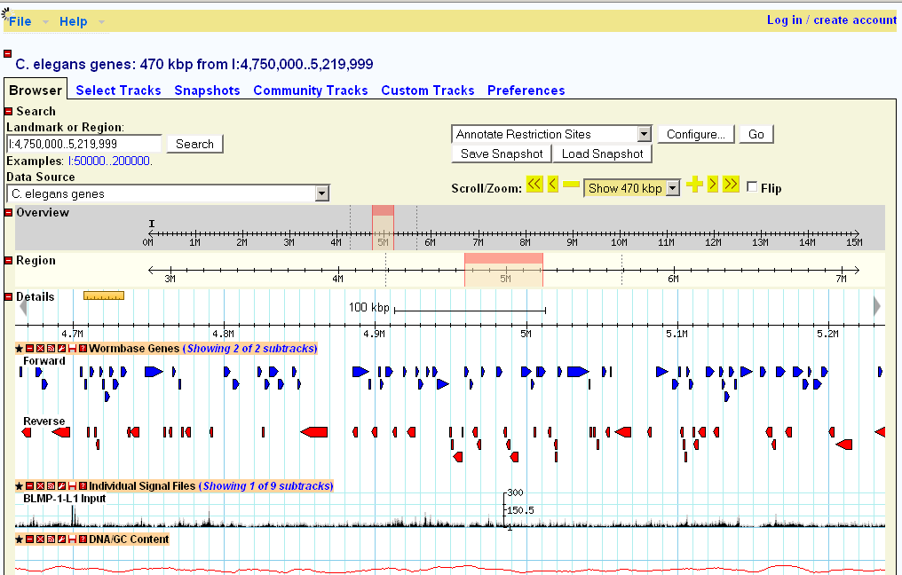
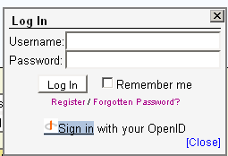
User Accounts

Slide 9
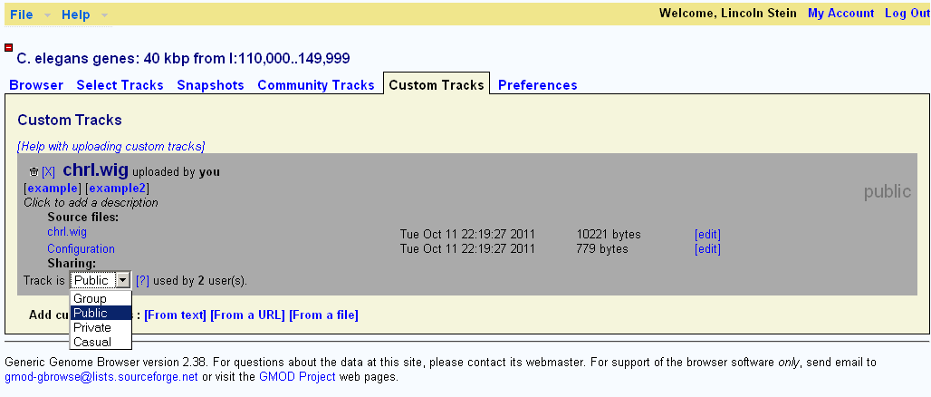
Track Sharing

Slide 10
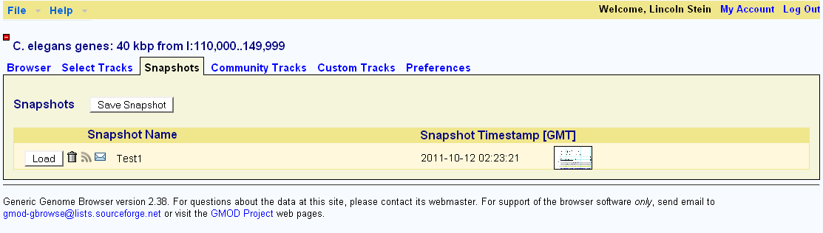
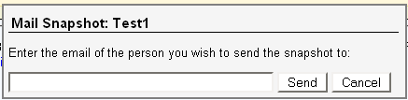
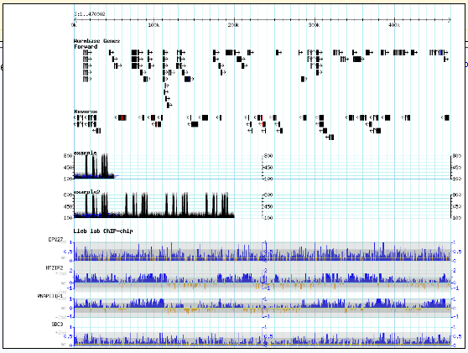
Snapshots

Slide 11
Authentication Plugins
Very general
  Plugin modules accept credentials.
  Return true if user is authenticated.
  (Optional) Provide user name and group(s)
Distributed plugins
  PAM – support Unix, LDAP, Kerberos, etc.
  LDAP – Support LDAP users and groups.

Slide 12
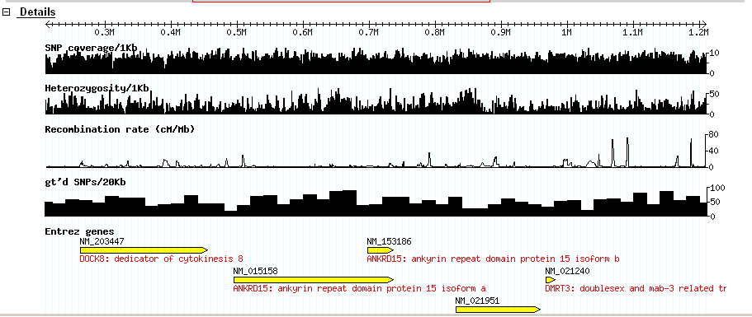
Performance Improvements
Cache parsed configuration files.
  Useful for configs with 1000’s of tracks.
Render-slave servers use preforking.

Slide 13
Cloud Image (in progress)
Master
Render
Slaves
Yeast
Fly
Worm
Human
Amazon Snapshots

Slide 14
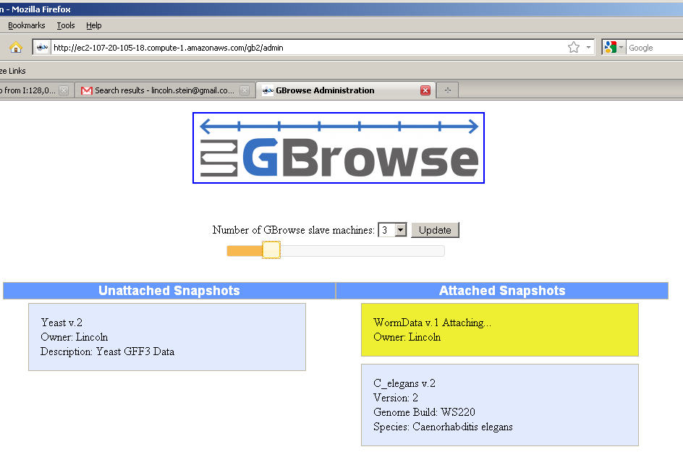
Cloud Admin Interface

Slide 15
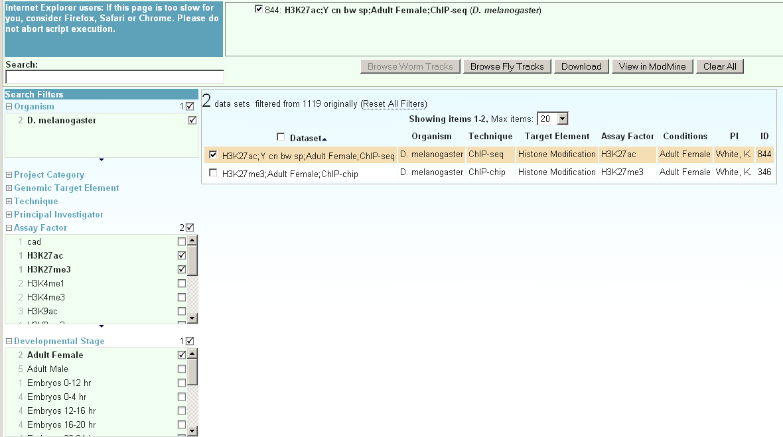
Faceted Track and Source Management (2.43?)

Slide 16
Source code, installation instructions & tutorials available at www.gmod.org
OICR
Scott Cain
Sheldon McKay
Peter Ruzanov
University of Waterloo
Ian Davies
Tony deCatanzaro
Ahmed Einalem
Sukhwinder Lall
Chris Vandevelde

