Slide 1
TableEdit and Wikibot Mediawiki
Jim Hu
Stein/Ware Retreat
May 14, 2007

Slide 2
Community Annotation with Wikis
The problem
  Wikis are potentially very nice for CA but the freetext nature of wiki content limits their usefulness
Possible solutions
  Semantic Mediawiki - extend markup (Users won’t do this)
  Natural language processing of wiki pages (Hard to implement)
  Tables
    Provide a natural way to display key-value pairs

Slide 3
The Plan
Community users
Curators
Special:TableEdit
Other GMOD tools
Wikibox_db
Wiki page
Chado
<!--box id=n-->
Table
<!--box id=n-->.
Mediawiki
Maintenance
Wikibox_Bot
<!--section id=n-->
Freetext comments
<!--section id=n-->.
Wikipage Parser
Key components:
Table editor (v0.3 prototype done)
Wikibox_bot

Slide 4
TableEdit, SpecialTableEdit, and wikibox_db
Community users
Special:TableEdit
Wikibox_db
Wiki page
TableEdit - allows placement of new tables
Special:TableEdit - allows forms-based editing of tables
Wikibox_db
  Box
    box_id, template, page_title, namespace, type, headings, heading_style, box_style, timestamp
  Row
    row_id, box_id, owner_uid, row_data, row_style, row_sort_order, timestamp
    col1 || col2 || col3 || …
<!--box id=n-->
Table
<!--box id=n-->.
<!--section id=n-->
Freetext comments
<!--section id=n-->.

Slide 5
My db is lighter than Todd’s
(but more complex than Ken’s)
box_id
template
page_name
page_uid
box_uid
type
headings
heading_style
box_style
timestamp
row_id
box_id
owner_uid
row_data
row_style
row_sort_order
timestamp

Slide 6
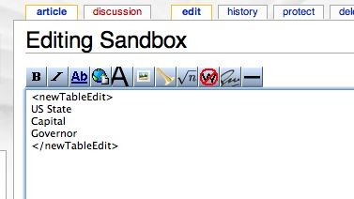
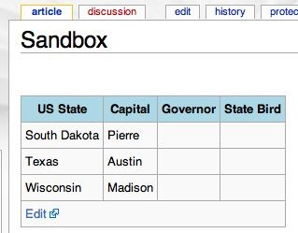
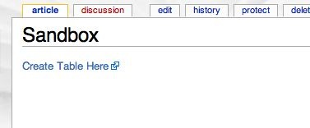
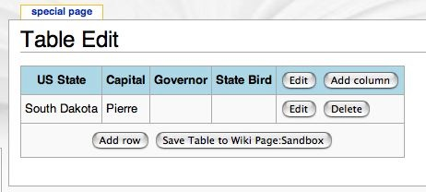
Using TableEdit

Slide 7
Using templates with TableEdit
<newTableEdit>Template:templatename</newTableEdit>
Template content can be simple or complex
  Simple: \n delimited list
Heading 1
Heading 2
Heading 3
Notes:
Templates are stored in the wiki - don’t need shell access to edit, load them

Slide 8
Using templates with TableEdit
<newTableEdit>Template:templatename</newTableEdit>
Template content can be simple or complex
  Intermediate: \n delimited list with extra properties
Heading||uniquename|property|params
Properties
  Text: use input type text instead of testarea
  Select: pulldown menu
    Pipe-delimited list of options
  Lookup: MySQL database lookup
    SQL statement
    Field
  Calc: simple calculation
    Calculation type
    Parameters
  Lookupcalc: Combines lookup and calc

Slide 9
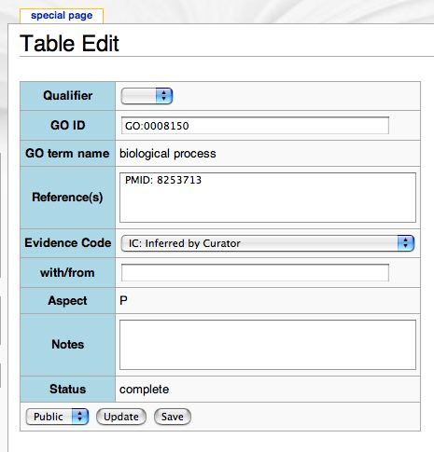
Template example
Qualifier||select| |NOT
GO ID||text
GO term name||lookupcalc|SELECT page_title FROM go_archive.term WHERE go_id = '{{{1}}}' ORDER BY term_update DESC LIMIT 1|page_title|split|_!_|1
Reference(s)
Evidence Code||select| |IC: Inferred by Curator|IDA: Inferred from Direct Assay|IEA: Inferred from Electronic Annotation|IEP: Inferred from Expression Pattern|IGC: Inferred from Genomic Context|IGI: Inferred from Genetic Interaction|IMP: Inferred from Mutant Phenotype|IPI: Inferred from Physical Interaction|ISS: Inferred from Sequence or Structural Similarity|NAS: Non-traceable Author Statement|ND: No biological Data available|RCA: inferred from Reviewed Computational Analysis|TAS: Traceable Author Statement|NR: Not Recorded
with/from||text
Aspect||lookup|SELECT namespace FROM go_archive.term WHERE go_id = '{{{1}}}' ORDER BY term_update DESC LIMIT 1|namespace
Notes
Status||calc|reqcomplete|1|3
Notes:
Cut to two examples

Slide 10
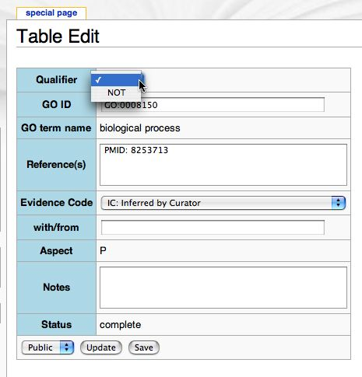
Template example
Qualifier||select| |NOT
GO ID||text
GO term name||lookupcalc|SELECT page_title FROM go_archive.term WHERE go_id = '{{{1}}}' ORDER BY term_update DESC LIMIT 1|page_title|split|_!_|1
Reference(s)
Evidence Code||select| |IC: Inferred by Curator|IDA: Inferred from Direct Assay|IEA: Inferred from Electronic Annotation|IEP: Inferred from Expression Pattern|IGC: Inferred from Genomic Context|IGI: Inferred from Genetic Interaction|IMP: Inferred from Mutant Phenotype|IPI: Inferred from Physical Interaction|ISS: Inferred from Sequence or Structural Similarity|NAS: Non-traceable Author Statement|ND: No biological Data available|RCA: inferred from Reviewed Computational Analysis|TAS: Traceable Author Statement|NR: Not Recorded
with/from||text
Aspect||lookup|SELECT namespace FROM go_archive.term WHERE go_id = '{{{1}}}' ORDER BY term_update DESC LIMIT 1|namespace
Notes
Status||calc|reqcomplete|1|3
select
Notes:
Example 1

Slide 11
Template example
Qualifier||select| |NOT
GO ID||text
GO term name||lookupcalc|SELECT page_title FROM go_archive.term WHERE go_id = '{{{1}}}' ORDER BY term_update DESC LIMIT 1|page_title|split|_!_|1
Reference(s)
Evidence Code||select| |IC: Inferred by Curator|IDA: Inferred from Direct Assay|IEA: Inferred from Electronic Annotation|IEP: Inferred from Expression Pattern|IGC: Inferred from Genomic Context|IGI: Inferred from Genetic Interaction|IMP: Inferred from Mutant Phenotype|IPI: Inferred from Physical Interaction|ISS: Inferred from Sequence or Structural Similarity|NAS: Non-traceable Author Statement|ND: No biological Data available|RCA: inferred from Reviewed Computational Analysis|TAS: Traceable Author Statement|NR: Not Recorded
with/from||text
Aspect||lookup|SELECT namespace FROM go_archive.term WHERE go_id = '{{{1}}}' ORDER BY term_update DESC LIMIT 1|namespace
Notes
Status||calc|reqcomplete|1|3
lookupcalc
Lookup alone gives:
GO0008150_!_biological_process
Notes:
Example 2

Slide 12
Using templates with TableEdit
<newTableEdit>Template:templatename</newTableEdit>
Template content can be simple or complex
  Advanced: tagged text:
<type>0</type>
<style>bgcolor=‘#6666FF’</style>
<headings>
Qualifier||select| |NOT
GO ID||text
GO term name||lookupcalc|SELECT page_title FROM go_archive.term WHERE go_id = '{{{1}}}’ ORDER BY term_update DESC LIMIT 1|page_title|split|_!_|1
Reference(s)
Evidence Code||select| |IC: Inferred by Curator|IDA: Inferred from Direct Assay|IEA: Inferred from Electronic Annotation|IEP: Inferred from Expression Pattern|IGC: Inferred from Genomic Context|IGI: Inferred from Genetic Interaction|IMP: Inferred from Mutant Phenotype|IPI: Inferred from Physical Interaction|ISS: Inferred from Sequence or Structural Similarity|NAS: Non-traceable Author Statement|ND: No biological Data available|RCA: inferred from Reviewed Computational Analysis|TAS: Traceable Author Statement|NR: Not Recorded
with/from||text
Aspect||lookup|SELECT namespace FROM go_archive.term WHERE go_id = '{{{1}}}' ORDER BY term_update DESC LIMIT 1|namespace
Notes
Status||calc|reqcomplete|1|3
</headings>

Slide 13
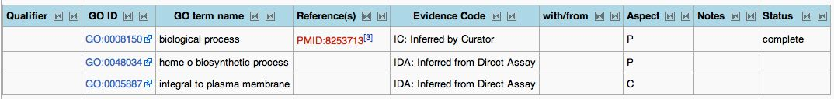
Hooks
MediaWiki Hooks:
  Hash of arrays hookname=>array=>Extension function names
  Extensions register their functions by adding to the appropriate hash for the hook they want to use.
Can define hooks inside extensions using same mechanism
  wfRunHooks( 'TableEditBeforeSave', array( &$this, &$table ) );
  #pass by reference
  $wgHooks['TableEditBeforeSave'][] = 'wfTableEditLinks';
  function wfTableEditLinks( $article, $table ){
  …code to do stuff to $table…
  }
TableEditLinks.php extension adds links based on regex
Foreshadowing: This became a design issue when I wrote the bot

Slide 14
The Next Step
Community users
Curators
Special:TableEdit
Other GMOD tools
Wikibox_db
Wiki page
Chado
<!--box id=n-->
Table
<!--box id=n-->.
Mediawiki
Maintenance
Wikibox_Bot
<!--section id=n-->
Freetext comments
<!--section id=n-->.
Wikipage Parser

Slide 15
Building the bot
Components:
  wikibot.pl - bot controller
    wikibot.pl -out for output from the wiki tables
    wikibot.pl -in for input into the wiki tables
  WikiBot.pm and a ridiculous number of other object classes
    get_wikirows
      reads the db and loads a data structure
      translates tags if necessary
      output xml-like tagged text to STDOUT
    save_wikirows
      take xml-like tagged text
      update the wikibox_db
      update the wiki via a php script runTableEdit.php
  runTableEdit.php
    runs parts of the table editor from the shell
  Various configuration pages in the wiki in the User namespace

Slide 16
Using wikibot -out
$ ./wikibot.pl -out -template GO_table_product -a JimHu/testadaptor1
<wikirows>
<row>
<page_name>Sandbox</page_name>
<page_uid>1861</page_uid>
<row_id>10</row_id>
<template>GO_table_product</template>
<box_uid>73c9eb6b3db48b95c5213e57bdbfb339.1861.1176475687</box_uid>
<go_id>GO:0000234</go_id>
<status>required field missing</status>
<aspect>F</aspect>
<go_term>phosphoethanolamine N-methyltransferase activity</go_term>
<notes>fake GO annotation for testing</notes>
<evidence>IDA: Inferred from Direct Assay</evidence>
</row>
…more rows…
</wikirows>

Slide 17
Using wikibot -in
$ ./wikibot_test.pl|./wikibot.pl -a JimHu/testadaptor1 -u JimHu -in
wikibot_test.pl generates some output
used a regex to munge it
output piped to wikibot.pl with params

Slide 18
Summary
TableEdit is ready for more testing
Bot just got to its current state yesterday
  Output is just yet another kind of text that different clients will have to parse
  Input works with a “standard” format
    If row_id is present, update, else insert
    Suggestions for improving the standard would be useful!
  Updating the wiki directly via the TableEdit instead of via XML
    Should be less prone to conflicts than saving and loading XML later.
  Probably should be rewritten to use Class::DBI at some point
Despite the need for more serious testing, I’m going to try to use this to load up EcoliWiki!

