Slide 1
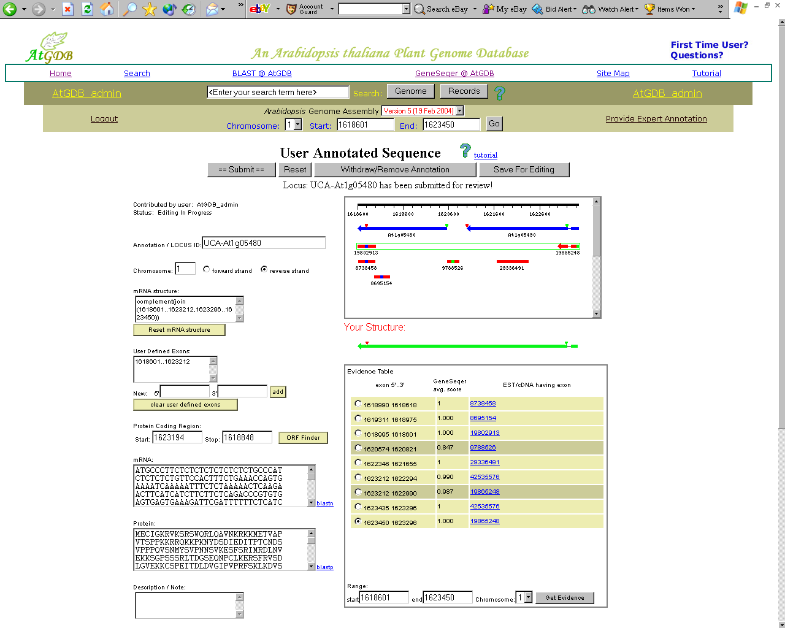
PlantGDB: Annotation Principles & Procedures

Slide 2
Genome Annotation
Computational gene modeling
  Ab initio approaches (Markov models)
  Spliced alignment
  Constrained gene prediction

Slide 3
GeneSeqer
Genomic Sequence
Fast Search
Spliced Alignment
EST or protein database
(Suffix Array/ Suffix Tree)
Output
Assembly

Slide 4
exon 44..160
/gene="kin2"
/number=1
CDS join(104..160,320..390,504..579) /gene="kin2"
/codon_start=1
/protein_id="CAA44171.1" /db_xref="GI:16354"
/db_xref="SWISS-PROT:P31169" I /translation= "MSETNKNAFQAGQAAGKAERRRAMFCWTRPRMLLLQLELPRNRA GKSISDAAVGGVNFVKDKTGLNK"
intron 161..319
/gene="kin2"
/number=1
exon 320..390
/gene="kin2"
/number=2
intron 391..503
/gene="kin2"
/number=2
exon 504..>579
/gene="kin2"
/number=3

Slide 5
LOCUS ATKIN2 880 bp DNA PLN 23-JUL-1992
CDS join(104..160,320..390,504..579)
EST Accession 3450035:
Exon 1 78 160 ( 83 n); cDNA 1 80 ( 80 n); score: 0.867
Intron 1 161 321 ( 161 n); Pd: 0.976 (s: 0.90), Pa: 0.972 (s: 1.00)
Exon 2 322 390 ( 69 n); cDNA 81 149 ( 69 n); score: 0.971
Intron 2 391 504 ( 114 n); Pd: 0.999 (s: 0.96), Pa: 0.964 (s: 0.98)
Exon 3 505 785 ( 281 n); cDNA 150 429 ( 280 n); score: 0.996
Alignment (genomic DNA sequence = upper lines):
///////
GTCAGGCCGC TGGCAAAGCT GAGGTACTCT TTCTCTCTTA GAACAGAGTA CTGATAGATT 197
|||||||||| |||| ||||| |||
GTCAGGCCGC TGGCCAAGCT GAG....... .......... .......... .......... 80
///////
ATAGGAGAAG AGCAATGTTC TGCTGGACAA GGCCAAGGAT GCTGCTGCTG CAGCTGGAGC 377
|||||| |||||||||| |||||||||| |||||||||| |||||||||| |||||||||
....GAGAAG AGCAATGTTC TGCTGGACAA GGCCAAGGAT GCTGCTGCTG CAGCTGGAGN 136
TTCCGCGCAA CAGGTAAACG ATCTATACAC ACATTATGAC ATTTATGTAA AGAATGAAAA 437
|||||| ||| |||
TTCCGCNCAA CAG....... .......... .......... .......... .......... 149
///////
GTTATAGGCG GGAAAGAGTA TATCGGATGC GGCAGTGGGA GGTGTTAACT TCGTGAAGGA 557
||| |||||||||| |||||||||| |||||||||| ||||||||| ||||||||||
.......GCG GGAAAGAGTA TATCGGATGC GGCAGTGGGA GGTGTTAAC- TCGTGAAGGA 201
///////
>Pcorrect (gi|399298|sp|P31169|KIN2_ARATH)
MSETNKNAFQ AGQAAGKAEE KSNVLLDKAK DAAAAAGASA QQAGKSISDA AVGGVNFVKD KTGLNK
>Pfalse (gi|16354|emb|CAA44171.1)
MSETNKNAFQ AGQAAGKAER RRAMFCWTRP RMLLLQLELP RNRAGKSISD AAVGGVNFVK DKTGLNK
Example of an erroneous GenBank annotation. The GenBank CDS gives incorrect assignment of both acceptor sites (319 should be 321, 503 should be 504), as pointed out by Korning et al. (1996). Spliced alignment with an Arabidopsis EST by the GeneSeqer program [Usuka & Brendel, 2000] proves the correct assignment (identities between the genomic DNA, upper lines, and EST, lower lines, are indicated by |; positions of the rightmost residues in each sequence block are given on the right; introns are indicated by …; for brevity, some sequence segments are replaced by ///////). The erroneous intron assignment led to an incorrect protein sequence prediction (Pfalse). Both the incorrect sequence and the correct protein sequence (Pcorrect) persist in the NCBI non-redundant protein database under different accessions.

Slide 6
LOCUS ATKIN2 880 bp DNA PLN 23-JUL-1992
CDS join(104..160,320..390,504..579)
=>
>Pfalse (gi|16354|emb|CAA44171.1)
MSETNKNAFQ AGQAAGKAER RRAMFCWTRP RMLLLQLELP RNRAGKSISD AAVGGVNFVK DKTGLNK
CORRECT ANNOTATION:
CDS join(104..160,322..390,505..579)
=>
>Pcorrect (gi|399298|sp|P31169|KIN2_ARATH)
MSETNKNAFQ AGQAAGKAEE KSNVLLDKAK DAAAAAGASA QQAGKSISDA AVGGVNFVKD KTGLNK

Slide 7
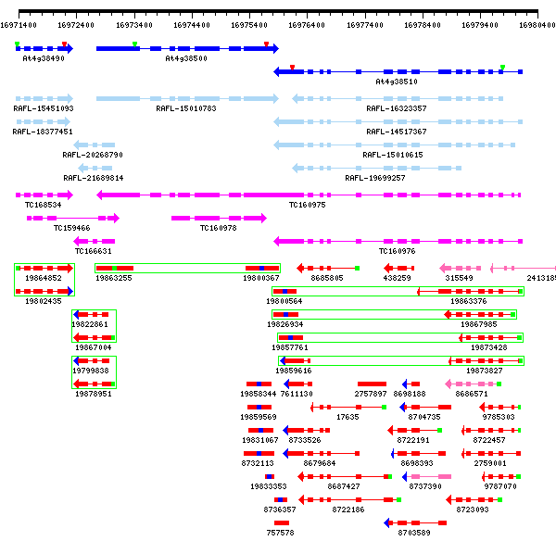
GenBank
Annotations
Fl-cDNA
Alignments
TIGR Consensus
Alignments
EST
Alignments

Slide 8
Principles of the PlantGDB Annotation System
Visually accessible
  To both curators & community users
Integrate automated & non-automated
Dynamic & Distributed
  A community “ owned & operated ” model

Slide 9
Gene Structure Annotation Problems
False intergenic region:
  Two annotated genes actually correspond to a single gene
False intronic region:
  One annotated gene structure actually contains two genes
False negative gene prediction:
  Missing annotation
Other:
  partially incorrect gene annotation, missing annotation of alternative transcripts

Slide 10
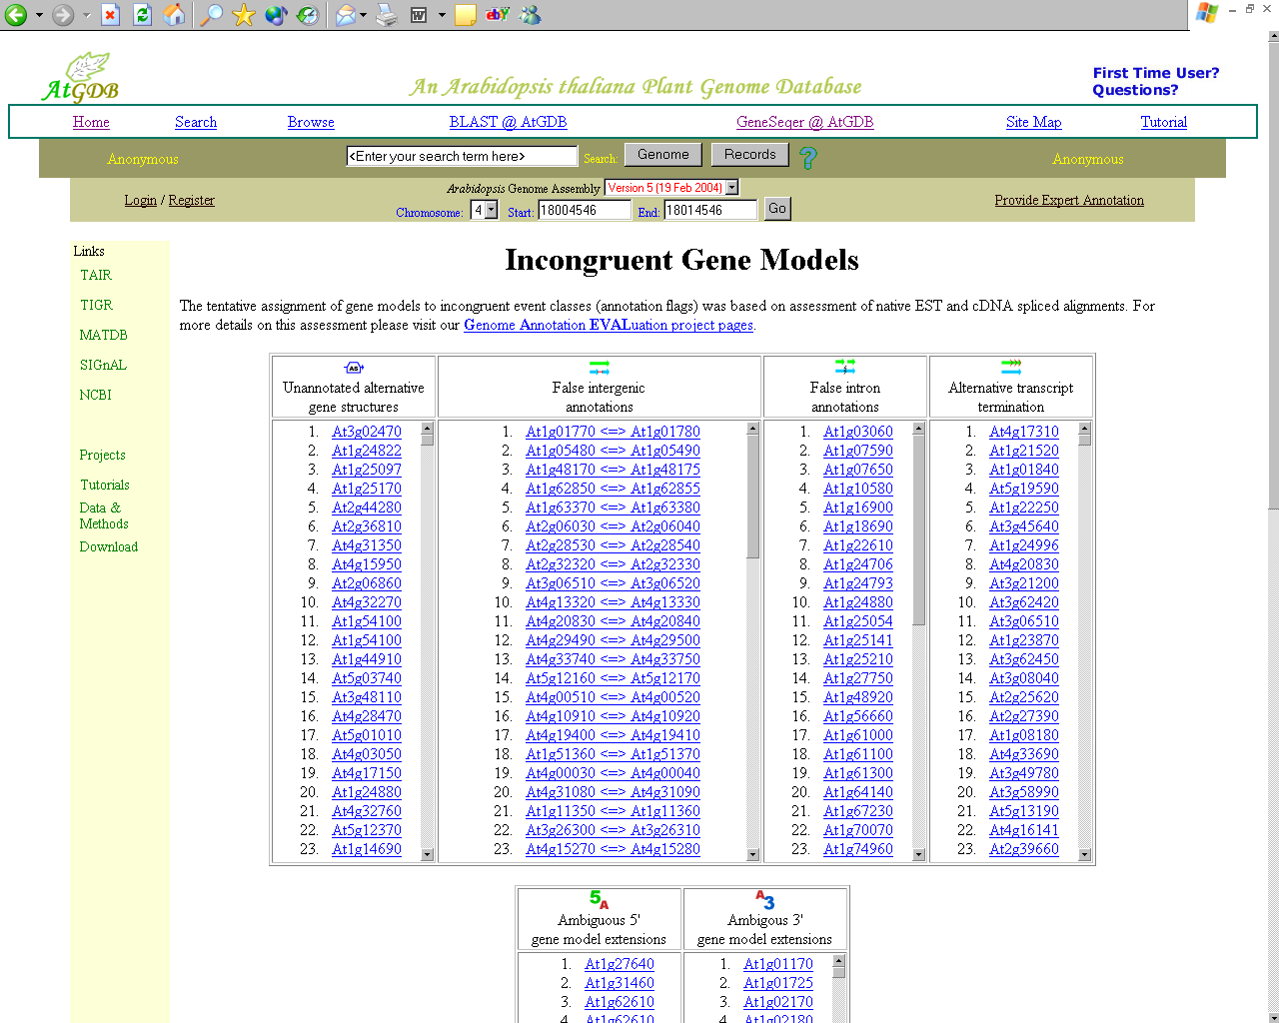

Slide 11
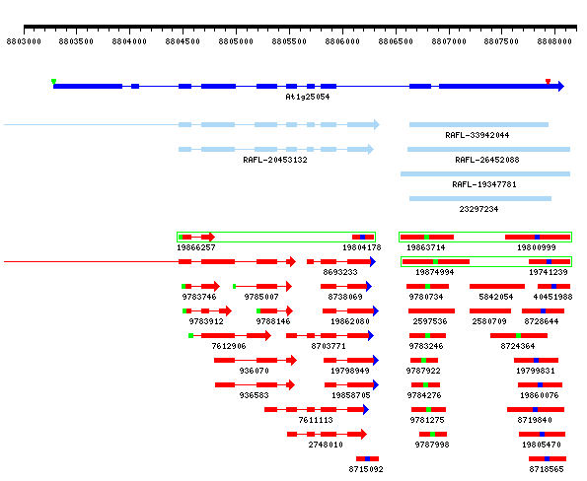

Slide 12
A Web-Based Gene Structure Annotation System
Evaluate a local region using all available EST and protein mapping data
Derive a gene structure (expert) annotation
Funnel contributed annotation through a curation check
Publish confirmed annotation to the WWW

Slide 13
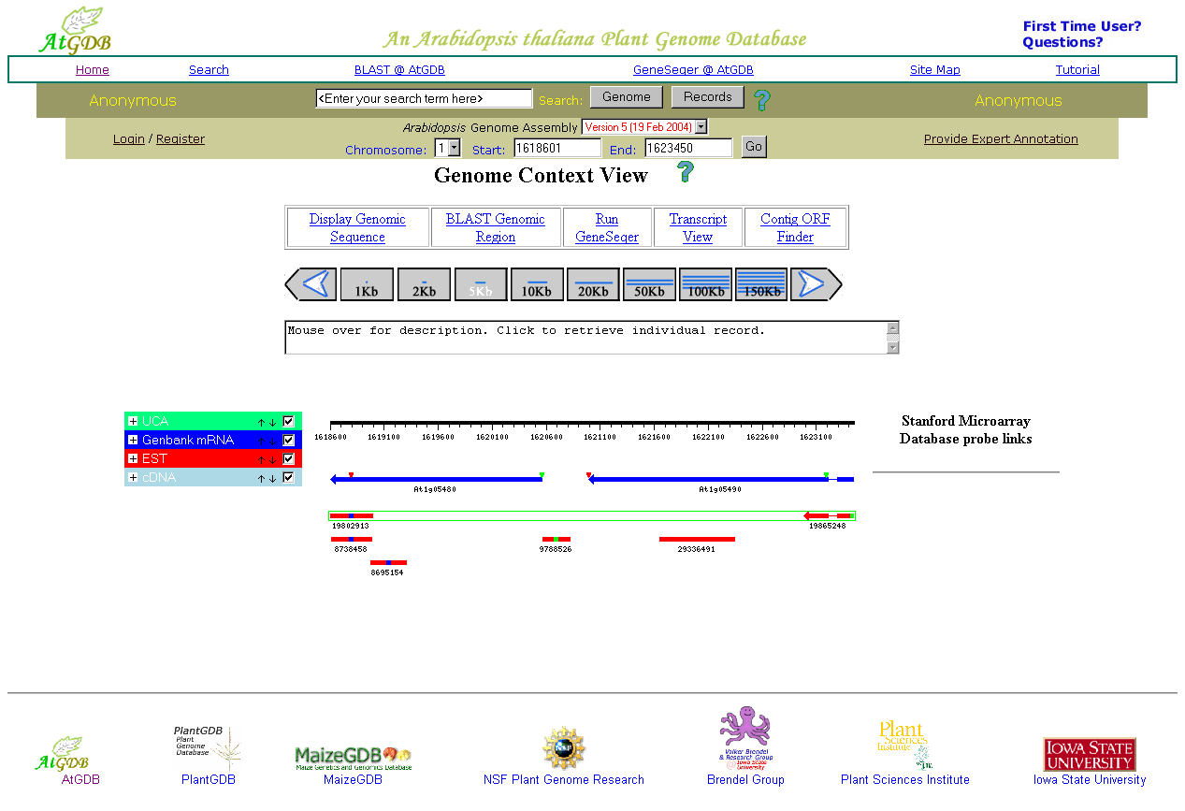

Slide 15
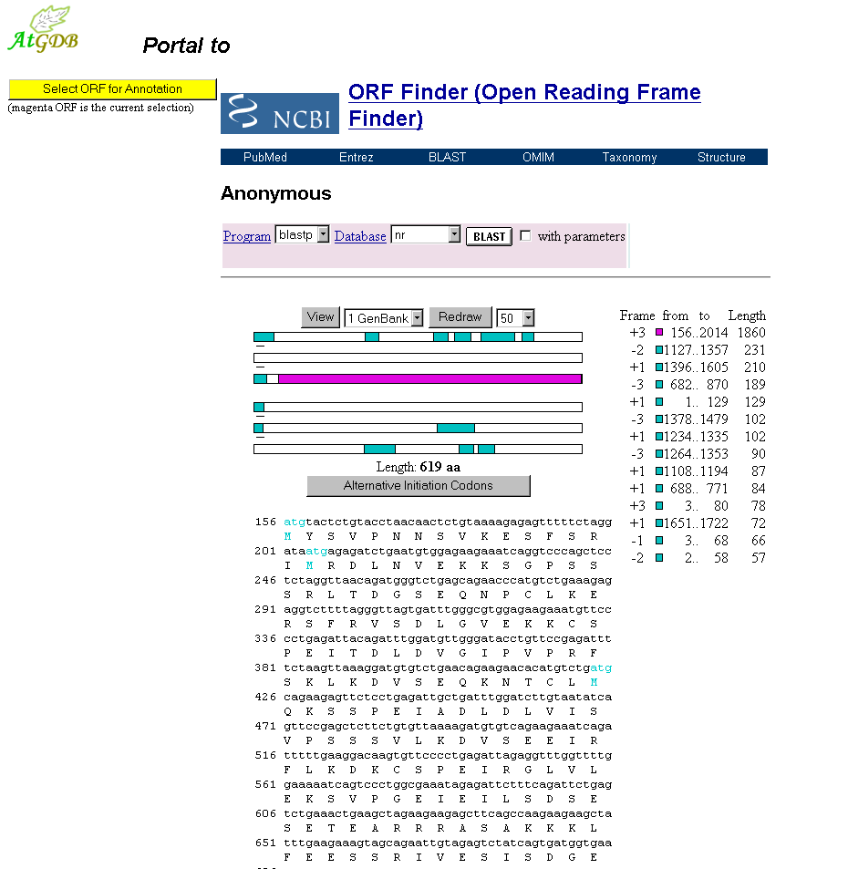

Slide 16
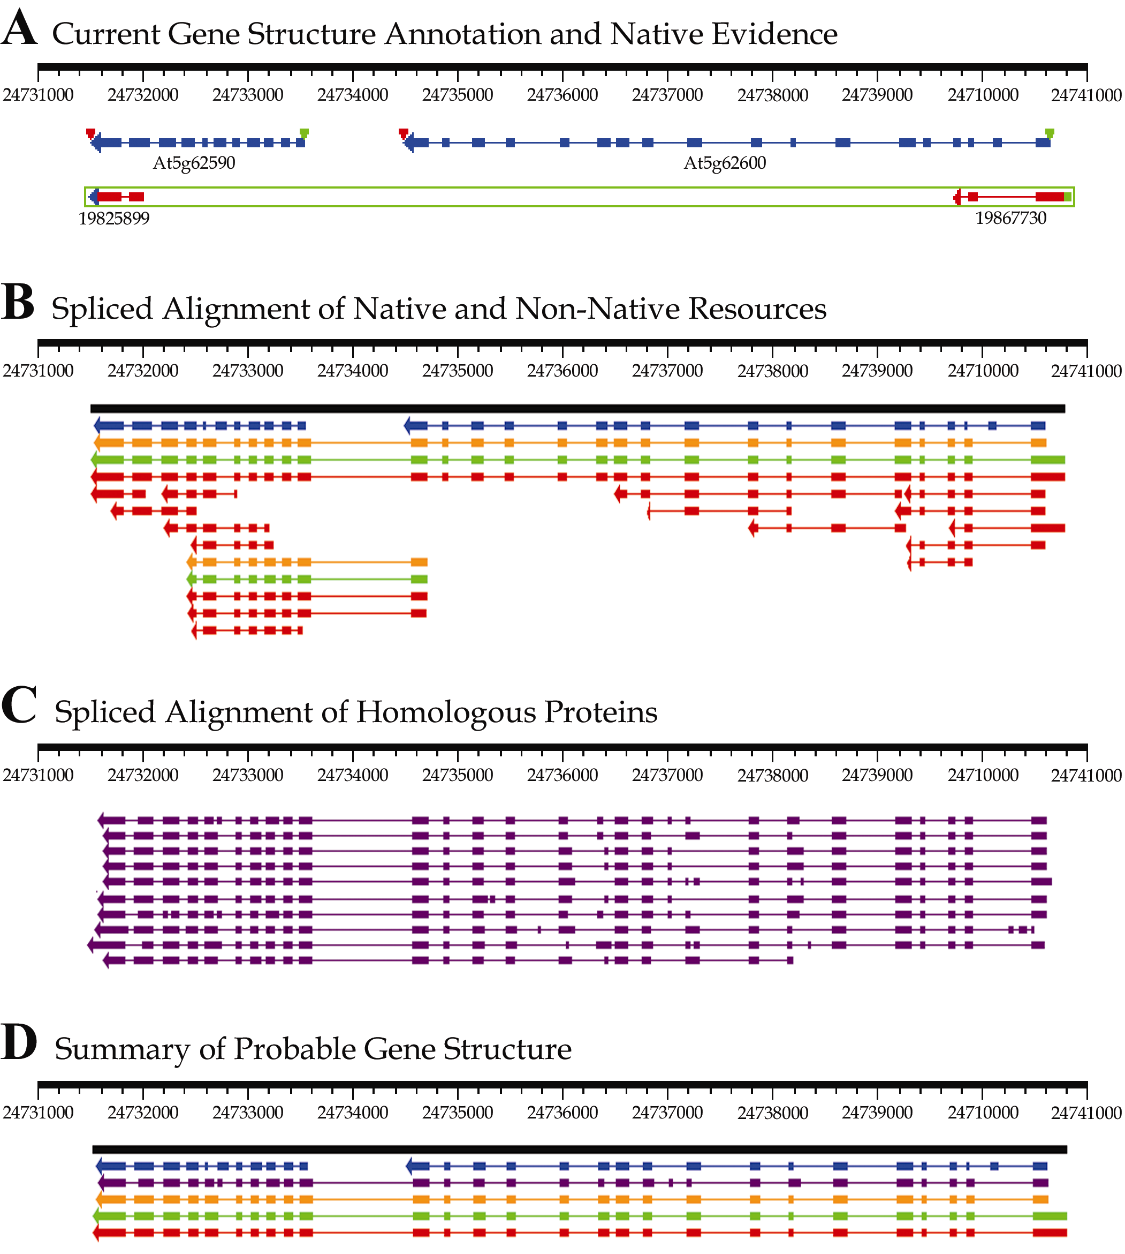
Nucl. Acids Res. 32, D354-D359

Slide 17
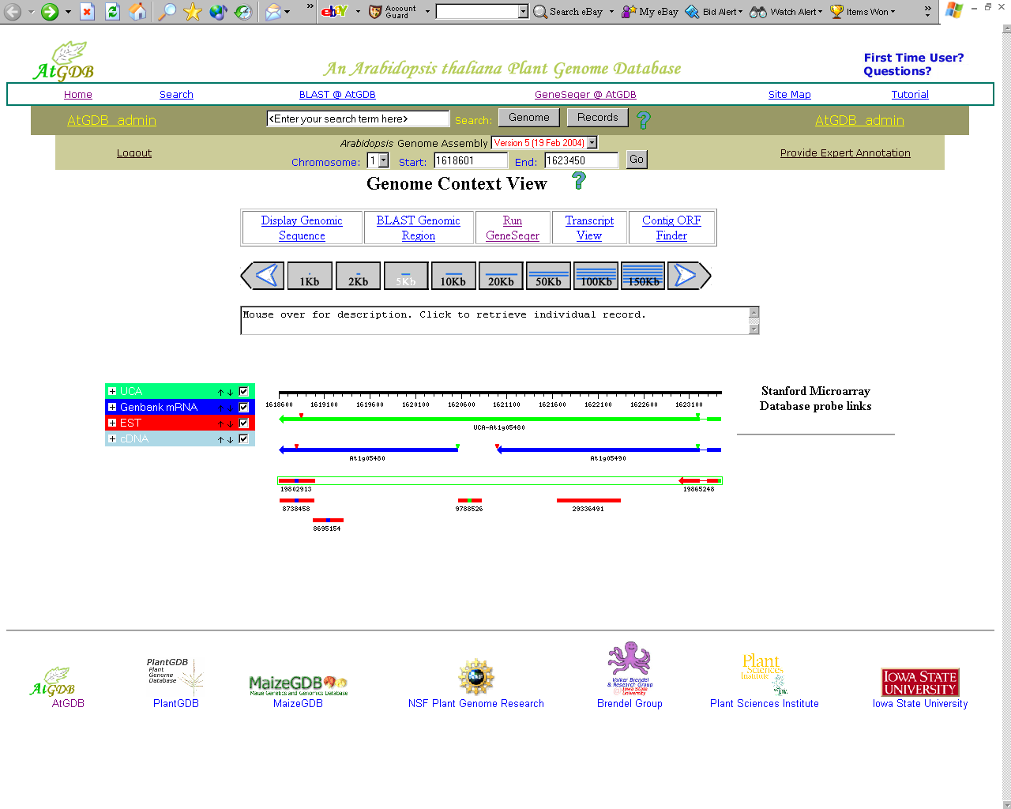

Slide 18
References
http://www.plantgdb.org/
http://www.plantgdb.org/AtGDB/
Zhu, Schlueter & Brendel (2003) Plant Physiology 132, 469-484
Schlueter, Dong & Brendel (2003) Nucl. Acids Res. 32, D354-D359
Acknowledgement
Volker Brendel
Qunfeng Dong
Matthew Wilkerson

