Slide 1
CMap and CMAE
Progress towards CMap 1.0
CMAE - CMap Assembly Editor
Ben Faga

Slide 2
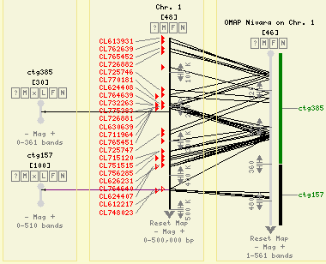
CMap

Slide 3
Highlighted Features in CMap 1.0
Dot plot view
Heat map glyph
Configurable buttons
Network install script
Bug Fixes

Slide 4
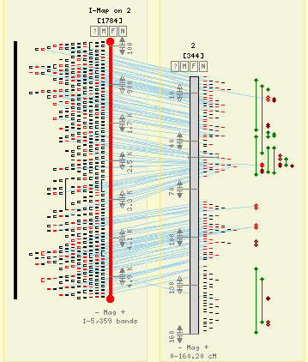
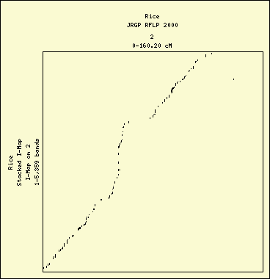
Dot Plot

Slide 5
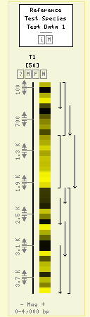
Heat Map Feature Glyph

Slide 6
Path to 1.0
Update Tutorial
Spice up Chado Synchronization
Test
Beta Test
VMWare Appliance
Release

Slide 7
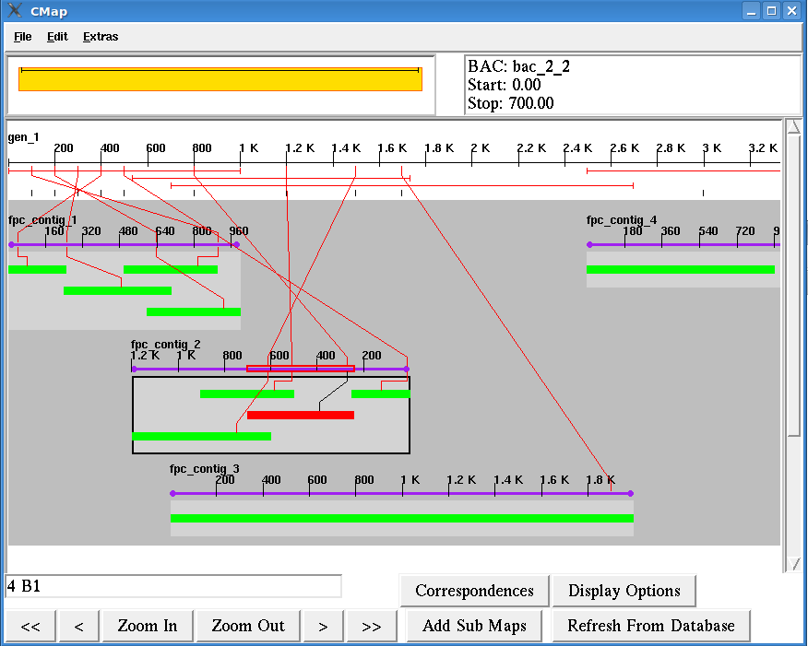
CMAE – CMap Assembly Editor

Slide 8
Thank You

