Slide 1
BioMart and CHADO
Arek Kasprzyk
GMOD meeting
16 May 2005

Slide 2
BioMart
User interfaces ‘advanced search’
  Web wizard
  GUI
  Text
Query optimization
Federation
Structured database views (dataset)

Slide 3
BioMart schema
databases
datasets

Slide 4
Dataset
Organised into 1 - n tables with 0,1 level referencing (database view)
Filters, Attributes
Exportables, Importables, Links
Properties captured by dataset configuration file
Can be derived from source schema by fixed schema transformation

Slide 5
Datasets and schema
Relational DB analogies
  Each dataset -> table
    Relational attributes translated to unique filters and attributes
  exportable/importable ->PK/FK
  A collection of datasets with unique names create a virtual schema

Slide 6
Structured and ‘ad hoc’ database views

Slide 7
Dataset
FK
FK
PK
PK
FK
FK

Slide 8
Dataset
PK
PK
FK
FK
FK
FK
FK
FK
PK
PK
PK
FK
FK

Slide 9
Dataset
FK
FK
FK
FK
PK
PK
FK
FK
FK
FK

Slide 10
Dataset - ‘reversed star’
FK1
PK1
main1
FK1
dm
dm
FK1
FK2
PK1
FK1
FK2
FK2
PK2 FK1
FK2
dm
2
FK2
PK2
PK1
FK2

Slide 11
Dataset
Fixed schema transformation
A
C
T_{A}
B
T_{B}

Slide 12
Transformation principles
Main
  1:1, n:1
Dimension
  1:n
  1:1,n:1

Slide 13
Application
Read database meta data
User input:
  main, dms, cardinalities
Write a configuration file
Translate configuration into DDLs
MartBuilder

Slide 14
Transformation configuration file
Focus tables
  Main,dm
Central, reference tables
Type: exported, imported
Keys
Optional
  Columns subset,
  User table names,
  Projections,
  Central filters

Slide 15
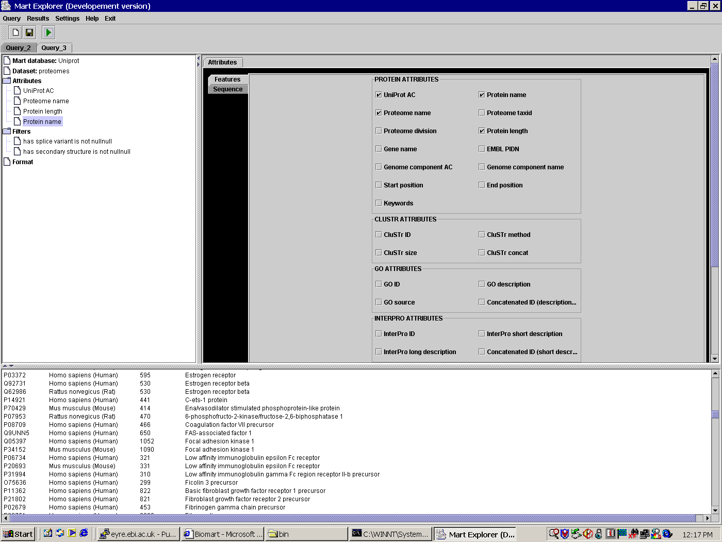
Datasets, Attributes and Filters
Mart
Dataset
Attribute
GENE
gene_id(PK)
gene_stable_id
gene_start
gene_chrom_end
chromosome
gene_display_id
description
Filter

Slide 16
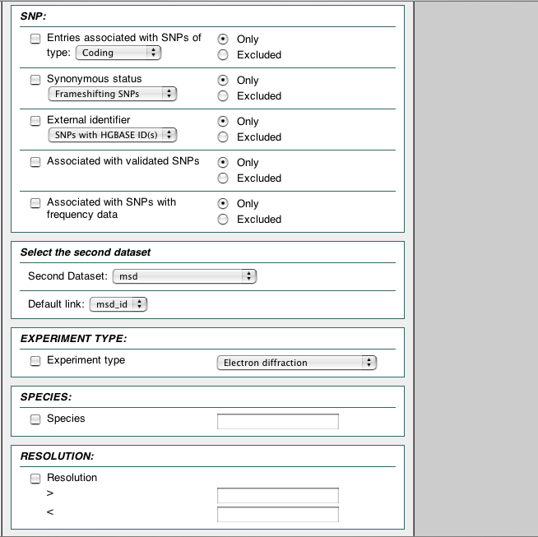
Exportables,
Importables and Links
Dataset 1
Links
Dataset 2

Slide 17
Exportables,
Importables and Links
Links
Exportable
Importable
name = uniprot_id
attributes = uniprot_ac
name = uniprot_id
filters = uniprot_ac_list
UniProt
Human Ensembl Genes
SELECT uniprot_ac FROM ...
SELECT … FROM … WHERE uniprot_ac IN (….)

Slide 18
Exportables,
Importables and Links
Links
Exportable
Importable
name=genomic_region
attributes=chr_name,
chr_start,
chr_end
name=genomic_region
filters=chr_name (=),
chr_start (>=),
chr_end (<=)
Human Ensembl Genes
Encode
SELECT chr_name, chr_start, chr_end FROM ...
SELECT … FROM … WHERE (chr_name = 1 AND chr_start >= 100 AND chr_end < = 10000) OR (chr_name = 2 AND chr_start >= 50 AND chr_end < = 56780) ...

Slide 19
Dataset configuration
Hierachical representation of fliters and attributes
  Trees
  Groups
  Collections
Exportables and Importables
Basic relational mapping
Meta data - defines user interface

Slide 20
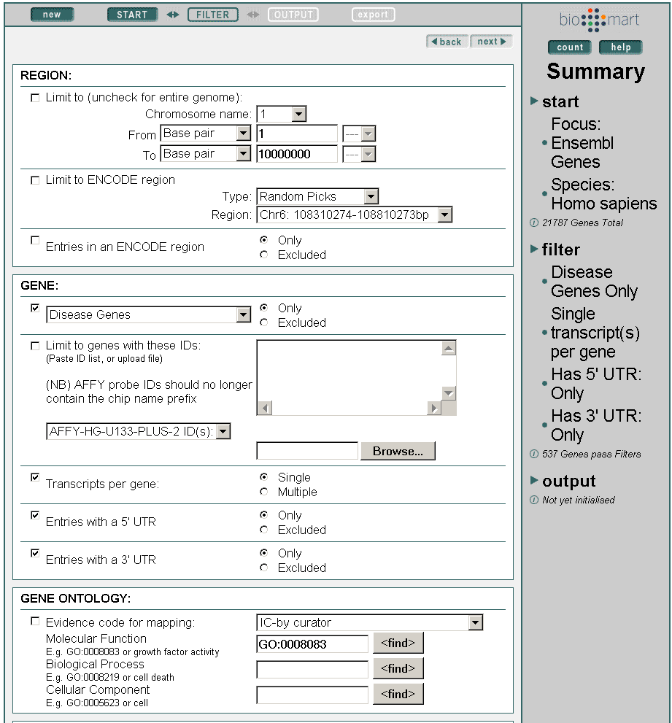
Dataset Configuration
XML
XML
XML

Slide 21
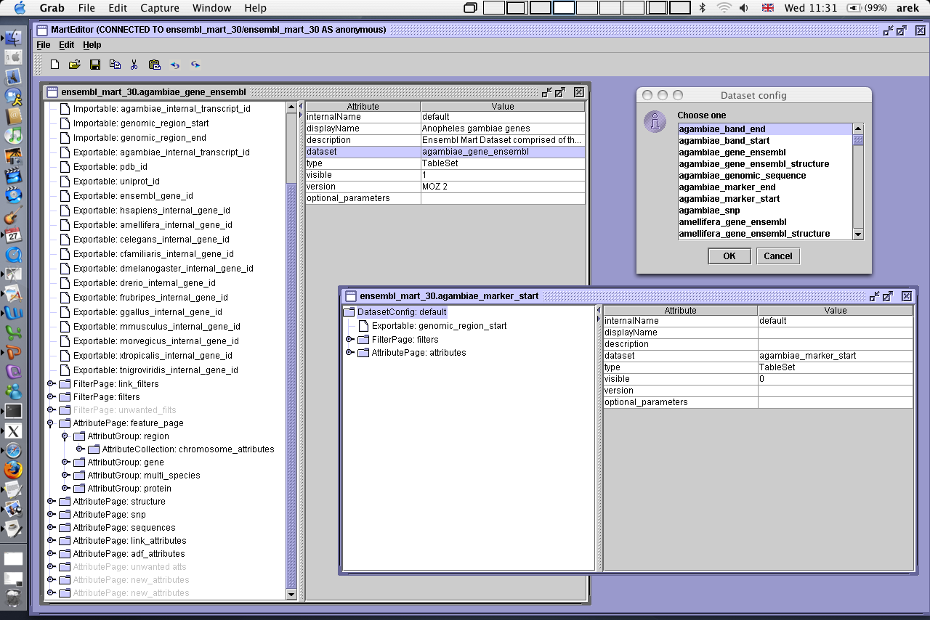
MartEditor

Slide 22
Table naming convention
Naïve configuration
Tables
  Meta tables meta_content
  Data tables dataset__content__type
Data tables
  Main __main
  Dimension __dm
Columns
  Key _key

Slide 23
BioMart architecture
Retrieval
MartExplorer
MartShell
MartView
JAVA
Perl
BioMart API
Databases
Public data (local or remote)
MartBuilder
MartEditor
myDatabase
Vega
SNP
myMart
MSD
UniProt
Ensembl
Schema
transformation
Configuration
XML

Slide 24
BioMart Registry
R
R
R
WWW
GUI

Slide 25
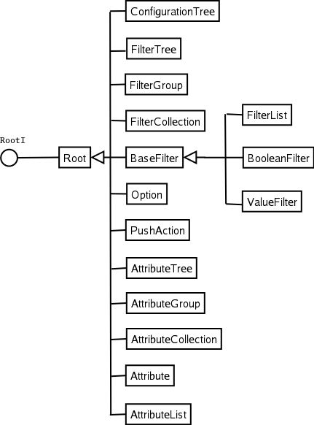
Class diagram - configuration

Slide 26
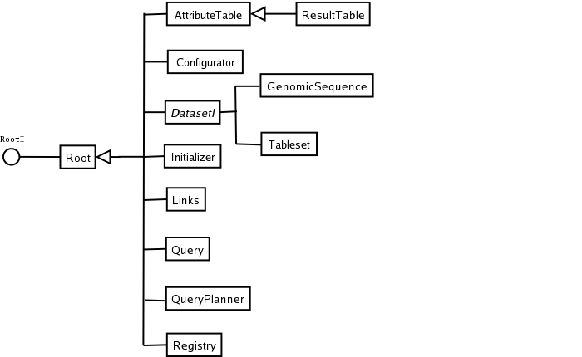
Class diagram - querying

Slide 27
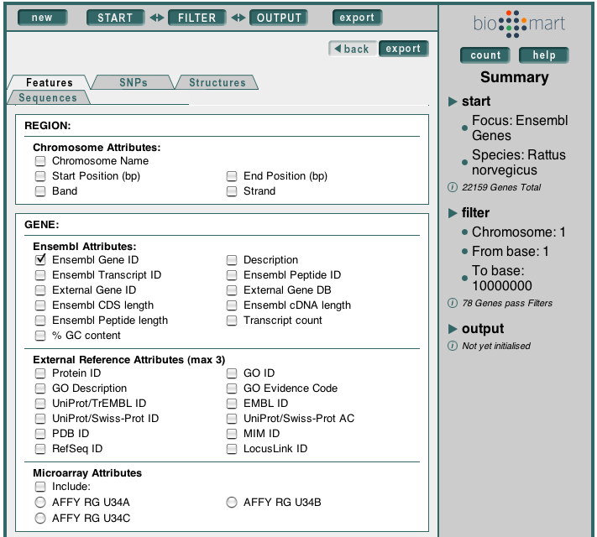
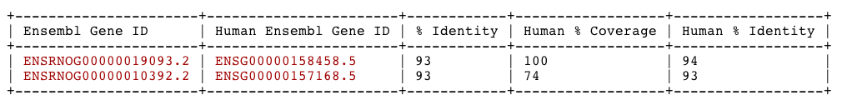
MartView

Slide 28
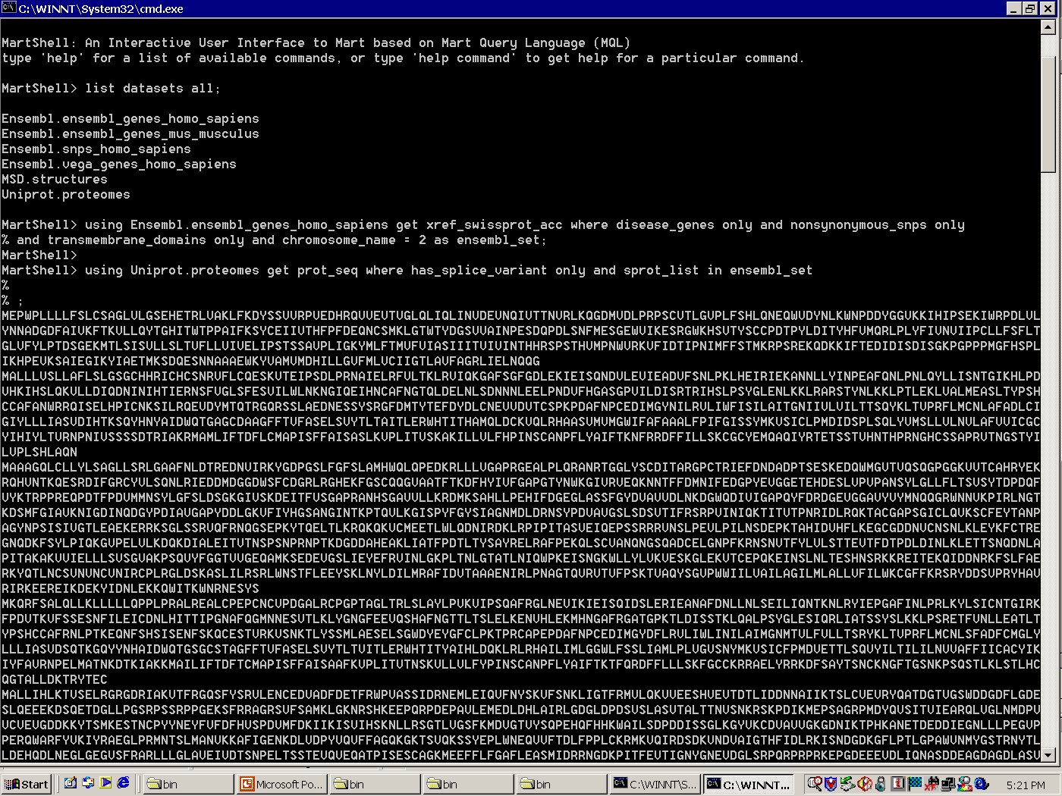
MartShell

Slide 29
MartExplorer

Slide 30
Third party software
Bioconductor (biomaRt)
  BioMart schema
Taverna
  BioMart java library
DAS ProServer
  BioMart perl library

Slide 31
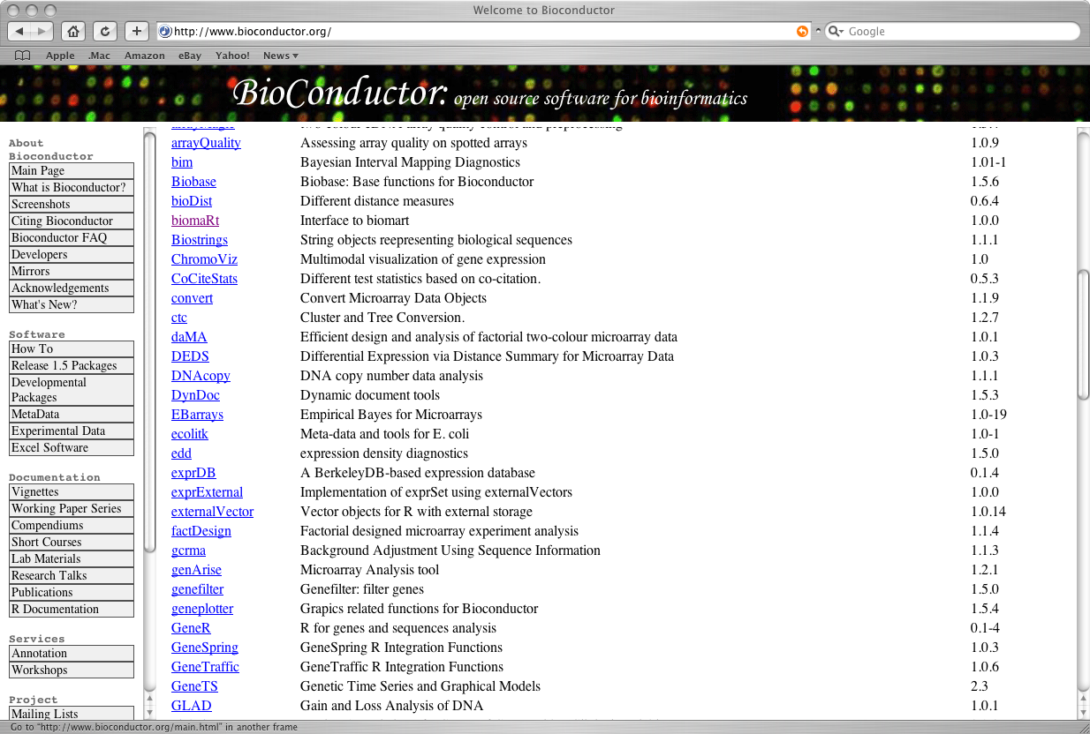
biomaRt

Slide 32
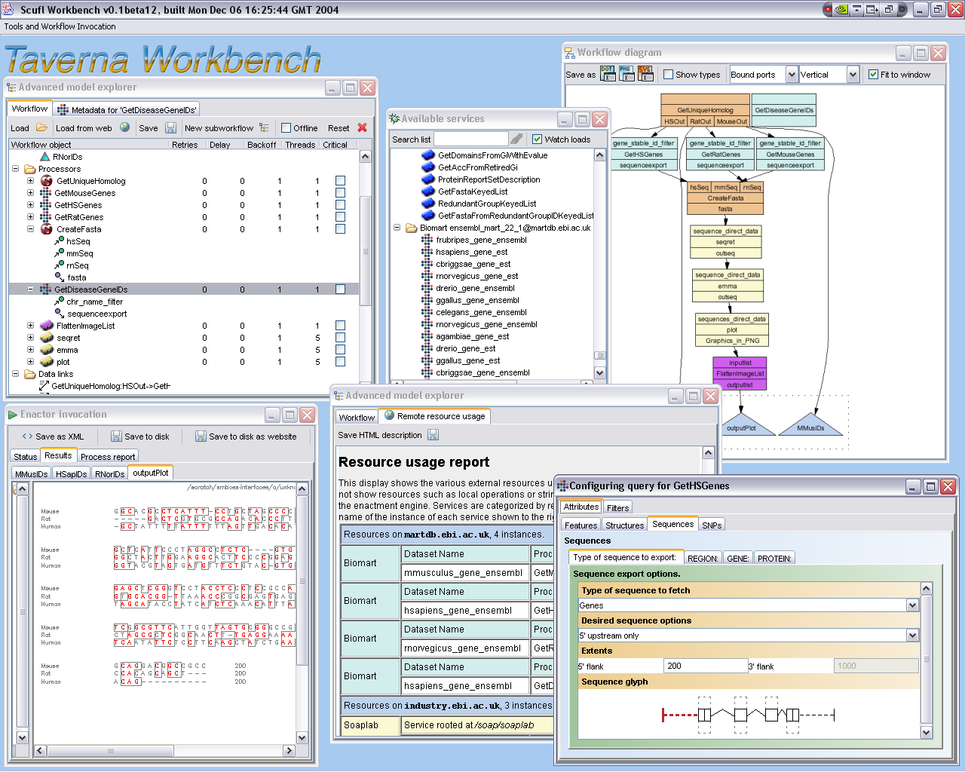
Taverna

Slide 33
ProServer
No programming
DAS request and responses defined by Exportables and Importables and configured by MartEditor
DAS1

Slide 34
Where are we?
0.2 released in february
0.3 to be released in june
  Platforms
    Mysql
    Oracle
    Postgres
  Robust error handling

Slide 35
Where are we?
BioMart v 0.2
  Large scale data federation (Hinxton)
    Uniprot Proteomes,MSD,Ensembl,Vega
  Optimizing access to a large database
    Ensembl, WormBase, ArrayExpress
  Federating small datasets with public data
    Pasteur, INRA, Bayer, Unilever, Serono, Sanofi-Aventis, DevGen, etc …

Slide 36
Immediate Future
MartBuilder
  GUI
  XML configuration
MartView
  Scalable
  Configurable

Slide 37
Acknowledgments
BioMart
  Damian Smedley (EBI)
  Darin London (EBI)
  Will Spooner (CSHL)
Contributors
  Arne Stabenau (Ensembl)
  Andreas Kahari (Ensembl)
  Craig Melsopp (Ensembl)
  Katerina Tzouvara (Uniprot)
  Paul Donlon (Unilever)

