Slide 1
Diversity Bioinformatics
Terry Casstevens
Institute for Genomic Diversity, Cornell University
GMOD Meeting at NESCent
Durham, NC – June 29-30, 2006

Slide 2
The Genomic Diversity and Phenotype Data Model
(GDPDM)
Terry M. Casstevens¹, Dallas Kroon¹, Peter Bradbury², Edward S. Buckler^{1,2}, and many other reviewers
¹Institute for Genomic Diversity, Cornell University
²USDA-ARS

Slide 3
What is GDPDM?
Database schema for holding data collected by QTL and Diversity Studies.

Slide 4
Objective of GDPDM schema
Hold the basic data behind QTL and diversity studies
Focuses on taxa, evaluation environments, trait values, genotyping experiments, and genotypic data
Does not focus on genomic location, QTLs, detailed passport data
Has no dependencies on QTL schema

Slide 5
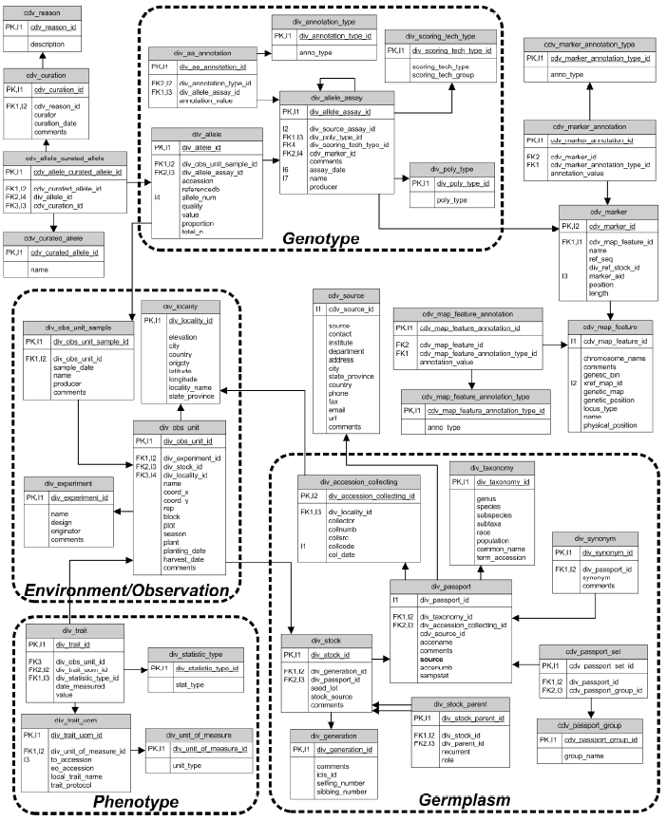
GDPDM
Schema

Slide 6
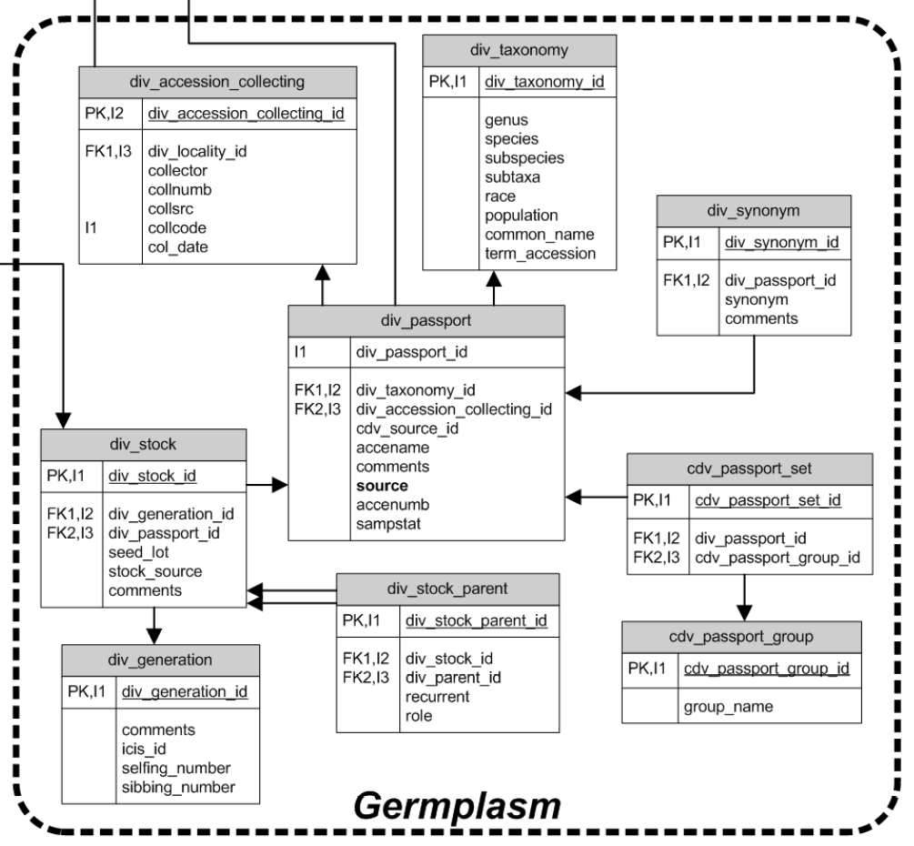
Germplasm
Basic Passport
Details link-out to germplasm banks
Curate groups of taxa
Supports complex genetic pedigrees
Follow seed lots and even plants

Slide 7
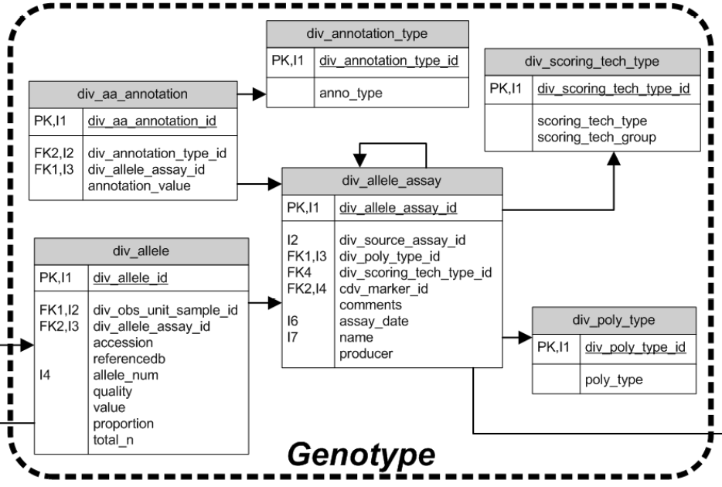
Genotype
Captures wide range of approaches (SNPs, SSR, sequence alignments, isozyme)
Support full range of ploidy
Can capture background on methodology
Connects to genomic map data

Slide 8
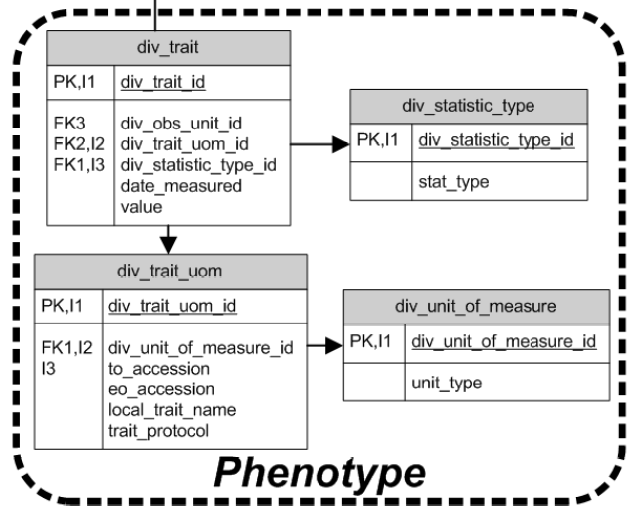
Phenotype (trait)
Quantitative or qualitative traits
Support ontology integration
Range of statistics can be recorded (mean, measure, median, std. deviation, etc.)

Slide 9
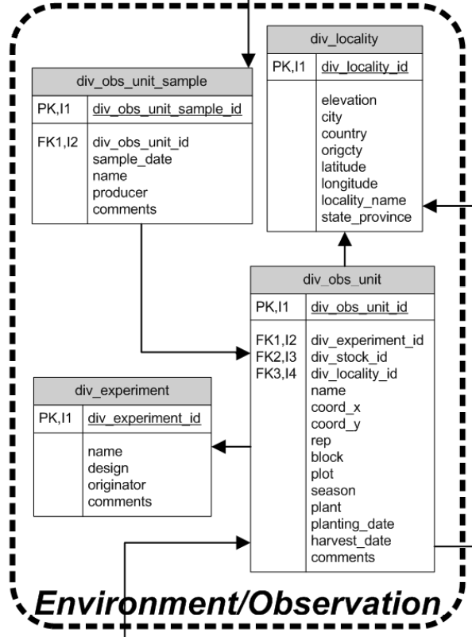
Environment
Full field design can be recorded (down to the plant if desired)
X-Y coordinates
Basic planting information, treatments
Integrates with locality information
Observations can be grouped into experiments

Slide 10
http://www.maizegenetics.net/gdpdm https://sourceforge.net/projects/gdpdm
Diversity Schema Web Sites

Slide 11

The Genomic Diversity and Phenotype Connection
(GDPC)
Terry M. Casstevens¹ and
Edward S. Buckler²
¹Institute for Genomic Diversity, Cornell University
²USDA-ARS, Institute for Genomic Diversity, Cornell University
Supported by National Science Foundation
DBI-0321685 and USDA-ARS.

Slide 12
GDPC Purpose
The purpose of GDPC is to simplify access to the large genomic and phenotypic datasets that are becoming available in plant biology.
www.maizegenetics.net/gdpc

Slide 13
Data Flow via GDPC
Database
GDPC
Software Viewer
or Analysis
Tool
User
www.maizegenetics.net/gdpc

Slide 14
Databases
Gramene Diversity (GDPDM schema)
Panzea (GDPDM schema)
Pea Database (Germinate schema)
Aztec (private GDPDM)
GRIN (passport data)

Slide 15
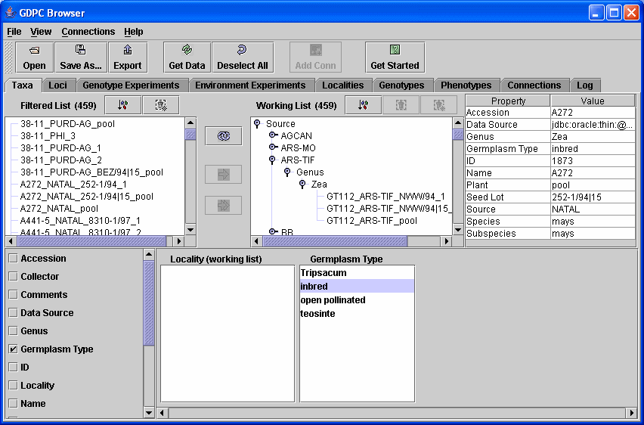

Slide 16
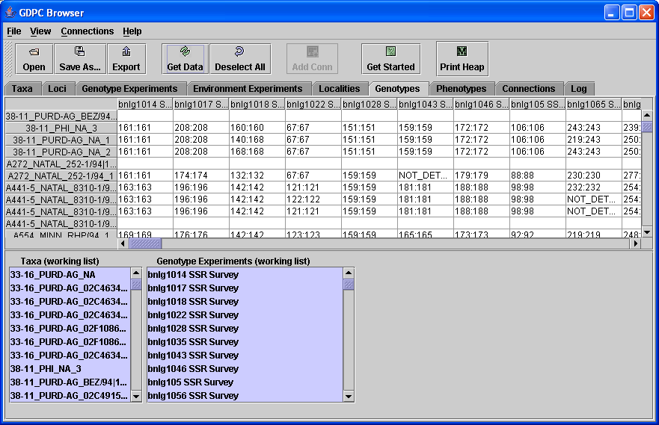

Slide 17
http://www.maizegenetics.net/gdpc https://sourceforge.net/projects/gdpc
GDPC Web Sites

Slide 18
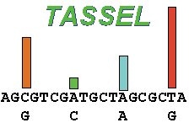
Trait Analysis by aSSociation, Evolution, and Linkage
(TASSEL)
Edward S. Buckler, Dallas Kroon, Peter Bradbury, Zhiwu Zhang, and Terry Casstevens
Institute for Genomic Diversity, Cornell University

Slide 19
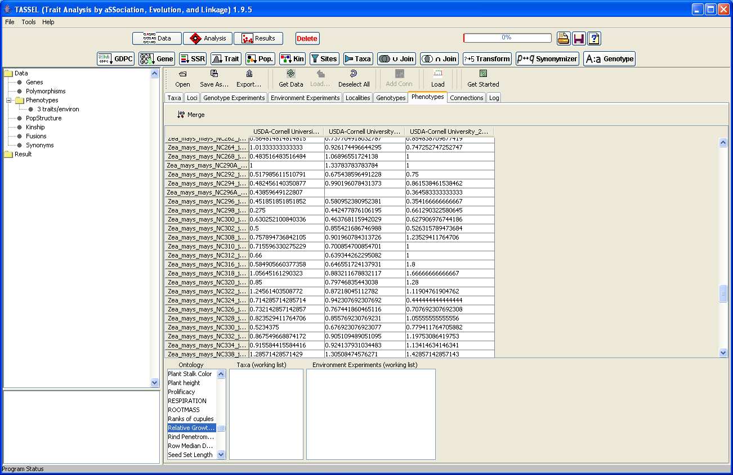

Slide 20
http://www.maizegenetics.net https://sourceforge.net/projects/tassel
TASSEL Web Sites

Slide 21
Pedigree Viewer
(beta version)
Terry M. Casstevens
Institute for Genomic Diversity, Cornell University
Supported by National Science Foundation
DBI-0321685 and USDA-ARS.

Slide 22
