Slide 1

2009 GMOD Meeting
Dhileep Sivam & Isabelle Phan
Seattle Biomedical Research Institute

Slide 2
Seattle Biomedical Research Institute (SBRI)
Founded in 1976
About 250 full-time staff
Focus on infectious disease
13 Labs
Strong ties to the University of Washington
Bioinformatics Core
Notes:
We were founded about 30 years ago in a mall in the seattle suburbs
We’ve grown to a full time staff of about 250 people

Slide 3
How we first came to use Chado
LmjF V4.0
LmjF V5.2
LinJ V2.0
LinJ V3.0
LinJ V4.0
LmjF Probe Set
LinJ Probe Set
Mapping
Mapping
Mapping
Result Set
Result Set
Result Set
Notes:
Tiling array project
Complicated and ongoing – point of slide is to show a concrete example of a few of the principles that we covered.
Top row – different versions of the genome assembly
Here we’ve taken information from several genome annotations and transferred them to a new version of a genome
Middle – designed probes to early versions of a genome – remapped them to newer ones
Last row – comparing result sets from several different genomes
The full systems described a couple of sides ago does not exist, but it components of it does, and we have used those components in this process
The hope is that the full system as described will facilitate and simplify projects like these.

Slide 4
Microarray Project
Nimblegen
Data
Chado
Parsers
Analysis Tools
Normalization
Scaling
Feature-level aggregation
Remapping
Visualization

Slide 5
Use Case: SSGCID
Seattle Structural Genomics Center for Infectious Disease
Project Aim
Bioinformatic Screening
3D Protein Structure
NIAID Emerging and re-emerging priority pathogens
Structures will serve as a starting point for drug development
Multi-center
Gene Cloning & Expression
Protein Crystallization
Structure Determination
Vaccine Targets!
Notes:
The aim of SSGCID is to determine the 3d structure of proteins from a variety of human pathogens
These pathogens are from a list compiled by the National institute of allergy and infectious disease, known as the priority pathogens list
The list contains a set of organisms that are emerging or re-emerging threats to human health.
Could be emerging due to drug resistance, changes in land use, human demographic factors, bioterrorism
This is a 5 year multi center collaborative project between SBRI, the UW, the Pacific Northwest National Laboratory in Richland and Decode BioStructures, a local biotech company
We are using a pipelining approach
I’ll talk about the Bioinformatic screening, as that is where I spend most of my time:
-Screening out genes that have physical properties that make them unlikely to have a solvable structure
-Screening out genes that have no significant similarity to existing drug targets
-Screening out genes that are too similar to an existing solved structure
-Redundancy screens

Slide 6
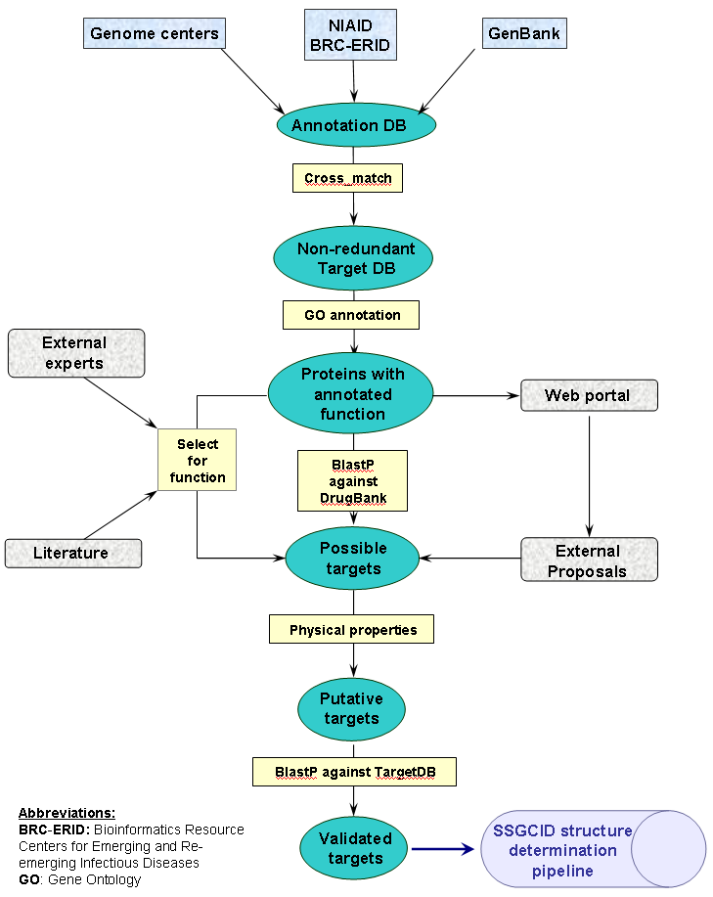
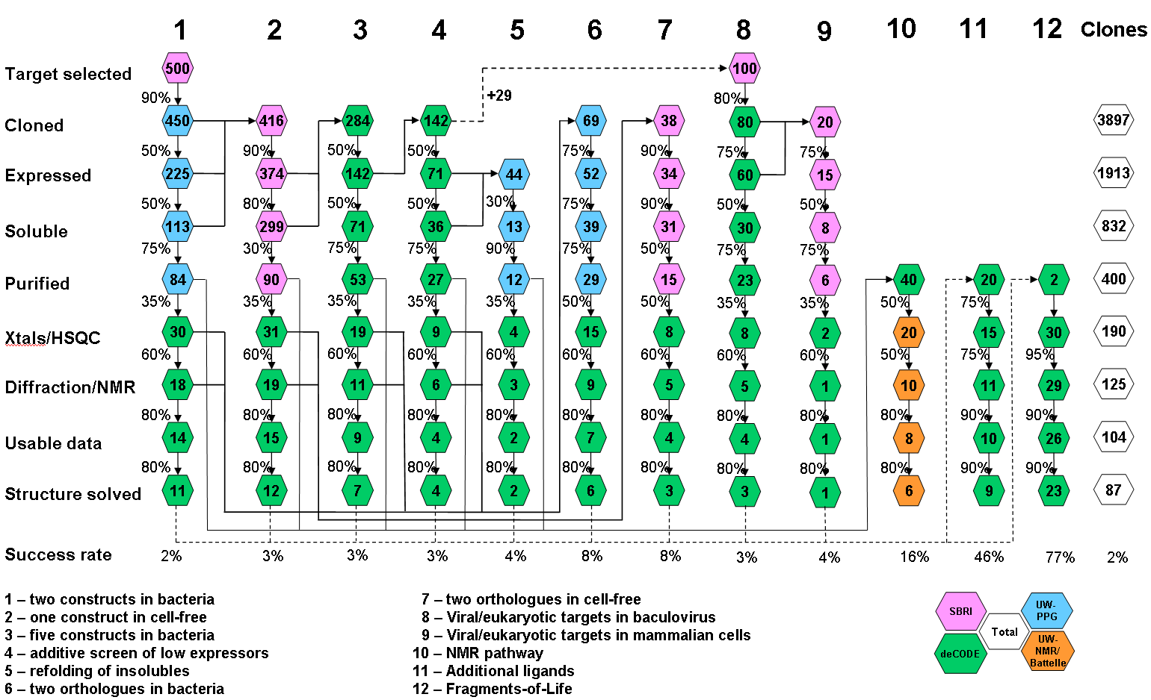
SSGCID
Bioinformatic Screening
Gene Cloning & Expression
Protein Crystallization
Structure Determination
Vaccine Targets!

Slide 7
SSGCID
Chado
External
Sequence
Resources
Parsers
Export
Bulk Loader
BLAST
Screening

Slide 8
Things that have come up…
Complexity of querying BLAST results
Materialized Views
Complexity of querying microarray data
“Grouping of Genes”
DBXrefs
Gene Models
Simplest
Possible Model

Slide 9
Sequence data management at SBRI
Proteomics
Microarray
Structural genomics
curation
warehouse
Data access
Automated
analysis
pipeline

Slide 10
Chado + GUS: why do we need both?
Chado
  Collaboration with IGS
  Annotation tools: Manatee (apollo), Ergatis
    Internal data production
Gus
  Collaboration with UPenn
  Web front end
    External data access

Slide 11
Sequence data management at SBRI
Proteomics
Microarray
Structural genomics
Manatee
Manual annotation
GUS
Chado
Ergatis
Analysis pipeline
GUS WDK

Slide 12
Chado2GUS: Lost in translation
Chado
  Denormalized schema
    Polymorphism
  Mysql (IGS Chado)
GUS
  Normalized schema
    Subclassing
  Postgres port from Oracle
performance issue
performance issue

Slide 13
Picking the best of two worlds
Chado
  Biological data model
  Flexibility
GUS
  Software engineering
  Flexibility

Slide 14
The future?
SQL-free data production
  Instead of custom wrappers over raw SQL:
    ORMs: Chado Hibernate, ActiveRecords
    Unified object model
RDBMS-free data mining
  Instead of GUS predefined query + set combination
    Biomart + Galaxy
    RDF + triple store + sparql (object store + Lucene)

