Slide 1

Genome Sequencing
Impact on Annotation
GMOD April 26-28, 2004
Kim C. Worley

Slide 2
Sequencing, Assembly, Finishing
Impact on Annotation
Gaps that interrupt genes (poor prediction)
Gaps that contain genes (missing data)
Duplications (extra gene copies)
Collapsed regions (missed gene duplications)
Order and orientation errors
Chromosome location errors

Slide 3
Overview of Sequence Methods
Whole Genome Shotgun (WGS) only
  Fast, inexpensive
  Good scaffolds with different insert sizes
  Can collapse recent duplications and repeats
BAC skim + WGS
  More expensive (more shotgun libraries)
  Better resolution of duplications (local assembly)
  BAC pools - potentially more efficient skims
Comparative Assembly
  Inexpensive shortcut when resources unavailable
  Can create artifacts in the assembly - no mousified rat

Slide 4
Ideal Genome
Haploid or Inbred organism (less polymorphism)
Good Map (better higher order scaffolding)
WGS (several insert sizes)
BAC skims (local assembly)
Well behaved distribution of clone representation
EST/mRNA data for QC, Assembly and Annotation
Finished sequences for QC, QA
Enough coverage (7x)

Slide 5
Real Genomes are not Ideal
 | Good | OK | Bad
Polymorphism | Haploid | Inbred | Outbred
Markers | Dense | Sparse | None
Insert Sizes | 3kb, 10kb, 50kb, 200kb | 3kb, 50kb | 3kb
Clone Distribution | Random | Random in some Sizes | Biased in all cases
BAC ends | Many, paired | Some, paired | None or not paired
ESTs | Many 300/Mb | Some 100/Mb | None
mRNAs | Many | Some | None
Finished Sequence | Many | Some | None
Coverage | 10x | 6x | 2x
Sequence Bias | None | Some/one strand | Many/both strands
Genome Size | 30Mb - 100Mb | 100Mb - 1Gb | >1Gb

Slide 6
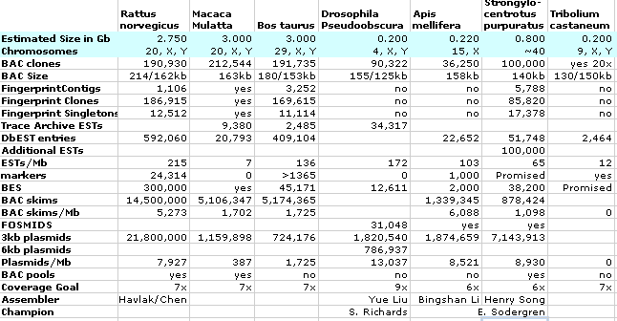
Genome Characteristics and Resources Available Change the Methods and Outcome
Notes:
Add number of Q20 bp per Gb

Slide 7
BCM Genomes
 | R.nor. | M.mul. | B.tau. | S.pur. | D.ps. | A. mel. | T.cas.
Polymorphism
Markers
Insert Sizes
Clone Distribution
ESTs
Finished Sequence
Coverage
Sequence Bias
Genome Size

Slide 8
Current Experiments
Cow - Bos taurus
  Inbred
  Good BAC resources
  Map resources
  QTLs
  Large genome
Rhesus - Macaca mulatta
  Large genome
  Poor resources
    Markers
    ESTs
  Comparative assembly
    Use Human genome sequence
    Use Human markers
  BAC resources to improve assembly

Slide 9
Honeybee - Apis mellifera
AT rich regions missing
  Looking at orthologous insect genes some were poorly represented, and those were more AT rich
  Gradient centrifugation to separate on base composition and select AT rich fraction
Bias in BAC representation
  Internal deletions that corrupt the assembly

Slide 10
Purple Sea Urchin
Strongylocentrotus purpuratus
15% of reads have premature termination due to poly G sequence
  The complementary poly C sequence does not have the same effect
  These regions will have 1/2 x the average coverage
Polymorphic - not inbred
  The extent of this may be underestimated due to the premature termination above
Notes:
Poly G may be sequence in an enhancer.

Slide 11
Sea Urchin Polymorphism

Slide 12
BCM Genomes
 | R.nor. | M.mul. | B.tau. | S.pur. | D.ps. | A. mel. | T.cas.
Polymorphism
Markers
Insert Sizes
Clone Distribution
ESTs
Finished Sequence
Coverage
Sequence Bias
Genome Size

Slide 13
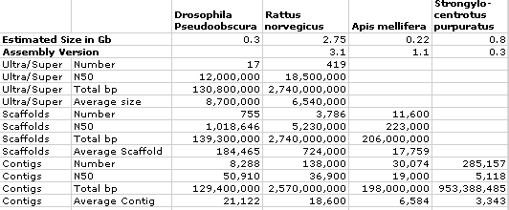
Current Genome Assemblies

Slide 14
Metrics for Quality of Assemblies
Finished sequence comparison
  Order and Orientation of assembled contigs
  Completeness of bp representation
  Correctness of bp representation
Comparison to other data
  Completeness and correctness of representation
    mRNAs
    ESTs
    Markers

Slide 15
Sequencing Cost is Everything
Metrics for inexpensive bases or reads
  Cost per Q20 base
  Cost per read
No measure of success of project being good quality assembly
  Sequence only the AT rich parts of the genome
Miss segmental duplications - interesting biology
  Recently evolving gene families that highlight species differences

Slide 16
Challenges Due to Changes in Production to Increase Read Length
Cautions - addressed by adjusting insert size
  More overlapping mate-pairs
  Skew overlap statistics
Problems
  Fewer reads total (project promised total bp)
  Virtual read length increase - no assembly improvement, since Phrap uses low quality bases

Slide 17
Assembly
Reads are easy (commodity)
Contig assembly is becoming easy (with exceptions)
Order and Orientation requires paired end links
Pinning to chromosomes requires high density maps
Comparative Assembly
  Humanized genomes or Homogenized genomes
  Fine for protein coding sequences
  Will miss regulatory sequences
  Will miss recent duplications

Slide 18
Future Genomes
Less data
  2x coverage on many genomes
  Few markers, ESTs, mRNAs
  Few BACs, Fosmids
  Little map information
Uncertain quality assemblies
  Are the sequences from the correct organism?
  Does the assembly capture the bulk of the genes?
  Does the assembly faithfully represent the genome?
  Are the contigs properly scaffolded to the genome?

Slide 19
Effects on Annotation
Incomplete Gene Predictions
  Cloning bias regions
  Short contigs, many gaps
Chimeric Gene Predictions
  incorrectly placed or joined contigs
  Problems for Gene families
Lost Segmental duplications
  Most interesting biology (what makes organisms different)
  Most difficult for WGS only and low coverage methods to resolve
Less Characterized Genomes - Gene Prediction
  De novo without evidence
    Tools developed for particular genome may not transfer well
    Little expressed sequences
    Protein sequence from other species
  Ensembl must stick to mammals in the future

Slide 20
Summary
Future Genomes will be Draft
Required Components
  Finishing
    For quality assessment
    Focus on syntenic breakpoints
    Focus on genes
    Resolve duplicated regions
  EST sequencing
    For quality assessment
    Annotation
  Mapping
    For long range scaffolding
Annotation
  Iterative
  More difficult
  Generic de novo tools

Slide 21
Acknowledgements
Paul Havlak
James Durbin
Rui Chen
Amy Egan
Stephen Richards
Yue Liu
Erica Sodergren
Bingshan Li
Henry Song
Qin Xiang
Huayang Jiang
Aleks Milosalvjevic
David A. Wheeler
Ryan Lozado
Shiran Pasternak
Donna M. Muzny
Sharon Wei
Shannon P. Dugan
Yan Ding
Christian Buhay
George M. Weinstock
Richard A. Gibbs

Slide 23
Apollo Development
Modifications at BCM

Slide 24
BCM Data Modifications
Import annotations from Ensembl
  homo_sapiens_core_15_33
  homo_sapiens_est_15_33
  Contig based coordinates
Added MySQL database tables
  to store feature sequence(cDNA, ESTs, etc...)
  for UCSC data (coordinates and sequence)
Import annotations from UCSC
  Genome coordinates
Limited data to chromosomes 3 and 12

Slide 25
Apollo Modifications: Baylor Adaptor Functions
GUI allows users to select a chromosome and a range
Retrieves features in region from database
Features are grouped based on the Apollo data objects (SeqFeatures and FeatureSets)
Features are added to a curation set.
For new regions all Ensembl genepredictions are "promoted" to the blue annotation area
For previously curated regions a GAME Adaptor is instantiated within the Baylor adaptor to read the existing annotations from the GAMEXML file into a GenericAnnotationSet
Annotations are saved in a GAMEXML file.
Notes:
An adapter GUI allows selection of region

Slide 26
Apollo Modifications: Baylor Adaptor Implementation
Apollo adaptor is a java package used to load feature data into Apollo from any database. This adaptor is tied to Apollo version 1.3.5.
Modified apollo.dataadapter.organism.OrganismAdapter
  remove the binding of gene definition to name adaptors.
New name adapter edu.bcm.hgsc.apollo.dataadapter.organism.HumanNameAdapter
  To control behavior of the "Show Gene Report" menu item.

Slide 27
Baylor Adaptor Implementation
Not upgraded to version 1.4.2 because it appears that some packages have been reorganized (or organized).
Consists of 95 java classes
50 junit test classes
Code duplication is minimal
Deployed using Ant
Design patterns, Refactoring, and Test Driven Development were use in creating the adaptor.

Slide 28
Proceedures to Annotate Human
Defined regions to avoid overlaps
Assigned regions
Smaller regions or trimmed data for some regions
Spanning genes annotated in one region only
In rare cases spanning genes annotated in separate overlap regions with unique annotations

Slide 29
Annotation Reports
Genbank feature tables
Accounts of genes and transcripts
  by assigned region
  By annotator
Gene counts
  known
  previously unknown genes
Sequence variation between genomic sequence and cDNA evidence

Slide 30
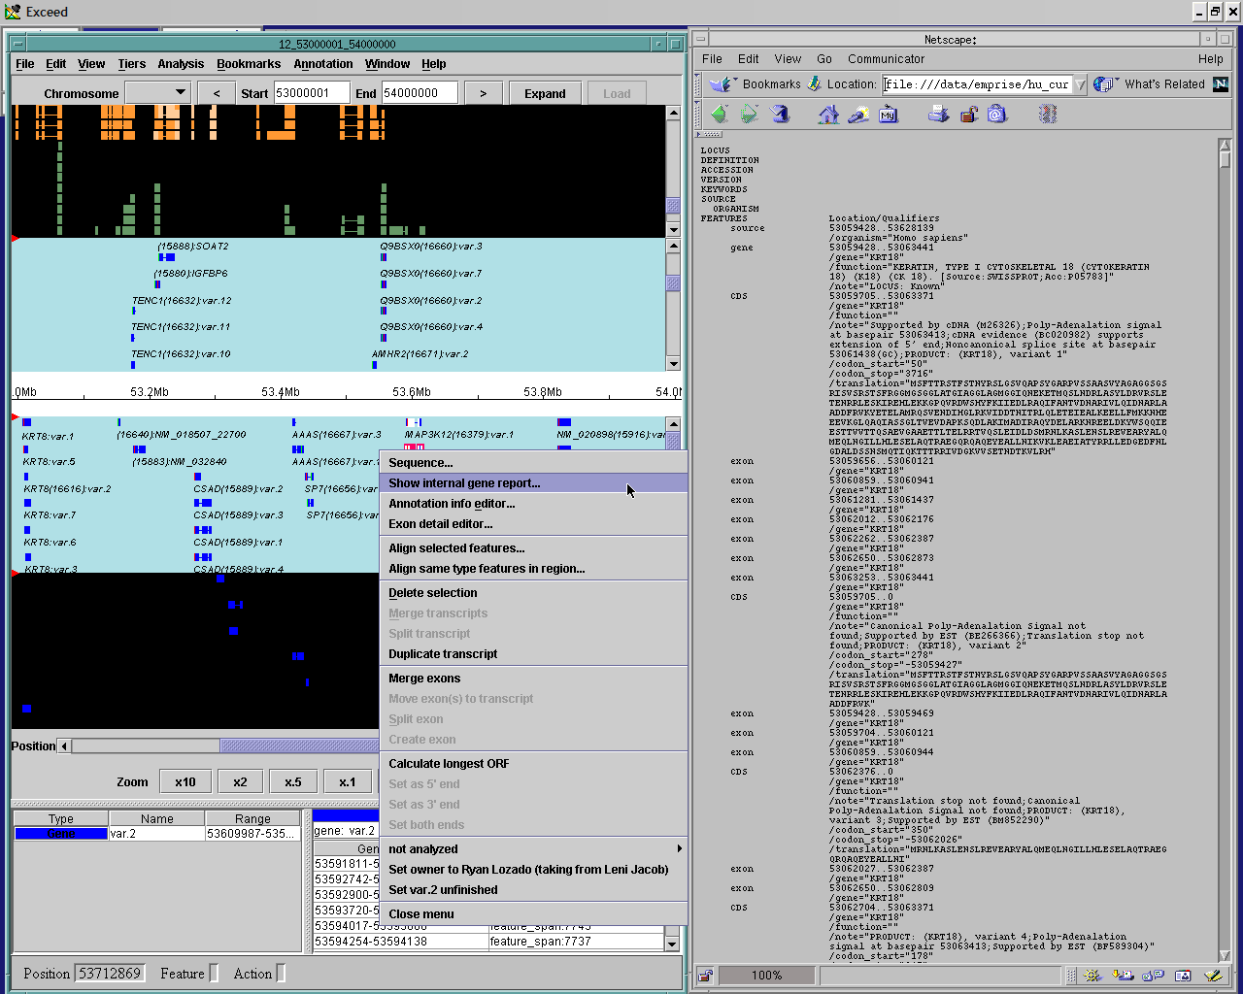

Slide 31
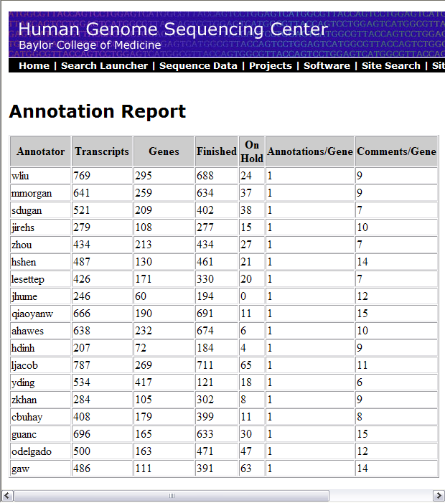
Annotation Accounting

Slide 32
Apollo
Wonderful for manual curation
  Work is needed to make it a more portable tool
  Database for curated annotations
  Download for local operation
Seek a standardized GAMEXML schema
  Vital for ease of use
  For communication of all users and developers
  Decrease time required to "plug into apollo" from any data source.

