Slide 1

chado
Generic model organism database schema

Slide 2
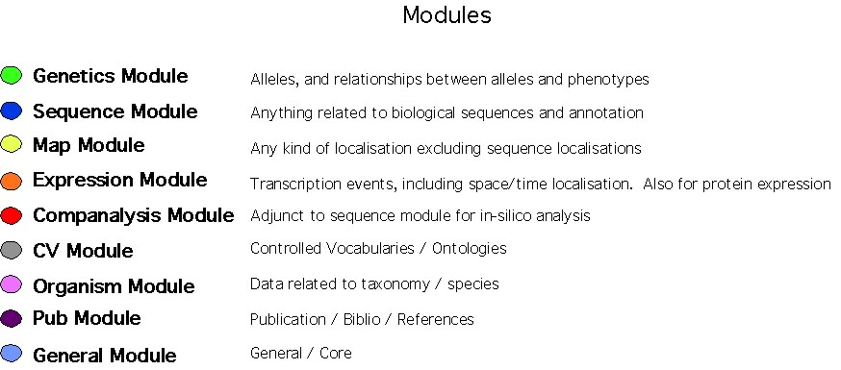
Chado modules

Slide 3
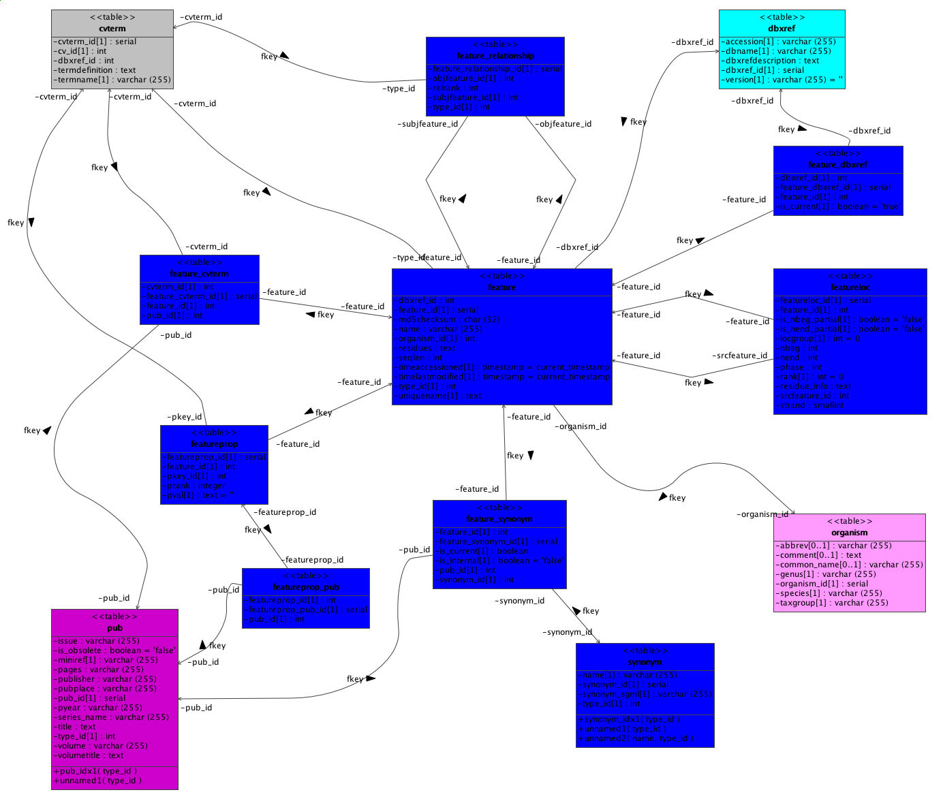
cvterm
dbxref
feature_relationship
feature_dbxref
feature_cvterm
feature
featureloc
featureprop
feature_synonym
organism
featureprop_pub
pub
synonym

Slide 4
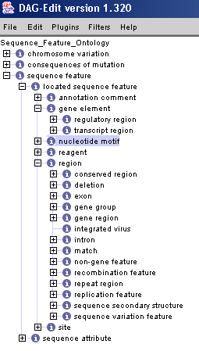
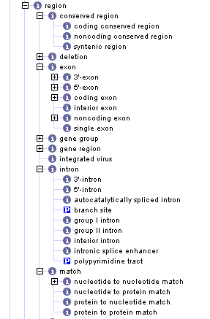
Sequence Ontology

Slide 5
Central Dogma: single spliced transcript
Feature (Colors: DNA, RNA, Protein)
Featureloc
protein
Feature_relation (subj->obj)
produced by
CDS
produced by
transcript
part of
exon
produced by
Use rank to order
gene
Genomic Contig

Slide 6
Central Dogma:
2nd transcript (alt. Splicing)
Feature (Colors: DNA, RNA, Protein)
Featureloc
protein
Feature_relation (subj->obj)
produced_by
CDS
produced_by
transcript
part of
produced_by
exon
Use rank to order
gene
Genomic Contig

Slide 7
Pathological Cases: trans-splicing
Feature (Colors: DNA, RNA, Protein)
protein
Featureloc
produced by
CDS
Feature_relation (subj->obj)
produced by
transcript
part of
transcript
produced by
part of
exon
produced by
Use rank to order
gene
Genomic Contig

Slide 8
Pairwise Alignments
query sequence
featureloc
Feature_relation (subj->obj)
rank = 1
HSP
part of
rank = 0
Genomic Contig

Slide 9
Sequence variations
SNPs
residue_info = “G”
rank = 1
A => G
SNP
residue_info = “A”
rank = 0
Genomic Contig

Slide 10
Sequence variations
SNPs (redundant mapping to protein)
protein
I => T
residue_info = “T”
rank = 1
locgroup = 1
residue_info = “I”
rank = 0
locgroup = 1
SNP
A => G
residue_info = “A”
rank = 0
locgroup = 0
residue_info = “G”
rank = 1
locgroup = 0
Genomic Contig

Slide 11
Query Performance
ROI Query
  Reasonable, not stellar performance on PostGreSQL with index on (srcfeature_id, min, max)
  Exploration of more sophisticated approaches yielded performance improvements in MySQL but not PostGreSQL
  PostGreSQL functions simplify queries, e.g. select * from contains(src,min,max)
Central Dogma Query
  a few seconds for 3 levels, all info
  1 minute to include all overlapping features

Slide 12
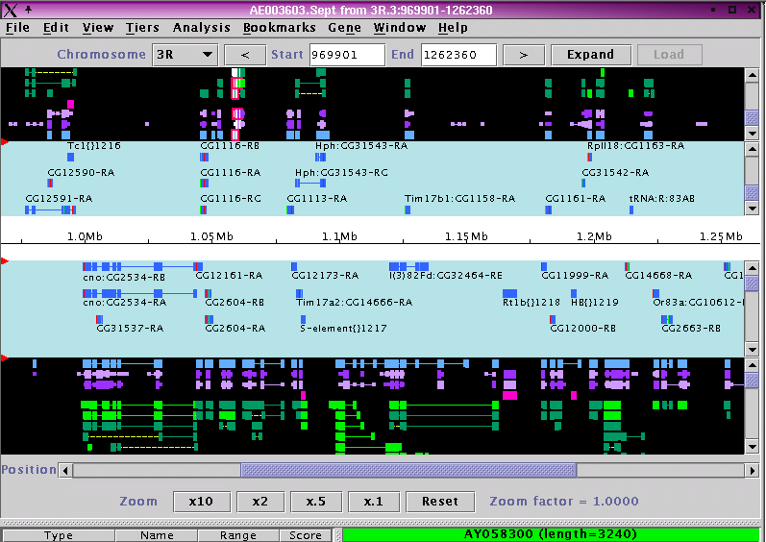
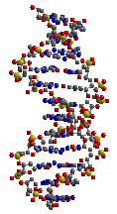
Cambridge UK
Chado Schema
Sequence
Genetics
Expression
. . .
Harvard
Ontologies
GO
SO
Others
FTP Site
Flatfile extracts
Apollo XML
PostgreSQL Dumps
Portable Mirror
Indiana
Berkeley
Literature Curation
Genes, Phenotypes
DB Cross refs
Aberrations
Transposon Constructs
Transposon insertions
Bibliography
Cambridge
Working
DB
report generators
chado XML DTD
gobo2chadx
FB WebInterface
Integrated Gene Reports
Gene Annotation
Genome Browser
Phenotypes
Expression
Interactions
etc.
XML Loader
+ validator
FlyBase
(read-write)
XML Dumper
Biological
Image
Annotation
CV-
Annotator
Public
(read only)
Stock
List
Users
Data
Entry
Forms
Interactions
Expression
QA/QC
chadx2game
Gbrowse
(GMOD)
game2chadx
Java
SEAN
Apollo chado adaptor?
chadx2gb
Sequence Features
from Literature
game2chadx
GenBank
Reference sequence
& Annotation Updates
Apollo
GenBank
SwissProt
Community
BDGP
Sequence
Analysis
Pipeline
& BOP
Gene Model Annotation

Slide 13
XORT
XML Object to Relational Translator
Schema-driven tools
  DTD generator: DDL -> DTD
    also generates html, xml, .pl versions of schema
  Validator:
    Not connected:
      Syntax Verification: legal XML, correct element nesting
      Some Semantic verification: NULLness, cardinality, local ID reference
    Connected: reference validation
    Loader-only: constraints, triggers
  Loader: XML -> DB
  Dumper: DB -> XML
    driven by XML “dumpspec”

Slide 14
Mapping XML to R-DBMS
Policy#1: XML is independent of schema
  Pro: ensures modularity, freedom to change one without the other (but why would you want to?)
  Con: must maintain mapping when either changes
Policy#2: XML locked to schema
  Pro: don’t have to learn two things, mapping is frozen
  Con: see Pro above.

Slide 15
XORT Mapping
Elements
  Table
  Column (except primary key -- not visible in XML)
Attributes
  few and generic: transaction and reference control
Element nesting
  column within table
  joined table within table -- joining column is implicit
  foreign key table within foreign key column
Modules
  No module distinctions in chadoXML
Limitations of DTD
  Cardinality, NULLness, data type

Slide 16
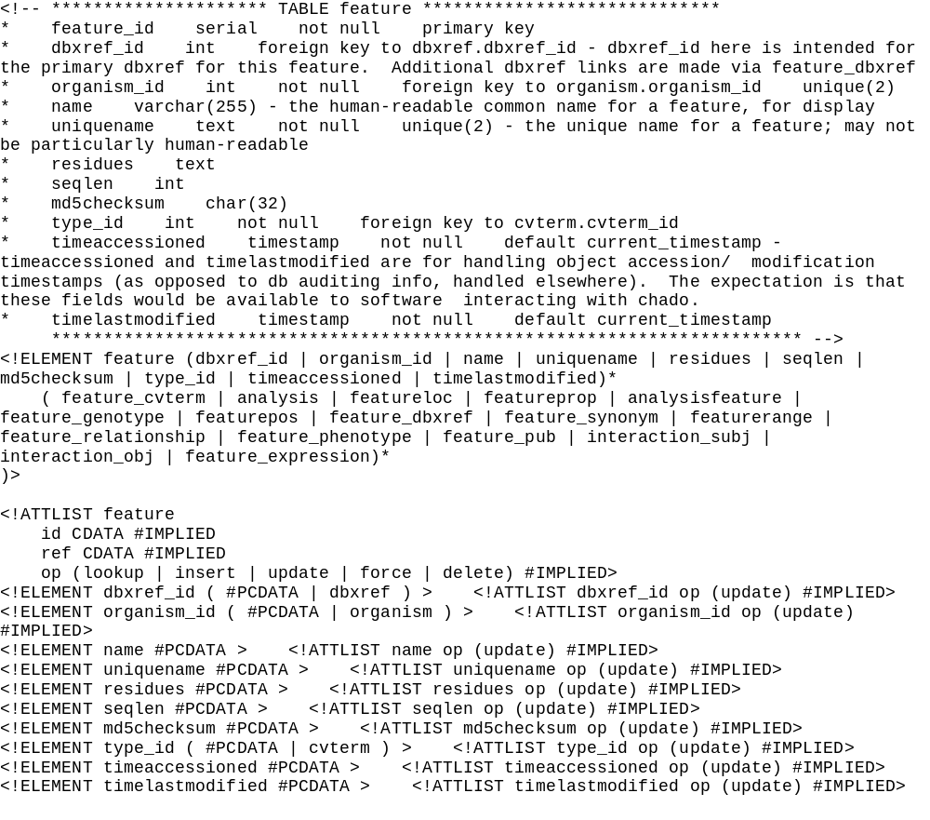

Slide 17
Object References
How to refer to persistent objects within XML?
(a.k.a. foreign key columns)
By Unique Key Value(s)
  object can be in XML file or DB
By local ID
  only for references to objects in same XML file
  need not be in DB
  local ID can be any symbol - def before ref
  reduces duplication within XML
By Global accession
  currently only for feature
  simple extension mechanism using Perl fragments

Slide 18
Object Reference by key values
<foreign_key_col>
<primarytable>
<keycol1>keyval1</keycol1>
... more key cols if needed
</primarytable>
</foreign_key_col>
E.g.
<feature>
<type_id>
<cvterm>
<cv_id>
<cv>
<name>Sequence Ontology</name>
</cv>
</cv_id>
<name>exon</name>
</cvterm>
</type_id>
….

Slide 19
Object Reference by Local ID
<cv id=“SO”>
<name>Sequence Ontology</name>
</cv>
<cvterm id=“exon”>
<cv_id>SO</cv_id>
<name>exon</name>
</cvterm>
<feature>
<type_id>exon</type_id>
...

Slide 20
Object Reference by Global Accession
<feature_relationship>
<subjfeature_id>GB:g012345
</subjfeature_id>
…

Slide 21
Transactions
Lookup: <table op=“lookup”>...
Insert: <table op=“insert”>...
Delete:
    <table op=“delete”>
      <keycol1>val1</keycol1>…
Update
<table op=“update”>
      <keycol1>val1</keycol1>
      <keycol2>val2</keycol1>
      <keycol1>newval</keycol1>
Force: <table op=“force”>...
Combination of lookup, insert and update

Slide 22
Dumper
XML-driven extraction
Default behavior: given an object class and ID, dump all direct values and linktables, with refs to foreign keys.
Nondefault behavior specified by XML dumpspecs using same DTD with a few additions:
  attribute dump= all | cols | select | none
  attribute test = yes | no
  element OR
  element _sql
  element _appdata
Workaround with views, _sql
Current use cases:
  Dump a gene for a gene detail page
  Dump a scaffold for Apollo

Slide 23
<?xml version="1.0" encoding="ISO-8859-1"?>
<!DOCTYPE chado SYSTEM "/users/zhou/work/flybase/xml/chado_stan.dtd">
<!-- 1. dump all information for gene CG9570 and all information for transcript, all for translation, for feature_evidence, dump all cols of foreign object:featureloc -->
<chado>
<feature dump="all">
<uniquename test="yes"><or>CG3665</or><or>CG3139</or><or>CG3497</or></uniquename>
<!-- get all mRNA of those gene -->
<feature_relationship dump="all">
<subjfeature_id test="yes">
<feature>
<type_id>
<cvterm>
<name>mRNA</name>
</cvterm>
</type_id>
</feature>
</subjfeature_id>
<subjfeature_id>
<feature dump="all">
<!-- get all exon of those mRNA -->
<feature_relationship dump="all">
<subjfeature_id test="yes">
<feature>
<type_id>
<cvterm>
<name>exon</name>
</cvterm>
</type_id>
</feature>
</subjfeature_id>
<subjfeature_id>
<feature dump="all">
<!-- feature_evidence for exon, type of evidence is either alignment_hit or alignment_hsp -->
<feature_evidence dump="no_dump">
</feature_evidence>
<!-- feature_evidence for exon, type of evidence is neithor alignment_hit nor alignment_hsp -->
<feature_evidence dump="no_dump">
</feature_evidence>
<scaffold_feature dump="no_dump" />
</feature>
</subjfeature_id>
</feature_relationship>
<!-- get all protein of those mRNA -->
<feature_relationship dump="all">
<subjfeature_id test="yes">
<feature>
<type_id>
<cvterm>
<name>protein</name>
</cvterm>
</type_id>
</feature>
</subjfeature_id>
<subjfeature_id>
<feature dump="all">
<!-- feature_evidence for protein, type of evidence is either alignment_hit or alignment_hsp -->
<feature_evidence dump="no_dump">
</feature_evidence>
<!-- feature_evidence for protein, type of evidence is neithor alignment_hit nor alignment_hsp -->
<feature_evidence dump="no_dump">
</feature_evidence>
<scaffold_feature dump="no_dump" />
</feature>
</subjfeature_id>
</feature_relationship>
<feature_relationship dump="all">
<subjfeature_id test="yes">
<feature>
<type_id>
<cvterm>
<name test="no"><or>protein</or><or>exon</or></name>
</cvterm>
</type_id>
</feature>
</subjfeature_id>
<subjfeature_id>
<feature dump="all">
<!-- feature_evidence for feature neither protein nor exon, type of evidence is either alignment_hit or alignment_hsp -->
<feature_evidence dump="no_dump">
..
<?xml version="1.0" encoding="ISO-8859-1"?>
<!DOCTYPE chado SYSTEM "/users/zhou/work/flybase/xml/chado_stan.dtd">
<!-- 1. dump all information for gene CG9570 and all information for transcript, all for translation, for feature_evidence, dump all cols of foreign object:featureloc -->
<chado>
...
<feature>
<uniquename test="yes"><or>CG3665</or> <or>CG3139</or><or>CG3497</or></uniquename>
<!-- get all mRNA of those genes -->
<feature_relationship dump="all">
<subjfeature_id test="yes">
<feature>
<type_id>mRNA</type_id>
</feature>
</subjfeature_id>
<subjfeature_id>
<feature>
<!-- get all exons of those mRNA -->
<feature_relationship>
<subjfeature_id test="yes">
<feature>
<type_id>exon</type_id>
….

Slide 24
Chado <-> Apollo Interaction
Chado
XML
XML Loader
+ validator
Chado
XML Dumper
Chado
XML
game2chadx
chadx2game
GAME
XML
GAME
XML
Apollo

Slide 25
DUMPER Concerns
Expressivity
Speed
XML file size
Memory

Slide 26
Whats next
Debug Apollo / chado roundtrip
CV issues
  Hierarchical queries
  SO compliance
  feature relationship types
Schema extensions
  genetics module - review in Fall
  expression?
UI development

Slide 27
Architectural Principles
Semi-permeable XML layer
Fix mapping, let schema vary
Plan for schema evolution -- schema-driven tools
Course-grained coupling of modules made possible by XML standardization

Slide 28
Credits
Pinglei Zhou - loader, dumper, XML design
Frank Smutniak - game2chadx, chadx2game
Colin Wiel - gadfly2chado migration, schema
David Emmert - schema, migration
Chris Mungall, Suzi Lewis - schema, SO
Stan Letovsky - XML/tool design, dtd generator
Susan Russo, Mark Z - PostGreSQL
Don Gilbert - XML customer
Scott Cain - GBROWSE/Chado
Allen Day - schema (expression)
Hilmar Lapp - ROI query optimization
...

