Slide 1


Slide 2
What's new with GMOD
Scott Cain
GMOD Coordinator
cain@cshl.edu

Slide 3
GMOD Applications widely adopted
Over 200 organizations, 22,000 downloads
  Mostly Gbrowse
  More than 10 orgs are using Chado
  Multiple orgs using Apollo, Textpresso, PubSearch

Slide 4
Outline
New GMOD website/GMOD test server
What's new for the 0.01 release
Changes to GFF3 to Chado mapping
New schema elements
"The State of Integration"

Slide 5
New GMOD website
www.gmod.org Running a drupal CMS
Registered users may add new nodes as well as edit some existing nodes (like docs)
Old site still exists at gmod.sourceforge.net, but I am trying to stamp out references to it and it should eventually go away
Suggestions always welcome—sometimes implemented :-)
Registration rules tightened because of gmod.com

Slide 6
GMOD test server
gmod.cshl.edu
Currently has:
  Chado with partial rice genome
  Chado with comparative yeast genome
  Gbrowse running on those Chados
  Cmap running on the comparative Chado
  BioMart 0.5 pre alpha (via gff2biomart5.pl)
  Turnkey (probably not running at the moment)

Slide 7
Future uses for GMOD server
Reference databases
  Could open PostgreSQL port for remote querying/app testing
Hosting more sample 'suites'
Hosting www.gmod.org

Slide 8
New for the gmod 0.01 release
Much improved GFF3 bulk loader
  Database connectivity split out to an adapter layer to allow subclassing
No dependence on Class::DBI
Ontology loading that makes use of go-perl

Slide 9
GFF3 to Chado mapping
CDS vs exons & polypeptides
  Old way: convert every line of GFF to a Chado feature, but this was wrong:
    Effectively created cds_part features
  New way: convert a CDS feature (that is, all of the CDS lines the correspond to a CDS) into exons and polypeptides
    With an option to suppress the creation of new exons if both CDS and exon features are in a GFF file

Slide 10
CDS/Exon rationale

Slide 11
Gbrowse Chado adaptor
New options
  inferCDS
    Seamlessly get CDS features when only exons and polypeptides are in the database
  recursivMapping
    Allow features that are mapped to intermediate features be drawn on the 'top most' feature, eg genes that are mapped to BACs and BACs mapped to chromosomes, the gene can be drawn on the chromosome.

Slide 12
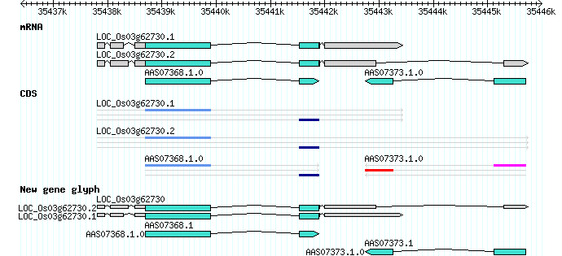
Chado/GBrowse & new gene glyph

Slide 13
New tables (in the last year)
featureloc_pub
That's it! Which means the core schema has been quite stable over the last year.
There have been some plpgsql functions added

Slide 14
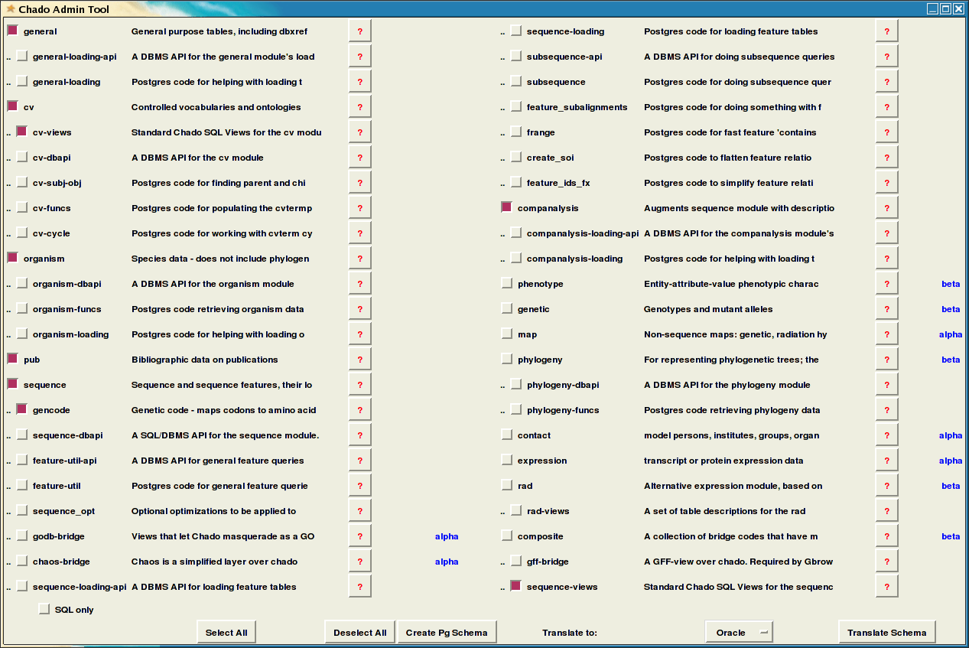
Schema builder

Slide 15
Schema builder
Primarily a tool for me (to build new default schemas)
Uses chado-module-metadata.xml to determine dependencies (selecting gff-bridge will automatically cause sequence-dbapi to be selected)
Could be used by users who have custom schema additions

Slide 16
State of the integration
Gbrowse/Chado integration is quite good (not surprising since I've been working on it for over two years)
Apollo/Chado (via JDBC) is good as well, though still difficult for naive (i.e., 'non-me') users
CMap/Chado good via function/trigger bridge
BioMart/Chado via gff2biomart.pl

Slide 17
More integration
AmiGO/Chado partially implemented via views and rules, not tried by me
Sybil/Chado ??? Runs on TIGR/Chado, not tried elsewhere that I know of

Slide 18
GMOD apps we probably won't hear about
PubSearch, PubFetch
Textpresso
FlashGViewer
BioPipe

Slide 19
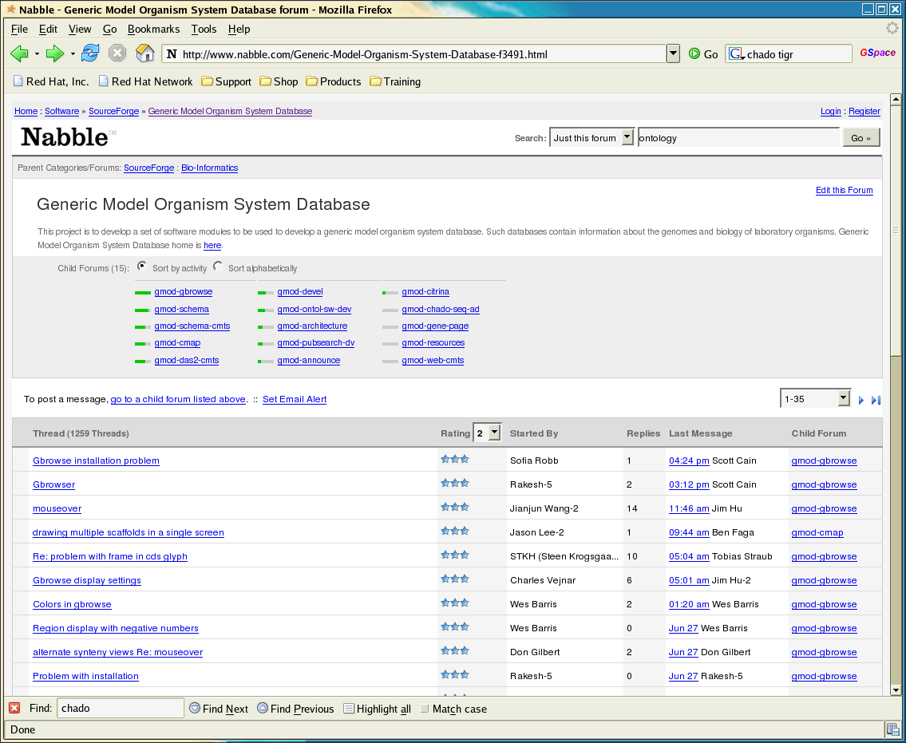
Nabble?

