Slide 1


GMOD Web Update
June 6, 2003
Allen Day

Slide 2
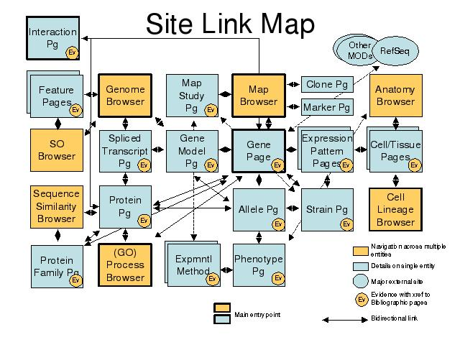
Site Link Diagram

Slide 3
Rendering Data
Data types
  1 Data type : 1 Data table
    and other types w/o tables
Rendering Plugins
  Convert data of type A into data of type B

Slide 4
Data types
Data tables map 1-to-1 to Class::DBI data objects.
Link tables represented by has_a() and has_many() functions of data objects.

Slide 5
Data Rendering
Recursive generation of HTML
2-pass traversal of a tree of Container and Plugin objects

Slide 6
Contextual Data Rendering
Appearance of “A” depends on:
  Tree context (1 vs. 2)
  Data type being rendered
  User preferences
0
1
2
A
A

Slide 7
Rendering Plugin API
Plugin is given an object being rendered, and the context which the plugin is acting
Plugin makes a decision to render or not render the object

Slide 8
Global Configuration
XML
Describes document tree topology
  …and which plugin nodes are given the option to render
  …and in what context
Look-and-feel options

Slide 9
User Customization
XML
User preferences stored as a diff to global configuration
XML::DifferenceMarkup

Slide 10
Customization Overview
Global
Conf
New
Prefs
(POST)
New
Prefs
Diff
DB
Merge
Old
Prefs
Render
HTML
Merge

Slide 11
Recap of Data Rendering
DB
Get
Session
Make
config
Get
Object
cookie
params
Render
Data

Slide 12
Site Link Diagram

Slide 13
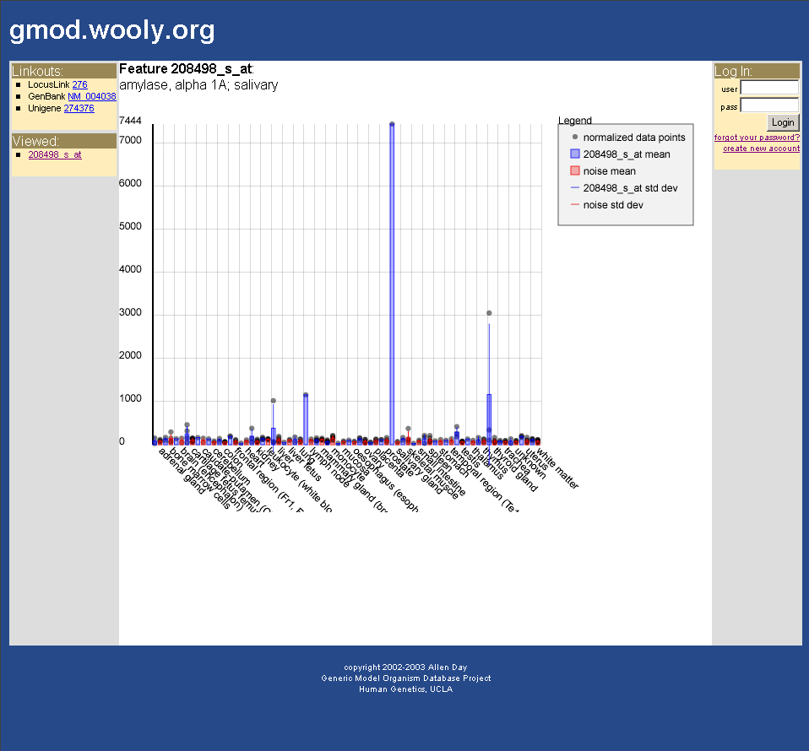
Major and Minor Foci

Slide 14
User Sessions and Preferences
Chado
Core
wwwuser
WWW
Module
organism
session
map
general
(dbxref)
sequence
pub
companalysis
cv
genetic
expression

Slide 15
Integration
Chado table namespaces
  “www” prefix on gmod-web tables
    Digression: Chado module linktable naming hierarchy?
GET/POST parameter namespaces
  “www.” prefix on gmod-web params

