Slide 1
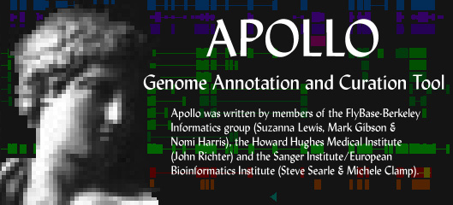
Apollo progress
Apollo Progress Report
Nomi Harris and Mark Gibson
Berkeley Drosophila Genome Project
GMOD Meeting, SRI
May 16-17, 2005
Notes:
I

Slide 2
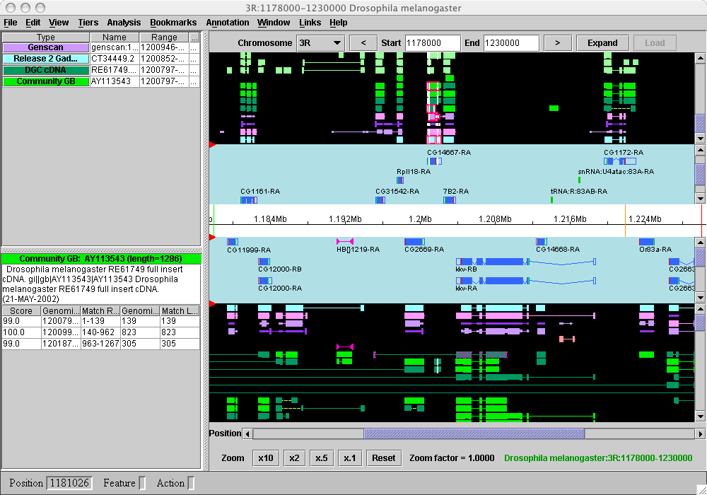
Notes:
We’re assuming all of you in the audience are familiar with Apollo, GMOD’s annotation curation tool.
Gbrowse: view annotations (as GIF in web page)
Apollo: view, edit, create annotations based on computational results; lets you modify transcript structures and edit auxiliary information associated with annotations.
Apollo is a Java application. Easy to install on your computer.

Slide 3
Improvements Since Release 1.4.6 (July 2004)
Transactions
Chado JDBC adapter
ChadoXML adapter
Selected minor improvements
Notes:
When talking through this slide, mention that Mark will discuss the first two points and then Nomi will talk about the ChadoXML adapter, recent minor improvements and future plans

Slide 4
Chado Roundtrip Options
GAME
Adapter
G2C
C2G
GAME
XML
Chadoxml
Adapter
Chado
XML
XORT
Apollo
ChadoTrans
Adapter
ChadoTrans
XML
JDBC
Adapter
Chado DB

Slide 5
Improvements Since Release 1.4.6 (July 2004)
Transactions
Chado JDBC adapter
ChadoXML adapter
Selected minor improvements

Slide 6
Transactions & Integrated DB
“Integrated” DB has non-Apollo data
“Wipeout & insert” will have a hard time preserving non-Apollo data
Transaction writeback does not affect non-Apollo data
Deleted objects are missing from saved data file—need transactions to keep track of them

Slide 7
Transactions & Writeback
Transaction
XML
(interim save)
Chado
Transaction
Transformer
Edit
Chado
Transaction
Transaction
Manager
(list)
Apollo
User
Chado
Transaction
XML
Chado
SQL
Undo
XORT
JDBC
Coalesce
Transactions
Chado DB

Slide 8
Apollo Transactions
Apollo
User
Apollo
Transaction
(edit)
Transaction
Manager
(trans list)
Capture fine grain edits
Transaction object contains:
  Operation (add, delete, update)
  Feature (gene, transcript, exon)
  Subpart (none, comment, name…)
One “action” can result in many transactions
Notes:
The one action -> many trans is the motivation for compound transactions

Slide 9
Coalesce Transactions
Transaction
Manager
(trans list)
Coalesce
Transactions
Filter out redundant edits
Done at commit time
Notes:
Its pretty good but not perfect yet… some redundant edits still get through - not the end of the world just means a few extra commits to the database
Note: Have to coalesce at commit time not during editing session for undo to work properly

Slide 10
Interim save for transactions
Transaction
Manager
(trans list)
Transaction
XML
Adapter
Transaction
XML
(interim save)
Saves transactions in separate xml file
GAME & Chado XML adapters save transactions
Depends on accompanying data file

Slide 11
Chado Transactions
Transaction
Manager
(trans list)
Chado
Transaction
Transformer
Chado
Transaction
(java)
Transform Apollo Transaction to Chado Transaction
One to many
One way

Slide 12
Exon Range Change Example
Delete Old
Feature
Relationship
Insert Exon
Feature
Exon Range
Change
Apollo transaction
User Edit
Exon Range
Change
Chado
Transaction
Transformer
Insert
FeatureLoc
Insert New
Feature
Relationship
Transcript
Range Change
Apollo transaction
Chado
Transaction
Transformer
Update
FeatureLoc
1 user edit to many Apollo trans. (compound)
1 Apollo transactions to many Chado trans.
Chado exons are shared
Chado lookups not included
Notes:
This is for going from a shared exon range to a non-shared exon range.
Theres a bunch of lookup queries as well not included here. Also an exon range change can very possible trigger a transcript & gene range change - not shown here(there would be Apollo transactions for that as well).
This makes clear why its hard to go from Chado transactions to Apollo transactions - how can you tell which Chado transactions get lumped into an Apollo transaction? Theres no way to add anything to Chado transactions to indicate as much (no compound transactions).
Intorducing compound transaction concept as well with 1 edit to 2 Apollo trans

Slide 13
Chado Roundtrip Options
GAME
Adapter
G2C
C2G
GAME
XML
Chadoxml
Adapter
Chado
XML
XORT
Apollo
ChadoTrans
Adapter
ChadoTrans
XML
JDBC
Adapter
Chado DB

Slide 14
Chado Transaction Writeback
Chado
Transaction
(java)
Chado Tran
XML Writer
Chado
Transaction
XML
XORT
Chado
DB
Chado transaction object gets written out as Chado XML
XORT commits XML to Chado DB
Notes:
This route is not being used or tested (an abandoned rice route).
We were actually implementing this strategy for rice/gmod, but Guanming recoginized it was pretty easy given the Chado transaction to just write out sql and do jdbc writeback.
Nonetheless for debugging purposes the Chado transaction xml is really handy.

Slide 15
Improvements Since Release 1.4.6 (July 2004)
Transactions
Chado JDBC adapter
ChadoXML adapter
Selected minor improvements

Slide 16
Chado Roundtrip Options
GAME
Adapter
G2C
C2G
GAME
XML
Chadoxml
Adapter
Chado
XML
XORT
Apollo
ChadoTrans
Adapter
ChadoTrans
XML
JDBC
Adapter
Chado DB

Slide 17
JDBC Writeback
Chado
Transaction
(java)
JDBC Trans
Writer
Chado
SQL
JDBC
Chado
DB
JDBCTransactionWriter creates SQL from Chado Transaction
JDBC commits SQL to Chado DB
Rice Chado project will use this (in testing phase)
Notes:
In fact Chado xml transactions and Chado sql and java Chado transactions are all just different manifestations of an operation on a Chado row.
Being tested & debugged for rice Chado project.
I've fixed a lot of bugs here - its in pretty good shape.

Slide 18
Name Adapter
Apollo
User
Name Edit
Name
Adapter
Name
Transactions
Transaction
Manager
(trans list)
Name adapters capture MOD specific behavior for IDs and names
Many edits affect names & IDs
(merge, split, …)
Rice & Fly have their own name adapters
  Inherit from new generic GMOD name adapter
Notes:
An example is name adapter gets a gene name edit and then changes the names of transcripts, proteins and exons.
For undo purposes name transactions are lumped into one compound transaction(covered in next slide)

Slide 19
Undo
Apollo
User
Undo
Transaction
Manager
(trans list)
Facilitated by Transactions
Compound Transactions for compound events (name change, split…)
Partial implementation (only in Annotation Info Editor)
Notes:
Name adapter slide is an example of an edit that causes a compound transaction - gene name edit causes transcript exon & protein names to be changed.
Transactions use the Command design pattern - which yields undo

Slide 20
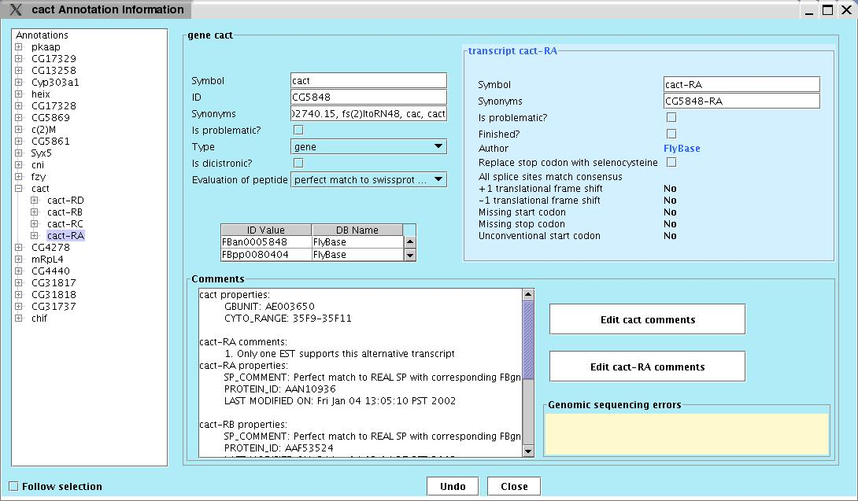
Annotation Info Editor

Slide 21
JDBC Reader Improvements
More configurable (XML config file)
Reads out of range leaf features
Queries optimized
New command-line arguments for reading and writing data
Notes:
The goal with the jdbc reader is to become fully configurable, so you don’t have to write java to configure (similar to name adap goal)

Slide 22
Improvements Since Release 1.4.6 (July 2004)
Transactions
Chado JDBC adapter
ChadoXML adapter
Selected minor improvements

Slide 23
Chado Roundtrip Options
GAME
Adapter
G2C
C2G
GAME
XML
Chado XML
Adapter
Chado
XML
XORT
Apollo
ChadoTrans
Adapter
ChadoTrans
XML
JDBC
Adapter
Chado DB

Slide 24
ChadoXML Adapter
GAME
Adapter
GAME
XML
G2C
C2G
Chado XML
Adapter
Chado
XML
Apollo
Read/write ChadoXML without G2C/C2G converters
Option to save annotations only
Names exons using shared exon numbers
  Collect non-redundant set of exons
  Number from lowest to highest start

Slide 25
ChadoXML adapter: What it doesn’t do (yet)
Doesn’t yet handle macros (will soon)
Doesn’t yet roundtrip all non-Apollo data (e.g. feature_cvterms)
  Don’t have appropriate datamodels inside Apollo
  Need to beef up some datamodels, e.g. for synonyms (author, etc.)
Still somewhat fly-specific

Slide 26
Improvements Since Release 1.4.6 (July 2004)
Transactions
Chado JDBC adapter
ChadoXML adapter
Selected minor improvements

Slide 27
Selected minor improvements
Better GAME XML schema description (game.rng)
  RELAX-NG can represent elements that occur in any order but only once
  (e.g. “start” and “end”)
  Can translate rng to xsd (less stringent)
<element name="annotation">
<interleave>
<optional>
<attribute name="problem">
<data type="boolean"/>
</attribute>
</optional>
<attribute name="id">
Notes:
Mention that game.dtd is inaccurate and should be ignored—use game.rng instead

Slide 28
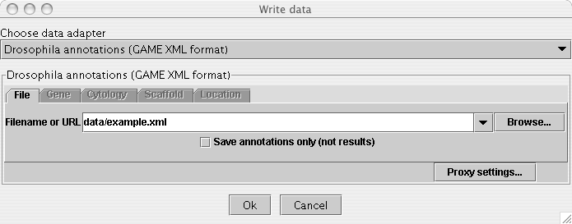
Selected minor improvements
Faster saving of GAME and ChadoXML:
  Buffered saving much faster
  (seconds vs. minutes)
  Can save just annotations (and genomic residues) without results

Slide 29
Selected minor improvements
Synonyms can now be deleted (as well as added or changed) in annot info editor
New command-line arguments
  Can specify input (or output) filename or source and format
  Guesses format if not specified
Centralized UserName class and GUI
Fixed Windows-only problem: mouse-over brought main window to front (Jon Slenk of TAIR)

Slide 30
Apollo Future Plans

Slide 31
Coming Soon
Improve analysis adapter
  Load/layer raw computational analysis output (BLAST, BLAT, GENSCAN, etc.)
  Cleaner UI
  More documentation
  Reverse analysis: from subject to query
Less fly-centric ChadoXML adapter
ChadoXML macros
Improve JDBC writeback & transactions

Slide 32
Coming Not As Soon
Full Undo?
Improve synteny?
Protein editor?
Full Types editor, incorporating Sequence Ontology (SO) terms?
Apollo webstart?

Slide 33
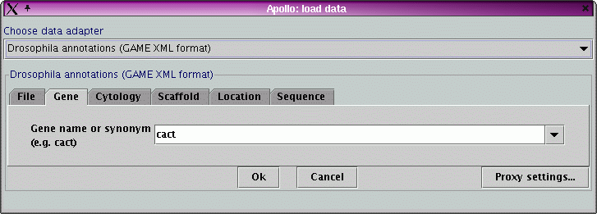
Apollo Webstart
Why?
  Need better query tool?
How?
  Launch blank Apollo
  Launch on particular region (Mozilla only)
Who?
  Rumors of success
  Help from community?

Slide 34
The End is Near
November 30, 2005: Apollo team runs out of money…unless grant application gets funded
Need justification for grant: Apollo community describes how important Apollo is to their work

Slide 35
Examples of Apollo Use
Arabidopsis Information Resource (TAIR)
  Manual curation of computational results
  Wrote new data adapter (relational db)
Institute for Systems Biology, Seattle (Alistair Rust)
  Visualizing putative transcription factor binding site predictions for various algorithms
University of British Columbia Bioinformatics Centre (UBiC)
  Pegasys computational pipeline-> GAME -> Apollo -> manual curation
TIGR
  Helped write initial Chado JDBC adapter
  Plan to use Apollo in production annotation pipeline
ParameciumDB, Genoscope
  Using GMOD software (Chado db, etc.)
  Planning to use Apollo for community annotation curation

Slide 36
The Apollo Team
FlyBase Berkeley:
  Suzanna Lewis, Nomi Harris, Mark Gibson, Sima Misra
CSH:
  Guanming Wu, Scott Cain
Past contributors:
  Sanger Institute--Steve Searle, Michele Clamp, Vivek Iyer
  HHMI--John Day-Richter
  TIGR--Jonathan Crabtree
  FlyBase--curators

Slide 37
Installer available at http://www.fruitfly.org/annot/apollo/install.html
Code available at SourceForge: http://sourceforge.net/projects/gmod
Notes:
We’d like more feedback from the Apollo community about what they’d like to see in Apollo—talk to us or send us email.

