Slide 1
Pathway Tools: Recent Developments
GMOD Meeting, June 2006

Slide 2
Pathway Tools Software
PathoLogic
  Predicts operons, metabolic network, pathway hole fillers, from genome
  Computational creation of new Pathway/Genome Databases
Pathway/Genome Editors
  Distributed curation of PGDBs
  Distributed object database system, interactive editing tools
Pathway/Genome Navigator
  WWW publishing of PGDBs
  Querying, visualization of pathways, chromosomes, operons
  Analysis operations
    Pathway visualization of gene-expression data
    Global comparisons of metabolic networks

Slide 3
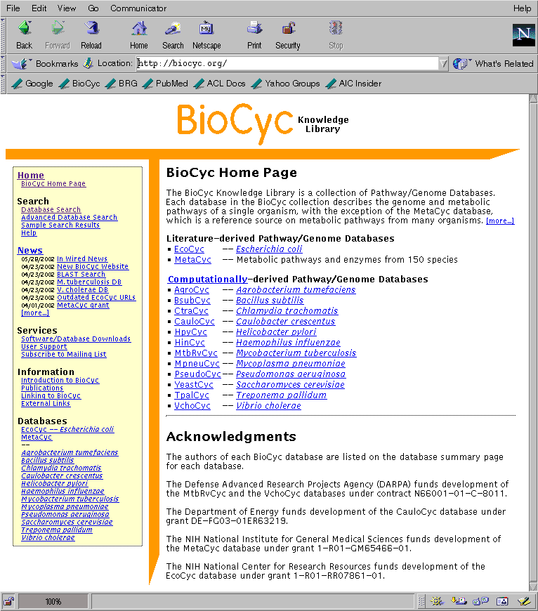
BioCyc Collection of
Pathway/Genome Databases
Pathway/Genome Database (PGDB) – combines information about
  Pathways, reactions, substrates
  Enzymes, transporters
  Genes, replicons
  Transcription factors/sites, promoters, operons
Tier 1: Literature-Derived PGDBs
  MetaCyc
  EcoCyc -- Escherichia coli K-12
Tier 2: Computationally-derived DBs, Some Curation -- 12 PGDBs
  HumanCyc
  Mycobacterium tuberculosis
Tier 3: Computationally-derived DBs, No Curation -- 191 DBs

Slide 4
PGDBs Created by External Users
600+ licensees -- 50 groups applying software to 100+ organisms
Software freely available to academics; Each PGDB owned by its creator
Saccharomyces cerevisiae, SGD project, Stanford University
TAIR, Carnegie Institution of Washington
dictyBase, Northwestern University
GrameneDB, Cold Spring Harbor Laboratory
Planned:
  CGD (Candida albicans), Stanford University
  MGD (Mouse), Jackson Laboratory
  RGD (Rat), Medical College of Wisconsin
  WormBase (C. elegans), Caltech
Large scale users:
  C. Medigue, Genoscope, 67 PGDBs
  G. Burger, U Montreal, 20 PGDBs
Selected others:
  G. Church, Harvard, Prochlorococcus marinus MED4
  Larimer/Uberbacher, ORNL, Shewanella onedensis
  J. Keasling, UC Berkeley, Desulfovibrio vulgaris
  Fiona Brinkman, Simon Fraser Univ, Pseudomonas aeruginosa

Slide 5
Recent Developments: Version 9.5, September 2005
New interfaces to Oracle and MySQL
Cell Component Ontology (CCO) introduced
Interface to Marvin chemical structure editor
PathoLogic ported to Windows
PathoLogic can use other organism PGDBs for pathway prediction
Transport Inference Parser
Support for detection and merging of duplicate reactions

Slide 6
Overview and Omics Viewer
Magnified views of pathways in Web Overview
Display omics data on individual pathways
Choice of 3-color display or full spectrum
Table of pathways

Slide 7
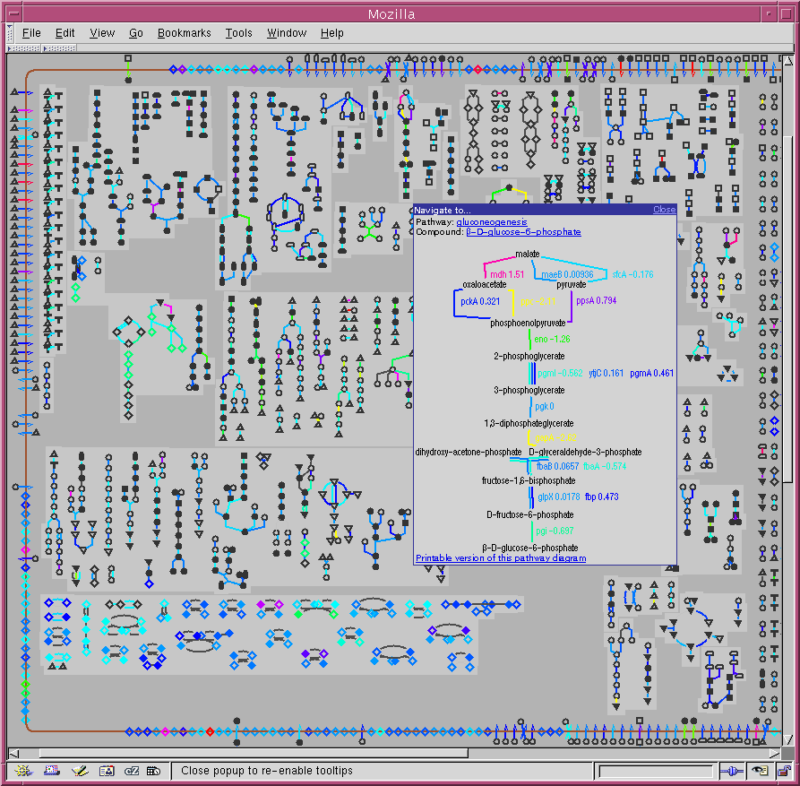
Overview and Omics Viewer

Slide 8
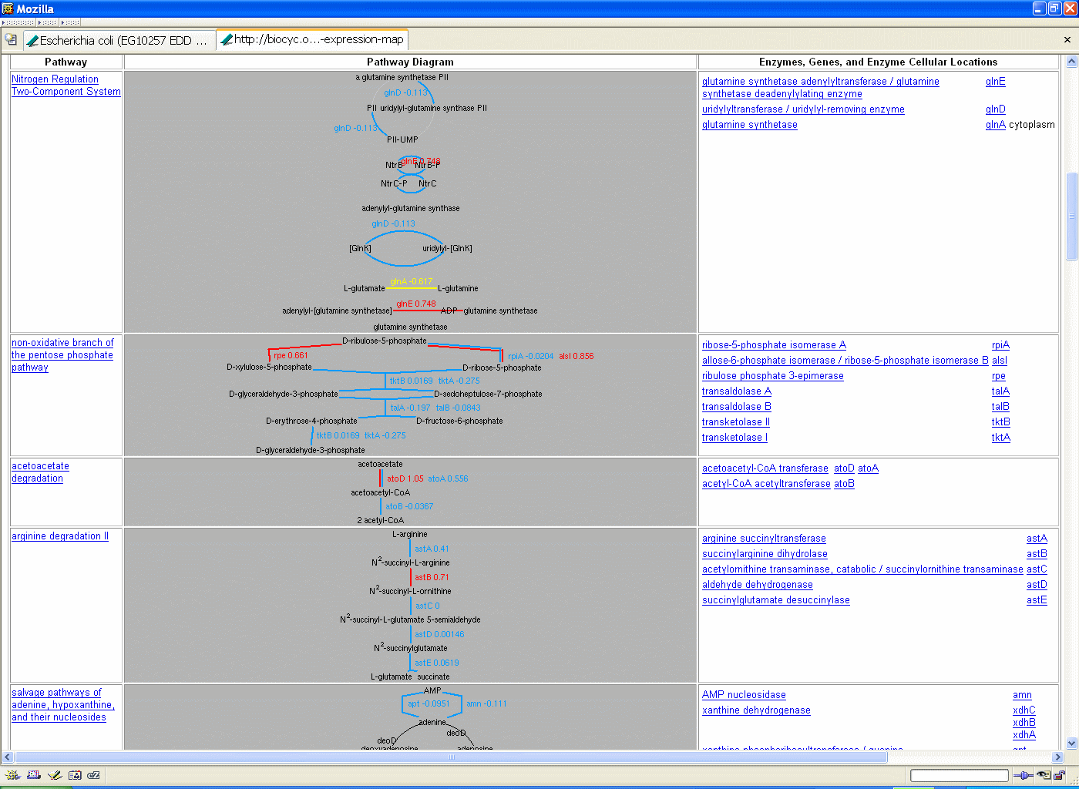
Omics Viewer – Table View

Slide 9
Cross-Species Comparative Operations
Comparative genome browser
Tables comparing pathways, reactions, proteins, transcription units, metabolites across organisms
Cross-species comparison of individual pathways and reactions

Slide 10
Comparative Genome Browser
One master organism that anchors the comparison
Set of selected organisms
One gene of master organism directs the alignment
Ortholog dblinks are followed to the
selected organisms
Ortholog links can be bulk loaded (UG II 2.4.10.5)
BioCyc uses best bi-directional BLAST hits
(from CMR), stored in a MySQL db
Genes connected by ortholog links have same color

Slide 11
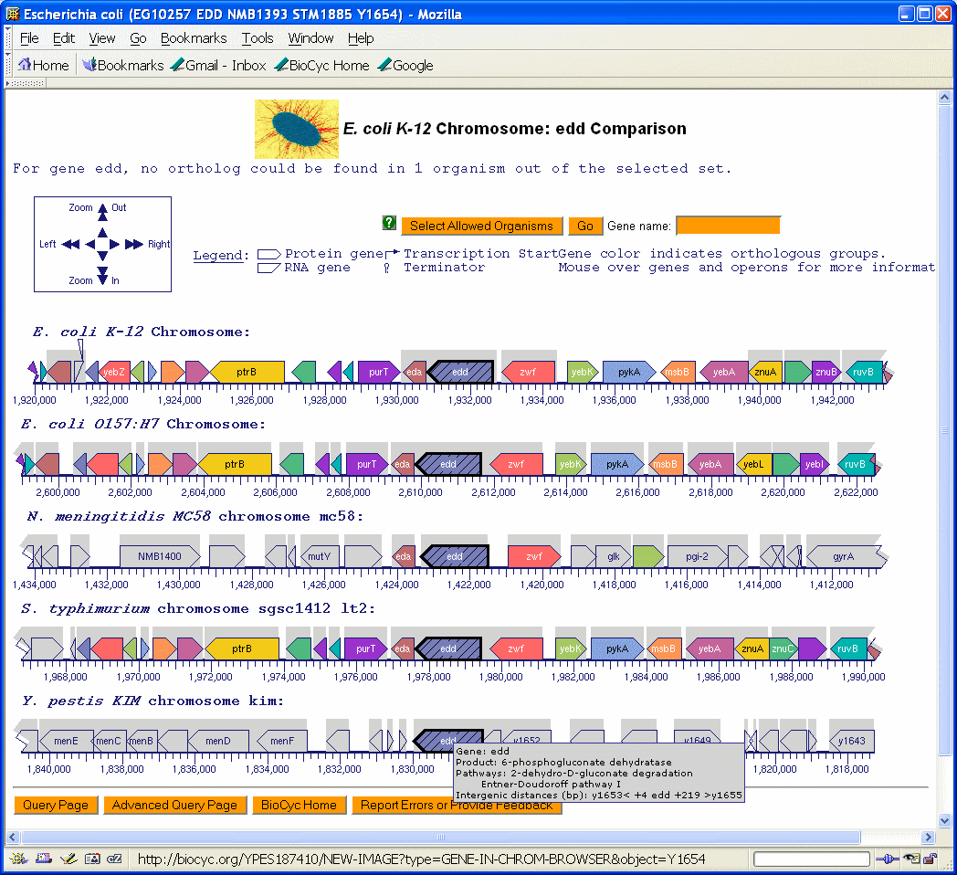
Comparative Genome Browser

Slide 12
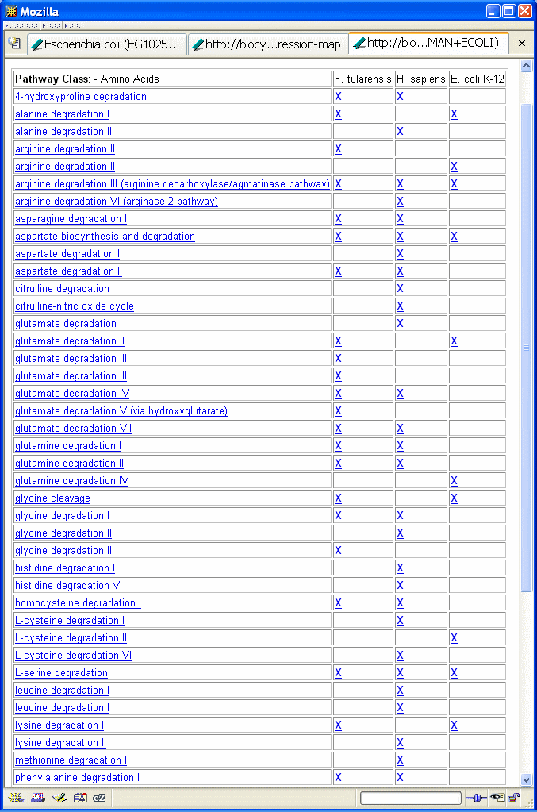
Cross-Species Pathway Comparison

Slide 13
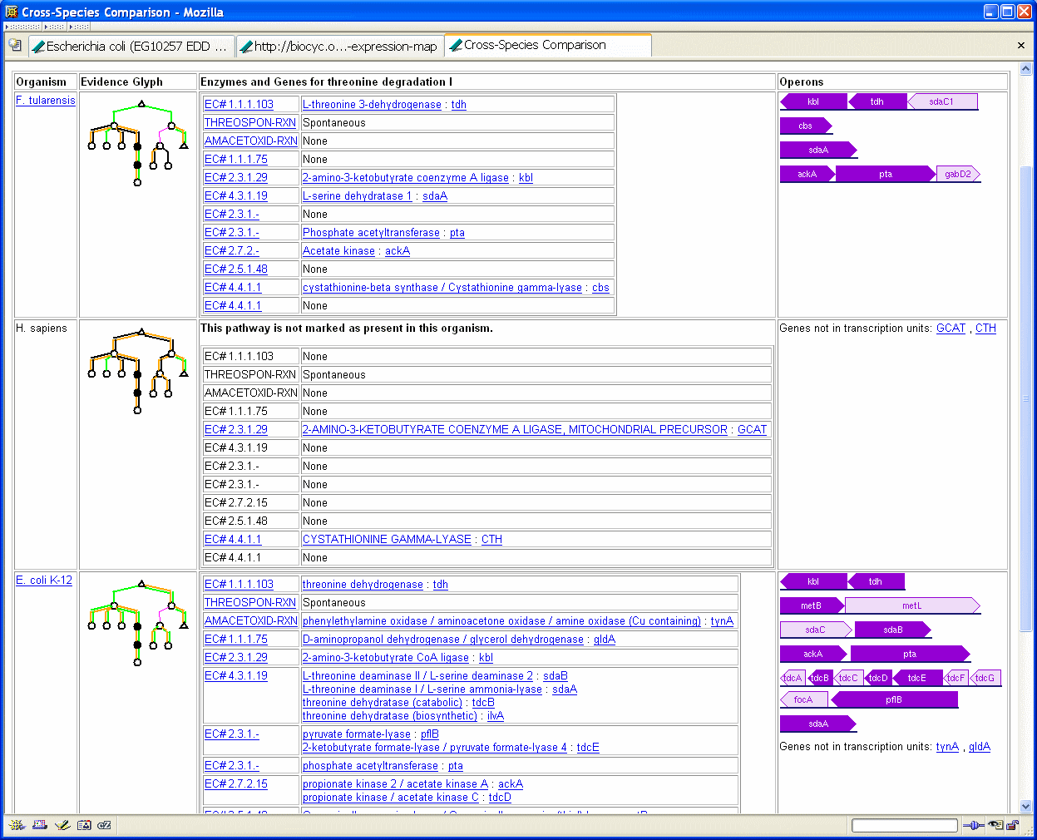
Cross-Species Pathway Comparison

Slide 14
Recent Developments: Version 10.0, March 2006
Added support for Gene Ontology
New author crediting system

Slide 15
Author Crediting System
For Pathways & Enzymes
Types of Credit: Created, Reviewed, Revised
Home Pages for Authors and Organizations

Slide 16
Coming in Version 10.5
Overview semantic zooming
Generate metabolic poster
Spell checker within editing tools
  Will use dictionary of biomedical terms
New sequence retrieval dialog
Hole filler will work under Windows
One-click pathway output to BioPAX
Compound duplicate checker
Consistency checker available through GUI

Slide 17
New Overview Semantic Zooming Capabilities
Can enlarge overview diagram to show
  Arrowheads on reaction arrows (120%)
  Substrate names and pathway labels (200%)
  Enzyme, gene names (300%, but more readable at 400%)
  At 400%, you have a diagram suitable for poster printing
Automatic poster printing facility
  Can customize title, text, highlighting, etc.
  Can custom build overview specifically for poster
    Include/exclude enzyme names, gene names, EC numbers
    Change font sizes
    Alter aspect ratio
Unfortunately, overview diagram now takes longer to generate (approx 1 hour vs. several minutes)

Slide 18
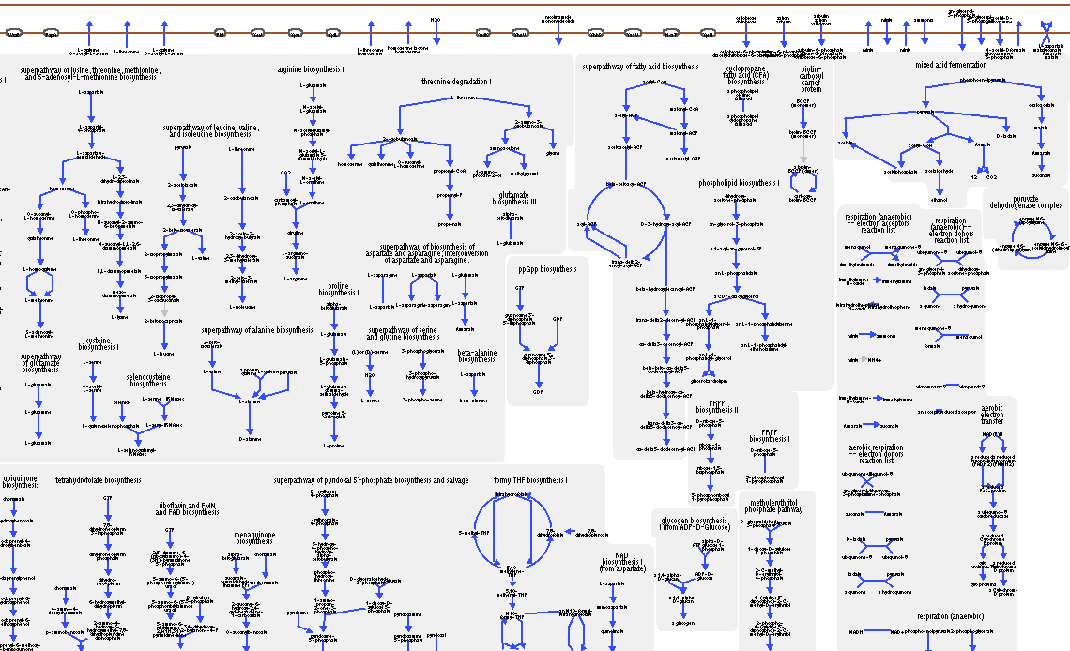
Fragment of Overview at 200% Zoom

Slide 19
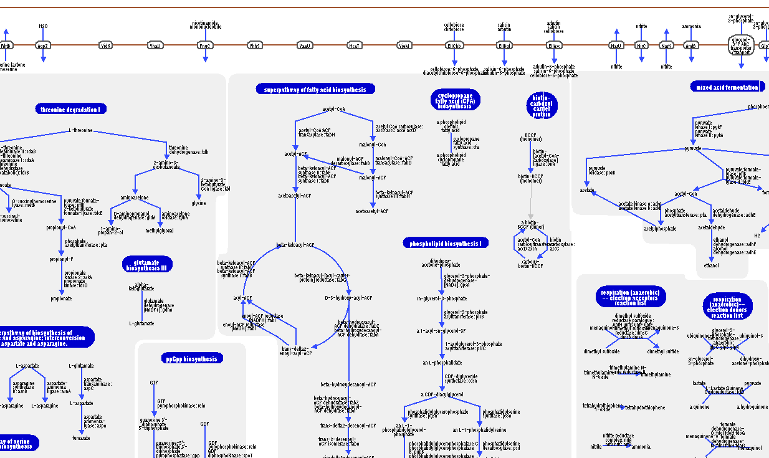
Fragment of Overview at 400% Zoom

Slide 20
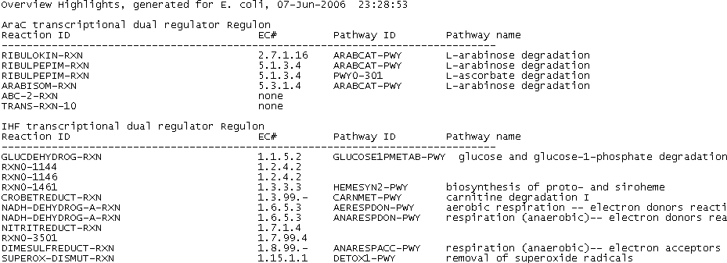
Using Overview Diagram for Global Queries
(Desktop Application)
Species Comparison
Highlight list of genes or reactions from file
Variety of “canned” queries
See all connections from one or more selected metabolites
API to highlight based on user computations
Can save highlights to (& reload from) a human-readable file

Slide 21
Using Omics Viewer for Global Analyses
Show gene expression, proteomics, metabolomics data
Customizable color schemes
Can superimpose results of multiple datasets on single display, or show as animation
Can also be used to show results of global computational analyses – anything that assigns a number to a gene, protein, reaction or substrate, or subdivides them into groups
Navigate from Omics Viewer to pathway displays to see omics data on a single pathway

