Slide 1
A couple of UI prototypes*
Jonathan Crabtree
jcrabtree@som.umaryland.edu
Institute for Genome Sciences (IGS)
University of Maryland, Baltimore
* Dramatization: actual presentation may have been significantly less well-organized

Slide 2
1. New! Dojo tree widget, now with 100% more bar graphs.
Took standard Dojo tree widget
Added graphs of node-associated quantities
Use case: Review counts of 454 sequence reads classified at different taxa in a taxonomic tree, using data from metagenomic survey sequencing classified using the RDP's Naïve Bayesian classifier and TOBA-based taxonomy.

Slide 3
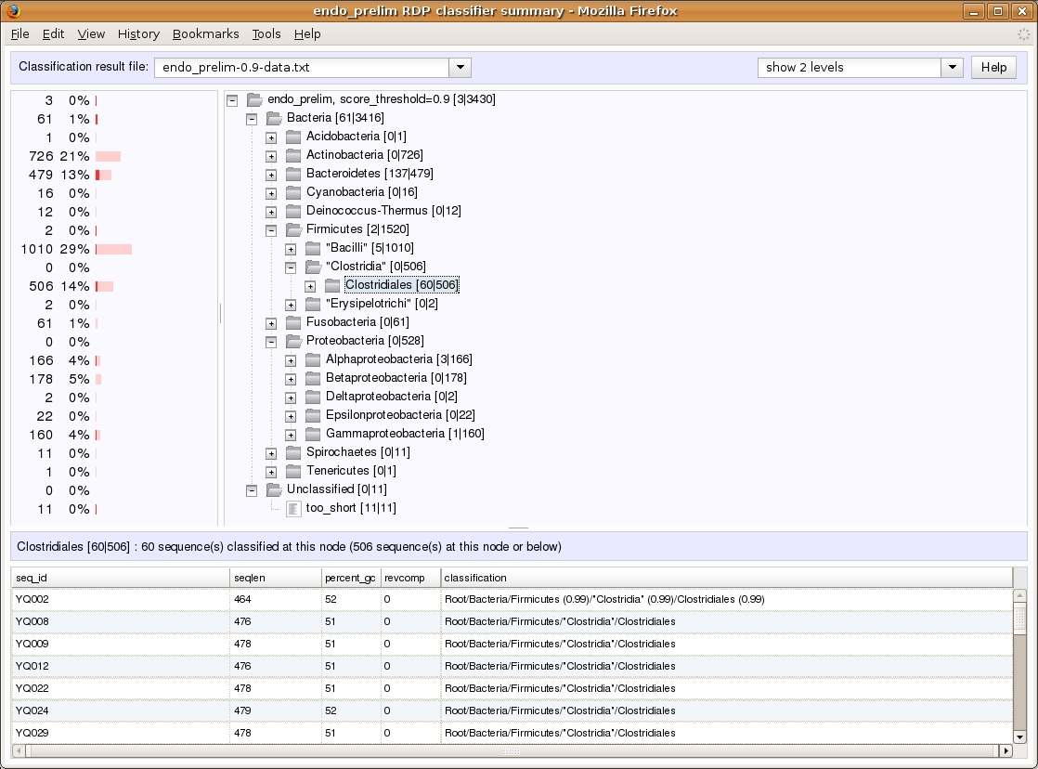

Slide 4
Tree/graph widget features
Synchronized scrolling of graph and tree panes
Graphs dynamically update as tree nodes are expanded or collapsed.
Clicking on a tree node loads a list of all the sequence reads classified at that node.
Graph colors differentiate between: 1. sequences classified at a node and 2. sequences classified at OR below a node.

Slide 5
Tree/graph widget cons
Not under active development
No connection with chado tools (currently reads data in simple JSON format)
Just an idea/prototype for the dynamic display of tree-associated abundance data in the context of a JavaScript framework.

Slide 6
2. An AJAX-Style Synteny Viewer
Goal: produce a proof of concept of an interactive version of the “Sybil” synteny viewer (see http://sybil.sf.net)
Under (extremely) sporadic development for several years now.
Uses Nested Containment Lists like JBrowse, but only on the server side.
Client uses Dojo, server is custom C app that uses libmicrohttpd, Cairo, NCLists.

Slide 7
Synteny viewer example
13 sequence/6 genome example reading from a 10 genome PostgreSQL chado comparative database
A protein clustering analysis is used for the comparative data.
The current prototype displays single protein clusters in their genomic context.
Sequences can be scrolled by dragging and the protein cluster display updates in real time.
Color coding indicates source genome.

Slide 8
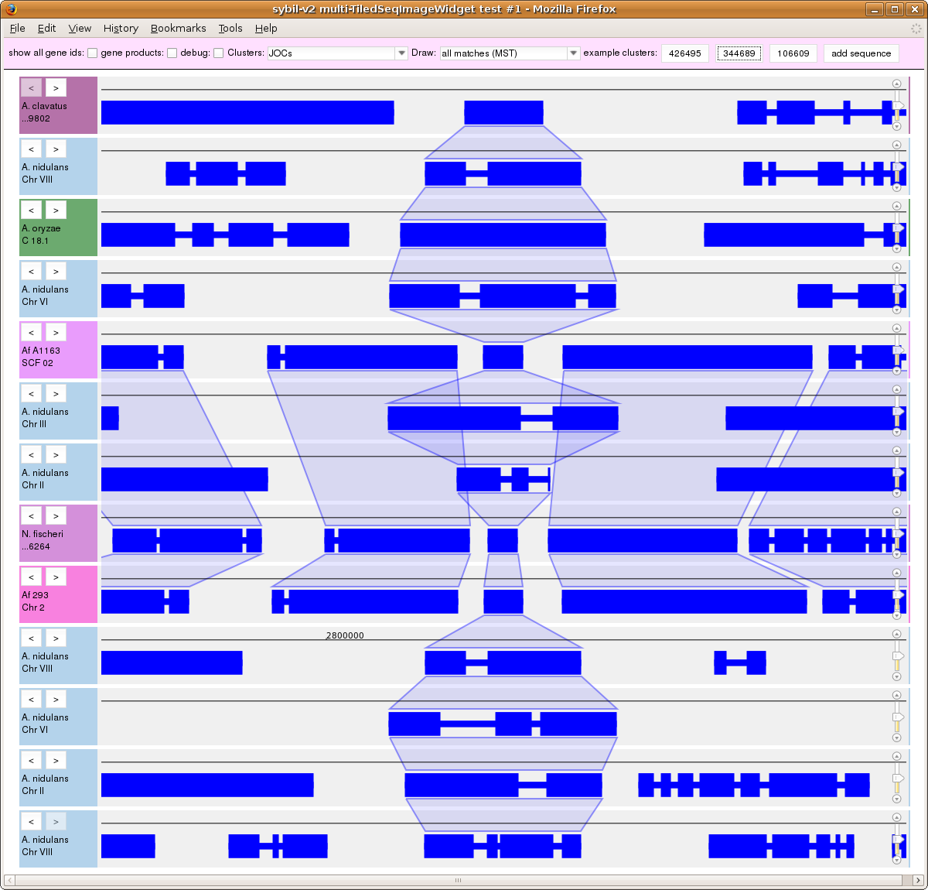

Slide 9
In the next slide...
Click on the arrows to reorder the sequences, or pick them up and drag them directly.
Here a sequence (the 5th from the top) is manually moved to be closer to those to which it is more similar (2 rows lower on the page.)

Slide 10
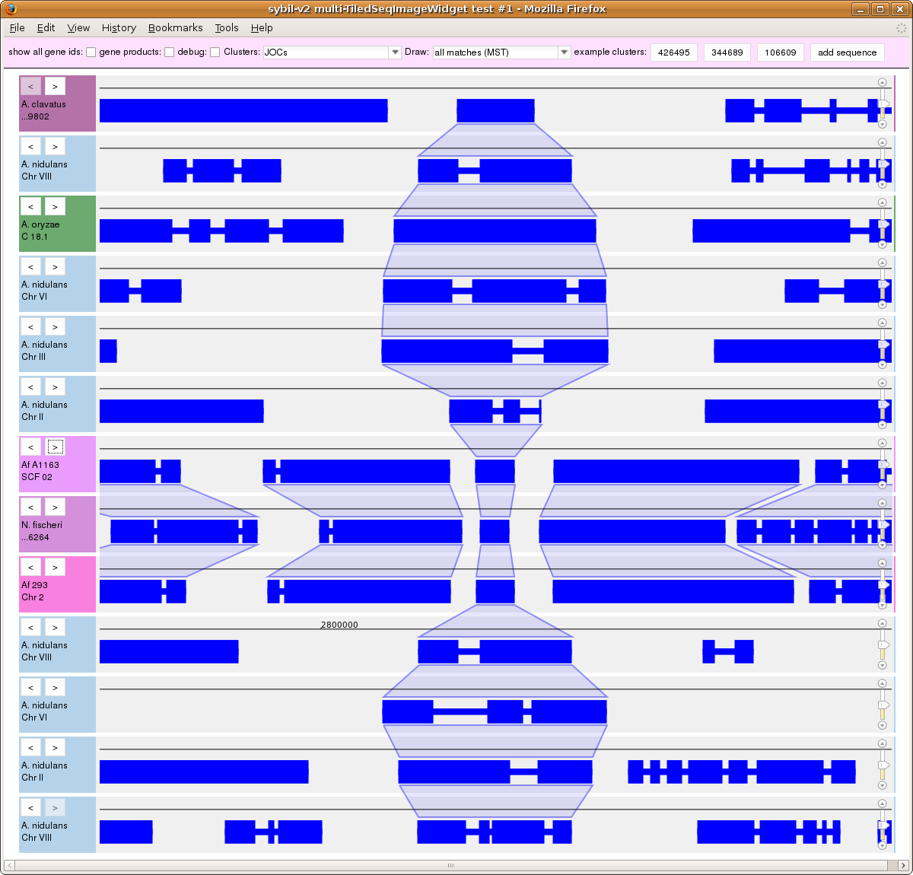

Slide 11
In the next slide...
Zoom/change scale by using the mouse wheel or the zoom slider at the right edge of each sequence.
Here we have zoomed out in 3 adjacent sequences.
Scrolling and zooming is currently independently controlled in each sequence.

Slide 12
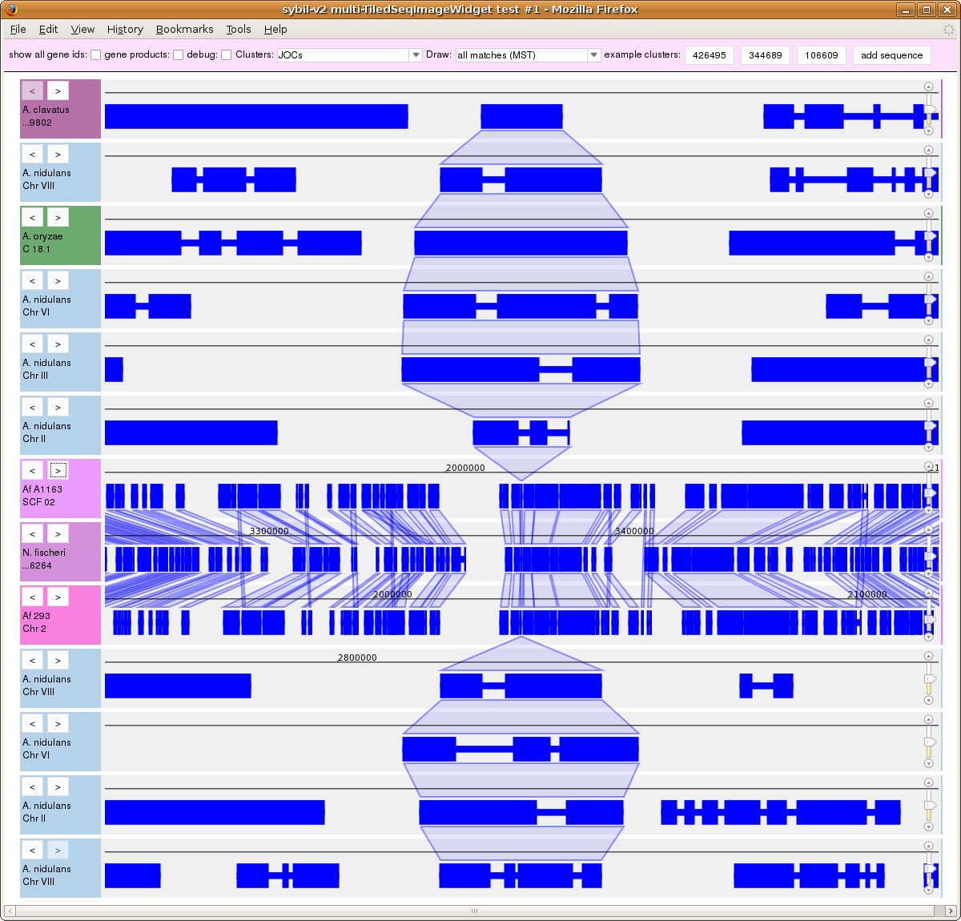

Slide 13
In the next slide...
Double-click to open up control panel for each sequence.
Control panel contains an overview of the entire sequence, which shows the currently-viewed position and can also be used as a scrollbar.

Slide 14
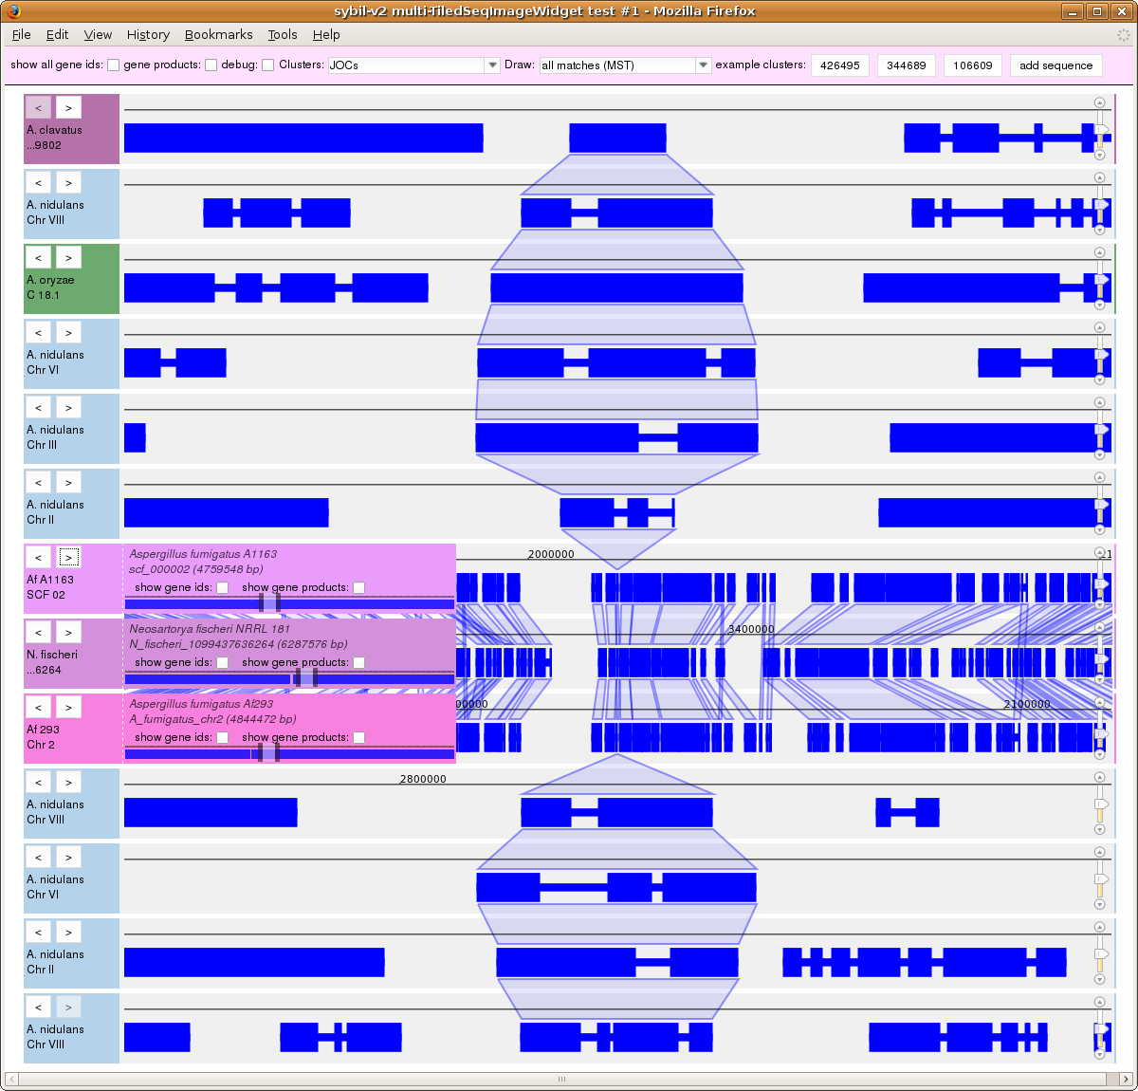

Slide 15
In the next slide...
Click to display gene ids and/or gene product names.
Gene ids and product names are retrieved asynchronously as needed.

Slide 16
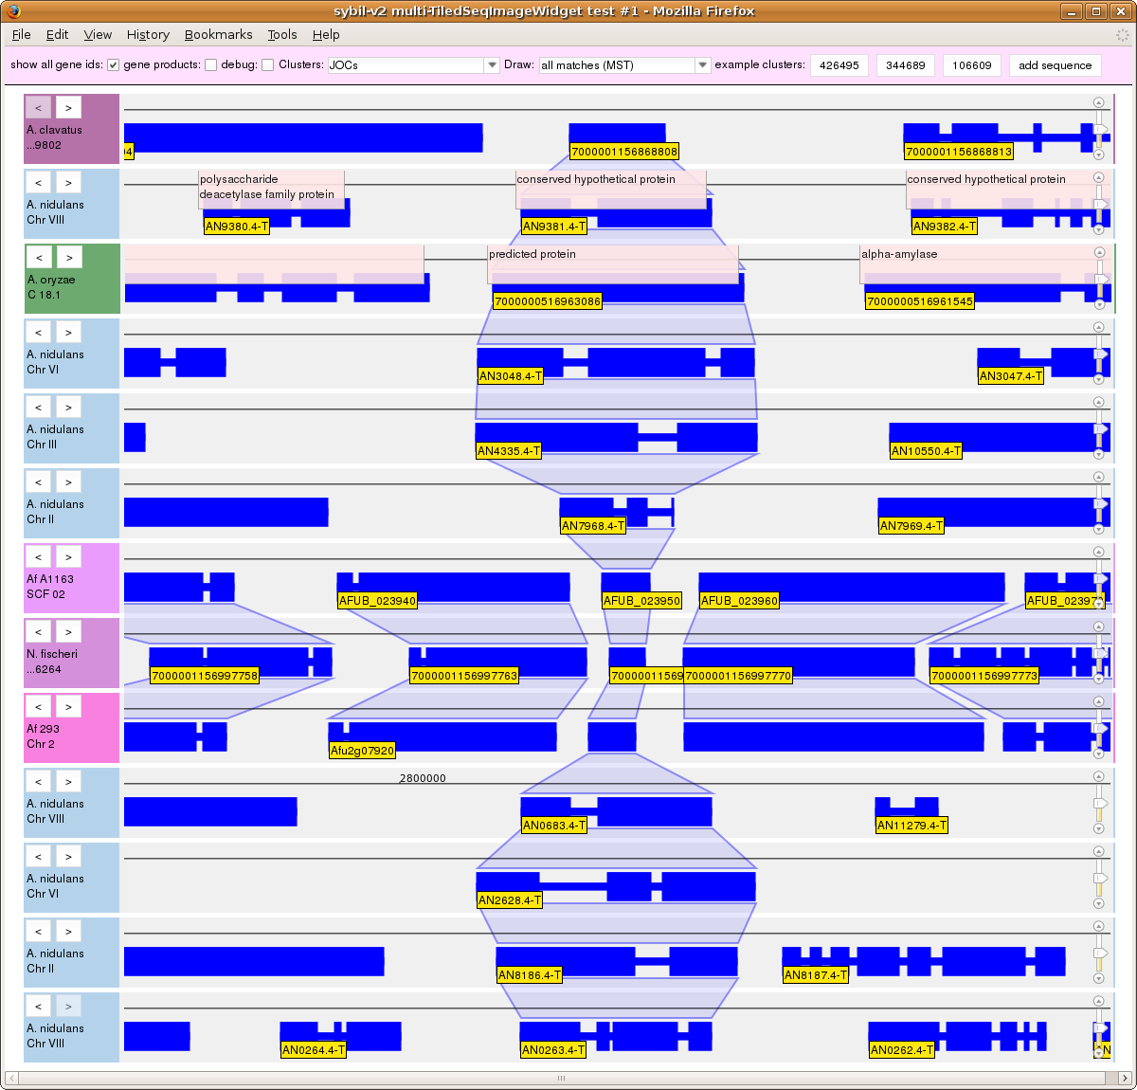

Slide 17
Synteny viewer summary
Still just a prototype/proof of concept, with a possible alpha release on the horizon if time permits.
Similar in concept to proposed JBrowse_syn tool
Current back-end is chado/PostgreSQL only
No attempt to deal with 2nd gen data here: assumes assembled and annotated sequence data.
All the heavy lifting is done on the server side, which could potentially be distributed on the cloud (although the current app runs fine—for a small number of users—with client (browser), server, and back-end chado db all on the same laptop.)

