Slide 1

The GMOD Project: Creating Reusable Software Components for Genome Data
Scott Cain
GMOD Project Coordinator
Cold Spring Harbor Laboratory

Slide 2
Model Organism Databases
Community-driven compilations of knowledge about one or more model organisms
Genotype/phenotype correlations.
Evolutionary relationships
Shared resources
  Genome annotation, stocks
  Other key datasets

Slide 3
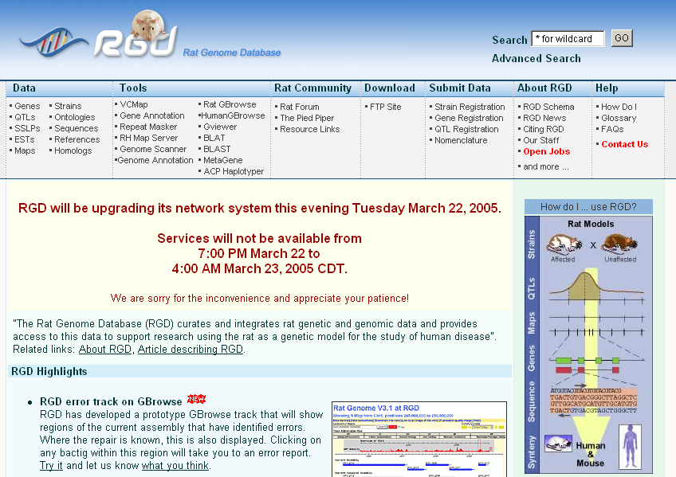
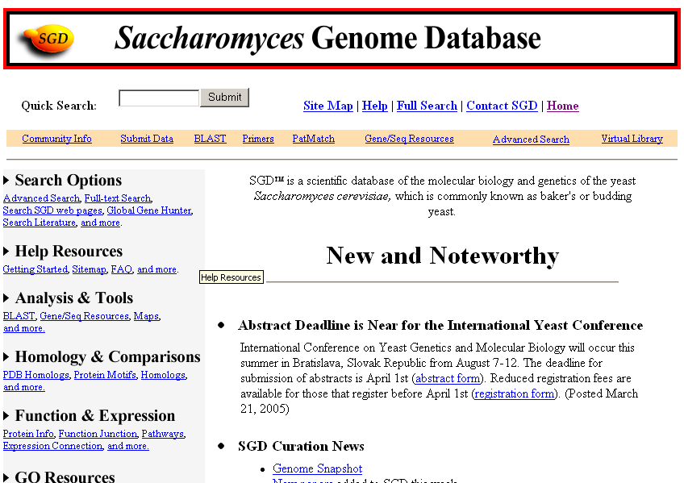
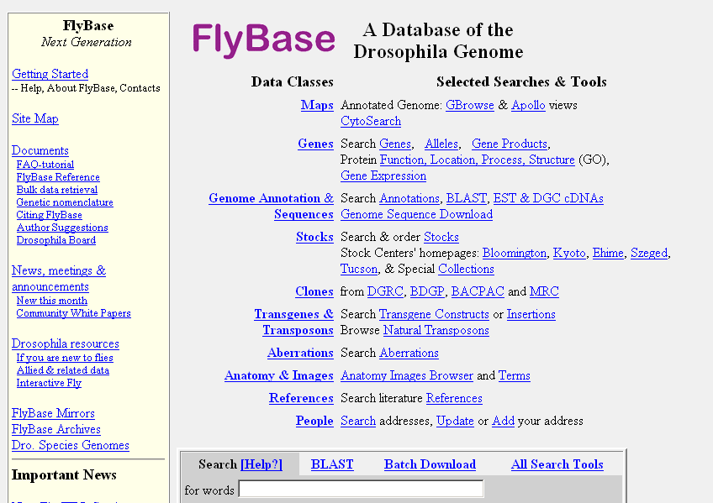
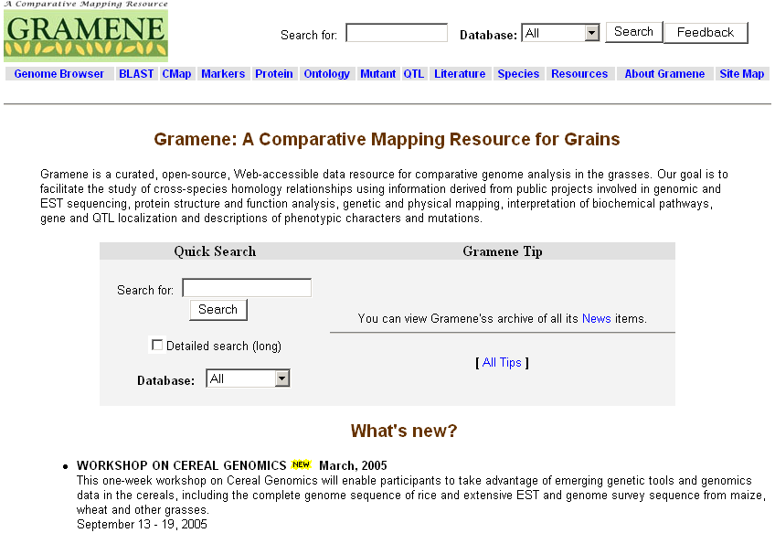
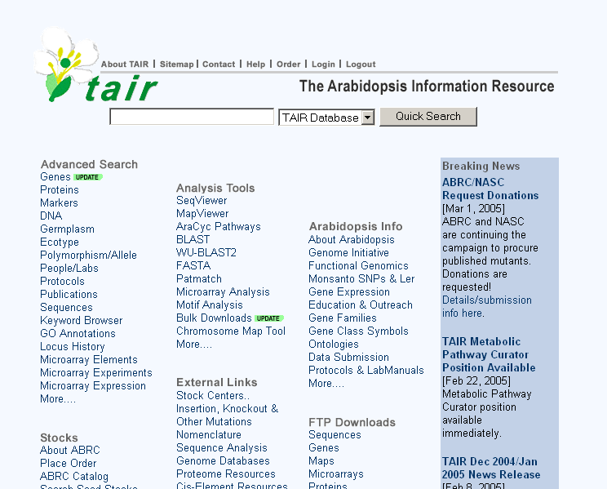
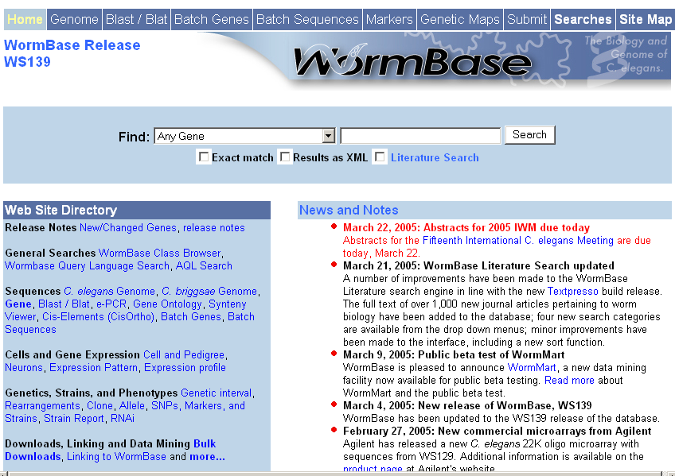

Slide 4
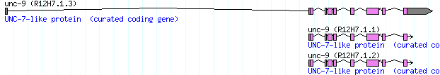
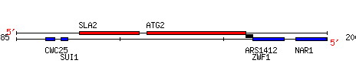
Three Views of a Gene
WormBase
SGD
TIGR

Slide 5
The GMOD Project
Standardized solutions for model organism databases
Multiple MODs involved
  Original participants: Worm, fly, yeast, mouse, arabidopsis, rat, rice, E. coli
Funded by NIH, USDA/ARS, NFS
  Programmers, coordinator, help desk, workshops
http://www.gmod.org

Slide 6
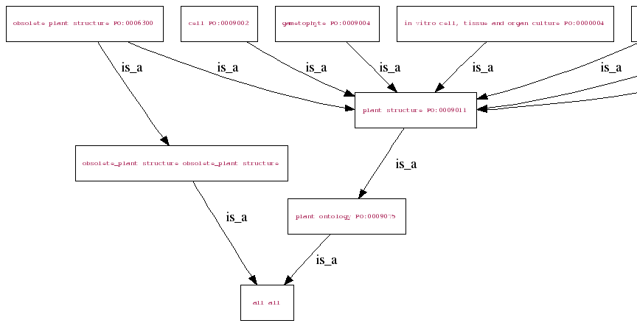
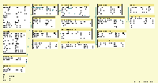
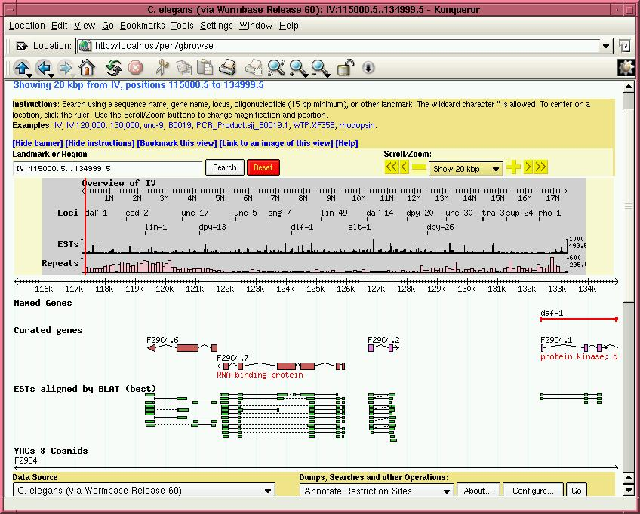
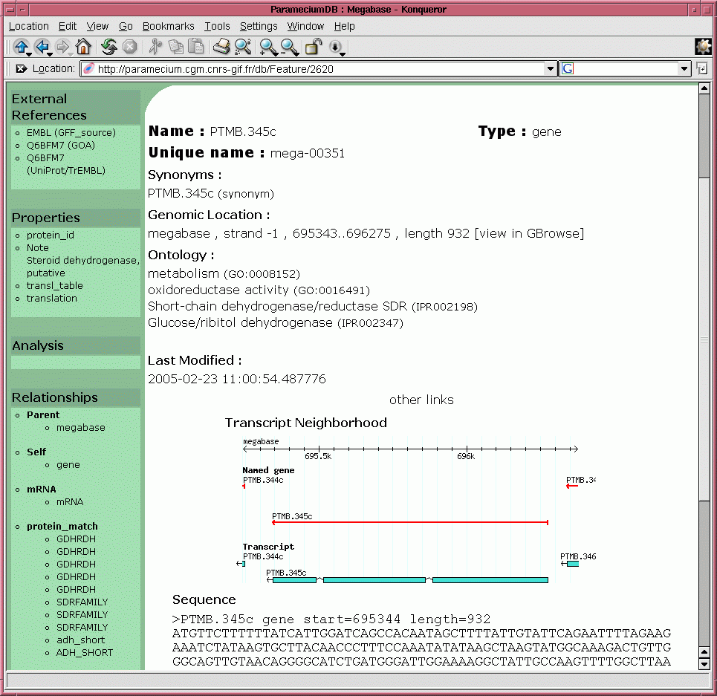
The Components of GMOD
Standard
ontologies
Standard
Schema
Standard
file formats
Standard
browsers &
editors
Standard
web site

Slide 7
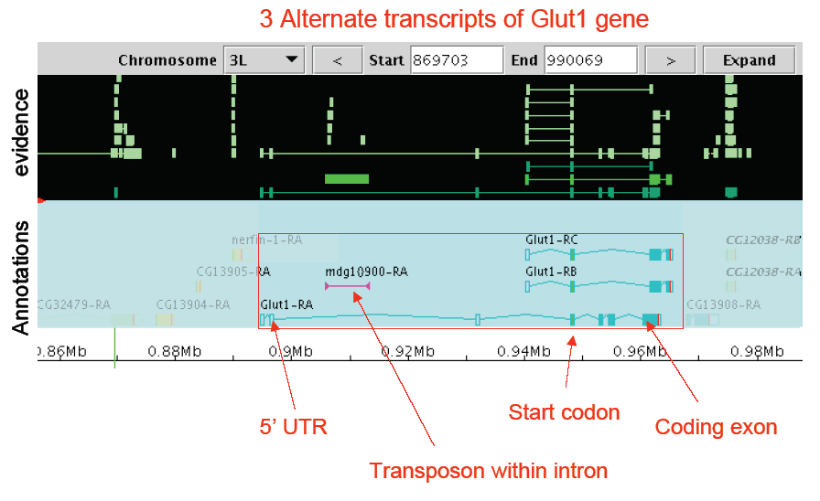
Sequence Ontology
Karen Eilbeck (U. Utah)
Slide from Karen Eilbeck

Slide 8
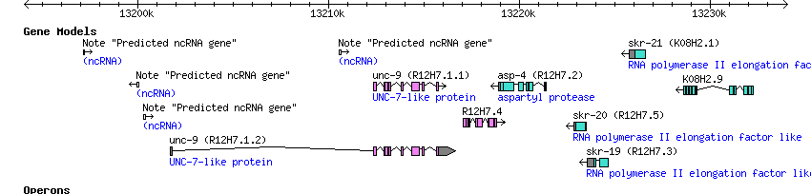
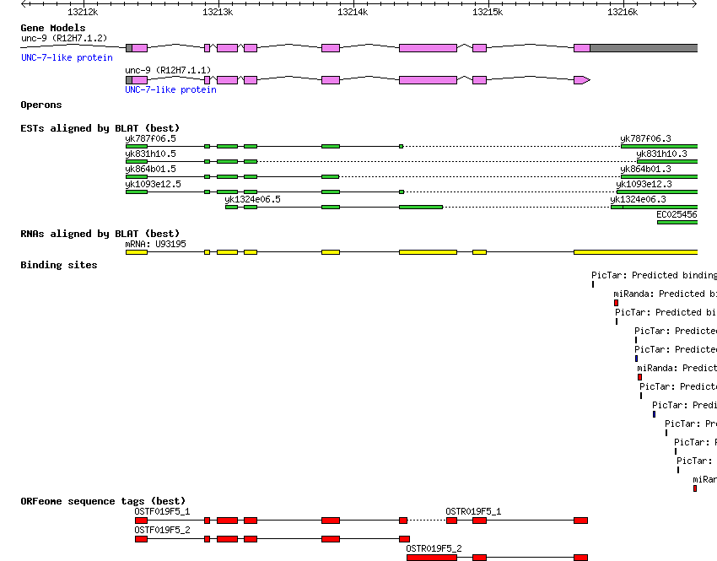
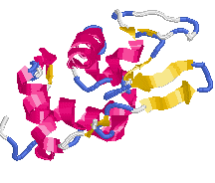
GMOD Schema: Chado
David Emmert (FlyBase), Chris Mungall (Berkeley)
Modular and ontology-driven for flexibility and extensibility.
gene
genomic location
transcript
mRNA
translation_product
protein

Slide 9
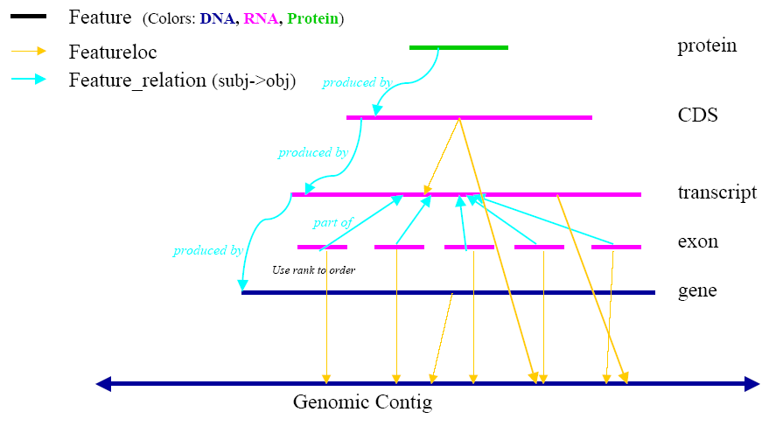
Central Dogma
Slide from Stan Letovsky

Slide 10
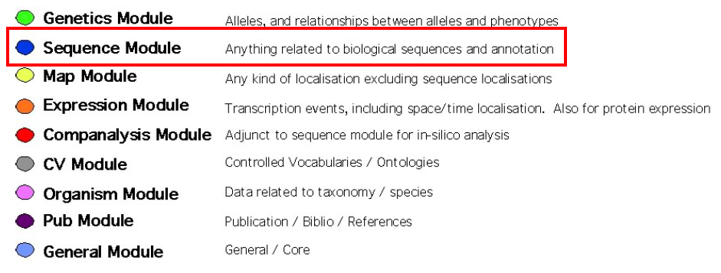
Chado – GMOD Schema
David Emmert, Chris Mungall
Slide from Stan Letovsky

Slide 11
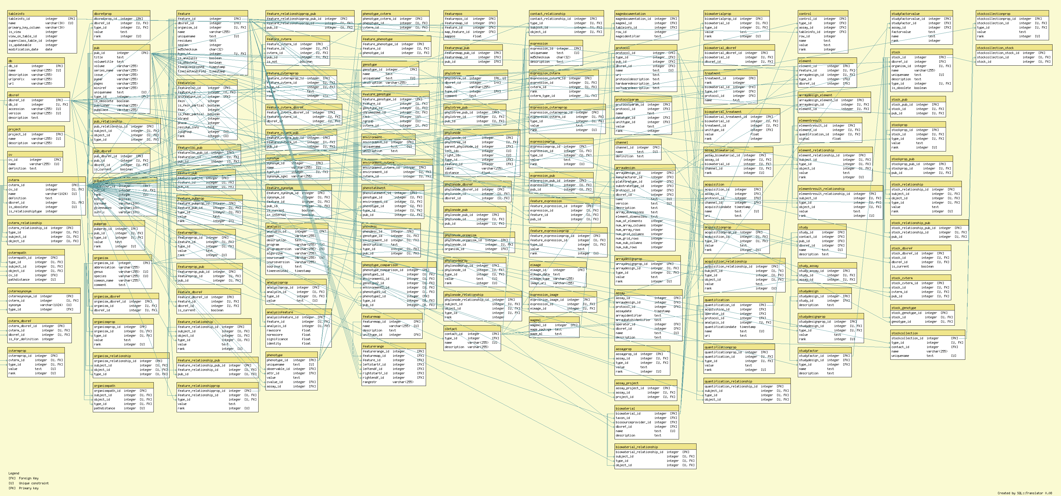
Chado Schema
Diagram created by SQL::Translator

Slide 12
What do you need for Chado?
PostgreSQL (Powerful OS RDMS)
BioPerl
go-perl (Gene Ontology consortium’s perl tools)
Optional:
  XORT, a perl tool for loading and dumping XML files to/from a database
  ModWare, a BioPerl-compatible API built on Class::DBI

Slide 13
Do you need Chado?
It depends…
It is the medium of interoperation for many GMOD applications
Chado is very good at capturing complex biological data, but…
It is a data warehouse, and so can be a little slow to query, so…
If you have only features on sequences, you probably want something else (but I’ve got that too)

Slide 14
Standard Browsers & Editors
GBrowse – Web-based genome annotation viewing (Lincoln Stein, Scott Cain, CSHL)
Apollo – Desktop-based genome annotation editing (Nomi Harris, Berkeley; Michelle Clamp, Broad)
CMap – Web-based comparative map viewing (Ken Clark, Ben Faga, CSHL)
GMODWeb – “Skin-able” Chado-based web site (Allen Day, Brian O’Connor, UCLA)
Textpresso – An ontology driven literature search tool (Hans-Michael Mueller, CalTech)

Slide 15
GBrowse—the Generic Genome Browser (L. Stein, S. Cain)
Cross platform, CGI-based sequence feature browser.
Supports multiple database backends (flat files; Bio::DB::GFF,SeqFeature; Chado; BioSQL)
Highly configurable.
User annotations and features.
Plugin architecture for importers, dumpers and drawers.

Slide 16
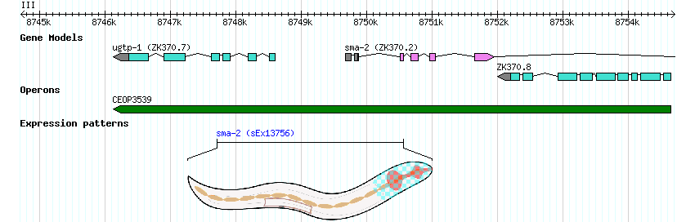
Lots of glyphs to choose from…
Or create your own!

Slide 17
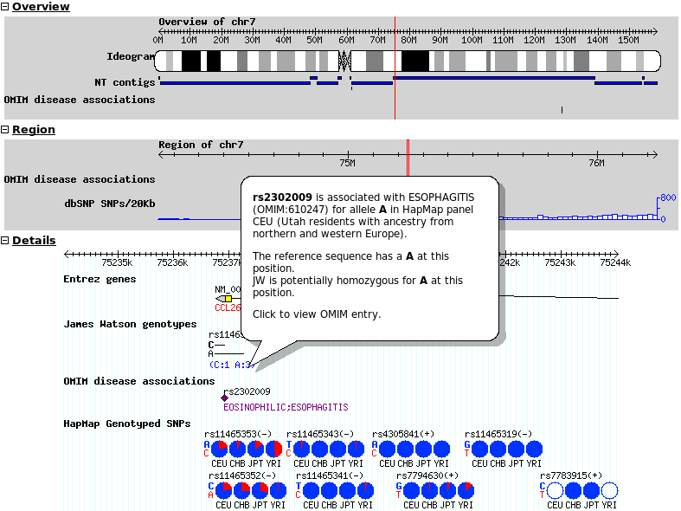
GBrowse moving to web 2.0
From jimwatsonsequence.cshl.edu

Slide 18
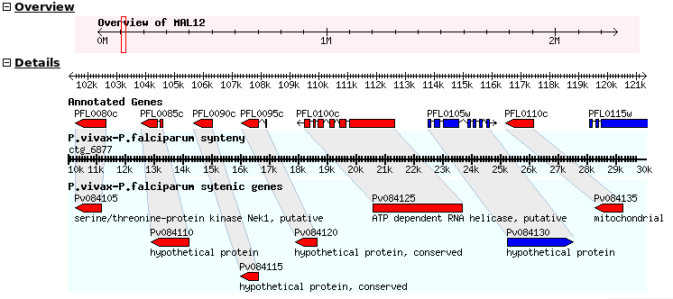
A synteny browser in GBrowse
From www.plasmodb.org, now distributed with
GBrowse in the ‘contrib’ directory.

Slide 19
What do you need for GBrowse?
Apache
libgd
BioPerl
Some place to put your data
Data: GFF2 or GFF3, or GenBank records, or something loaded in to Chado or BioSQL.

Slide 20
Installing GBrowse is easy (no, really!)
Get Apache
Get perl (only if on Windows)
Get libgd (only if on a Unix-like)
Get gbrowse-netinstall.pl from www.gmod.org
Run (sudo) perl gbrowse-netinstall.pl
See http://www.gmod.org/GBrowse

Slide 21
Getting started with GBrowse is not too hard
Sample data installed so browsing can start right away.
A tutorial is included to cover many aspects of track configuration, including writing perl callbacks to do very sophisticated stuff.
A very active user mailing list.

Slide 22
Apollo (Nomi Harris, Michelle Clamp, Mark Gibson)
Downloadable Java application for editing genome annotations
Works with GAME-XML, Chado, Chado-xml, GFF, GenBank
http://www.fruitfly.org/annot/apollo for a double-click installer.

Slide 23
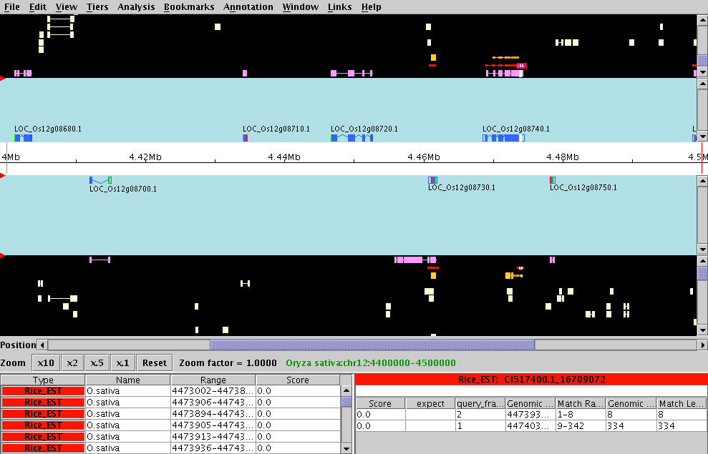
Apollo

Slide 24
CMap (Ken Clark, Ben Faga)
Comparative map viewer for physical, genetic and sequence maps
Web based
Developing an application to use as an assembly editor (CMAE)
Requires Apache, an RDMS, and many perl modules (Bundle::CMap)

Slide 25
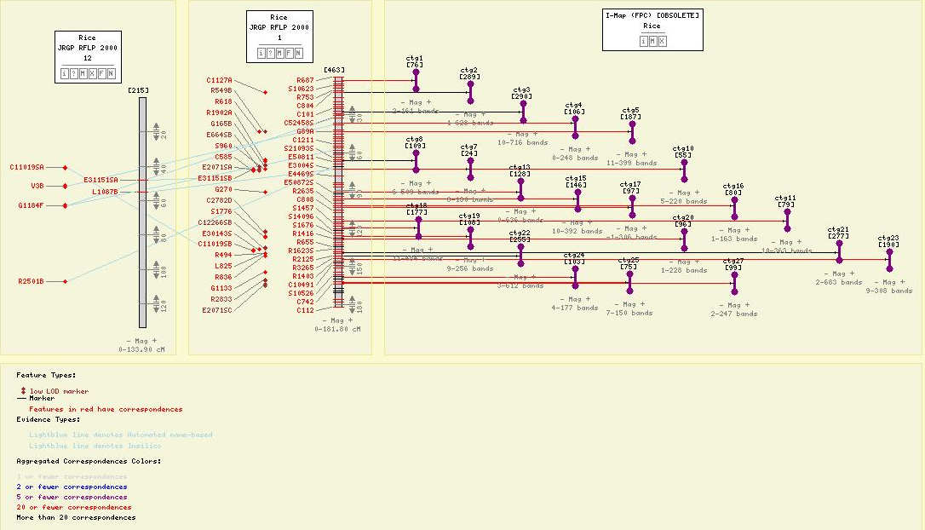
CMap

Slide 26
GMODWeb—A mod-perl, template driven window into Chado (Allen Day, Brian O’Connor)
Built on Turnkey (an autogenerated MVC website for any “reasonable” DB).
Uses SQL::Translator to create a perl Class::DBI API for a database.
Creates user-customizable templates for tables in the database.

Slide 27
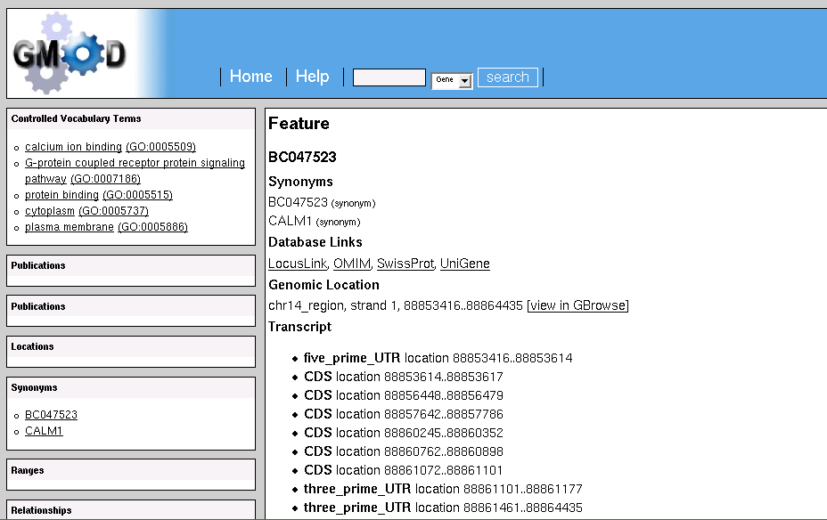
GMODWeb: Basic Skin
Slide from Brian O’Connor
Slide from Brian O’Connor

Slide 28
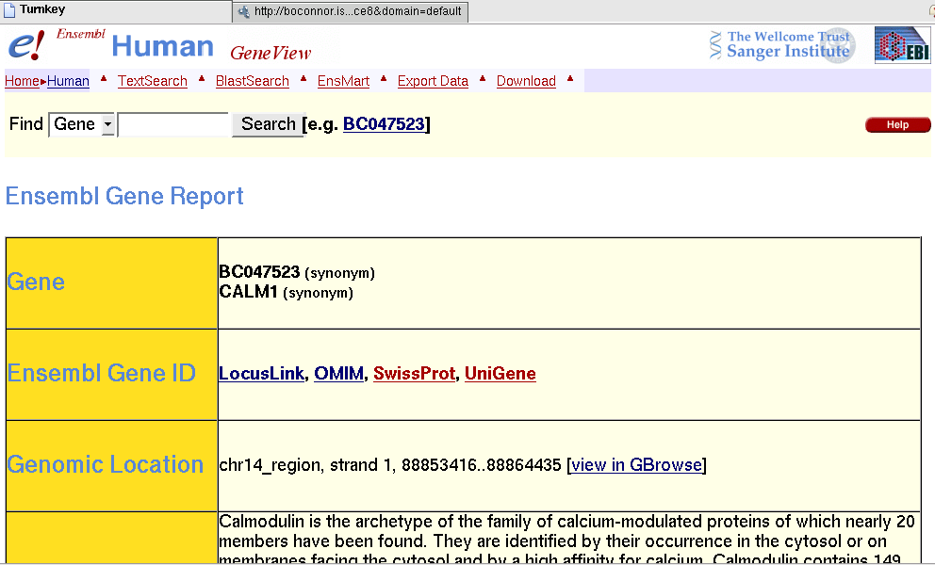
GMODWeb: EnsEMBL Skin
Slide from Brian O’Connor

Slide 29
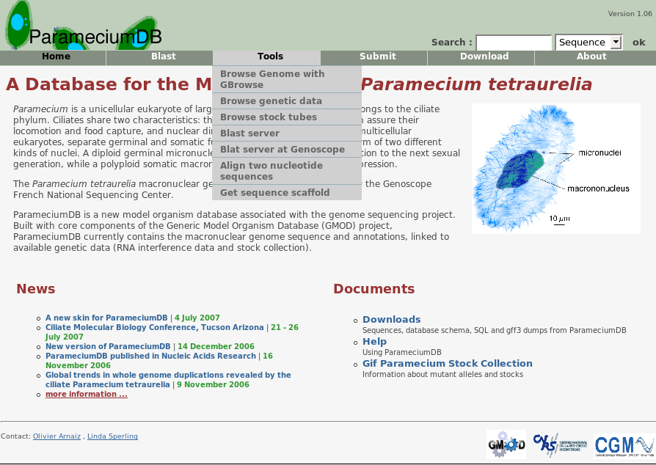
ParameciumDB—a ‘Pure’ GMOD DB

Slide 30
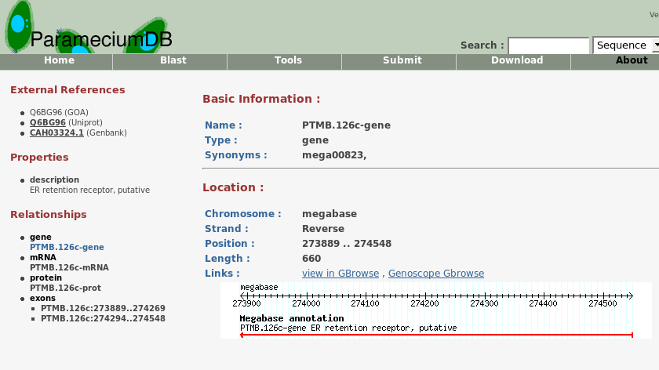
ParameciumDB Gene Page

Slide 31
Textpresso
Slide from Hans-Michael Mueller
Facilitates full text searches of research papers (search scope from single sentence to full document)
Facilitates keyword and category searches (adds meaning)
Ontology
  has set of 50 categories containing 1.1 million terms
  consists of scientific part (such as GO) as well as “colloquial” one
C. elegans corpus has 7,800 papers, 22,000 abstracts, updated weekly

Slide 32
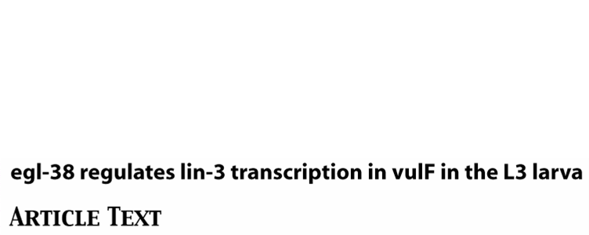
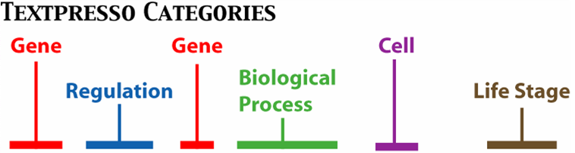
Text markup
Slide from Hans-Michael Mueller
Mark up the whole corpus of papers with terms of categories and index mark-ups for searching.

Slide 33
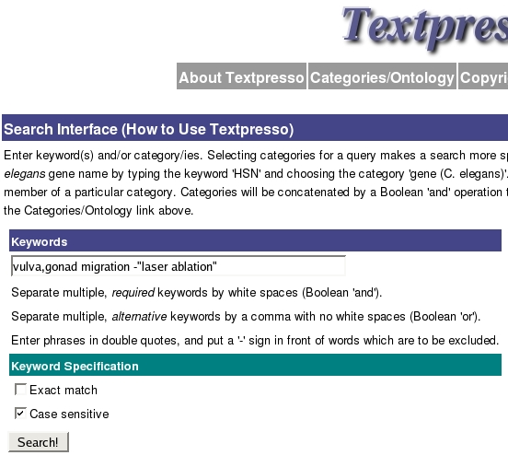
Textpresso searching
Slide from Hans-Michael Mueller
Boolean operations for keywords
(will including bracketing in near future)
Phrase searches
Case sensitive searches
Lets you query like:
I want to learn about all genes that interact with gene x in cell B

Slide 34
Getting started with Textpresso
Linux
Apache
Lots of disk space (~3GB/1000 full text papers)
Full text papers in pdf format
http://www.textpresso.org/

Slide 35
Other Components
Pathway Tools – metabolic pathways
BioMart – data mining
Ergatis – genome analysis workflow
PubSearch/PubFetch – literature management
Lucegene – keyword search of genome annotations
Sybil – synteny viewer for Chado

Slide 36
Packaging
RPM-based installs: biopackages.net (Fedora and CentOS)
Virtual machines with software (new)
Source-based “make install”
Examples & tutorials
Help desk
Mailing lists

Slide 37
Tangible Benefits
A community-supported platform on which to build genome-scale databases.
New generation of semantically interoperable MODs (DAS2).
ParameciumDB, BeetleBase, BeeBase, VectorBase, BovineBase, GallusDB, AphidBase, Xanthusbase,ToxoDB, GiardiaDB, LIS, KISS, T1Db, T2Db, CNV Browser, SwissRegulon...

Slide 38
More Information
www.gmod.org for:
downloads, documentation, mailing lists
Credits:
  Lincoln Stein
  Ken Clark
  Allen Day
  Karen Eilbeck
  David Emmert
  Ben Faga
  Linda Sperling
  Olivier Arnaiz
Nomi Harris
Mark Gibson
Sima Mishra
Chris Mungall
Brian O’Connor
Eric Just
Don Gilbert
Peter Karp
…and many more

