Slide 1

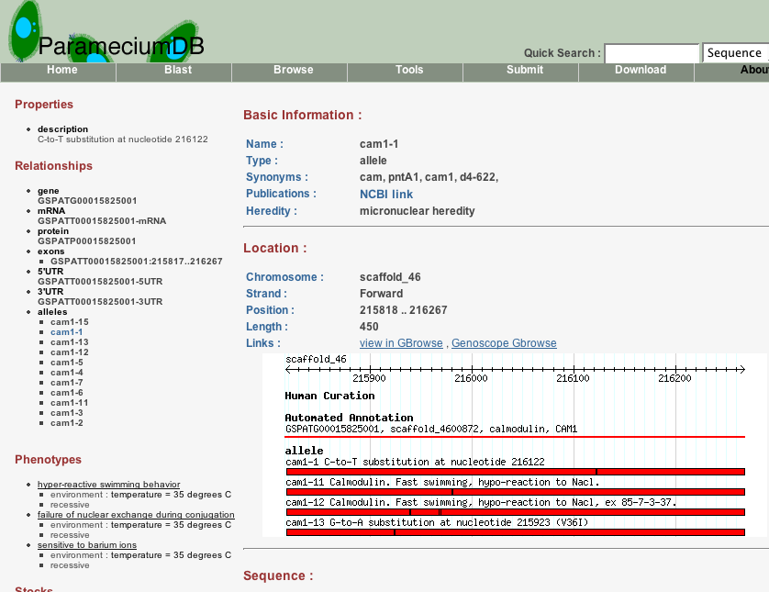




GMODWeb : Pathway Tools : Flash GViewer : Tripal : TableEdit : GBrowse_syn : Apollo : InterMine : GBrowse : MAKER
Databases
http://gmod.org/wiki/Databases_and_GMOD
Community Meetings
http://gmod.org/wiki/Meetings
GMOD has several choices for creating web-accessible biological databases. Chado is a modular and extensible relational database schema that supports many common biological data types. Chado integrates sequence data and annotation, ontologies and controlled vocabularies, publication, strains, microarray data, libraries, and several other data types into an integrated whole. Websites
The GMOD community meets semi-annually to discuss GMOD components, best practices, and project direction. These meetings often occur immediately before or after a major conference of interest to community members. Meetings are open to everyone: developers, users, and potential users. Registration is often free. GMOD also sponsors a few other types of meetings such as hackathons.
GMOD.org
got genome?
large (FlyBase)
and small
(ParameciumDB)
use Chado to
manage and
integrate their data.
Tripal and GMODWeb are customizable web front ends for Chado. Many organizations also create their own web interfaces using Chado APIs.
If you need to visualize, annotate, integrate or share your data, then GMOD can help you. GMOD is a collection of interoperable, open source software tools for common data-related tasks in biological research.
GMOD is used in hundreds of organiza-tions from major model organism databases to smaller communities and individual labs. Many GMOD components can be installed and maintained with only minimal informatics support.
In addition to software, GMOD is also an active community of developers and users that are addressing common challenges with their biological data. GMOD has mailing lists, regular meetings, project staff, a wiki-based web site, and training workshops for new users.
Training
http://gmod.org/wiki/Training_and_Outreach
GMOD includes BioMart and InterMine for data mining and warehousing tasks.
GMOD offers training through multi-day hands-on courses, workshops at conferences, and online tutorials and documentation. Training sessions and workshops are also offered on individual GMOD components such as Galaxy, Pathway Tools, MAKER and InterMine.
GMOD offers summer courses at NESCent in North Carolina, and at one non-US location per year, when possible.
InterMine and BioMart are end-to-end packages that include relational database back ends, web front ends, and middleware to connect them. These packages give end users the ability to build custom and arbitrarily complex queries using web interfaces.
modENCODE : SmedGD : TAIR : AphidBase : Gramene : SGN : GNPAnnot : wFleaBase : SoyBase : MGI : dictyBase

Slide 2
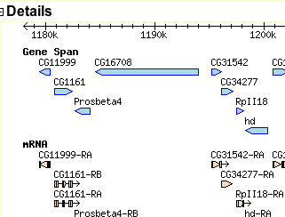
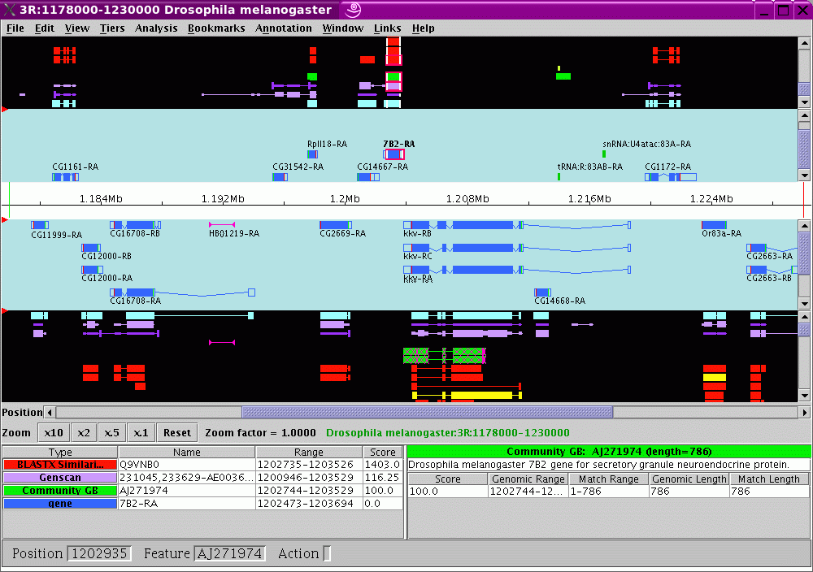
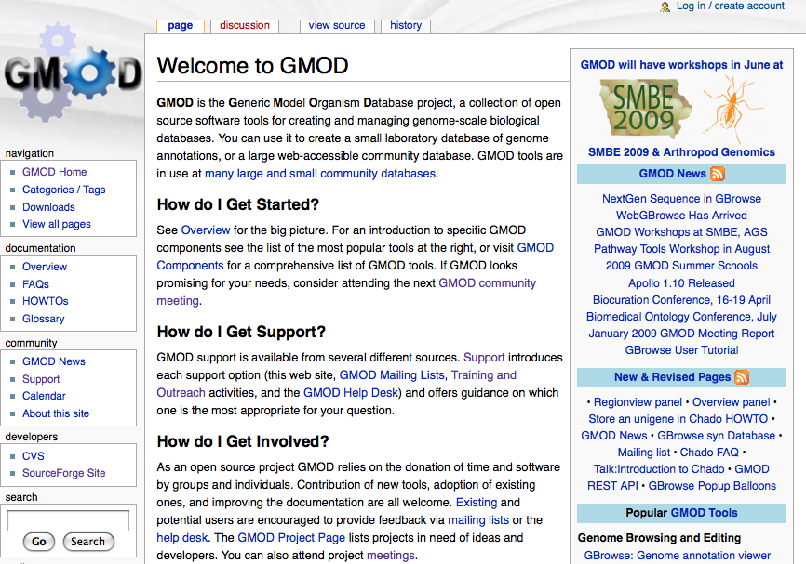
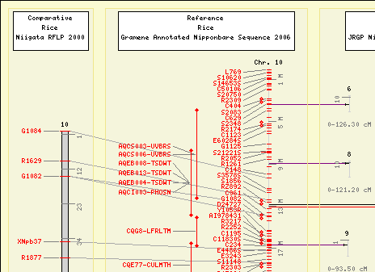


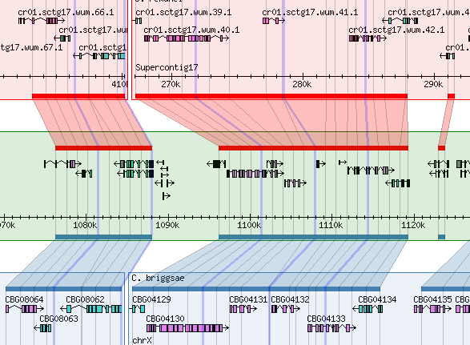

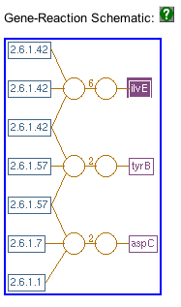
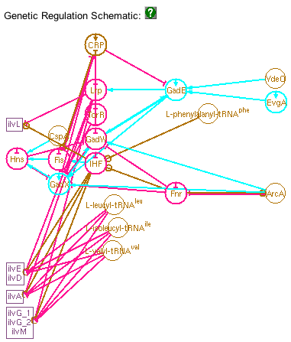
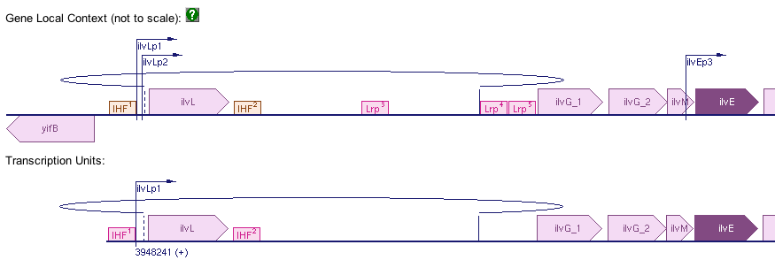
Ergatis : Galaxy : DIYA : Textpresso : LuceGene : GMODTools : Sybil :Genome Grid : Chado : CMap : JBrowse : BioMart
Visualization
http://gmod.org/wiki/Visualization
Annotation
http://gmod.org/wiki/Annotation
GMOD Support
http://gmod.org/wiki/Support
GMOD can visualize genomic data with
the GBrowse and JBrowse genome browsers. GBrowse is widely used, and is highly configurable. It allows users to integrate data from many sources, including their own uploaded files. JBrowse is a fast AJAX-based browser. Any type of data associated with a genomic region can
be integrated and visualized in either browser.
Comparative genomics data is
visualized with CMap, GBrowse_syn, Sybil, and SynView.
Pathway information, both metabolic and regulatory, can be
Supporting annotation
of biological data is a
central goal of GMOD
and many tools sup-
port it. Apollo is a
popular genome
annotation editor that allows users to manually add and update genomic annotations. Many organism communities use Apollo in community annotation efforts to maintain and update genomic annotation. Efforts are underway to build a wiki based front end to the Chado database using TableEdit, a MediaWiki extension for updating tabular and database data.
GMOD has an active community of users, developers and staff. GMOD support is available from several different sources.
We_x0013_b Site
http://gmod.org
GMOD.org includes FAQs & HOWTOs, component documentation, community calendar & news and
information about the GMOD project.
GMOD has tools for generating
Mailing Lists
http://gmod.org/wiki/GMOD_Mailing_Lists
annotation computationally. MAKER and DIYA are pipeline tools for automatically annotating genomes. Ergatis, Galaxy and Genome Grid are all tools for building, running and reusing custom pipelines on one or a cluster of computers.
The Textpresso package does automatic annotation of publications by searching abstracts and the full text of publications for relevant terms and concepts.
GBrowse and JBrowse are being extended to include user authentication and annotation uploading and sharing.
The GMOD project has active mailing
lists for user questions, troubleshooting, best practices, and announcements. These 20+ lists (some for the project as a whole and some for specific components) have almost 1000 threads per year. Questions are answered by GMOD users, developers, and staff.
Help Desk
help@gmod.org
visualized using Pathway Tools.
Several database components (see "Databases") also provide web front ends.
The GMOD Help Desk answers support questions, maintains and develops documentation and the web site, and offers training.
GeneDB : FlyBase : ParameciumDB : BioCyc : SGD : BeetleBase : SpBase : VectorBase : LepidoDB : WormBase : RGD

