Slide 1

WebGBrowse
A Web Server for GBrowse Configuration
Ram Podicheti B.V.Sc. & A.H. (D.V.M.), M.S.
Staff Scientist – Bioinformatics
Center for Genomics and Bioinformatics
Indiana University
01/16/2009
GMOD Conference 2009
San Diego CA

Slide 2
Generic Genome Browser
Most popular web based genome browser
Visualize genome features along a reference sequence
Open Source
Highly customizable
Excellent usability
Rich set of “glyphs”
  Genome features
  Quantitative Data
  Sequence Alignments
Notes:
GBrowse is one among the most popular genome browsers
The popularity is due to its usability and the glyph set
The variety of glyphs will allow the depiction of
- genome features such as coding sequences, reading frames, centromeres, point access mutations
- quantitative data such as microarray or tiling array data, GC content
- sequence alignments (gaps, mismatches, indels etc.)

Slide 3
Scope of GBrowse Usage
Large Scale databases such as Community databases, Model organism databases
Current Research Trends
Lower sequencing costs
In-house sequencing and data maintenance by molecular biology labs and researchers
Notes:
The current research trends are expanding the genomic studies from centralized research community databases (eg: FlyBase, Ensembl) to much smaller and specific databases owned by individual molecular biology labs, more so because of low cost sequencing techniques being made available and as a result biologists are doing their own sequencing.

Slide 4
Scope of GBrowse Usage
More specific, but smaller databases such as a lab owned database or Individual Researcher’s database
Large Scale databases such as Community databases, Model organism databases
Notes:
The current research trends are expanding the genomic studies from centralized research community databases (eg: FlyBase, Ensembl) to much smaller and specific databases owned by individual molecular biology labs, more so because of low cost sequencing techniques being made available and as a result biologists are doing their own sequencing.

Slide 5
GBrowse Setup
Software installation and maintenance
GFF3 dataset preparation
Writing the configuration file
Notes:
The documentation/instructions are intended for a professional bioinformatician. GBrowse setup, not an easy task for a typical biologist.

Slide 6


GBrowse Setup
Software installation and maintenance
GFF3 dataset preparation
Writing the configuration file
Perspective
Perspective
Notes:
The documentation/instructions are intended for a professional bioinformatician. GBrowse setup, not an easy task for a typical biologist.

Slide 7
Goal
Make GBrowse Available to Biologists without
  installation hassles
  worries about GBrowse configuration semantics
Notes:
We, at CGB, wanted to bring GBrowse a little more closer to Biologists by allowing them more control over the GBrowse Administration without actually worrying about the details about installation and configuration.

Slide 8

WebGBrowse
Notes:
So we came up with WebGBrowse

Slide 9
WebGBrowse
Allows users to upload their GFF3 datasets
Powered by a Glyph Library
Configuration information for 40+ glyphs
Assists in Configuring the display of each genomic feature into individual tracks
Hosts the datasets with the specified configuration settings on an integrated GBrowse server

Slide 10
WebGBrowse
http://webgbrowse.cgb.indiana.edu/

Slide 11
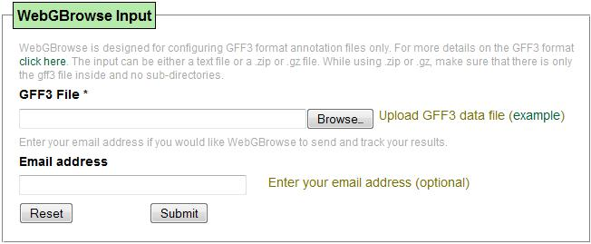
WebGBrowse Input
Upload the dataset
Provide Email Address (optional)
Upload the GFF3 dataset

Slide 12
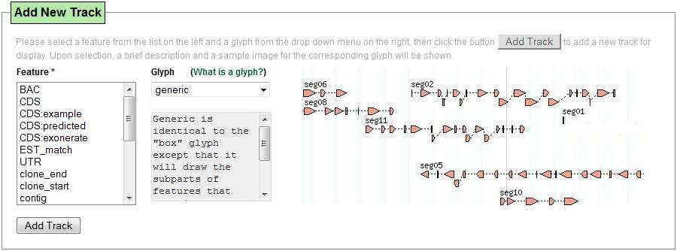
Configuration Panel
Unique Feature set Identified
from the uploaded dataset

Slide 13
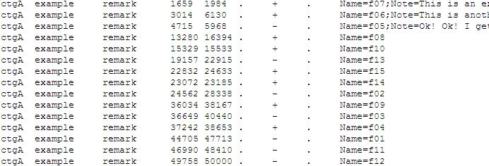
Configuration Panel

Slide 14
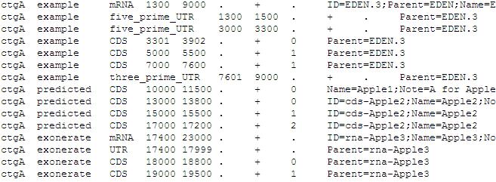
Configuration Panel

Slide 15
Configuration Panel
Unique Feature set Identified
from the uploaded dataset

Slide 16
Configuration Panel
List of glyphs supplied
by the glyph library
A Sample Image of the selected glyph
Add Track
Button
Unique Feature set Identified
from the uploaded dataset
Brief description of the selected glyph

Slide 17
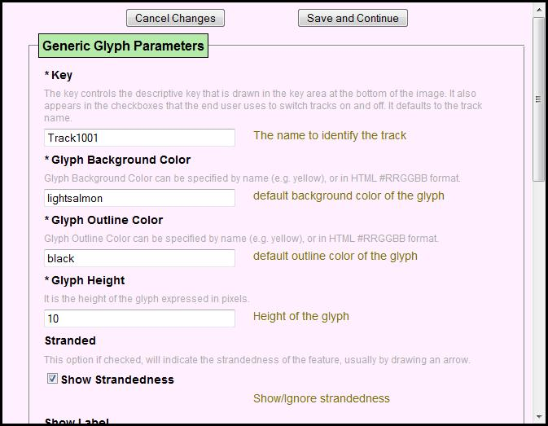
Glyph Parameters Form
Parameter
Description

Slide 18
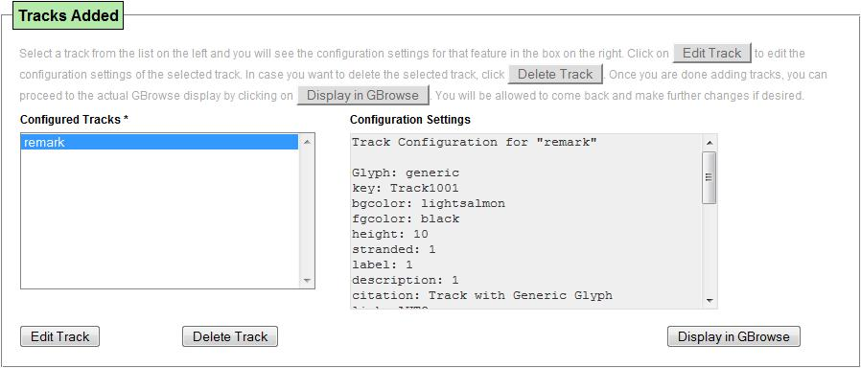
Configured Tracks shown in the configuration panel
Button to display
configured tracks
in GBrowse
Configuration for the selected track
Delete Track Button
List of tracks added so far
Edit Track Button

Slide 19
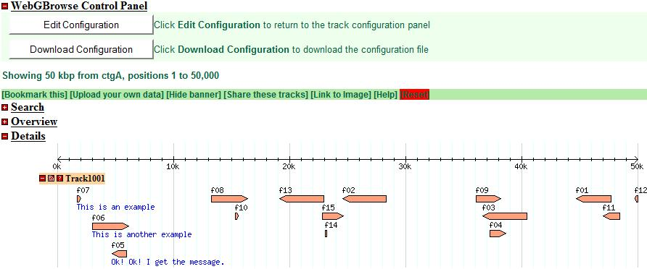
GBrowse Display with WebGBrowse Control Panel
WebGBrowse Control Panel

Slide 20
Architecture
Data Driven
Glyph Library
Configuration information
  Initialize a data structure compatible with HTML::FormEngine
  Load into the data structure
  Serialize into a YAML file (http://www.yaml.org/)

Slide 21
WebGBrowse Demo
http://webgbrowse.cgb.indiana.edu/

Slide 22
Important resources on the website
Glyph Library
Tutorial
Software
FAQ

Slide 23
To Do List
Expand the glyph library
Allow uploading of a pre-existing conf file and start from there
Provide "General Section" configuration (optional)
Add more features (Balloons, plugins etc.)
Categorizing the glyphs
Tutorial on how to add new glyphs
Callbacks?
Suggestions from GMOD group

Slide 24
References
Karolchik, D. et al. (2003) The UCSC Genome Browser Database, Nucleic Acids Res, 31, 51-54.
Schlueter, S.D. et al. (2006) xGDB: open-source computational infrastructure for the integrated evaluation and analysis of genome features, Genome Biol, 7, R111.
Stalker, J. et al. (2004) The Ensembl Web site: mechanics of a genome browser, Genome Res, 14, 951-955.
Stein, L.D. et al. (2002) The generic genome browser: a building block for a model organism system database, Genome Res, 12, 1599-1610.

Slide 25


Acknowledgements
Rajesh Gollapudi
Graduate Student
School of Informatics
Indiana University
Dr. Qunfeng Dong
Director Bioinformatics
Center for Genomics and Bioinformatics
Indiana University

Slide 26

Acknowledgements
Chris Hemmerich
Staff Scientist & Database Unit Leader
Center for Genomics and Bioinformatics
Indiana University

Slide 27

Acknowledgements

Slide 28
Acknowledgements
This research was supported in part by the Indiana METACyt
Initiative of Indiana University, funded in part through a major
grant from the Lilly Endowment, Inc.

