Slide 1


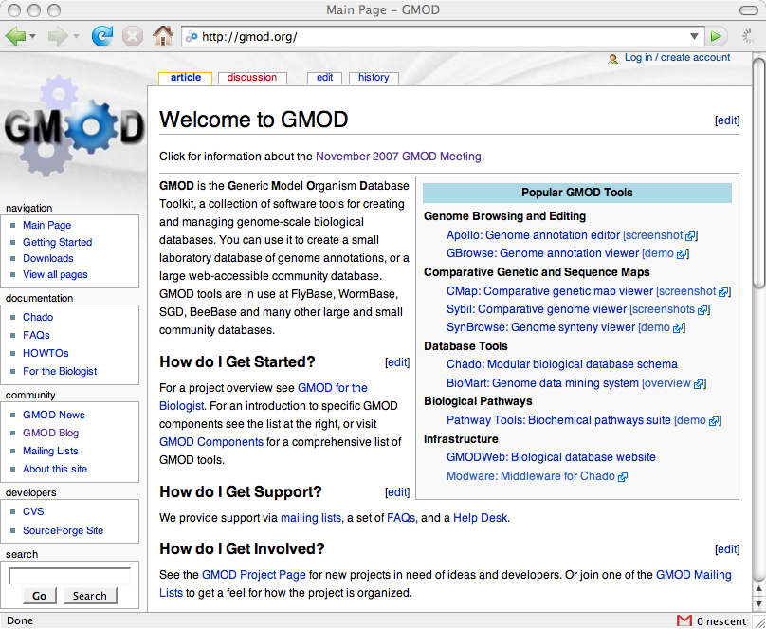
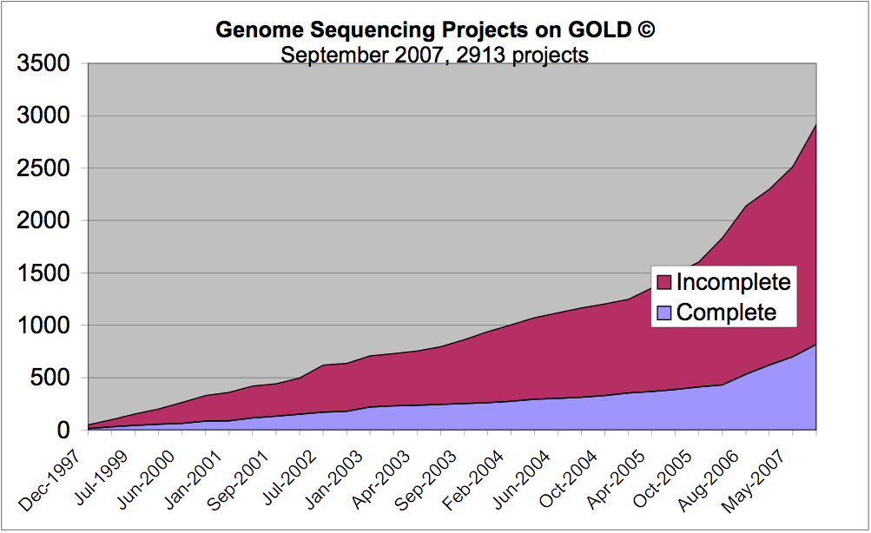
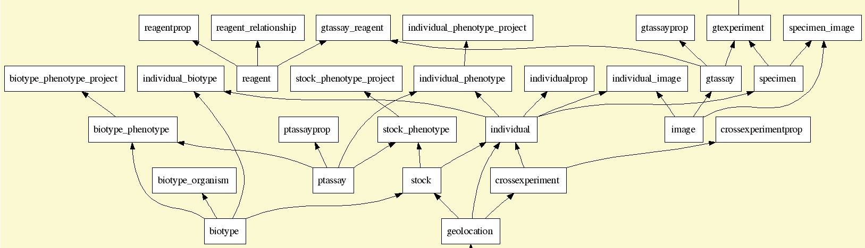
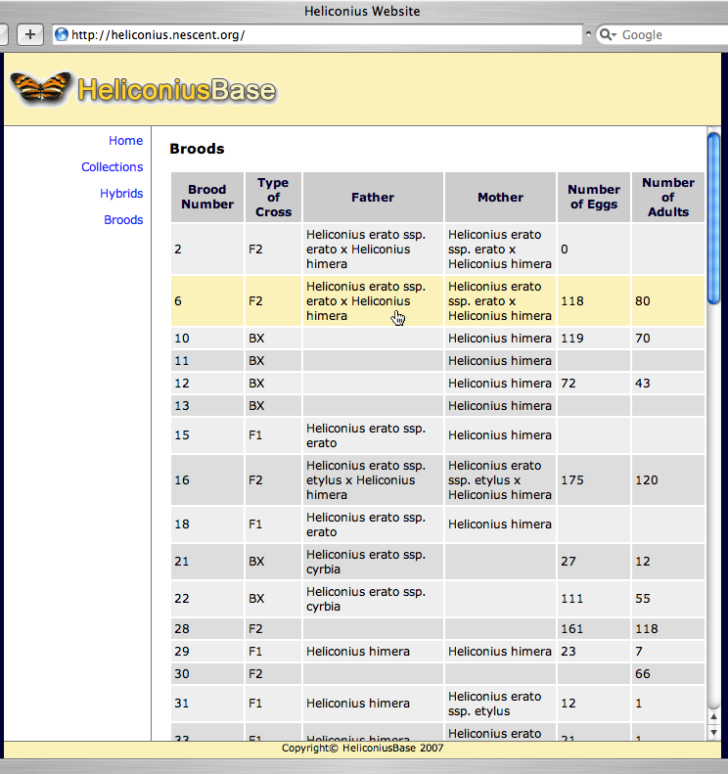
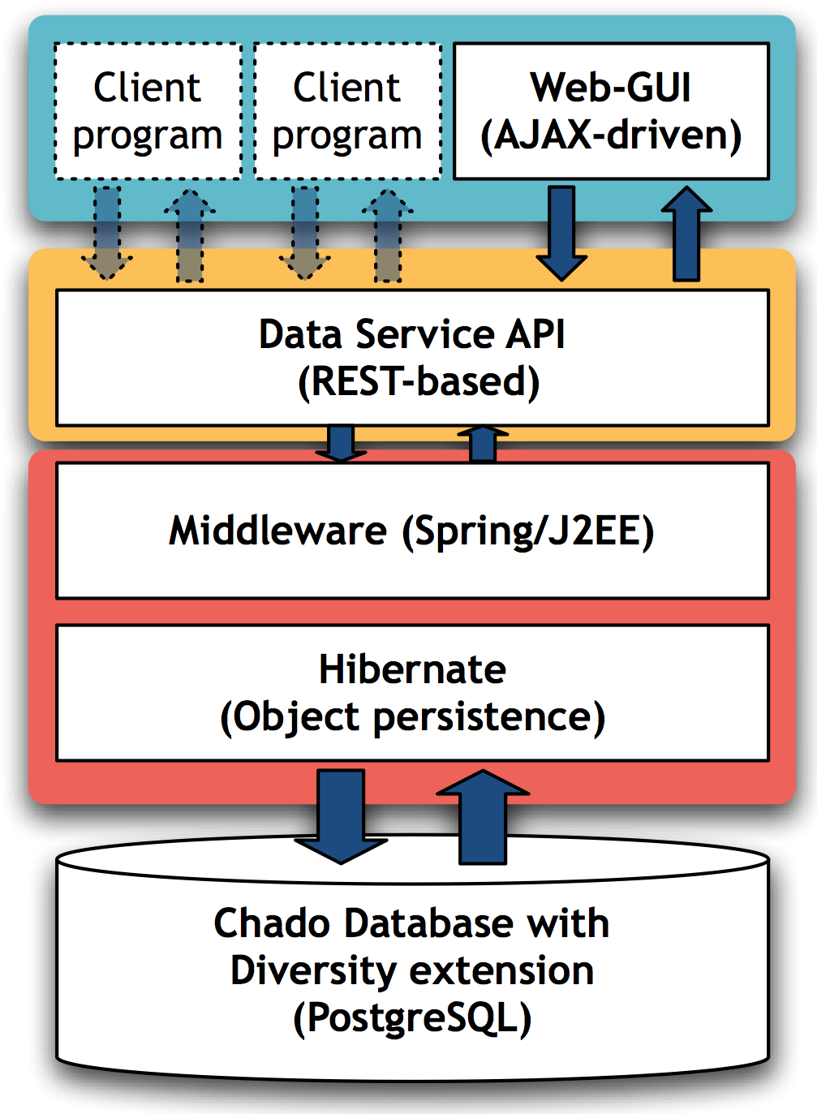
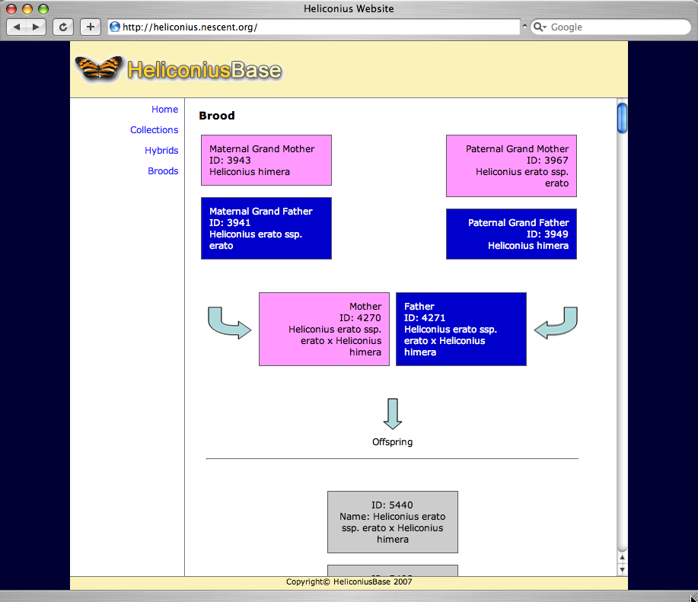







Digesting the Genome Glut
Promoting the Use and Extension of GMOD
To Emerging Model Organisms
David Clements¹ Brian Osborne² Hilmar Lapp¹ Xianhua Liu¹
W. Owen McMillan³ Nassib Nassar⁴ Todd J. Vision¹
¹National Evolutionary Synthesis Center ²ZBio LLC ³North Carolina State University ⁴Renaissance Computing Institute
GMOD.org
NESCent.org
Abstract
An ever-increasing volume of genomic data is being generated from organisms well suited to comparative genomic, evolutionary and ecological studies. More data offers more potential for discovery, but it also makes it is harder to organize, visualize and annotate.
Getting Started with GMOD_x0013_
Start at GMOD.org
Contribute doc!
GMOD.org is a wiki.
Download software
The most popular
GMOD components.
The Generic Model Organism Database (GMOD, http://gmod.org) is a toolkit of interconnected components that meet many of the data management, analysis, and visualization needs of these studies, and on a small informatics budget.
FAQs and HOWTOs
GMOD Support
Helpdesk: help@gmod.org
and mailing lists for each
GMOD Component
GMOD for the Biologist
GMOD Mailing Lists
Contribute code!
GMOD is open source.
Feature requests &
Bug Reports
GMOD has recently added a helpdesk to promote use of GMOD more broadly in emerging model organism research communities. GMOD has also been extended to better support evolutionary research.
In the past year, the GMOD web site has been revamped and a GMOD Helpdesk (help@gmod.org) has been created.
What Can GMOD Do?
GMOD is a collection of software tools for creating and managing genome-scale biological databases. You can use it to create a small laboratory database of genome annotations, or a large web-accessible community database. GMOD includes a modular database schema called Chado that supports many common needs.
GMOD for Natural Diversity Data
Heliconius butterflies are a favored model for studying mimicry, because geographically overlapping populations of different species frequently converge on similar wing color patterns. Complementing the long history of evolutionary genetic studies in the genus, an increasing amount of molecular marker and sequence data are being collected.
If you have | & you need to | then GMOD can help with
Genomic Sequence | View Annotate Organize | GBrowse Apollo Chado Sequence Module
Physical, Genetic & Comparative Maps | View Annotate Organize | CMap,SynView,SynBrowse,Sybil Sybil Chado Map Module
Phylogenetic Trees | Organize View | Chado Organism & Phylogeny modules GMODWeb
Phenotype, Genotype | Organize View | Chado Genetics Module GMODWeb
Microarray and Expression | View Organize | Java TreeView, Caryoscope, GeneXplorer Chado Mage and Expression Modules
Ontologies | Curate View | Chado CV module GO Term Viewer, GMODWeb
Phylogenetic Trees | Organize View | Chado Organism & Phylogeny modules GMODWeb
Publications | Curate, search Organize | TextPresso, PubSearch Chado Publication Module
To capture the diversity data in a GMOD-compatible way, Chado (GMOD’s relational data model) has been extended with the ‘diversity’ module (see http://sf.net/projects/heliconiusdb). The module supports stocks, individuals, pedigrees, cross experiments, geolocations, and phenotype and genotype experiments. In addition, some of Chado’s core modules have been revised to consolidate how organism relationships and phylogenetic trees are represented.
Entity graph of the ‘diversity’ extension to Chado, and architecture and Web GUI for HeliconiusDB, an evolutionary model database.
The National Evolutionary Synthesis Center (NESCent) Sponsors Synthetic, Interdisciplinary and Transformative Research in Evolutionary Biology.
The center hosts working groups, catalysis meetings, sabbaticals, post-doctoral fellowships, and a short-term visitor program. NESCent’s informatics branch undertakes initiatives in support of software interoperability, data sharing, and informatics training. The center also solicits whitepapers for projects that fall outside the scope of existing programs. More information on how to apply or become involved at:
http://www.nescent.org
NESCent is located in Durham NC and is a collaborative effort of Duke University, North Carolina State University, and the University of North Carolina at Chapel Hill.
The GMOD Helpdesk is hosted by NESCent and is funded by a National Institutes of Health grant to Ian Holmes and a USDA Agricultural Research Service grant to Doreen Ware.
NESCent is supported by the National Science Foundation (Grant # EF-0423641)

