Slide 1
GMODWeb,
Biopackages, &
Virtual Machines
Brian O'Connor
Nelson Lab, UCLA
1/16/2009

Slide 2
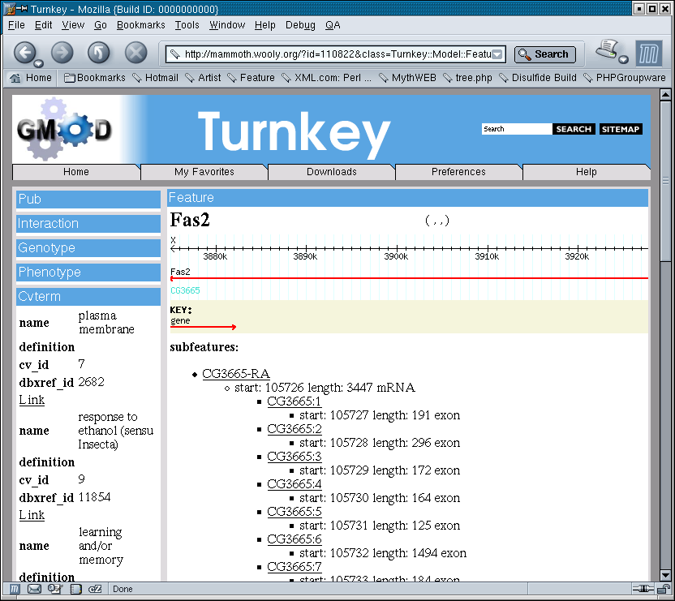
Turnkey is...
A website auto-generator
SQL:
Create
table
foo...

Slide 3
GMODWeb is...
GMODWeb = Turnkey + Chado + Integration w/ other projects (GBrowse, Amigo, etc)
SQL:
Create
table
foo...
Chado
GMODWeb

Slide 4

Active Code Generation
SQL Schema
SQL:
Create
table
foo...
SQL::Translator
Directed Graph
XML Layout
& Templates
Mapping Layer
Data
Objects

Slide 5
Strengths & Weaknesses
Strengths
  Good prototyping tool
  Great tool for active code generation
  Quickly build up-to-date webapps integrated with other GMOD tools
Weaknesses
  Perl dependencies are ridiculous and the source of all pain
  Early design decision to use custom Perl rendering engine limits performance and appeal to users

Slide 6
Status
Turnkey 1.4 is available and addresses some bugs since the release of the paper
GMODWeb: a web framework for the Generic Model Organism Database.
Genome Biol. 2008 ; 9(6).
Try the virtual machines at:
http://gmod.org/wiki/VMWare_HOWTO
Working on Updated RPMs
http://turnkey.sf.net

Slide 7
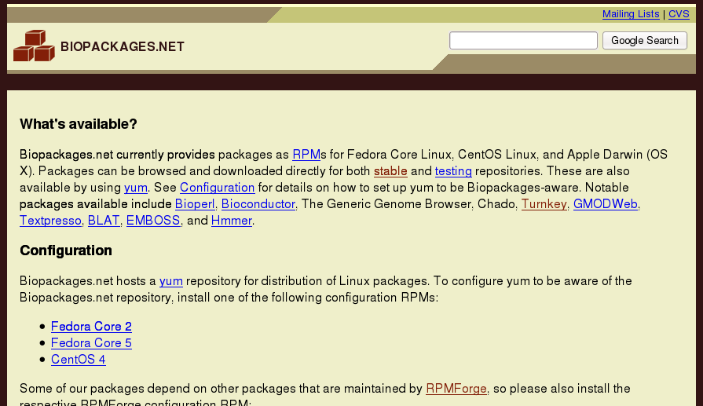
http://Biopackages.net

Slide 8
Biopackages.net is...
A repository of software compiled for CentOS (mostly CentOS4) and Fedora
“yum install chado”
Wanted to make it easy to install software dependencies

Slide 9
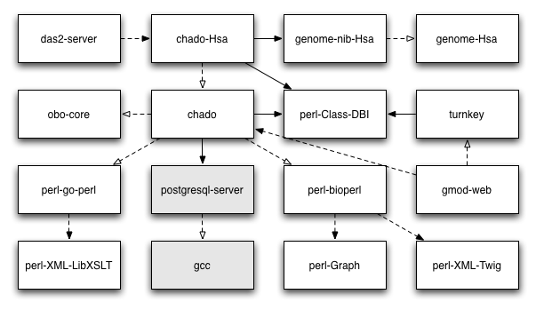
Biopackages
Dependency resolution is a huge part of the work

Slide 10
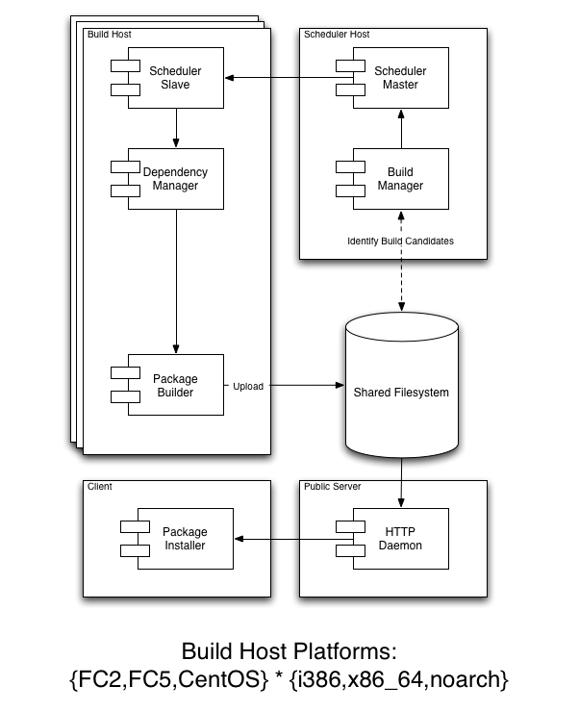
Biopackages
Build Farm
Goal is to build as much in an automated way as possible

Slide 11
Status
Previously focused on CentOS4 RPM packages for the Nelson Lab
Transitioning now to CentOS5
Currently packaging Chado DBs using the 1.0 schema:
  Base DB with ontologies
  Human hg18 DB
  Possibly others (mm9, rn4, panTro2, rheMac2...)
DAS/2 reference server
Dependencies

Slide 12
Virtual Machines
On paper RPMs solve many problems
However, machines can be tainted by other repositories, source-based installs, other customizations
Virtual machines can be used to:
  A mechanism to quickly try the GMOD catalog of tools
  A mechanism to distribute clean testing and development environments

Slide 13
Status
Idea is to have a virtual machine with all the Biopackages-provided tools pre-installed
Currently based on CentOS4
Have a prototype CentOS4 machine with Chado 1.0 schema, recent BioPerl, and Turnkey/GMODWeb 1.4
Working with Dave Clements on RPMs to create an updated CentOS5 VM

Slide 14
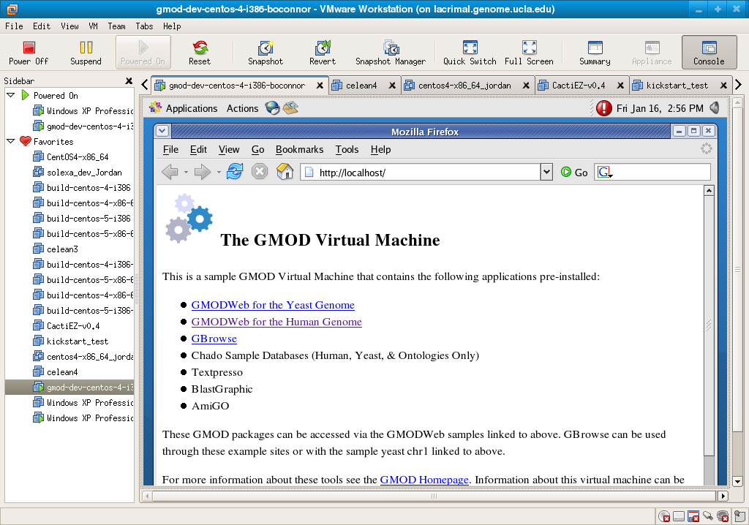
Status
http://gmod.org/wiki/VMWare_HOWTO

Slide 15
Contact Me...
Turnkey/GMODWeb: looking to expand Java producer to eliminate Perl dependency problem
Biopackages: looking for RPM developers (or deb package builders for Ubuntu)
Virtual Machines: looking to create CentOS5 machines
  Pre-configured GMOD demo/dev kit
  Pre-configured Biopackages dev kit
Anyone using GMOD tools for Next Gen Sequencing???
briandoconnor@gmail.com

