Slide 1
Update on The Pathway Tools Software
Peter D. Karp, Ph.D.
Bioinformatics Research Group
SRI International
pkarp@ai.sri.com
BioCyc.org
EcoCyc.org
MetaCyc.org
HumanCyc.org

Slide 2
Terminology –
Pathway Tools Software
PathoLogic
  Prediction of metabolic network from genome
  Computational creation of new Pathway/Genome Databases
Pathway/Genome Editors
  Distributed curation of PGDBs
  Distributed object database system, interactive editing tools
Pathway/Genome Navigator
  WWW publishing of PGDBs
  Querying, visualization of pathways, chromosomes, operons
  Analysis operations
    Pathway visualization of gene-expression data
    Global comparisons of metabolic networks
Bioinformatics 18:S225 2002

Slide 3
Pathway/Genome Database
Pathways
Reactions
Compounds
Proteins
Operons,
Promoters,
DNA Binding Sites
Genes
Chromosomes,
Plasmids
CELL

Slide 4
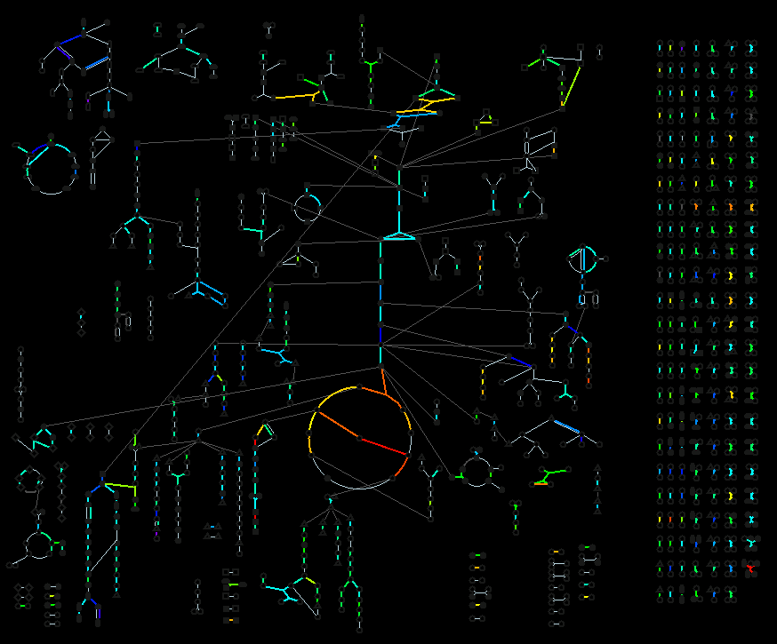
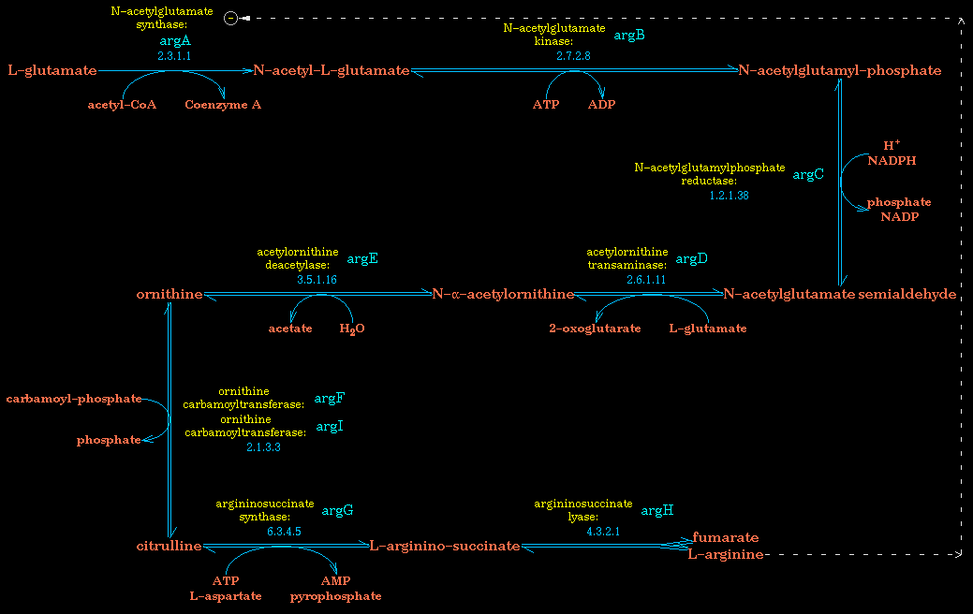
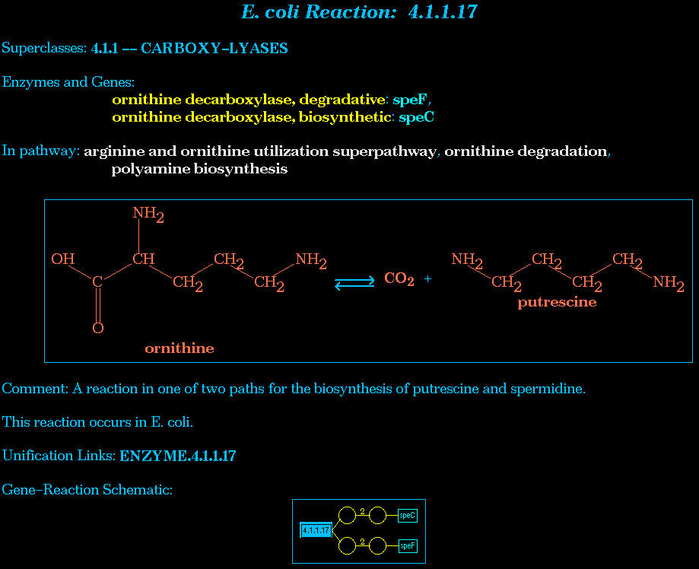
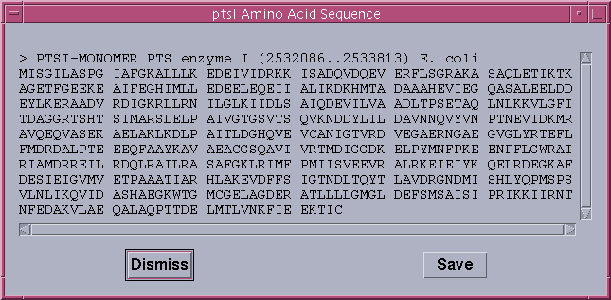
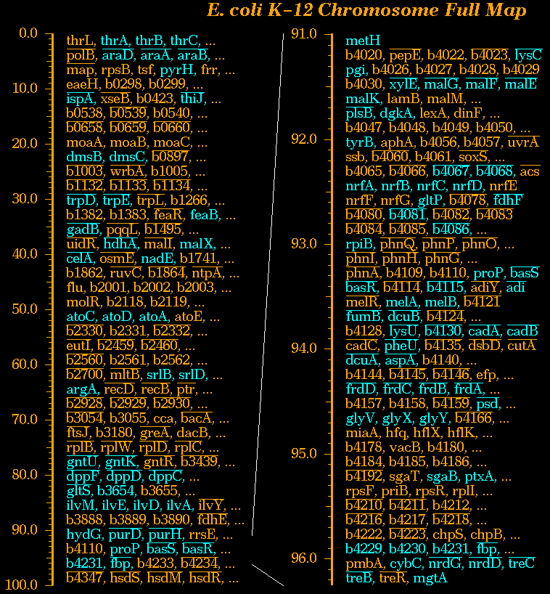
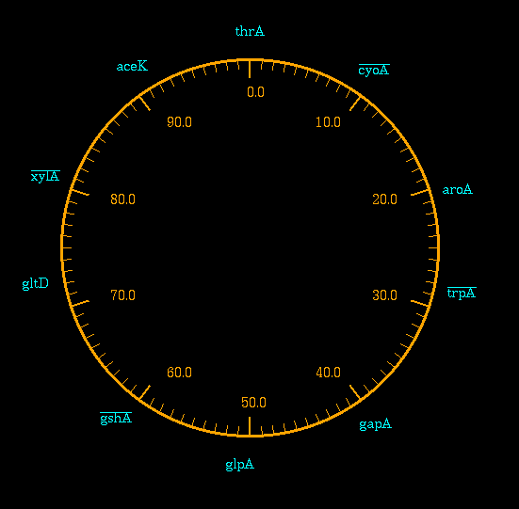
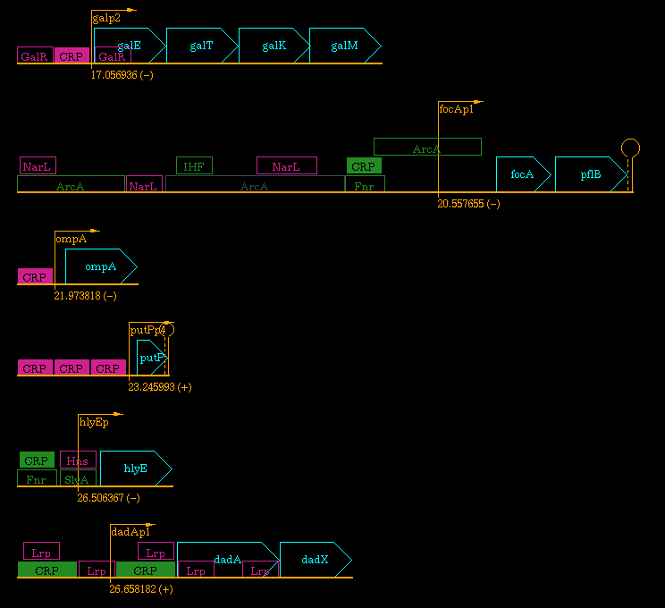
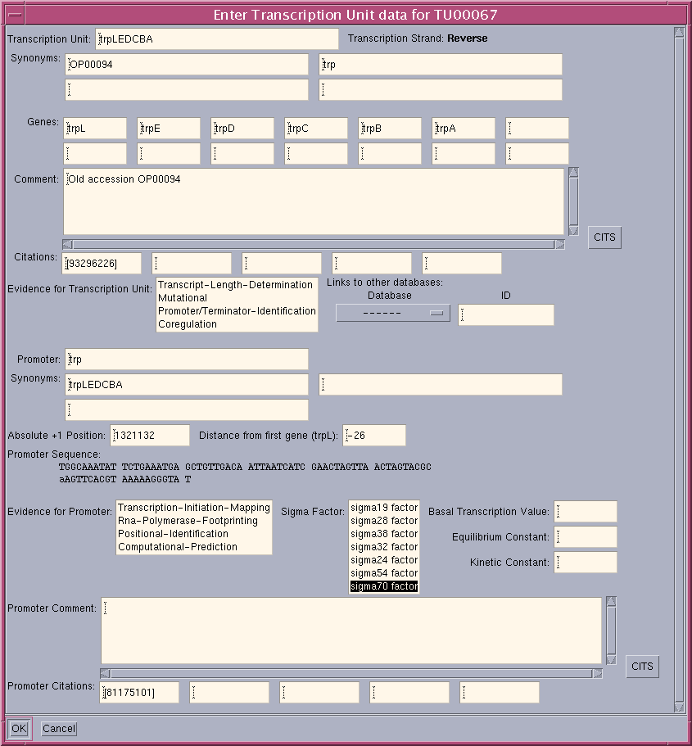
Pathway Tools Algorithms
Query, visualization and editing tools for these datatypes:
Full Metabolic Map
  Paint gene expression data on metabolic network; compare metabolic networks
Pathways
  Pathway prediction
Reactions
  Balance checker
Compounds
  Chemical substructure comparison
Enzymes, Transporters, Transcription Factors
Genes: Blast search
Chromosomes
Operons
  Operon prediction

Slide 5
August 2003 Release – v7.5
General import/export facility added
Evidence ontology added (PSB paper avail)
  Updates to displays, editors
JavaCyc from Carnegie Institution
  www.arabidopsis.org/tools/aracyc/javacyc/
Web page buttons can be customized
New queries
  Query pathways by reactants and products
  Query proteins by molecular weight and pI
  Query compounds by name, MW, formula, substructure
Reference list displayed at bottom of page
Parentage displays revised
All objects query
Display of chemical structures improved

Slide 6
February 2003 Release – v7.0
PTools now supports introns, exons, alternative splicing
Expression viewer can load data from SAM
Web crawlers can be blocked
Gene pages can be suppressed in favor of another DB
Chemical structure editor has been extended and documented
May 2003: HumanCyc released – HumanCyc.org

Slide 7
In Future Releases
Support for GO
Support for protein domains and active sites

Slide 8
MetaCyc: Metabolic Encyclopedia
Nonredundant metabolic pathway database
Describe a representative sample of every experimentally determined metabolic pathway
Literature-based DB with extensive references and commentary
Pathways, reactions, enzymes, substrates
460 pathways, 1267 enzymes, 4294 reactions
  172 E. coli pathways, 2735 citations
Nucleic Acids Research 30:59-61 2002.
Jointly developed by SRI and Carnegie Institution
  New focus on plant pathways

Slide 9
Family of Pathway/Genome
Databases
MetaCyc

Slide 10
Pathway/Genome DBs Created by
External Users
Saccharomyces cerevisiae, Stanford University
  pathway.yeastgenome.org/biocyc/
Plasmodium falciparum, Stanford University
  plasmocyc.stanford.edu
Mycobacterium tuberculosis, Stanford University
  BioCyc.org
Arabidopsis thaliana and Synechosistis, Carnegie Institution of Washington
  Arabidopsis.org:1555
Methanococcus janaschii, EBI
  Maine.ebi.ac.uk:1555
Other PGDBs in progress by 30 other users
Software freely available
Each PGDB owned by its creator

Slide 11
Pathway Tools Tutorial This Week
Wed 9/17: Navigator, PathoLogic
Thu 9/18: Editors
Fri 9/19: APIs – Lisp, PerlCyc, JavaCyc

Slide 12
Acknowledgements
SRI
  Suzanne Paley, Pedro Romero, John Pick, Cindy Krieger, Martha Arnaud, Randy Gobbel, Michelle Green
EcoCyc Project
  J. Collado-Vides, J. Ingraham, I. Paulsen, M. Saier
MetaCyc Project
  Sue Rhee, Lukas Mueller, Peifen Zhang, Chris Somerville
Stanford
  Gary Schoolnik, Harley McAdams, Lucy Shapiro, Russ Altman, Iwei Yeh
Funding sources:
  NIH National Center for Research Resources
  NIH National Institute of General Medical Sciences
  NIH National Human Genome Research Institute
  Department of Energy Microbial Cell Project
  DARPA BioSpice, UPC
BioCyc.org

