Slide 1
Chado for evolutionary science
Chris Mungall
HHMI _{(until June)}
National Center for Biomedical Ontologies _{(after June)}

Slide 2
Outline
Chado key concepts
Chado selected module tour
  sequence: genome annotations
  cv: ontologies and terminologies
  phylogeny: evolutionary trees
  phenotype: character based descriptions
    PATO: attribute ontology

Slide 3
Chado: what is it?
A Database schema for molecular biology
  primarily model organism
Relational schema
  DBMS-independent
    PostgreSQL, Sybase, Oracle, DB2
  Has XML form
    ChadoXML
      comes “for free”
Part of GMOD
  interoperates with Apollo, GBrowse, Turnkey, ..
  in use at various MODs and genome centers

Slide 4
Chado key concepts
Integrated
  not federated
  foreign key relations between entities
Modular
  separation of concerns
  mix-n-match
Generic and extensible
  uses ontologies and ‘cv’s for typing
Normalisation over efficiency
Community & open source

Slide 5
Chado modules
Core
  general (dbxrefs)
  cv (ontologies)
  pub (bibliographic)
  audit
Domains
  sequence (genomics)
  companalysis
  expression
  RAD
  map
  genetic
  phenotype
  phylogeny
  organism
  event

Slide 6
Sequence module
sequence
cv
phylogeny
phenotype
some key tables:
  feature
  featureloc
  feature_relationship
  featureprop
plays well with GFF3
feature types come from SO (sequence ontology)

Slide 7
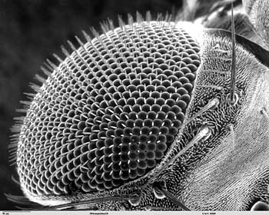
A biological ontology is:
A precise representation of some aspect of biological reality
sense organ
  what kinds of things exist?
eye
disc
is_a
  what are the relationships between these things?
develops
from
eye
part_of
ommatidium

Slide 8
cv module
sequence
cv
phylogeny
phenotype
Ontologies and controlled vocabularies (‘cv’s) are ubiquitious in Chado
key tables
  cvterm (a term, or class in an ontology)
  cvterm_relationship
  cv
can represent any ontology in OBO
compatible with RDF/RDFS

Slide 9
phylogeny module
sequence
cv
phylogeny
phenotype
key tables:
  phylotree
  phylonode
    has one parent; branchlength
  phylonodeprop
    extensible tag-value pairs; eg statistics
Also:
  phylonode_feature
    can make trees from any feature type
  phylonode_organism

Slide 10
phylogeny module status
sequence
cv
phylogeny
phenotype
Status: new
  needs more community input!
SQL Query support
  nested set representation
  SQL functions
Currently no links to phenotype module

Slide 11
phenotype module
sequence
cv
phylogeny
phenotype
Originally intended for model organism mutant phenotypes
  adaptable?
Based on 2003 EAV model
  requires extensions?
    e.g. Diederich 1997
Currently mixed in with genetics module
  in production use at FlyBase

Slide 12
key tables
sequence
cv
phylogeny
phenotype
EAV model
phenotype
  entity_id (a cvterm from e.g. anatomy)
  attribute_id (cvterm from PATO)
  value_id (cvterm from PATO)
  value (free text alternative to above)
  stage_id (cvterm from e.g. dev stage)
phenotype_comparison

Slide 13
PATO: Attributes
sequence
cv
phylogeny
phenotype
Attributes (qualities)
  physical attribute
    weight
    color
    morphology
      shape
      size
  temporal (process) attribute
    duration
    frequency

Slide 14
PATO: Attributes
sequence
cv
phylogeny
phenotype
Attributes (qualities): values (states)
  physical attribute
    weight: heavy, light
    color: red, magenta
    morphology
      shape: branched, cleft, coiled
      size: large, small, hypertrophied
  temporal (process) attribute
    duration: long, short
    frequency: frequent, infrequent

Slide 15
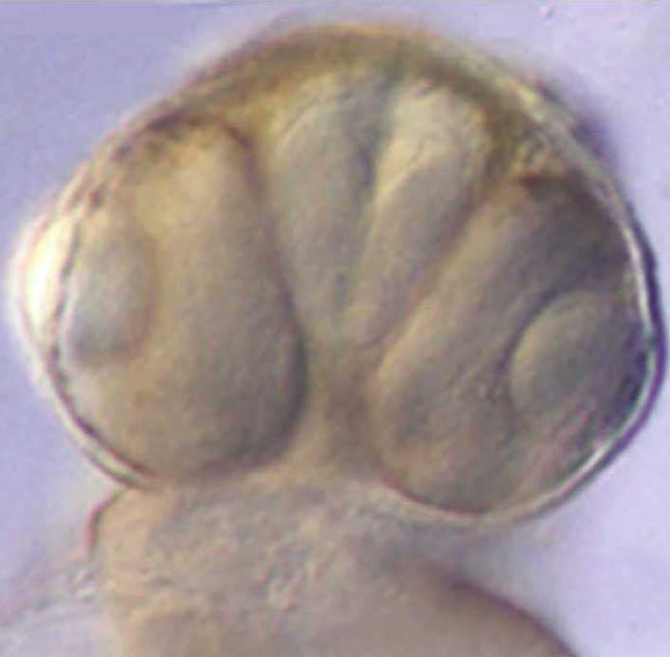

sequence
cv
phylogeny
phenotype
Combining entity terms and PATO terms
Entity-attribute structured annotations
  Entity term; PATO term
    tail fin _{ZDB:020702-16}; ventralized _{PATO:0000636}
    kidney _{ZDB:011143-431}; hypertrophied _{PATO:0000584}
    midface _{ZDB:020702-16}; hypoplastic _{PATO:0000645}
Pre-composed phenotype terms
  Mammalian Phenotype Ontology
    “increased activated B-cell number” _{MPO:0000319}
    “pink fur hue” _{MPO:0000374}

Slide 16
Extensions to simple EAV?
sequence
cv
phylogeny
phenotype
New phenotype XML schema being developed for:
  Relational attributes
  Separation of measurements from attribute states
  Composing entity terms
  Value/state sets
  Relative states
  Variation in space and time
  Is the ‘A’ superfluous?
  Alternative to absence/number
See Diederich 1997

Slide 17
OBD and NCBO
sequence
cv
phylogeny
phenotype
National Center for Biomedical Ontology
  driving biological project:
    genotype-phenotype-disease
Tool development
  phenotype annotation (EAV)
OBD
  Data counterpart to OBO
  Generic metamodel (RDFS/OWL)
  Chado relational views

Slide 18
Summary
cv module is stable
genomics part of chado is stable
    weeelllll, the meta-schema is still evolving…
phylogeny and phenotype untested
  more input required
  complexity of phenotypes
PATO may need to evolve a lot
a lot of software still to be written

Slide 19
Thanks
Chado
  Dave Emmert
  Stan Letovsky
  Shengqiang Shu
  Pinglei Zhou
  Aubrey de Grey
  Scott Cain
  Lincoln Stein
  Mark Gibson
  Peili Zhang
  Colin Wiel
  Richard Bruskiewitz
  Allen Day
  Bill Gelbart
  Gerry Rubin
  Suzanna Lewis
PATO
  Georgios Gkoutos
  Monte Westerfield
  Fabian Neuhaus
  John Day-Richter
  Rachel Drysdale
  Michael Ashburner

Slide 20
supplemental slides follow…

Slide 21
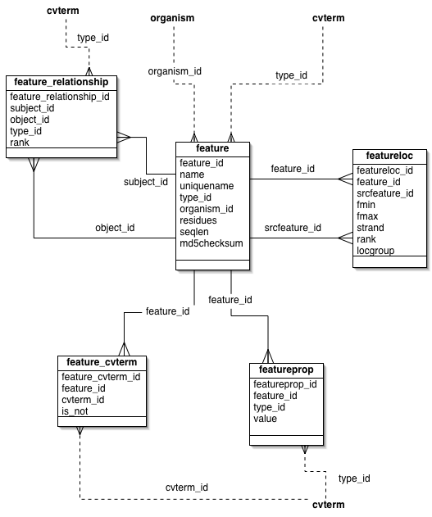

Slide 22
the feature_relationship table
Feature graphs
Relationships between pairs of features
  this exon part_of that mRNA
  this polypeptide derives_from that mRNA
Feature graphs constrained by SO
  (all) exon part_of (some) mRNA
  (all) polypeptide derives_from (some) mRNA

Slide 23
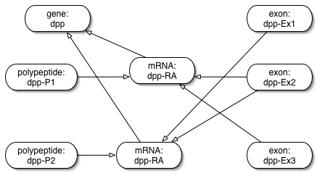

Slide 24
organism module
ultra-simple
key (only!) entity
  organism (actually: taxon)
NCBI taxon compatible
  unique(genus, species)
Each feature must be linked to an organism
Strains?
But what about evolution?…

Slide 25
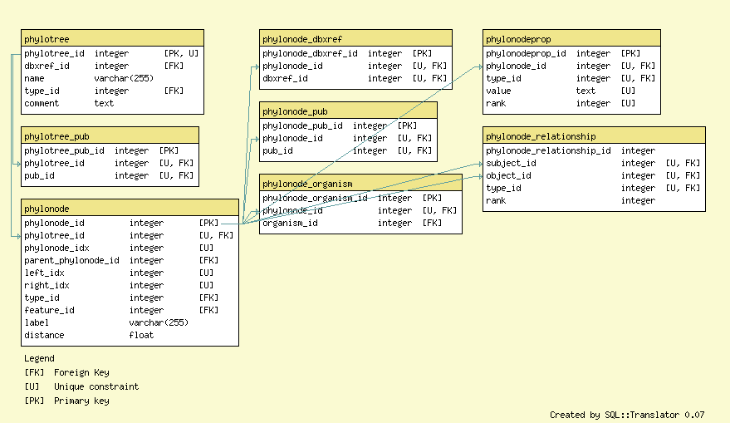

Slide 26
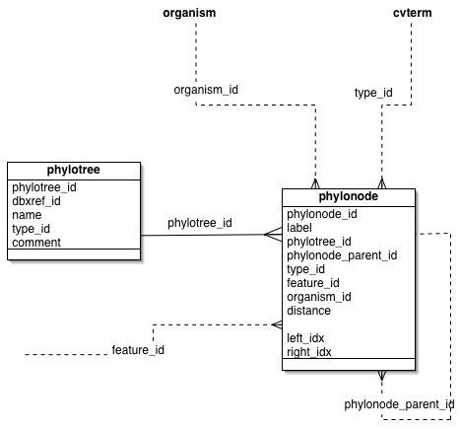

Slide 27
phylogeny module
Status: mature, not yet in production use
Original design:
  Richard Bruskiewitz (IRRI)
  Adapter from Aaron Mackey’s design
Key concept: trees
  nodes
  nodes have a single parent (except root)
    branch length
  node belongs to one tree
  nodes can be linked to other chado entities
  nodes can have data attached (e.g. statistics)
Notes:
ironically, whilst phylogenetics is riddled with controversies, phylo schema designs are relatively uncontroversial

Slide 28
phylogeny: SQL functions
Views and SQL functions can greatly enhance queryability
Implemented:
  phylonode_height(phylonode_id)
  phylonode_depth(phylonode_id)
TODO
  is_monophyletic(phylonode_id[ ], outgroup_id)
  etc

Slide 29
phylogeny module
Can make trees of anything (within reason)
  taxonomies
      table: phylonode_organism
  features of any type in SO
      table: phylonode_feature
    polypeptides (protein)
    introns
    …
  links to alignments, etc

Slide 30
phylogeny module: open questions
controversial?
  optional phylonode_relationship (DAGs!)
Query efficiency vs redundancy
  nested set representation
Attaching characters (phenotypes)
  nothing in place at present

Slide 31
Linking phylogeny to phenotype
phylonode already linked to feature
  (features have sequences)
how do we link phylonode to phenotype
  nature of linkage
    essentialist
    statistical
what have we missed?
  e.g. environment

Slide 32
phenotype module: status
Is basic EAV model sufficient for
  model organism mutant phenotypes
  systematics
Extension required?
  Diederich 1997
Managing multiple versions
  compatibility layers

Slide 33
Software integration
Molecular phylogeny
  easy?
    eg via Bio::Tree in bioperl
Character-based phylogeny
  NEXUS etc
  easy/hard???

