Slide 1
Modware: Its latest development using Moose and Bio::Chado::Schema
Siddhartha Basu
dictyBase
http://www.dictybase.org
Center for Genetic Medicine
Northwestern University

Slide 2
Modware - Chado middleware
ORM for chado/biological concepts
  Hides chado specific storage details
  Think about Gene/Protein, Alignment, Publication, Ontology etc.
CRUD API
Search/Finder API
Traversal API between biological concepts
Compatibility with other API(e.g bioperl)
Building command line tools
Model of MVC web applications(Catalyst/Mojo/Dancer etc)
Notes:
API not autogenerated

Slide 3
Modware - Chado middleware
Started with Class::DBI layer
Technical issues
  Last release of Class::DBI module (4 years back)
Latest development
  Started with dictyBase data migration
  Layer on Bio::Chado::Schema
  Moose for API
  Publication module
Notes:
API not autogenerated

Slide 4
Modware Datasource
use aliased ‘Modware::DataSource::Chado’;
  Chado->connect(
  dsn => ‘dbi:Pg:database=mymod’,
  user => ‘user’,
  password => ‘password’
  );
  Chado->connect(
  dsn => ‘dbi:Oracle:sid=mymod’,
  user => ‘user’,
  password => ‘password’,
  attr => { AutoCommit => 1, LongTruncOk => 1 }
  );
  Chado->connect( dsn => ‘dbi:SQLite:database=mydb.sqlite’);
Get/Set through Bio::Chado::Schema(BCS)
  my $bcs = Chado->handler;
  Chado->handler(Bio::Chado::Schema->connect($dsn,$user,$pass,$attr));

Slide 5
CRUD API
use Modware::Publication::Pubmed;
use Modware::Publication::Author;
my $pub = Modware::Publication::Pubmed->new (
year => 2010,
status => ‘published’,
cv => ‘pub_type’
);
$pub->pubmed_id(332228);
$pub->journal(‘JBC’);
$pub->abstract(‘This is a cool abstarct’);
$pub->title(‘Charming);
$pub->add_author(
Modware::Publication::Author->new(
first_name => ‘Larry’,
last_name => ‘Johnson’,
initials => ‘Mr.’
)
);

Slide 6
my $new_pub = $pub->save;
Update
  $new_pub->add_author(
  { first_name => ‘Jerry’,
  last_name => ‘Seinfeld’,
  initials => ‘Mr’,
  suffix => ‘Jr.’
  }
  );
  $pub->medline_id(1278202);
  $pub->full_text_url(‘http://journal.org’);
  $pub->title(‘Charming);
  $new_pub->save;
Remove
  $new_pub->delete;
BCS object
  my $bcs = $new_pub->dbrow;

Slide 7
Finder/Search API
Retrieve single object
  $pub = Modware::Chado::Publication->find(23);
  $pub = Modware::Chado::Publication->find_by_pubmed_id(32298302);
Retrieve multiple objects
  @pubs = Modware::Chado::Publication->search(
  first_name => ‘Harry’,
  last_name => ‘Williams’,
  journal => ‘EMBO journal’
  );
  $itr = Modware::Chado::Publication->search(
  first_name => ‘Harry’,
  last_name => ‘Williams’,
  journal => ‘EMBO journal’
  );
  while(my $pub = $itr->next) {
  $pub->title;
  $pub->journal;
  ……
  }

Slide 8
  @authors = $pub->authors;
  for my $author(@authors) {
  $author->first_name;
  }
Calcuation
  $count = Modware::Chado::Publication->count(
  first_name => ‘Harry’,
  last_name => ‘Williams’,
  journal => ‘EMBO journal’
  );
Misc.
  Modware::Chado::Publication->search(
  %options,
  cond => { clause => ‘OR’}
  );
  Modware::Chado::Publication->search( title => ‘genomics*’);

Slide 9
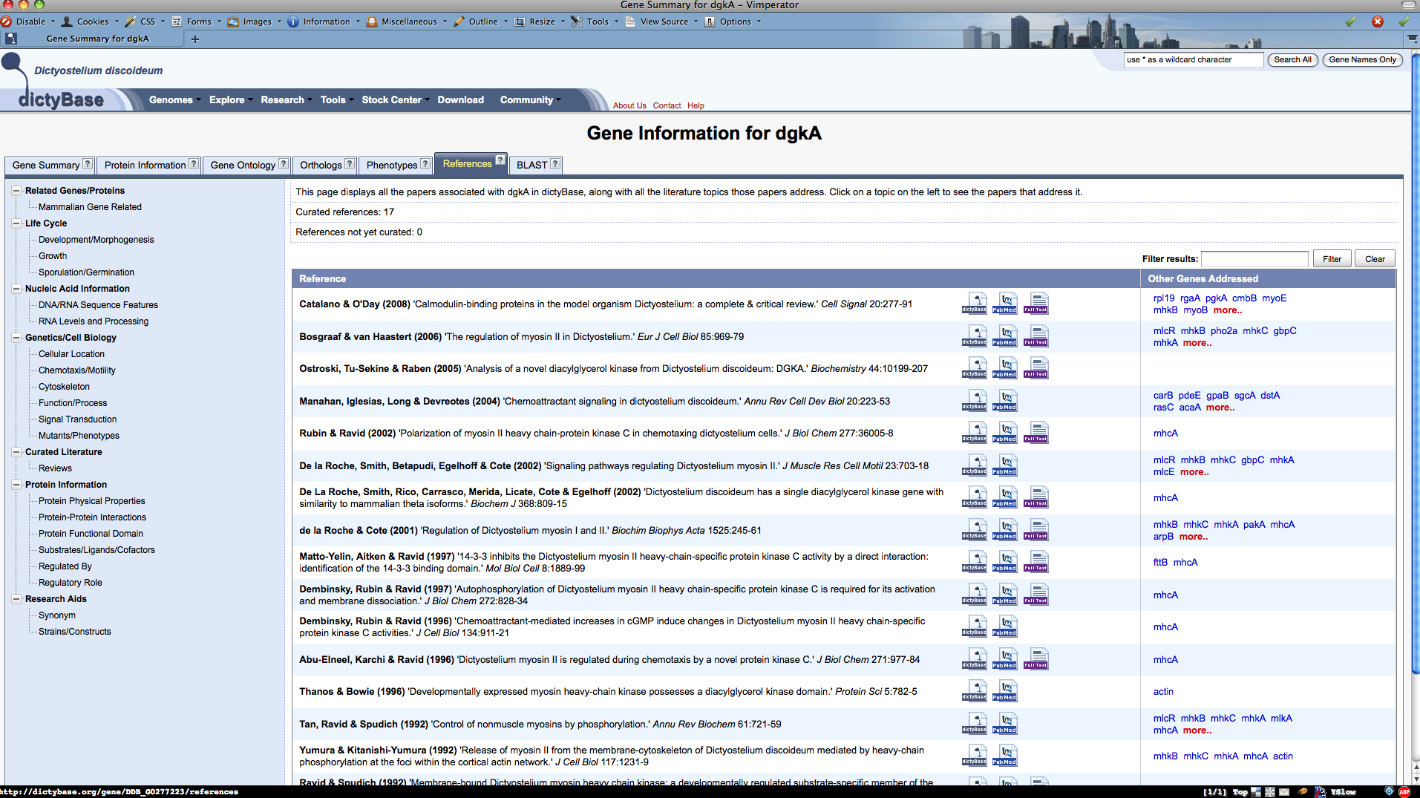
Web application (List of publication)

Slide 10
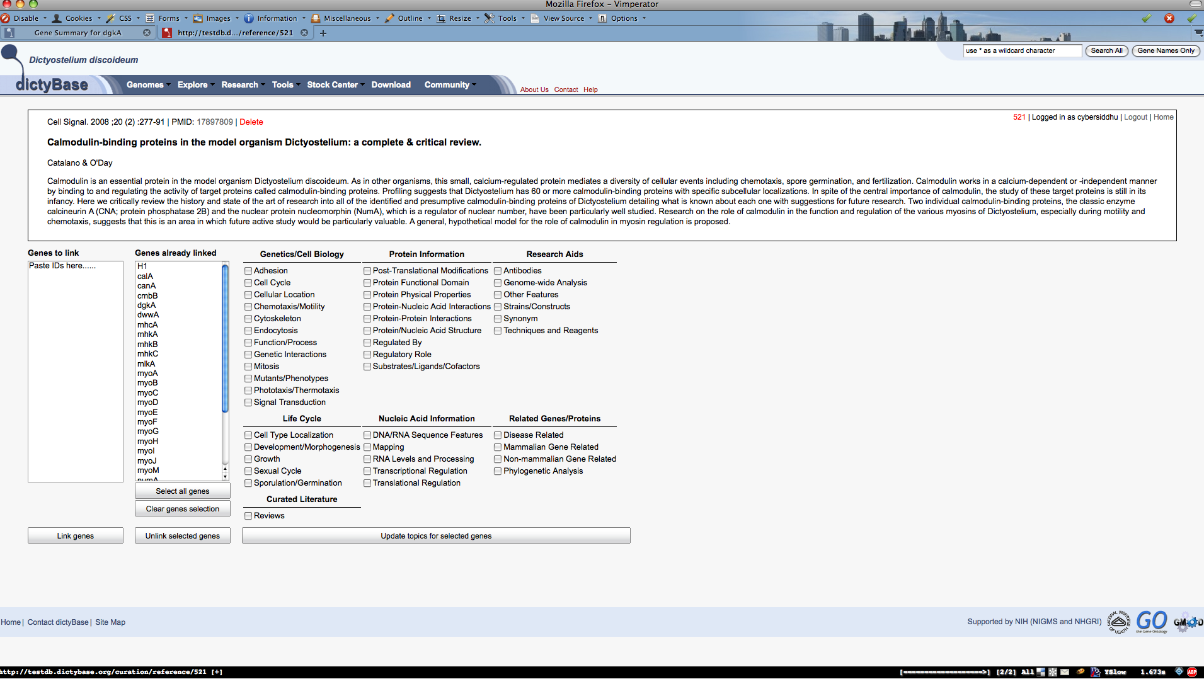
Web application(Literature curation)

Slide 11
Command line tools
import publication(from pubmed)
export publication
import ontology(obo files)
import GAF 1.0/2.0
export GAF

Slide 12
Experimental builder API
package Modware::Publication::Pubmed;
use Modware::Chado;
bcs_resultset ‘Pub::Pub’;
chado_has $_ for qw/title pages issue volume/;
chado_has ‘pub_id’ => (column => ‘primary’);
chado_has ‘year’ => (column => ‘pyear’);
chado_has ‘pubmed_id’ => (column => ‘uniquename’);

Slide 13
chado_type ‘type’ => (cv => ‘pub_type’);
chado_property ‘abstract’ =>
(cv => ‘pub_type’, cvterm => ‘pub_abstract’);
chado_has_many ‘authors’ =>
(class => ‘Modware::Publication::Author’);

Slide 14
chado_type ‘type’ => (cv => ‘pub_type’);
chado_property ‘abstract’ =>
(cv => ‘pub_type’, cvterm => ‘pub_abstract’);
chado_has_many ‘authors’ =>
(class => ‘Modware::Publication::Author’);

Slide 15
package Modware::Chado::Stock;
use Modware::Chado;
bcs_resultset ‘Stock::Stock;
chado_dbxref ‘id’ => (db => ‘Stock’);
chado_belongs_to ‘organism’ =>
(class => ‘Modware::Chado::Organism’);

Slide 16
Project information
http://github.com/cybersiddhu/Modware
http://gmod.org/wiki/Modware
gmod-ware-users@lists.sourceforge.net

Slide 17
Related Projects
Mojolicious::Plugin::Caching (in CPAN)
  http://search.cpan.org/dist/Mojolicious-Plugin-Cache
Mojolicious::PluginBundle
  YAMLConfig
  BCS
  Modware
  Modware::Oracle
  AssetTagHelper
  http://github.com/cybersiddhu/Mojolicious-PluginBundle

Slide 18
Acknowledgements
dictyBase
  Rex Chisholm
  Warren Kibbe
  Eric Just
  Yulia Bushmanova
  Petra Fey
  Pascale Gaudet
  Bob Dodson
BCS(Bio::Chado::Schema)
Bioperl
GMOD community
Moose

