Slide 1
What are orthologs?
True homology of molecular sequences, i.e. descended in toto from the same ancestral sequence.
Orthologous sequences exist in only one copy per organism, and can accurately reflect the phylogenetic relationships of species (cf. paralogy, plerology, xenology).
www.science.uts.edu.au/sasb/glossary.html

Slide 2
How do we identify orthologs??
A. “Near” Relatives
Sequence Similarity
  Reciprocal Best Hits
Conserved Neighborhood
  Within Syntenic Blocks

Slide 3
How do we identify orthologs??
B. “Far” Relatives
Sequence Similarity
  Reciprocal Best Hits

Slide 4
Why is it hard to identify orthologs??
Quality of Genome Assembly
  WGS assemblies have holes; ortholog to query sequence may live in one such hole.
  WGS assemblies have undetected misassemblies; ortholog tests may fail because there is apparently not a 1:1 match.
  WGS assemblies tend to collapse near-identical clusters.
Quality of Annotations
  Ortholog of query sequence may not have been annotated (at all / correctly).
  Creating gene models in near-identical gene clusters can be challenging.
Realities of Biology
  Expansion and contractions of repeated gene families
  Multiple transcripts per “gene”
  Pseudogenes vs. true genes

Slide 5
G
G
G
G

Slide 6
G
G1, G2
G1, G2
G1, G2
G

Slide 7
G
G1, G2
G1, G3
G2, G3
G1, G2, G3
G1, G2
G

Slide 8
How should MODs represent orthology, similarity, paralogy??
Each tub on its own bottom - do your own thing
  + Encourages creativity
  - No consistency
Pool resources - compute common set of similarities
  + Consistency
  - Some MOD group has to run the computes
  - Stalinistic
Ask multiple groups to periodically compute orthology relationships according to their own criteria on the latest snapshots of our gene models
  + Consistency
  + No attempt to annoint the “best” approach
  + Can blame other groups who are doing the work
  - Limited by the approaches of outside groups

Slide 9
How do we proceed??
Supposing we adopt approaches 2 or 3
  What data set do we provide?
    All final transcripts and proteins?
    Proteins only?
    All proteins or one per “gene”?
  Do we only represent best hits? Gene families? Other?
  How do we create robust reciprocal links?
  Which genomes do we compare?
  How often do we recompute orthologies/similarities?
  How do we keep all this in synch?

Slide 10
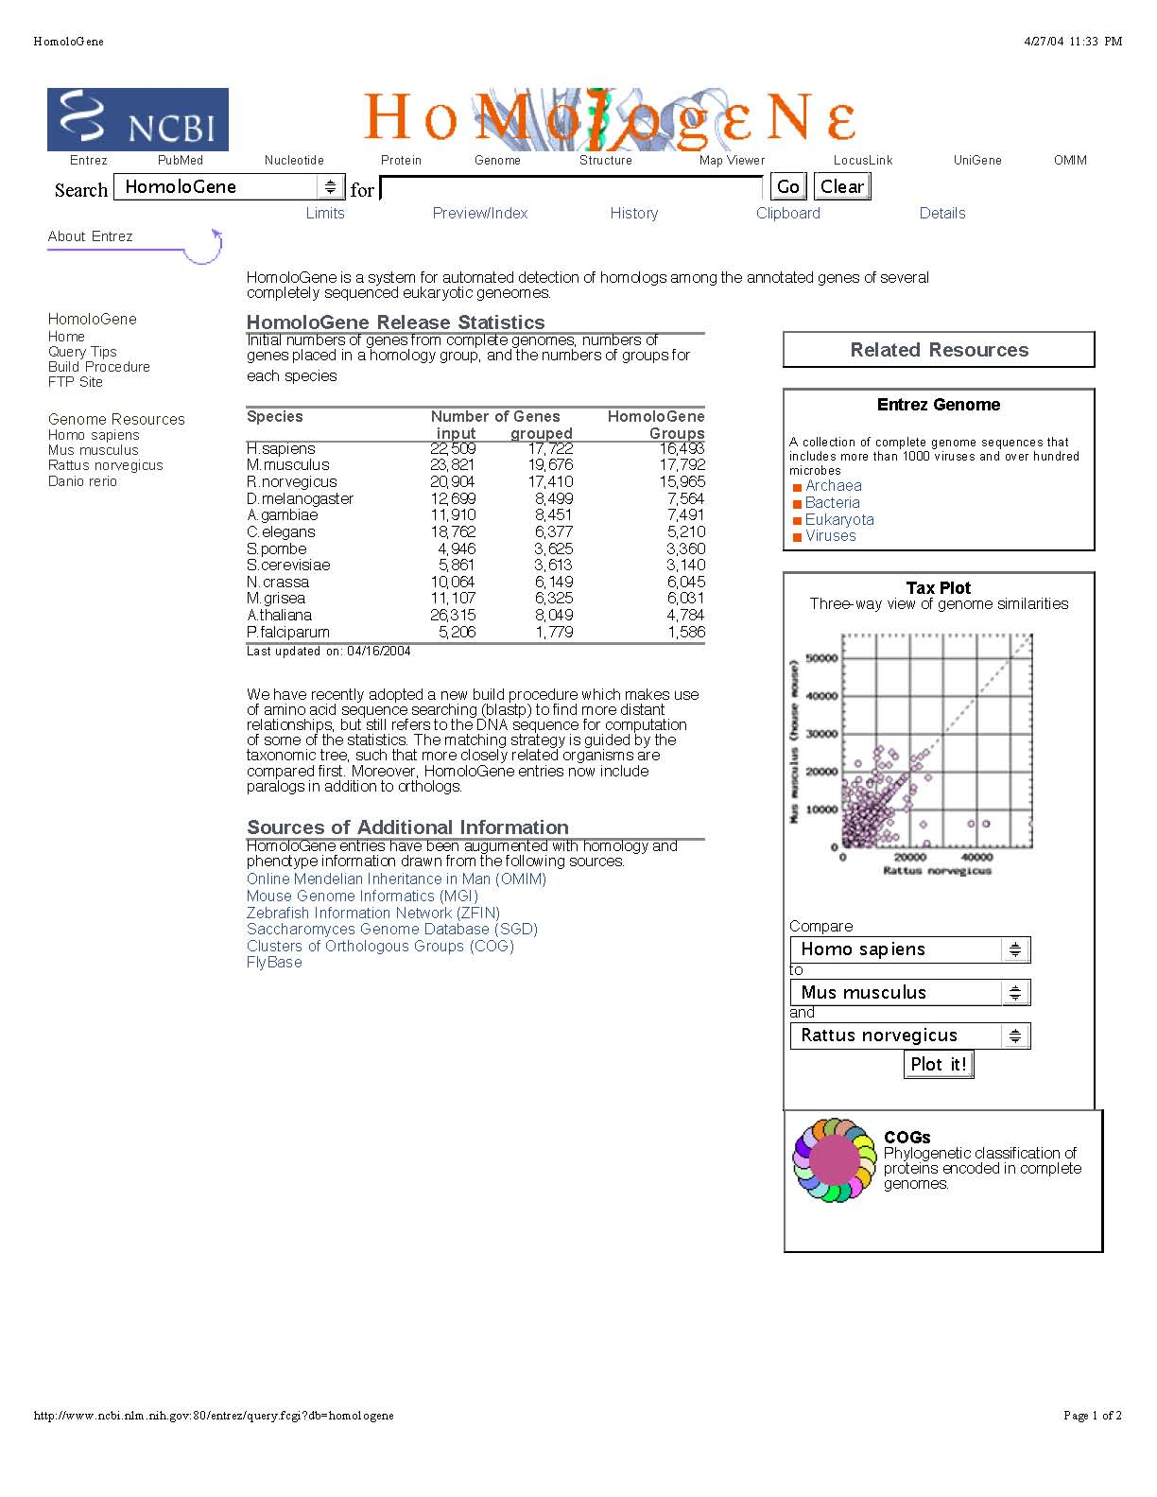

Slide 11
Species Number of Genes HomoloGene
input grouped Groups
H.sapiens 22,509 17,722 16,493
M.musculus 23,821 19,676 17,792
R.norvegicus 20,904 17,410 15,965
D.melanogaster 12,699 8,499 7,564
A.gambiae 11,910 8,451 7,491
C.elegans 18,762 6,377 5,210
S.pombe 4,946 3,625 3,360
S.cerevisiae 5,861 3,613 3,140
N.crassa 10,064 6,149 6,045
M.grisea 11,107 6,325 6,031
A.thaliana 26,315 8,049 4,784
P.falciparum 5,206 1,779 1,586

Slide 12

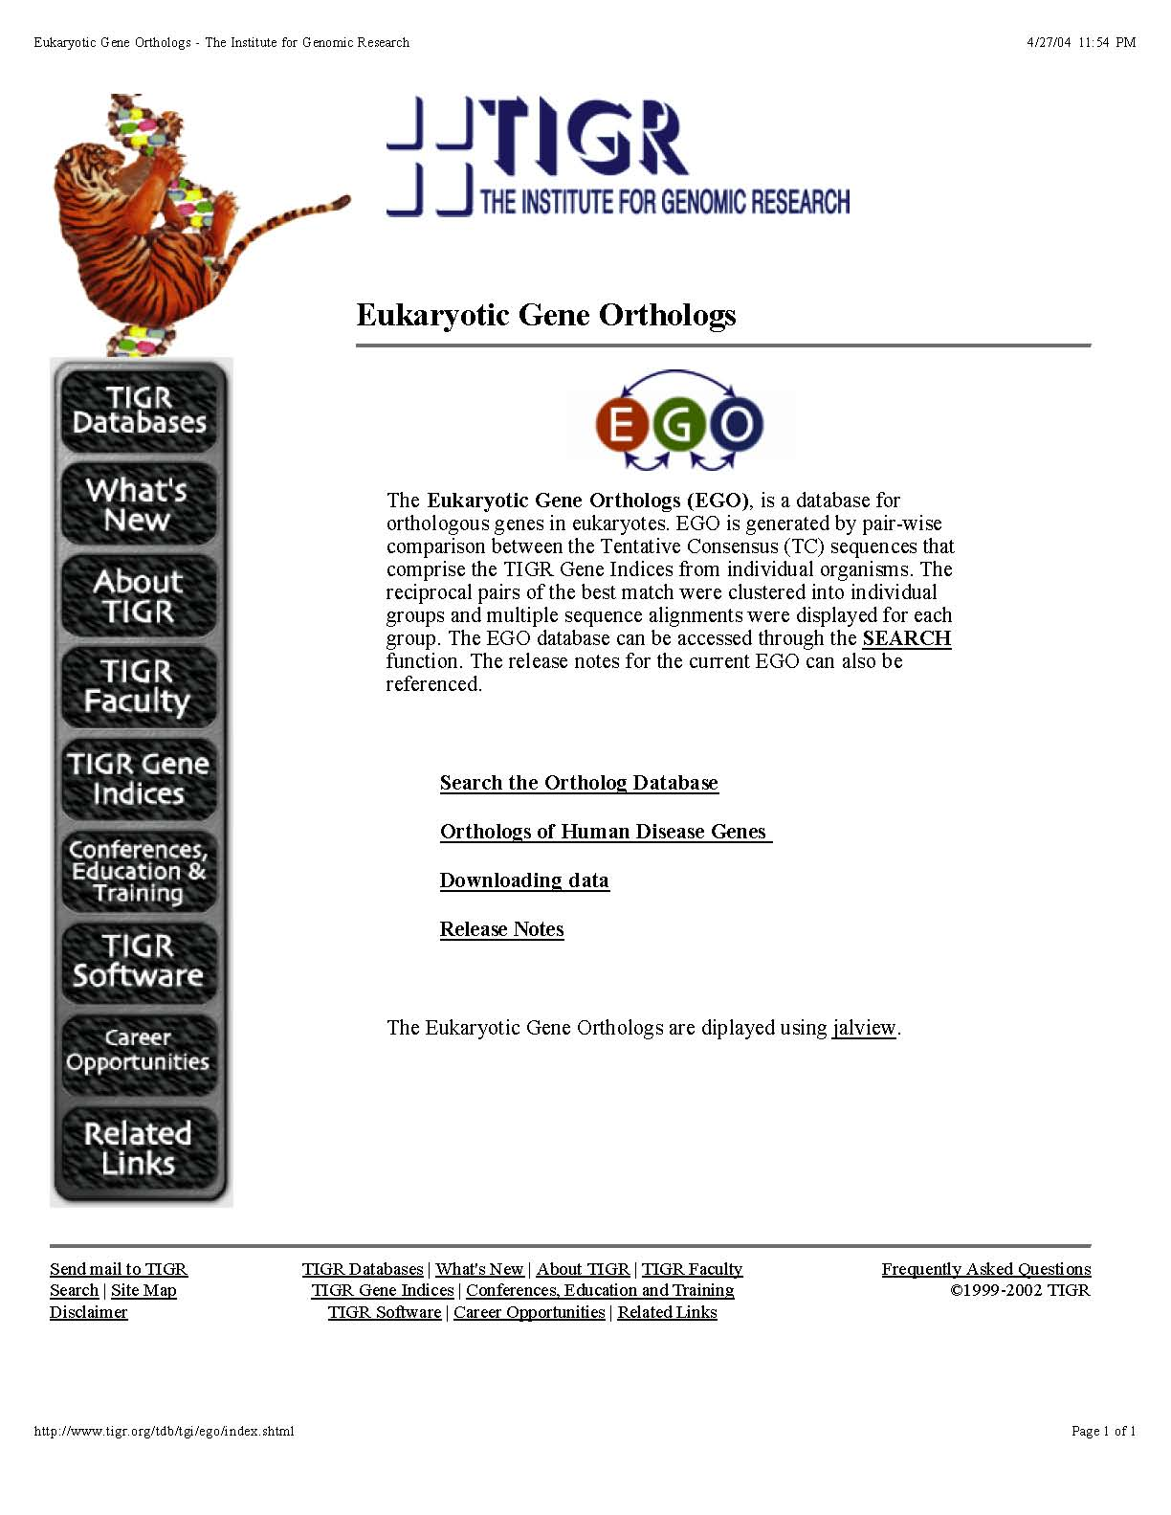

Slide 13
