Slide 1
chado
Generic model organism database schema
Presented at the NESCent GMOD Meeting
20 January, 2005
David Emmert
emmert@morgan.harvard.edu

Slide 2
Chado modules
Genetics Module
Genetic/phenotypic interactions in genotypic/environmental context
Sequence Module
Biological sequences and objects which can be localized on them
Map Module
Adjunct to sequence module for non-sequence localization
Expression Module
Transcript and protein expression events
Companalysis Module
Adjunct to sequence module for in-silico analysis
CV Module
Controlled vocabularies and ontologies
Organism Module
Taxonomy / species information
Pub Module
Publication / Biblio / Reference information
General Module
General information / database cross-references

Slide 3
chado module dependencies
organism
general
(dbxref)
map
pub
sequence
genetic
expression
cv
companalysis

Slide 4
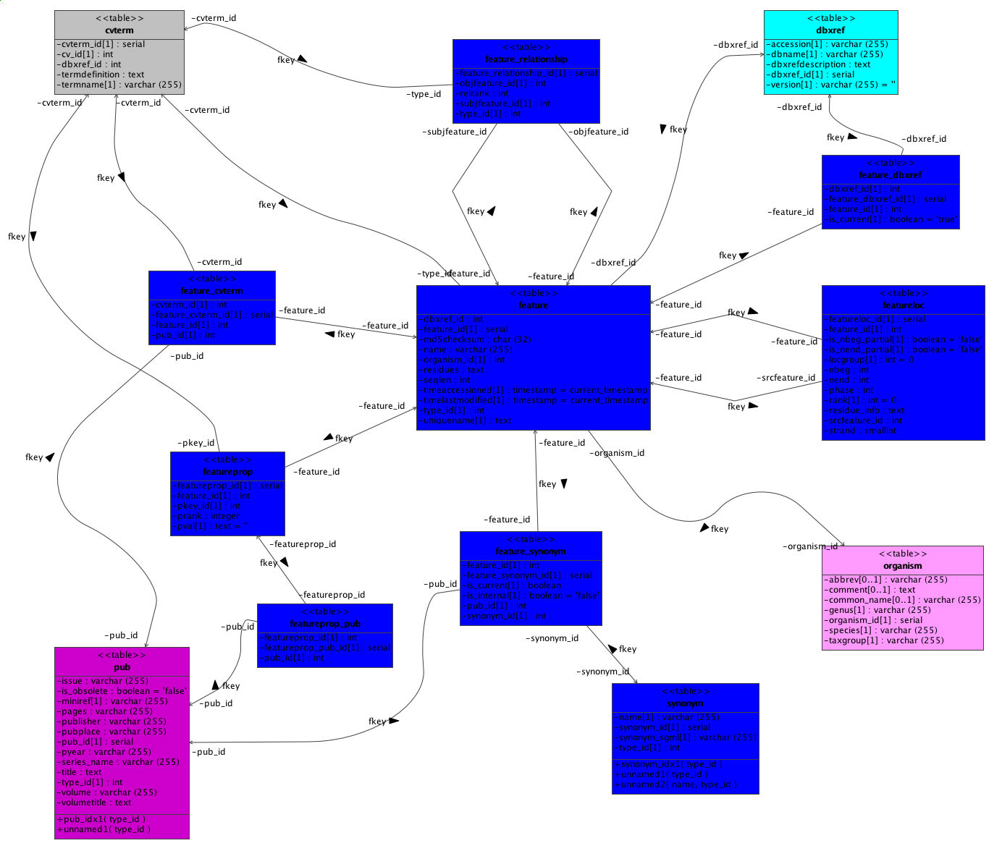
cvterm
dbxref
feature_relationship
feature_dbxref
feature_cvterm
feature
featureloc
featureprop
feature_synonym
organism
featureprop_pub
pub
synonym

Slide 5
flexible property types
cv
property type
push as many attributes as possible into property tables
control property types with controlled vocabs
link properties to publications
type_id
table
tableprop
record_id
property_id
pub

Slide 6
flexible relationship types
cv
relationshp type
using controlled vocabularies for relationship types makes customization and extension possible without altering the schema.
type_id
table_relationship
subject_id
object_id
table

Slide 7
Acknowledgements
Bill Gelbart, FlyBase PI
chado schema design
  Chris Mungall (HHMI/BDGP/FlyBase)
  Colin Wiel (FlyBase)
  Pinglei Zhou (FlyBase)
  Aubrey de Gray (FlyBase)
  Bill Gelbart (FlyBase)
  Stan Letovsky (FlyBase)
chado I/O
  chadoXML & chado loader
    Pinglei Zhou and Stan Letovsky
  Bioperl chadoxml.pm
    Peili Zhang and Chris Mungall
  GAME -> chadoXML converter
    Frank Smutniak
  GFF3 -> chado loader
    Scott Cain
GMOD
  Lincoln Stein (PI)
  Scott Cain
Comments and Feedback
  Mark Yandell (BDGP)
  Sam Angiuoli (TIGR)
  Jennifer Wortman (TIGR)
  Owen White (TIGR)
  Many others…

Slide 8
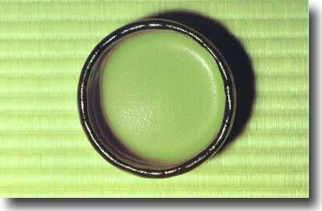

chado

