Slide 1
Distributed Annotation System
Version 2
Allen Day, UCLA
Anthony Cox, EBI
Gregg Helt, Affymetrix
Andrew Dalke, Dalke Scientific
Lincoln Stein, CSHL

Slide 2
DAS/1
Annotation Server
Reference Server
Annotation Server
Annotation Server
AC003027
M10154
AC003027
M10154
AC005122
AC005122
WI1029
AFM820
AFM1126
WI443

Slide 3
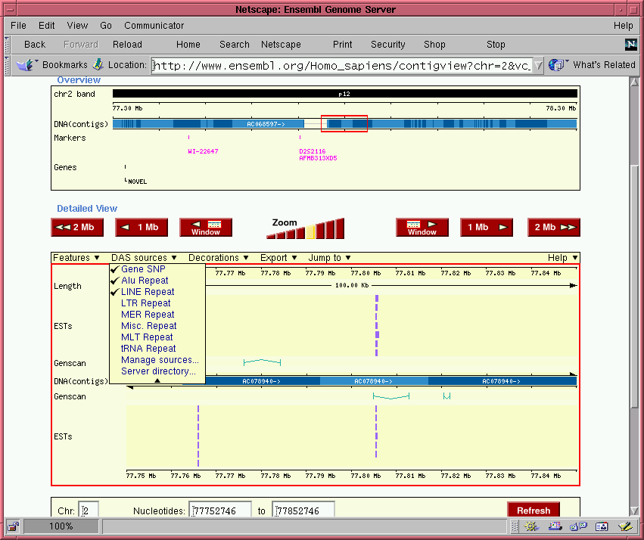
EnsEMBL 1

Slide 4
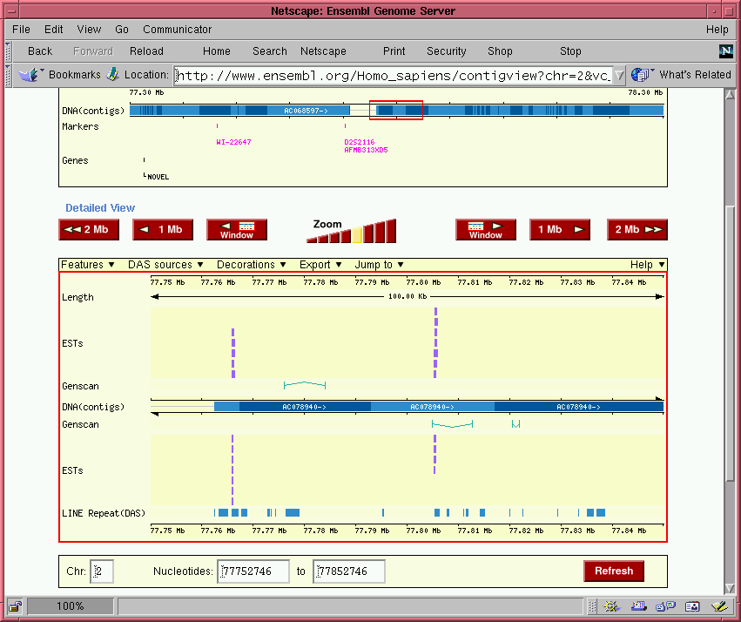
EnsEMBL 2

Slide 5
Deficiencies of DAS/1
Format for representing genomic features too rigid.
Description of genomic features too flexible.
No IDs for genomic features.
No write-back.

Slide 6
DAS/2
Less Rigid
  Multiple formats for representing genomic features.
  Arbitrary nesting of features..
DAS/2 More Rigid
  Uses Sequence Ontology (SO) for describing features
  Ready to accept attribute ontologies
  Add your own ontology, but publish it!

Slide 7
REST-Style IDs
Addressing a Data Source
  http://wormbase.org/das/genome/wormbase/1
Addressing a Feature Type
  http://wormbase.org/das/genome/wormbase/1/type/tRNA
Addressing a Feature
  http://wormbase.org/das/genome/wormbase/1/feature/gene0038

Slide 8
Write-Back
PUT http://wormbase.org/das/wormbase/1/genome/feature/M7.1
  Update identified feature
POST http://wormbase.org/das/wormbase/1/genome/feature
  Create feature
DELETE http://wormbase.org/das/wormbase/1/genome/feature/M7.1
  Delete feature

Slide 9
Progress
Draft spec up and ready for comments
  http://www.biodas.org
Server prototype up and running
  See Allen Day
Client prototype up and running
  See Gregg Helt
Project still in flux

